Slide 1
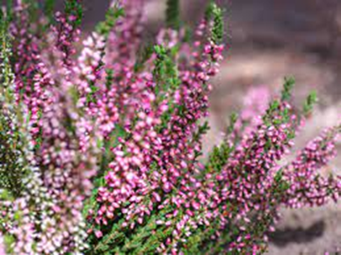
Auchterhouse Nursery
One Planet Picnic Pocket Garden 2022
Our design story

Slide 2
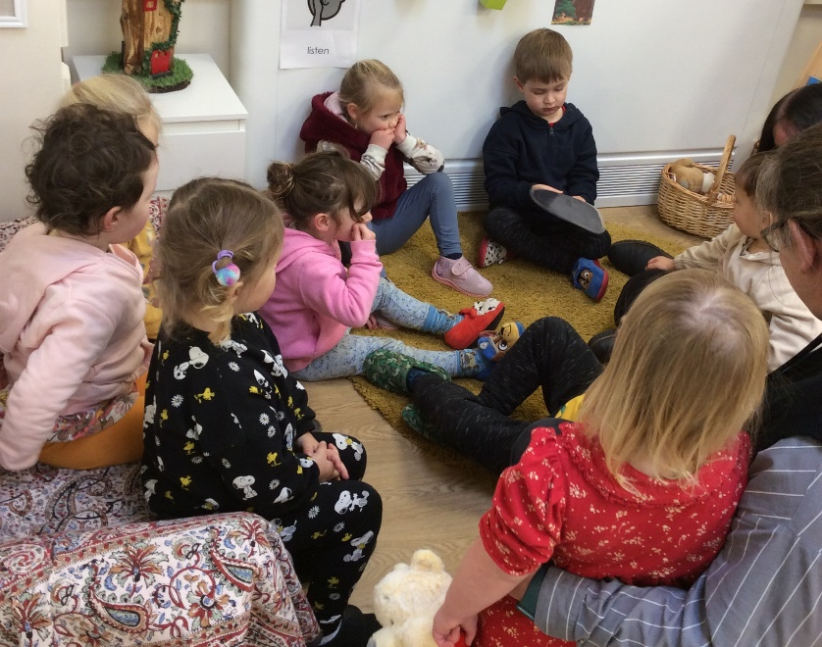
Starting point:
Bippity Boppity Bumble Bee visits our nursery every week. It is very forgetful and needs reminding of our names. We take it turn to ask each other:
Bippity Boppity Bumble bee, can you tell your name to me?
Can you clap your name?
How many claps do you have?
Can everyone clap …..’s name?
The children were asked where they thought Bippity went when it wasn’t at nursery. Through their ideas, the garden was most frequently mentioned and seemed a natural starting point for our design.

Slide 4
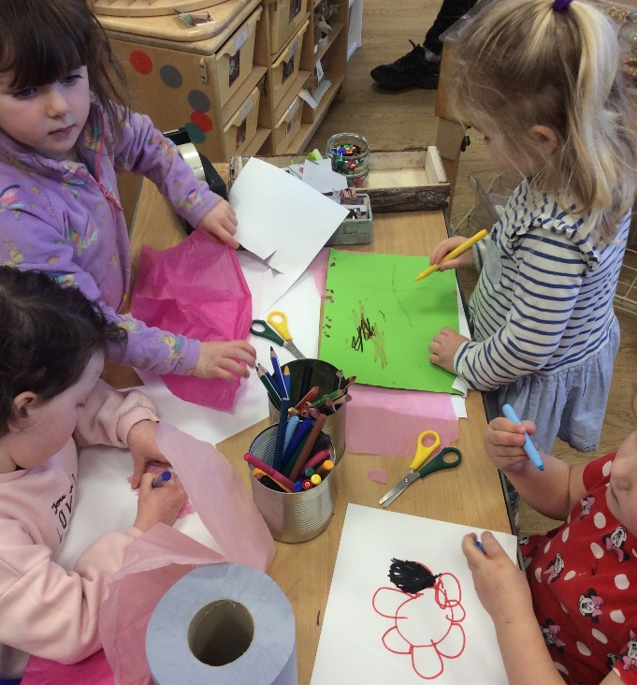
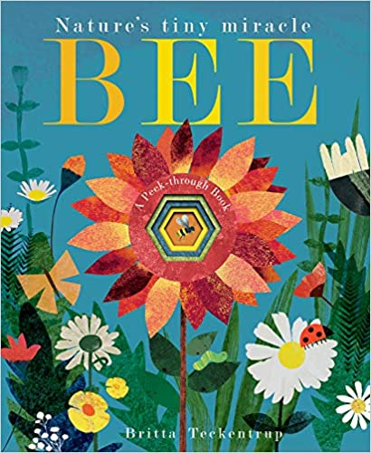
Where does Bippity go when it is not at nursery? What might it do?
We read ‘Bee – Nature’s tiny miracle’ by Patricia Hegarty and Britta Teckentrup. The bee travelled through beautifully coloured gardens, woodlands alongside other animals and with its bee friends, sharing pollen. This predominately visual story communicated with all the children in our setting, sparking curiosity and generating ideas.
The illustrations inspired us to experiment with a variety of resources to create a garden that Bippity would like to hang out in. We were also mindful of how Bippity needed to feel safe and having a garden of it’s own would be a nice home. These ideas were connected to our nursery and school values, SHANARRI (Scottish Government 2006) and UNCRC Article 27.

Slide 5
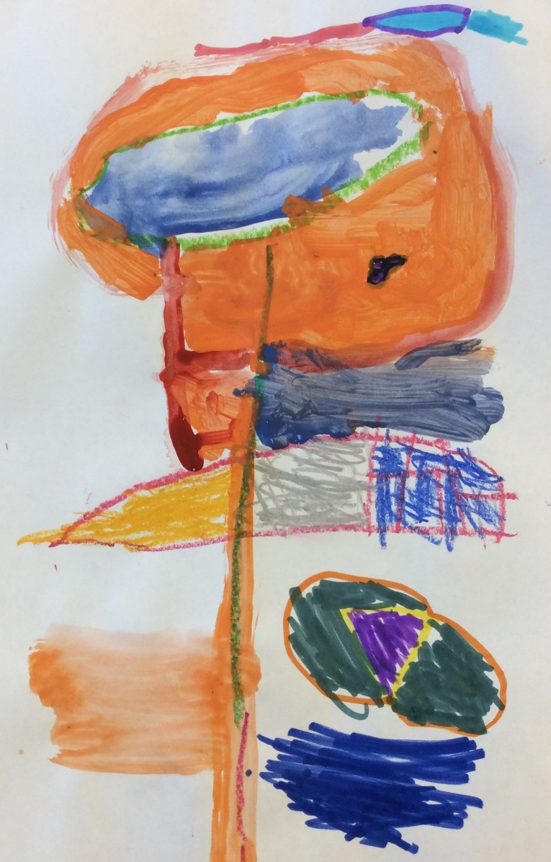
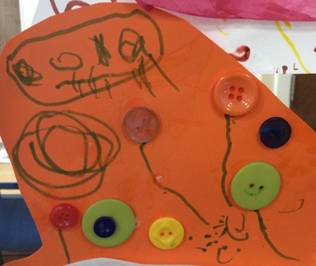
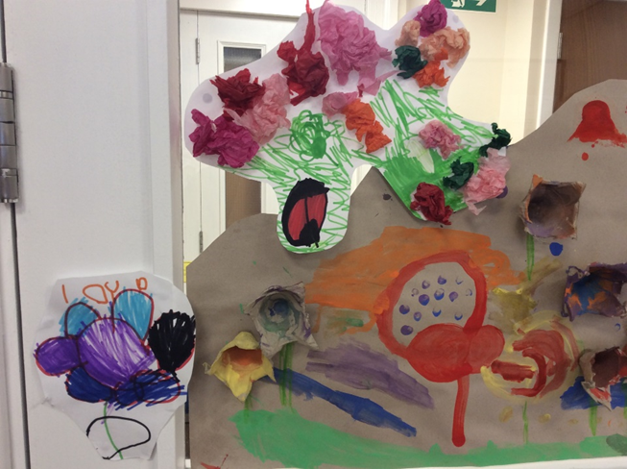
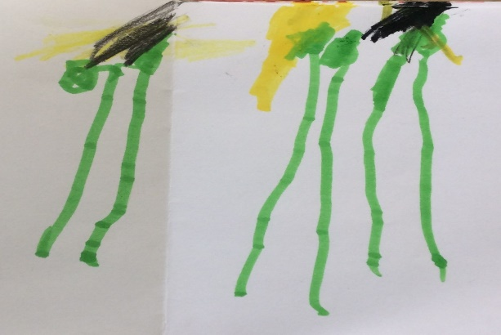
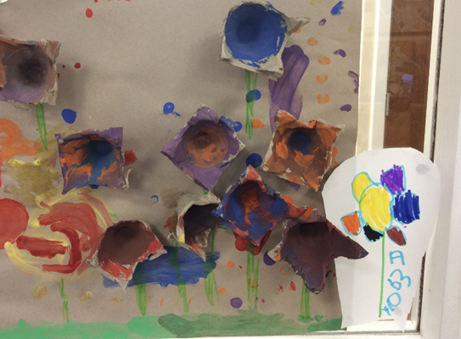
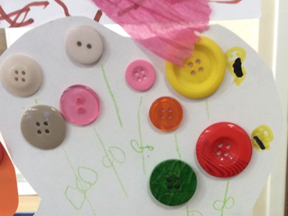
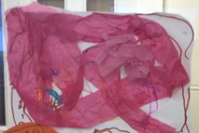
Our garden ideas

Slide 6
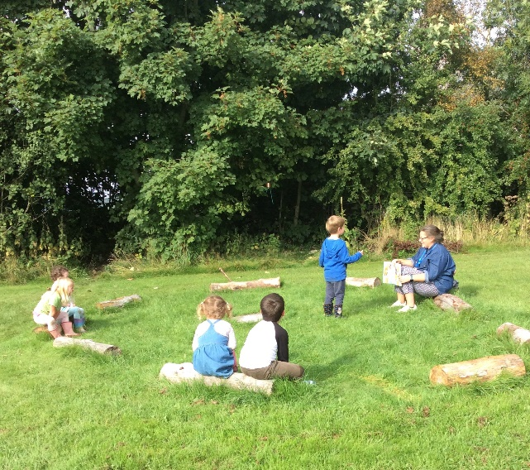
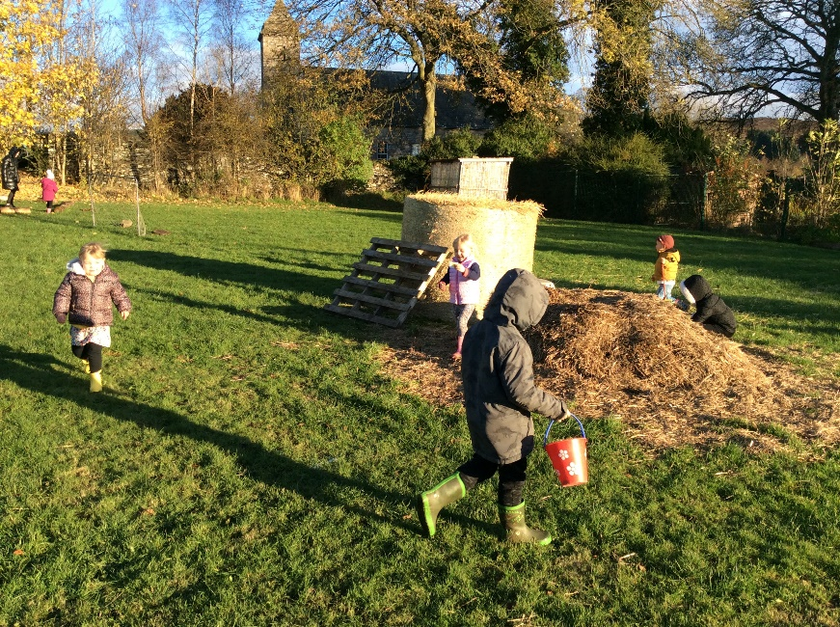
Meaningful learning for the future:
The relationship the children have with a fictional bee is full of warmth and care. The opportunity to build on the emotional attachment through the development of a physical space is a true opportunity to celebrate how we can make positive impacts on our environment.
The small independent sections of our design honour the Froebelian principle of the connection a child develops with nature. The children will be enabled to tend an individual space to grow and nurture living things. Mistakes are an essential part of the learning process and build our skills of problem solving and perseverance.

Slide 7
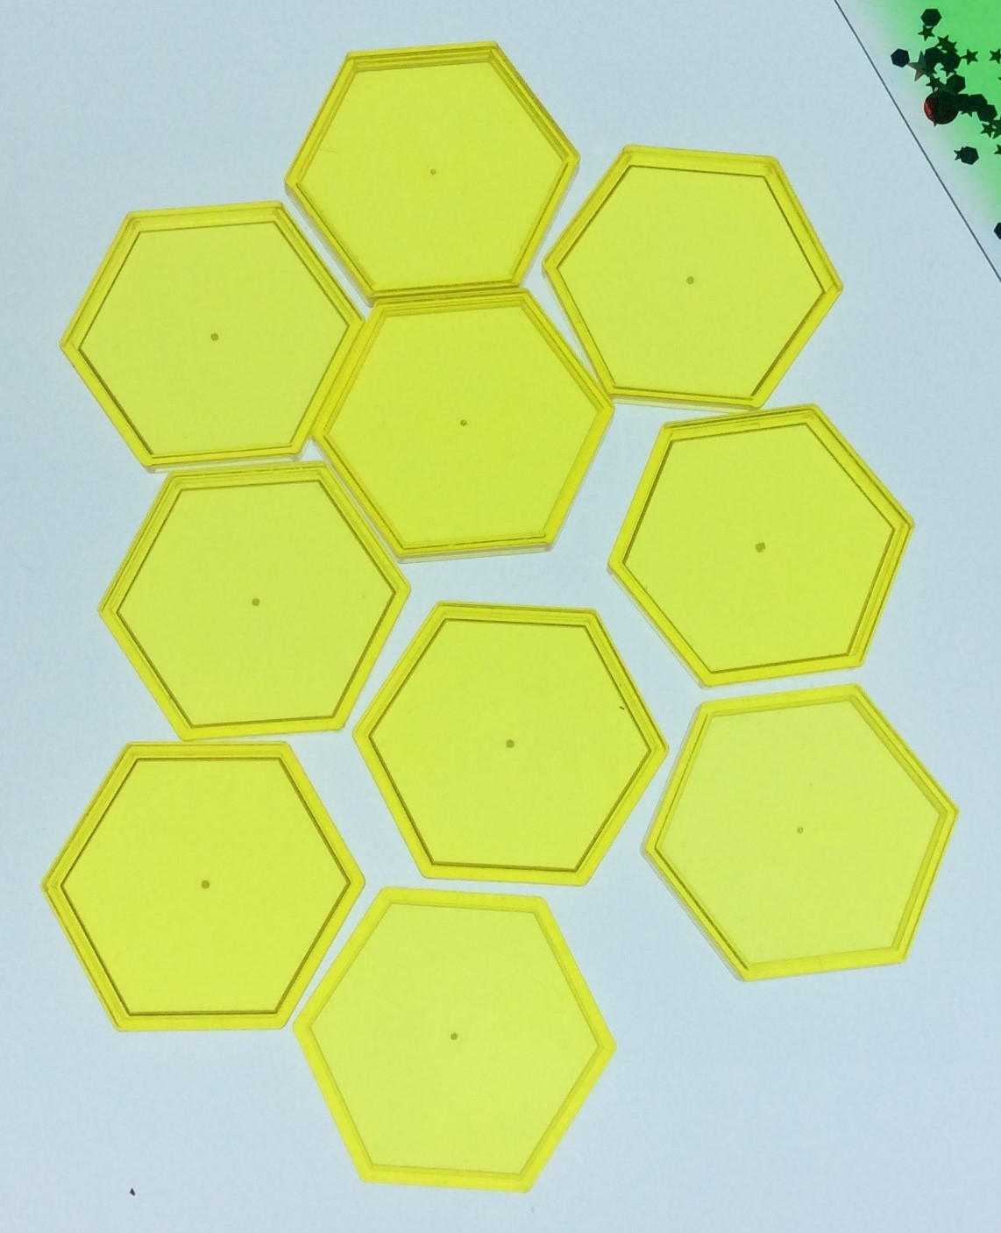
The details:
Our raised-bed plan has been influenced by the bee’s hexagon design.
‘The bees would like to be outside with the flowers. They make the honey from the flowers. This is what the hive looks like outside’ (BK)
The location of our bed has been chosen because of it’s sun and shade. It is also protected by trees on one side as our nursery garden is windy.
Our building materials for the raised bed will come from our old wooden story shed which is being replaced.
The compost will be supplied by our community garden and soil from a surplus created by our sandpit.
We will problem solve as our garden grows, thinking about water for the plants and insects. This will give the children the real-life situation of trial and error to experiment with their actions.

Slide 8
More details:
We have been exploring air and gas and have experimented with carbon dioxide. We have emerging knowledge about damaging gases and what we can do to support planet Earth. We will use volcanic rock dust to capture carbon and enhance our plant growth.
Our planting has been influenced by our research, collecting advice from a local gardener through emails, sourcing planting from the community garden and local gardens near the nursery.
The nursery is in a rural location with local produce provided by some of the families. Growing herbs and edible plants (nasturtiums) will give the children their own produce to share with their family.

Slide 9
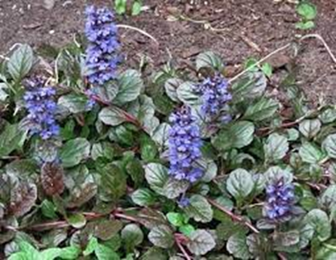
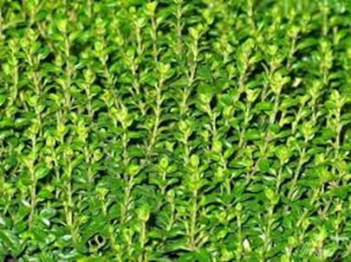
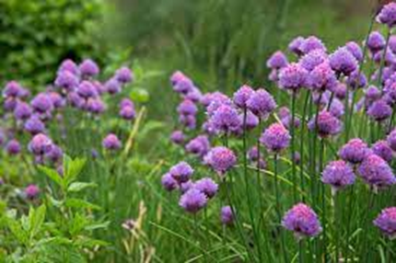
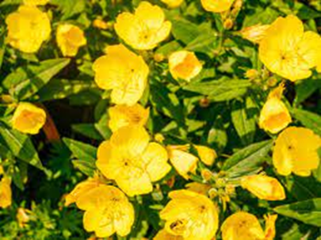
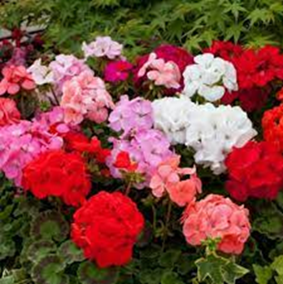
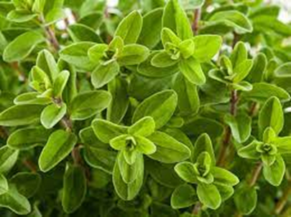
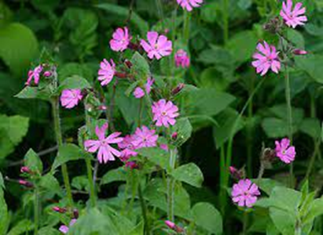
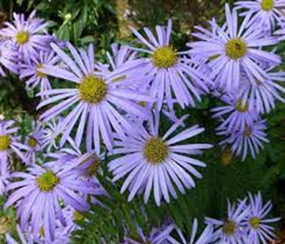
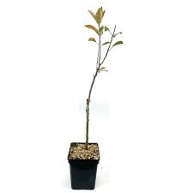
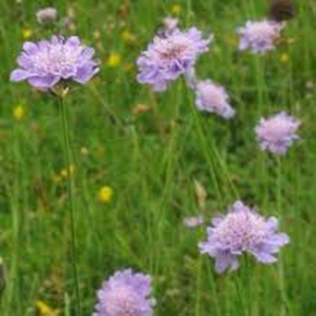
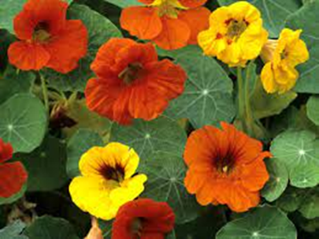
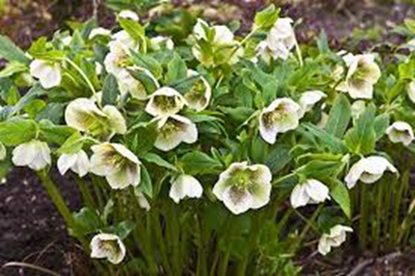
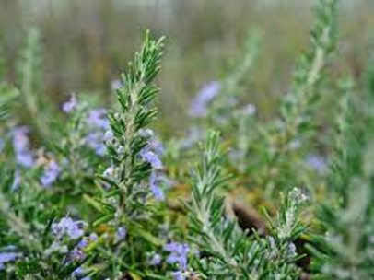
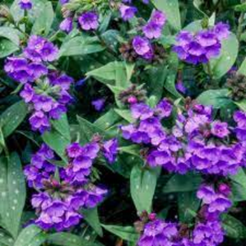
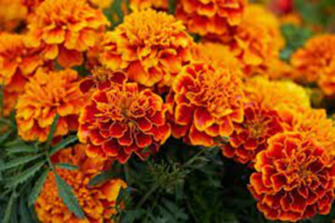
Our design:
16
1
15
14
2
14
211
13
10
15
13
6
4
12
3
2
1
3
9
16
5
12
5
4
11
11
8
7
8
9
6
10
7

Slide 10
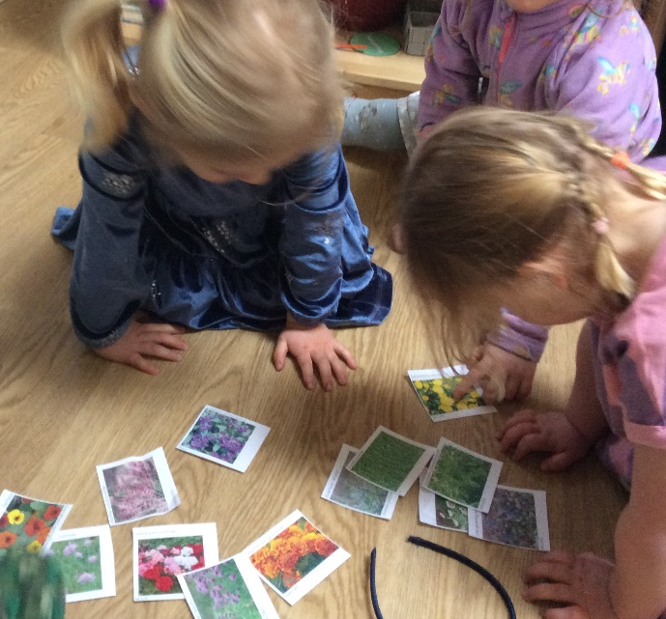
Index of planting:
1 Low growing ajuga (Summer)
2* Geranium (Summer)
3 Marjoram (Summer/Autumn)
4* Michaelmas daises (Autumn)
5* Apple tree – will be supported with established trees in the school grounds.
6 Nasturtiums (Spring/Summer)
7* Rosemary (evergreen)
8* Lungwort (Winter/Spring)
9 Marigolds (Spring/Summer)
10* Hellebore (Winter/Spring)
11 Scabious (Summer)
12 Heather (Autumn) –
covers our local hill bright
purple when the sun shines
13 Red Campion (Summer)
14 Tall evening primrose
(Summer)
15* Chives (Summer)
16* Thyme (Summer)
The children selected the planting, making their preferences by colour, shape and how tasty the herbs will be.
* Indicates planting specific to supporting bees.

