Slide 1
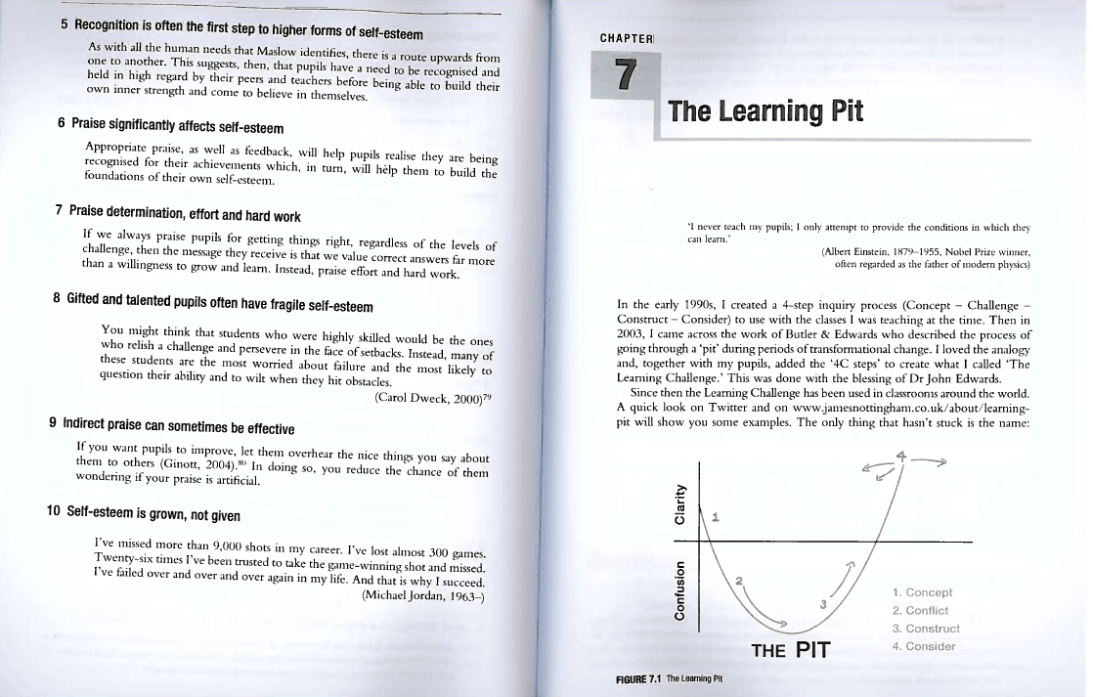
Nottingham, James
Challenging Learning, (2nd ed.), Routledge, London, 2016, Chapter 7

Slide 2
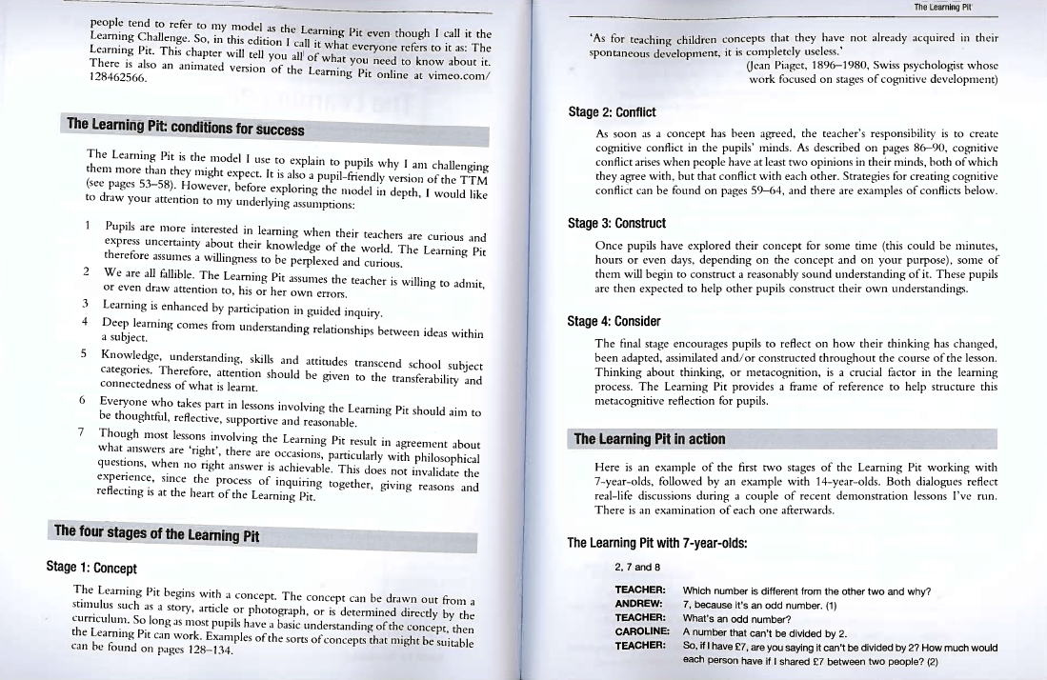

Slide 3
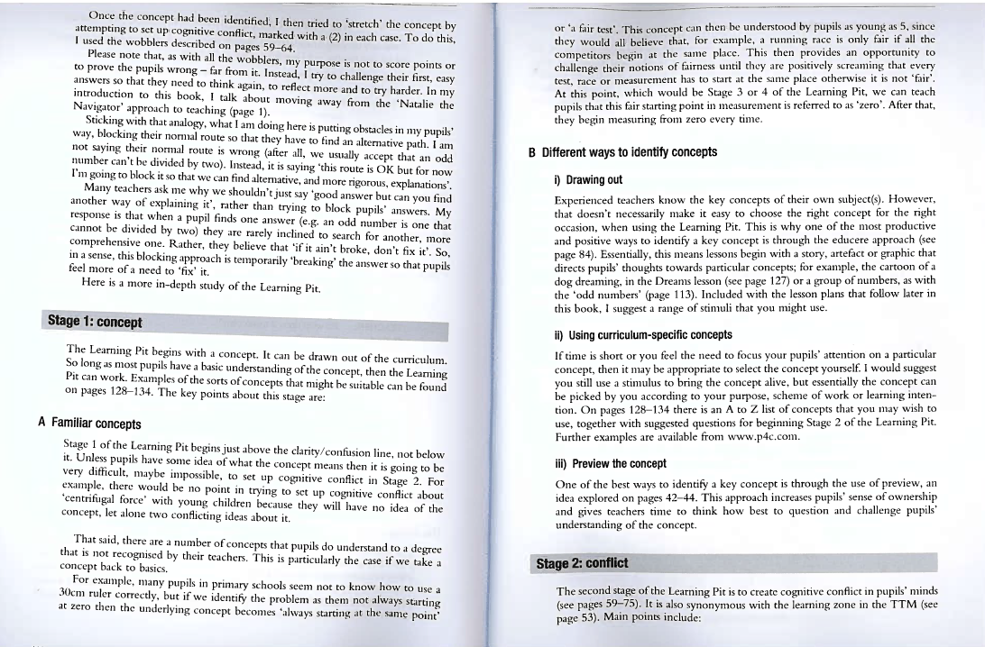

Slide 4
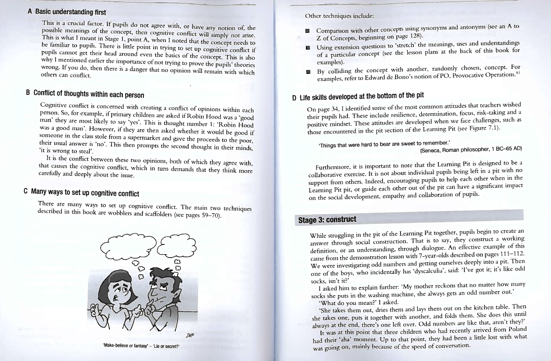

Slide 5
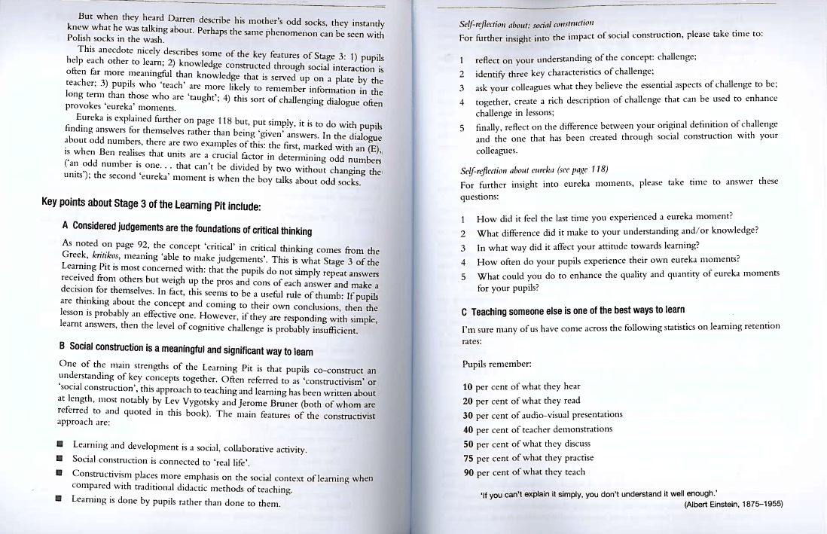

Slide 6
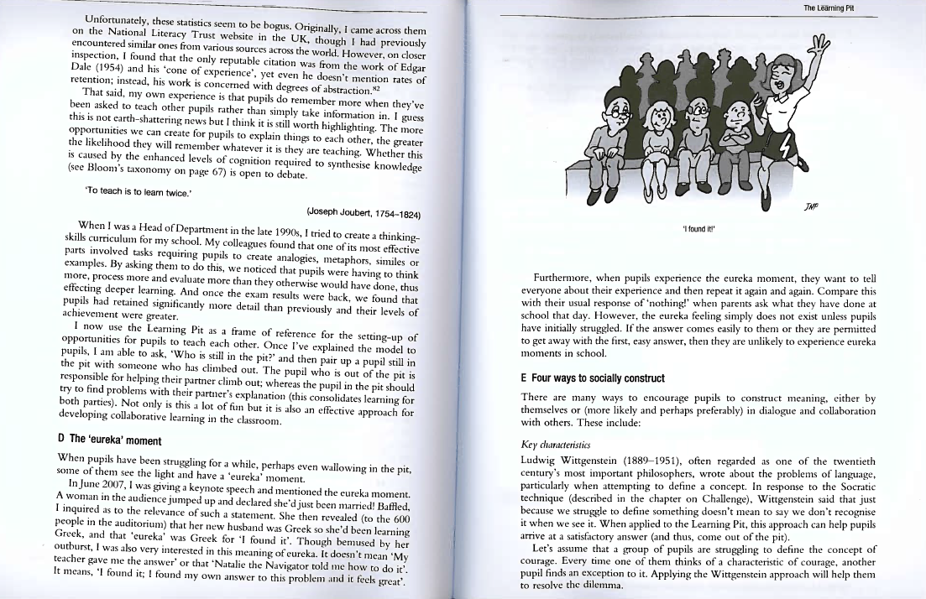

Slide 7
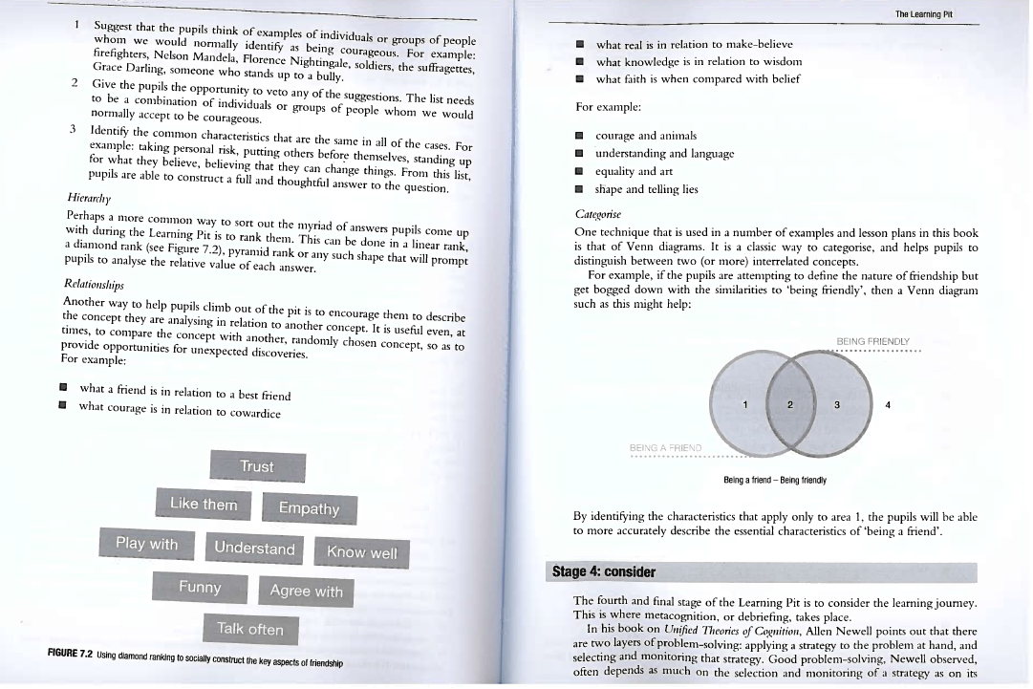

Slide 8
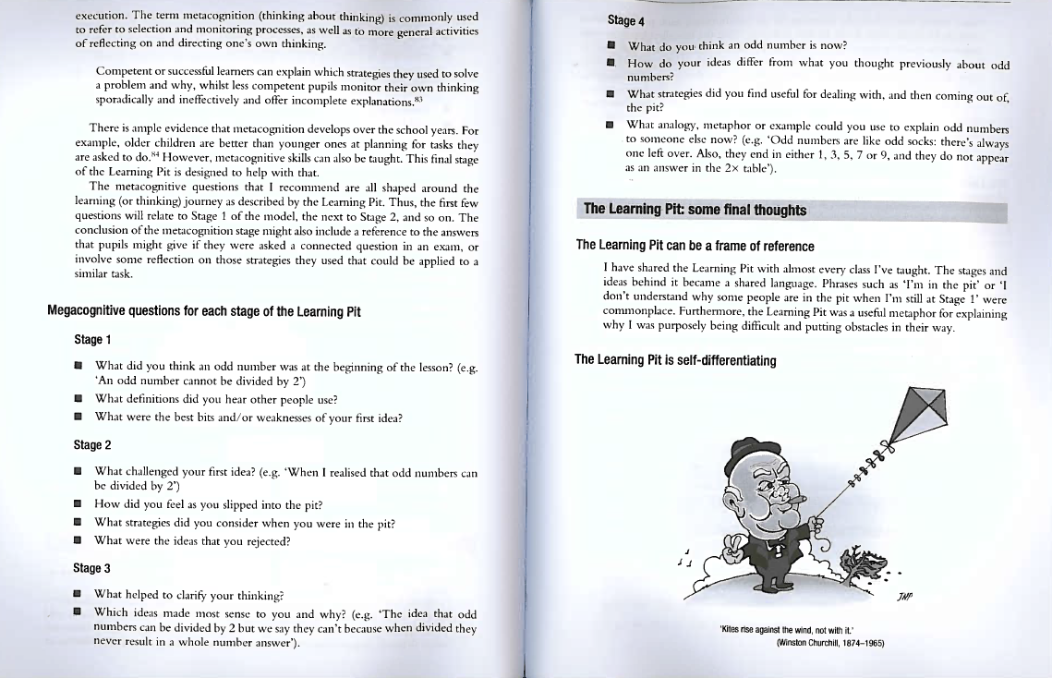

Slide 9
Nottingham, James
Challenging Learning, (2nd ed.), Routledge, London, 2016, Chapter 7

Slide 10
