Slide 1
Bun-sgoil Bhogha Mòr
Our journey…so far
Notes:
Background – PPT / SIP /S&Q

Slide 2
Why The Need for Change?
RIF
National Guidance
Self Evaluation
CfE Data
The School Context – GME
Notes:
Unique GME

Slide 3
The RIF
Management of Self Evaluation
School Improvement
Leadership
Monitoring and Tracking Progression

Slide 4
National Guidance
Total Immersion – Practice
Immersion – Practice
Experiences and entitlements
Parental Involvement
Transitions
ASN
Teaching, Learning and Assessment
Notes:
Gaelic Advice 2015 -reputation parents relevance Experiences

Slide 5
Data
CfE data indicated gaps in attainment
Lack of Data
Notes:
Lack of knowledge of the importance of data

Slide 6
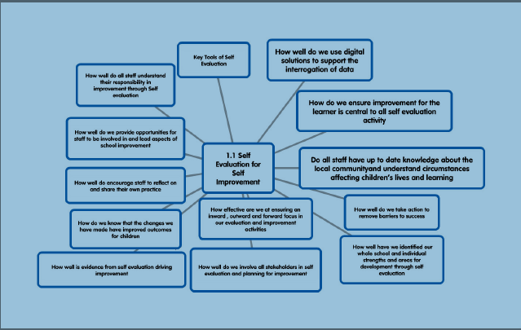
Self Evaluation
HGIOS 4 - Focus
1.1 Self Evaluation for self improvement
1.3 Leadership of change
2.2 The Curriculum
2.3 Learning Teaching and Assessment
3.1 Ensuring Wellbeing Equality and Inclusion
3.2 Raising Attainment and Achievement
Notes:
Popplets

Slide 7
Priorities for Improvement
Raising Attainment in Literacy, Numeracy
Learning, Teaching and Assessment
Healthy, Active and Supported
Leadership
Curriculum Design
Had to be Visual!
What about Gaelic?
Notes:
Gaelic had to be seen , present in each of the Priorities, OCTF – we were first

Slide 8
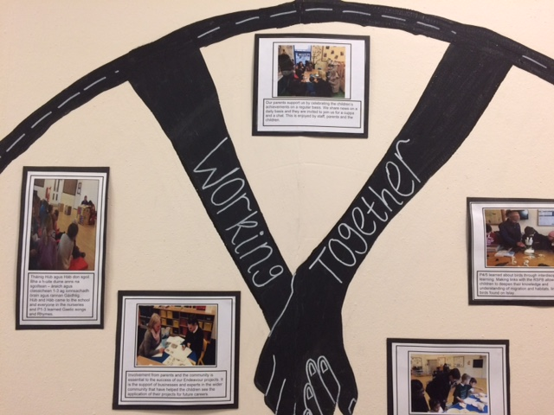
Priorities for Improvement
Curriculum
Partnerships
Notes:
Pictures, Font, Important

Slide 9
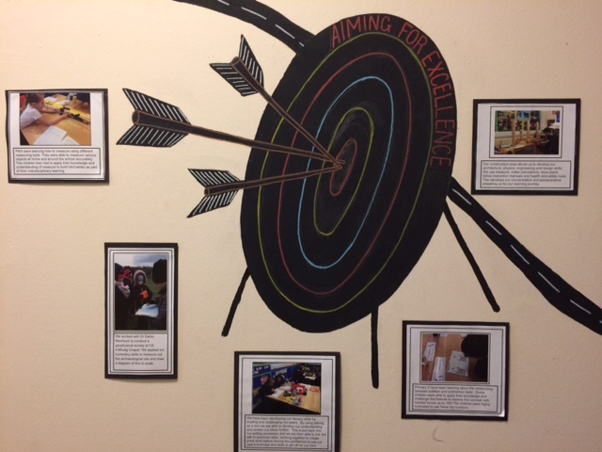
Priorities for Improvement
Raising Attainment
in literacy and numeracy
Learning and Teaching

Slide 10
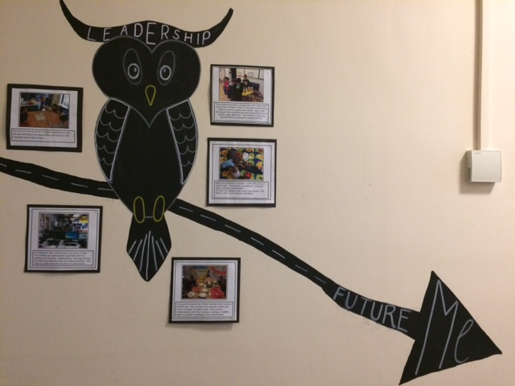
Priorities for Improvement
Improving Health and
Wellbeing Outcomes
Leadership
at all levels
Notes:
Supported, Equity

Slide 11
Steps for Improvement
Staffing
Assessment Data
Programmes
The Rationale
Moderation
Networking
Increasing the Learning Experiences
Parental Involvement
Notes:
The steps overlap

Slide 12
Steps for Improvement
Staffing
Worked with ICCI to employ 0.3 class teacher for 3 mornings
Used staffing allocation to employ more Gaelic Classroom Assistants, one in the class all the time
( This allowed me to change the learning space)
Worked with IHS to share a GCA

Slide 13
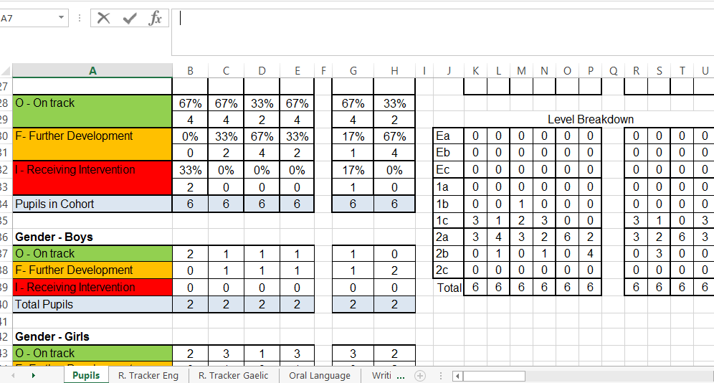
Steps for Improvement
Staffing
Assessment Data
Created our own in-house assessment tracker for literacy and numeracy
Had to be comprehensive

Slide 14
Steps for Improvement
Spelling Tracking Kicked us off
Writing Planning and tracking
Reading Tracking - Story worlds and RR strategies
Oral Gaelic Progression - SALi
Maths planning – based on HAM (works for GME )
Health and Wellbeing – 3 year
Science – 3 year
Staffing
Assessment Data
Programmes
Making a start
Notes:
Used the benchmarks

Slide 15
Steps for Improvement
Moderated an aspect of literacy and numeracy each term EM/GM
Moderated Science
Used SALi for support material for progression in literacy
Used the Benchmarks
Moderated across the cluster – particularly at 2nd level . This changed the marking criteria for writing – up-levelled
Moderated Learning Intentions /Success Criteria *
Learning Logs
IDL
Sgoil Àraich- Environment, Interactions (across two schools)
Staffing
Assessment Data
Programmes
Moderation
Notes:
Changed Planning and it’s ongoing * Gillian

Slide 16
Steps for Improvement
It’s a small pool!
Made links within the community…
CnaG- Orienteering , Bushcraft
IHS – Maths teacher
ICCI – After school clubs, Bogha Frois
Rejig
CnP
Local Councillor
And Outwith
BnG- Trip to Skye
Sleat Primary
Whitewave outward bound Centre
CnP – National
Important to use the support and advice of the ESO
Staffing
Assessment Data
Programmes
Networking
Moderation

Slide 17
Steps for Improvement
Curriculum Design?
The 4 contexts – Totality?
Taking the learning beyond the school ?
Staffing
Assessment Data
Programmes
Increasing the learning experiences
Moderation
Networking
Notes:
IDL – progression, Ethos, Community,

Slide 18
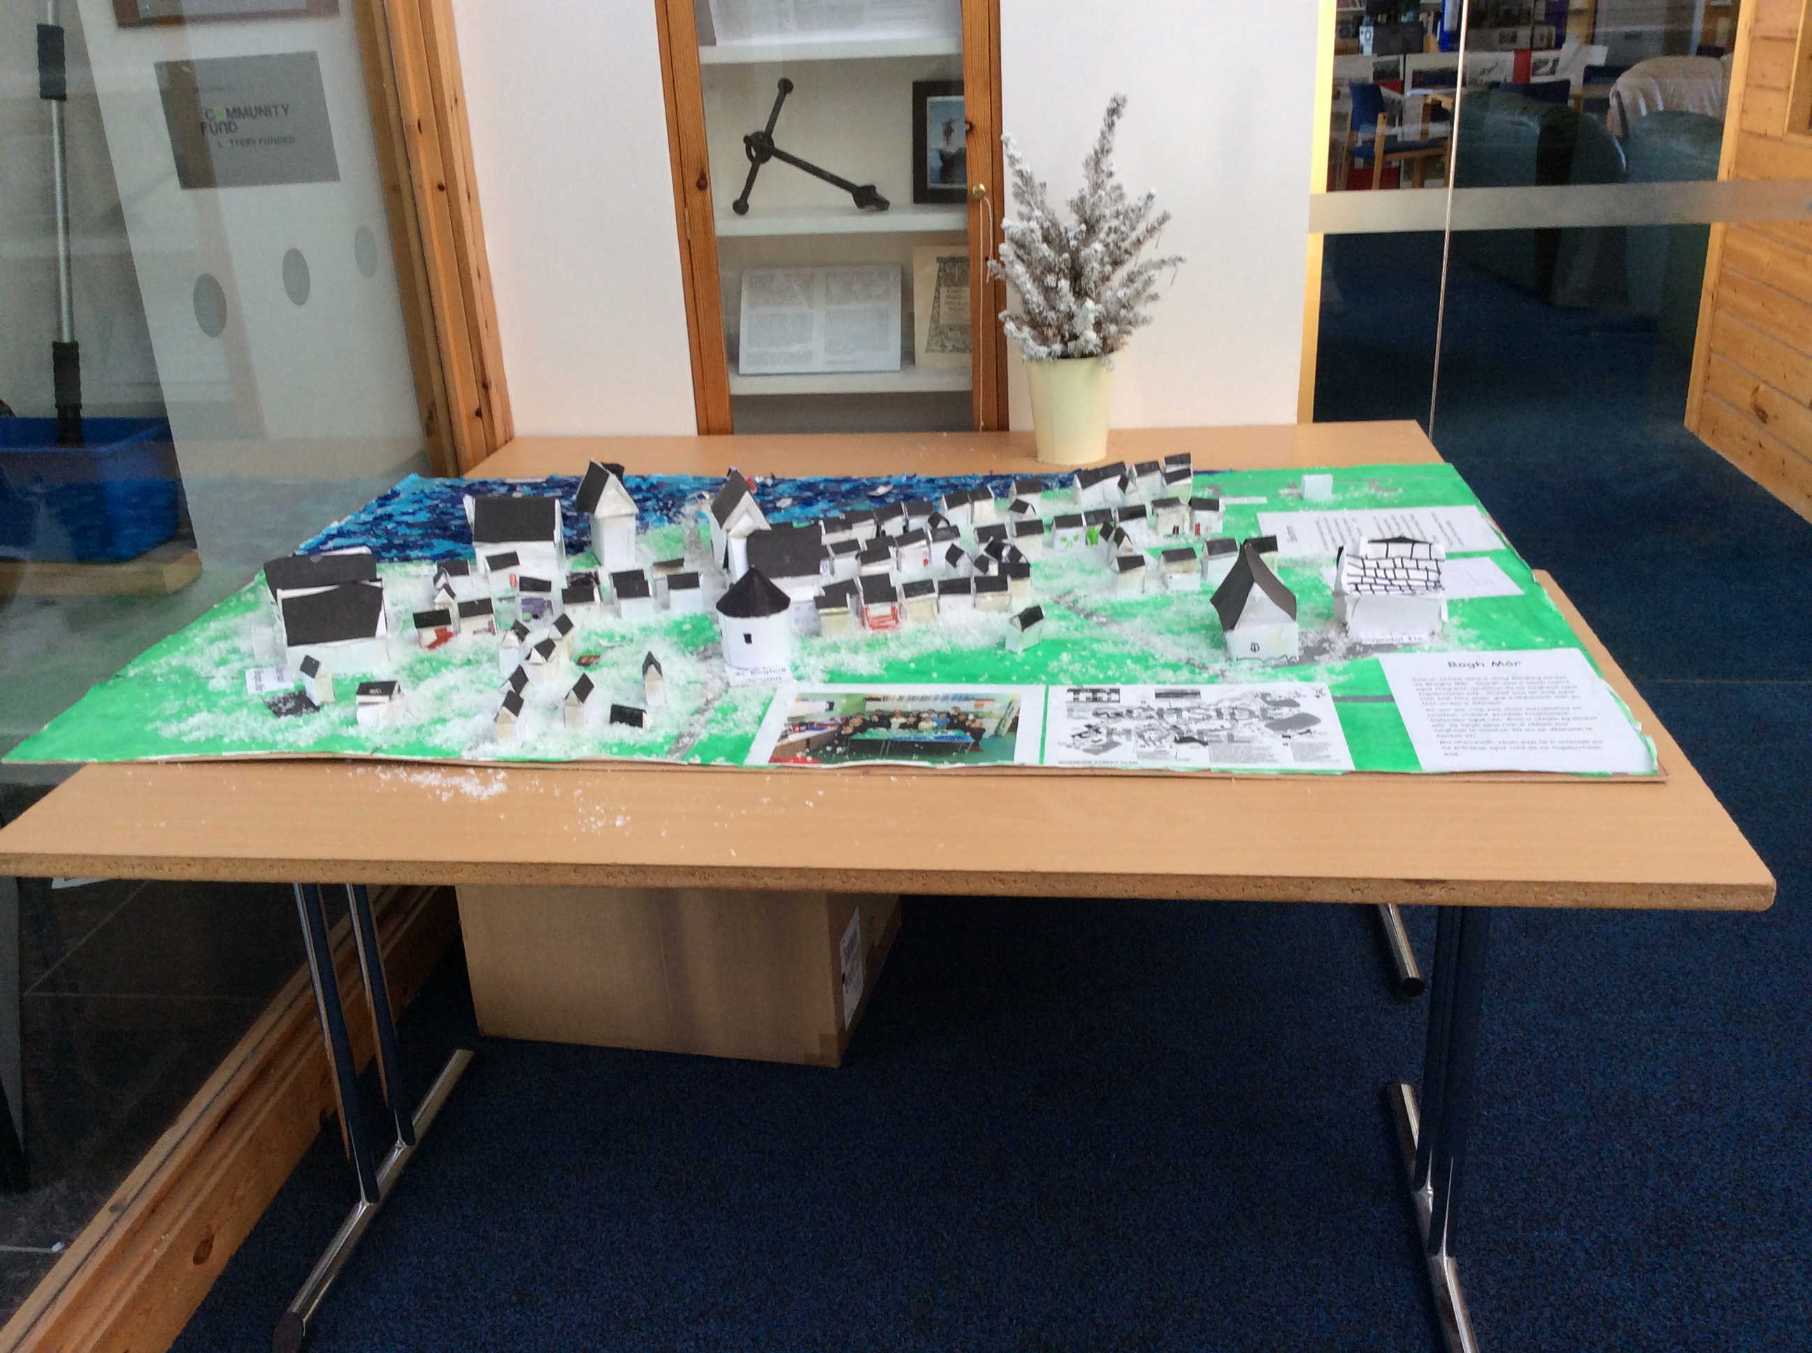
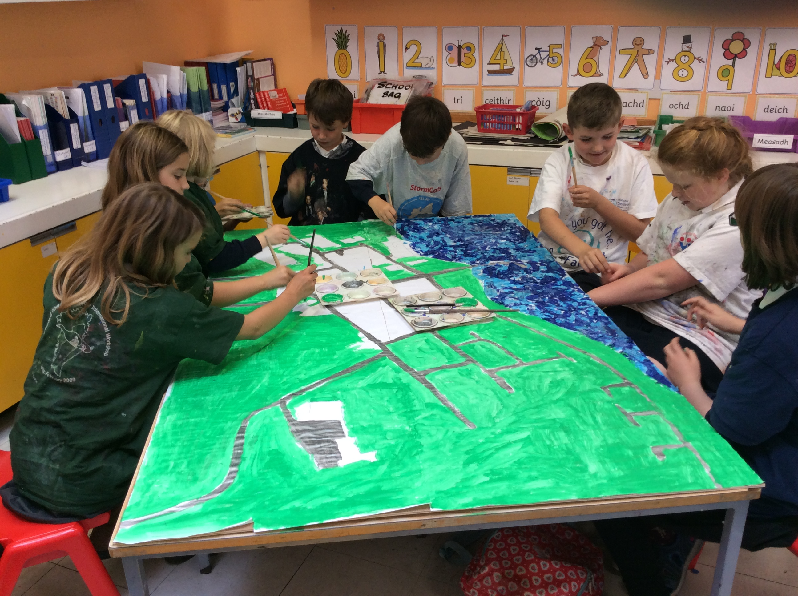
Steps for Improvement Some pictures
Bowmore 3d Map – IDL

Slide 19
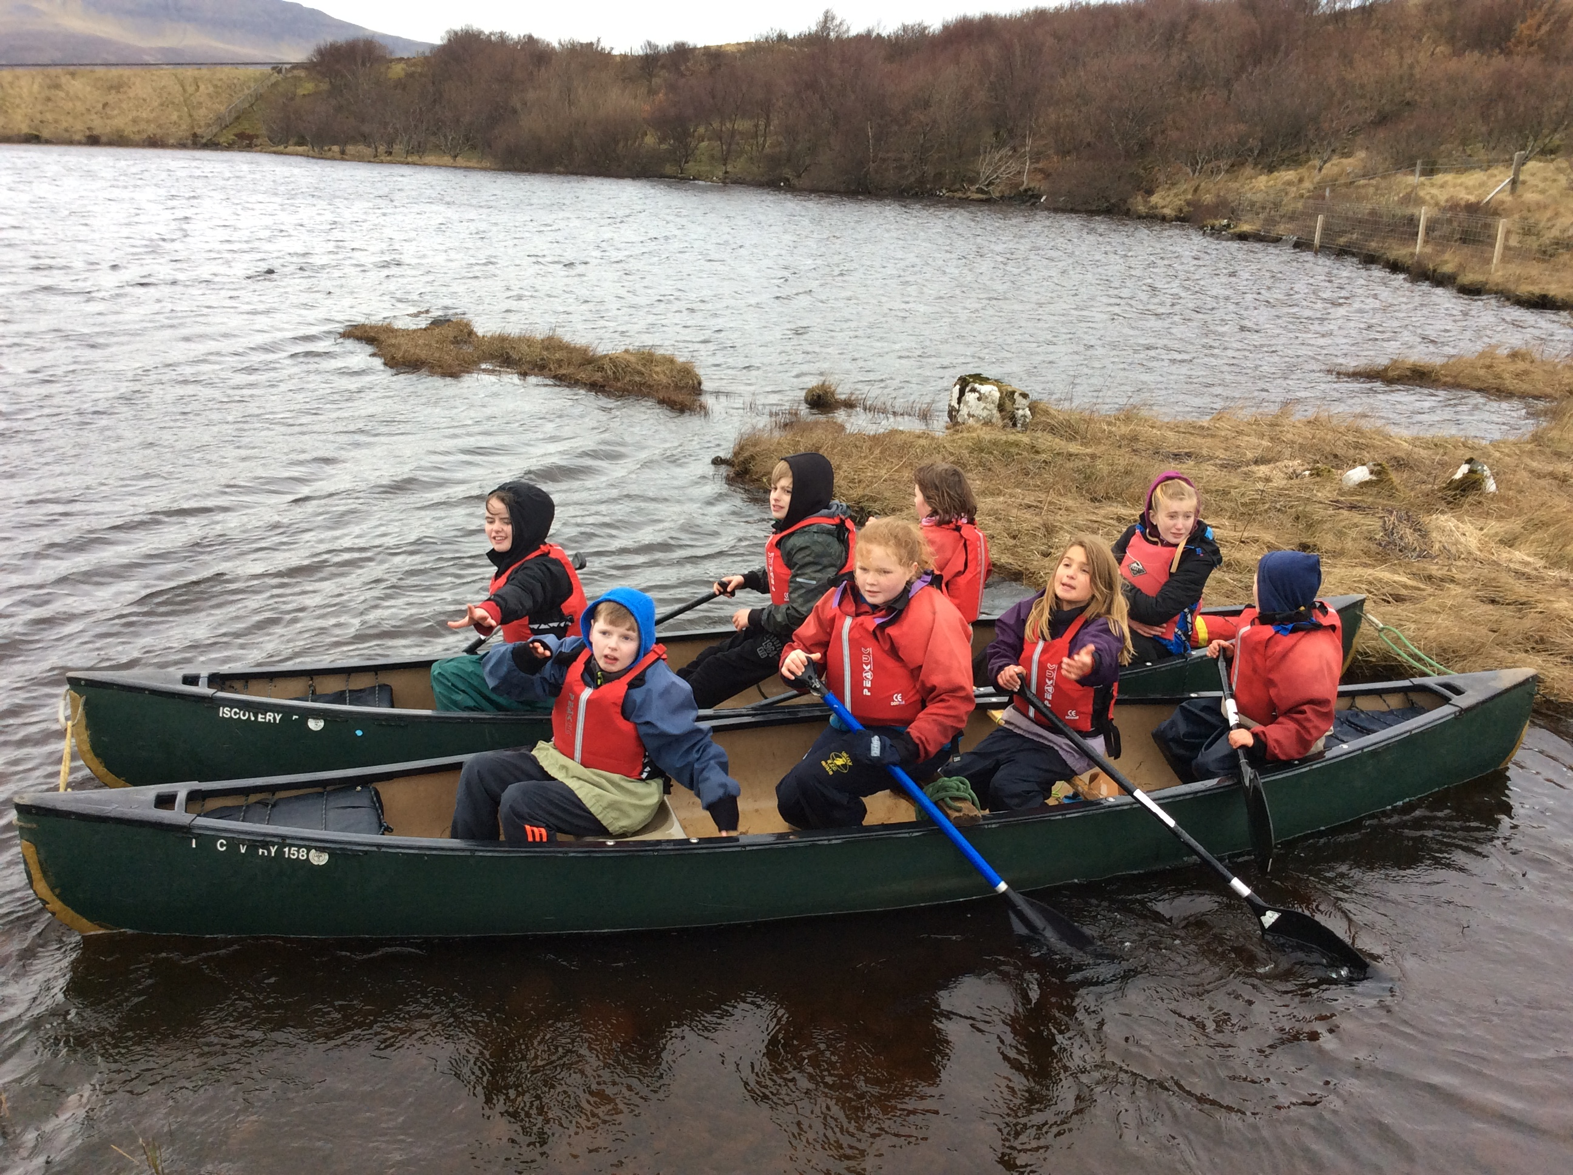
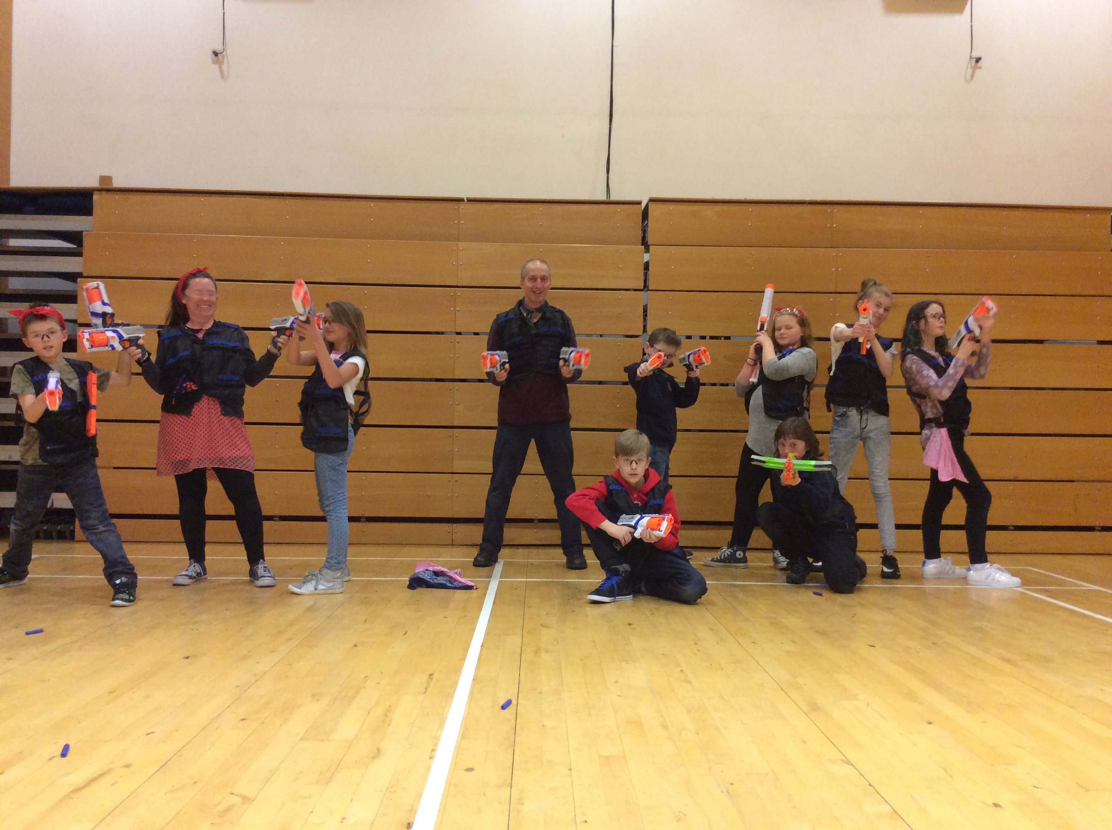
Steps for Improvement Some pictures
Skye
Notes:
Skills , Bonding , Success, Careers, Gaelic beyond school

Slide 20
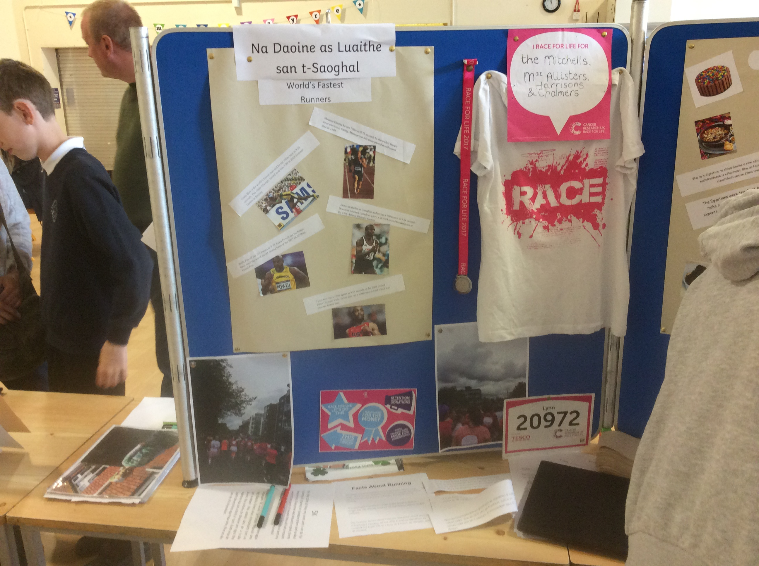
Steps for Improvement Some pictures
Independent Learning – Endeavour
Notes:
Presenting the learning – In Gaelic

Slide 21
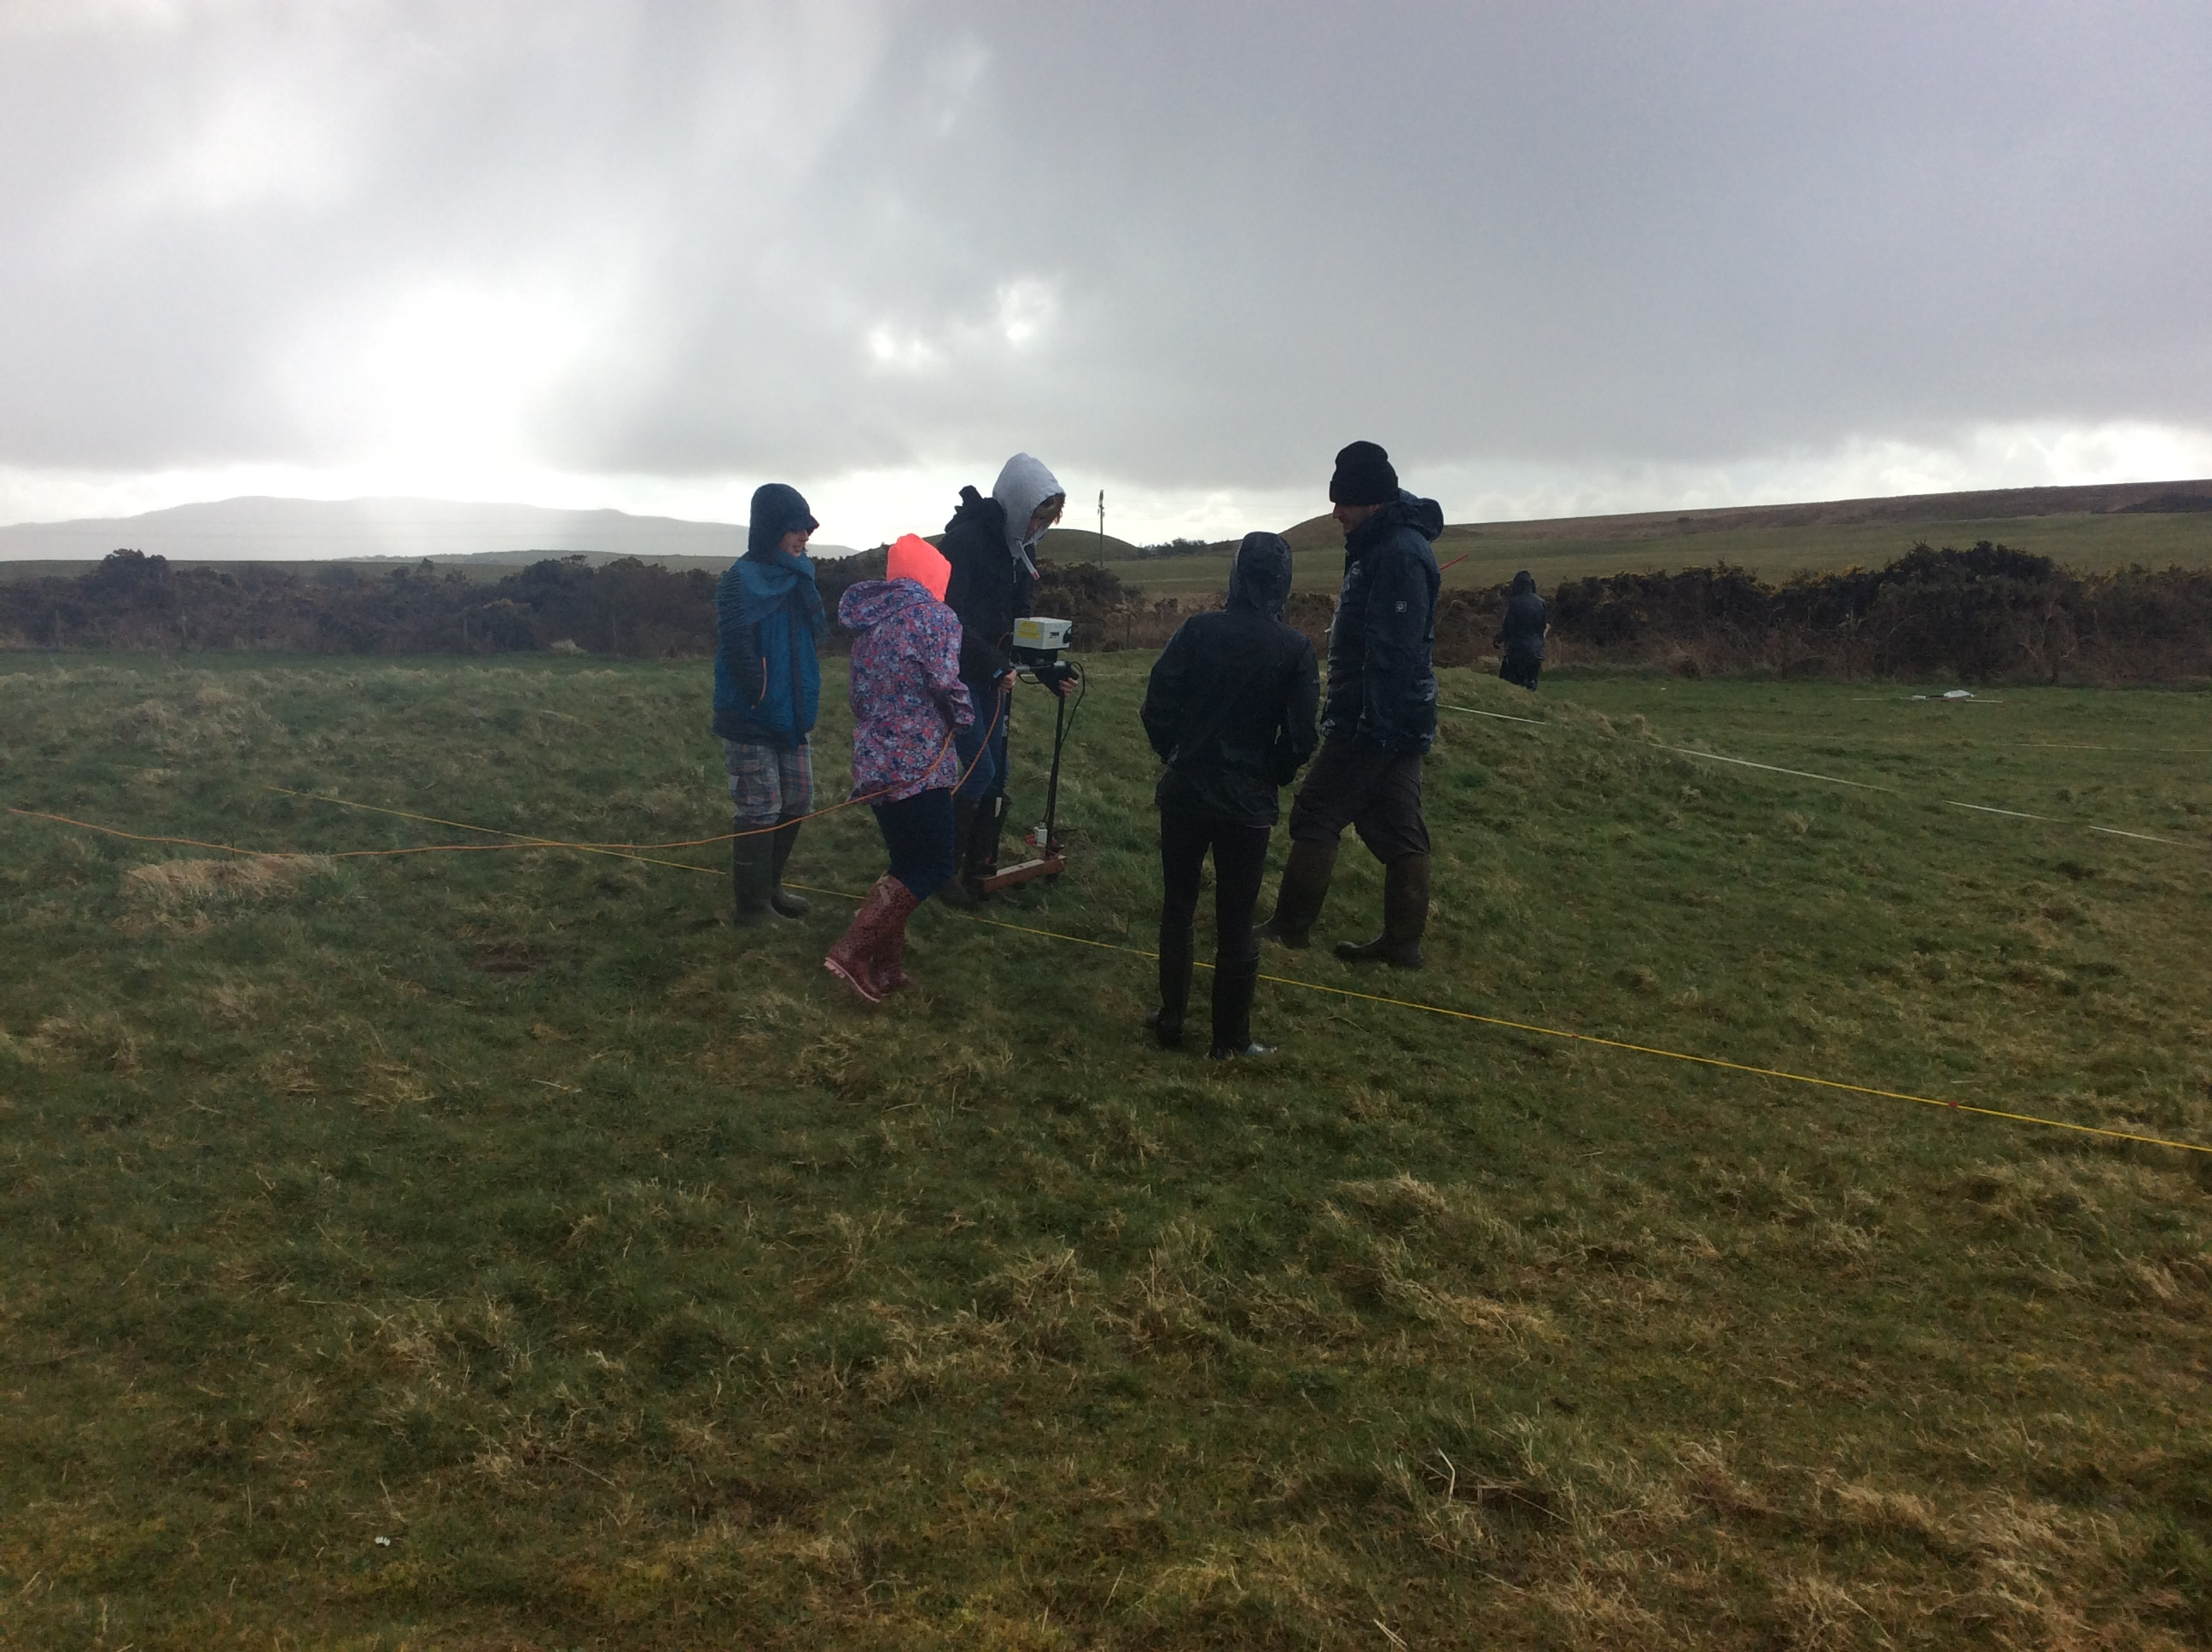
Steps for Improvement Some pictures
Orienteering at Finlaggan
Geophysics
Notes:
Bilingual

Slide 22
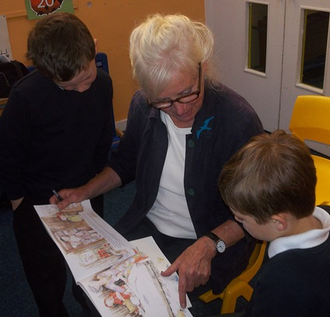
Steps for Improvement Some pictures
Positive Role Models
Visitors
Notes:
Dux , CA in nursery – supply list

Slide 23
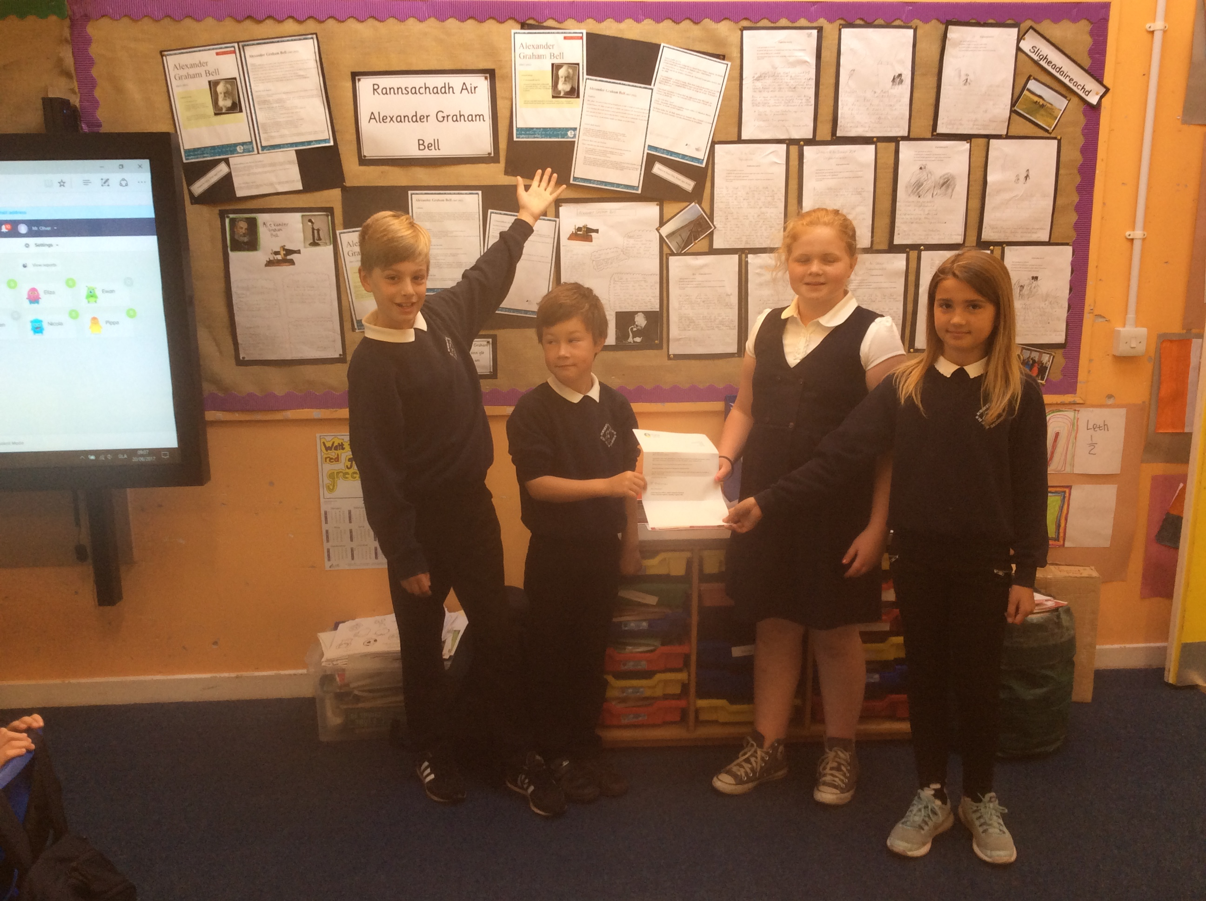
Steps for Improvement Some pictures
Challenge and Success
Notes:
* Gillian

Slide 24
Steps for Improvement
Staffing
Assessment Data
Programmes
Parental Involvement
Moderation
Networking
Increasing the Learning Experiences
Forming positive relationships with parents
Attendance at CnP Meetings
Parent Council/CnP
Celebrating the Learning
Celebrating success
Celebrating Gaelic
Bringing the 2 schools together, staff, parents
Notes:
Having a presence at meetings, being involved , Joint Choir

Slide 25
Steps for Improvement
Staffing
Assessment Data
Programmes
The Rationale
Moderation
Networking
Increasing the Learning Experiences
Parental Involvement

Slide 26
The Rationale
Notes:
Explain

Slide 27
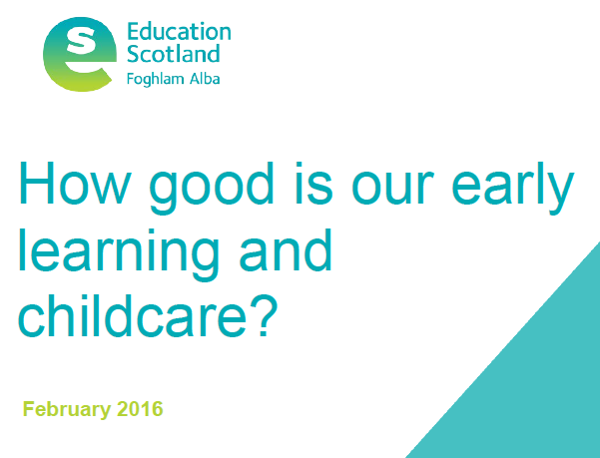
Steps for Improvement
Staffing
Assessment Data
Programmes
Ongoing Self Evaluation
Moderation
Networking
Increasing the Learning Experiences
Parental Involvement
The Rationale
Remember the Working Time Agreement !

Slide 28
A few rules
1) Let’s hear Gaelic!
Pupils, Staff
2) More Gaelic on display
Writing , Endeavour, Maths, Skills
3) Celebrate Gaelic
Value Gaelic
Credibility and Integrity
Notes:
Gaelic Open Day

Slide 29
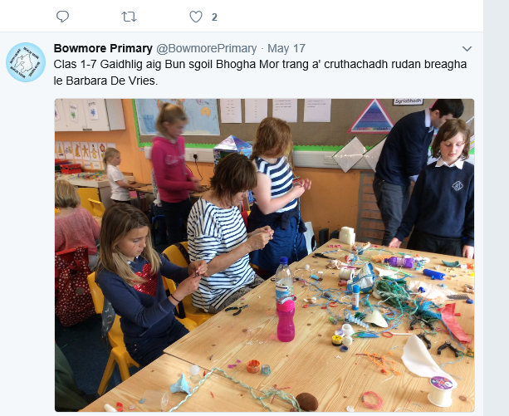
Dè Gàidhlig airson – Bigging it up?
Notes:
Promoting Gaelic place in society

Slide 30
Impact
Positive Ethos /Inclusion
Increase from 50% to almost 90% Total Immersion
Increased Gaelic Oral skills /spoken Gaelic
Pupil Motivation and Confidence – Leadership
Continue to Raise Attainment in literacy and numeracy
ASN – support is making a difference – targeted and focused
Staff Motivation, Confidence – Leadership
Raised Expectations for GME
Parent Trust and Confidence
Increased Experiences
See the need for an Early Level Class – numbers
Clarity – the way forward – we know what we need to do to improve
Transition – it’s started and will develop , there is a plan!!
Pace of change - need a holiday
Notes:
Rationale

Slide 31
An ath cheum (The next step)
Continue to Raise Attainment in literacy and numeracy
Continue to raise the profile of Gaelic at Bowmore Primary
Consistent 90% Total Immersion
Increase numbers into GME –Early Level Class
Increase Experiences beyond the classroom
Credibility, Integrity, stability

