Slide 1

Maeve MacKinnon
Update on National Developments
February 2017
Ag atharrachadh beatha tro ionnsachadh

Slide 2
Amasan / Aims
To give an overview of Education Scotland’s online services and provide an update on recent developments.
To increase awareness of how to locate resources to support learning, teaching and assessment in Gaelic.
To highlight the Professional Learning Community for Gaelic Education and encourage engagement; to promote dialogue, share information and practice, to support quality and improvement in Gaelic Education.
Ag atharrachadh beatha tro ionnsachadh

Slide 3
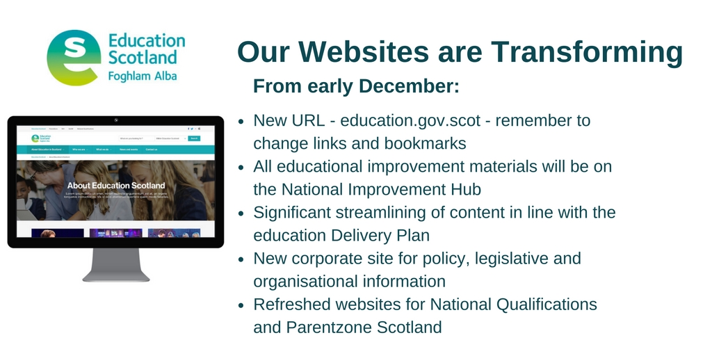
Ag atharrachadh beatha tro ionnsachadh

Slide 4


Slide 5
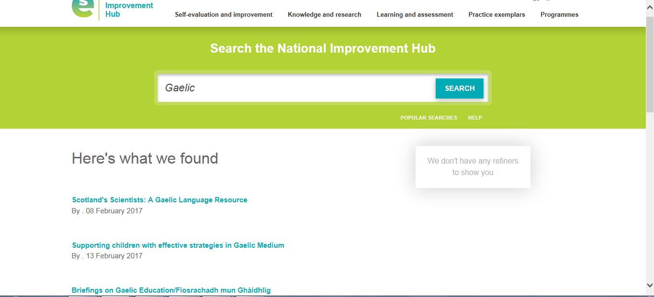
Ag atharrachadh beatha tro ionnsachadh

Slide 6
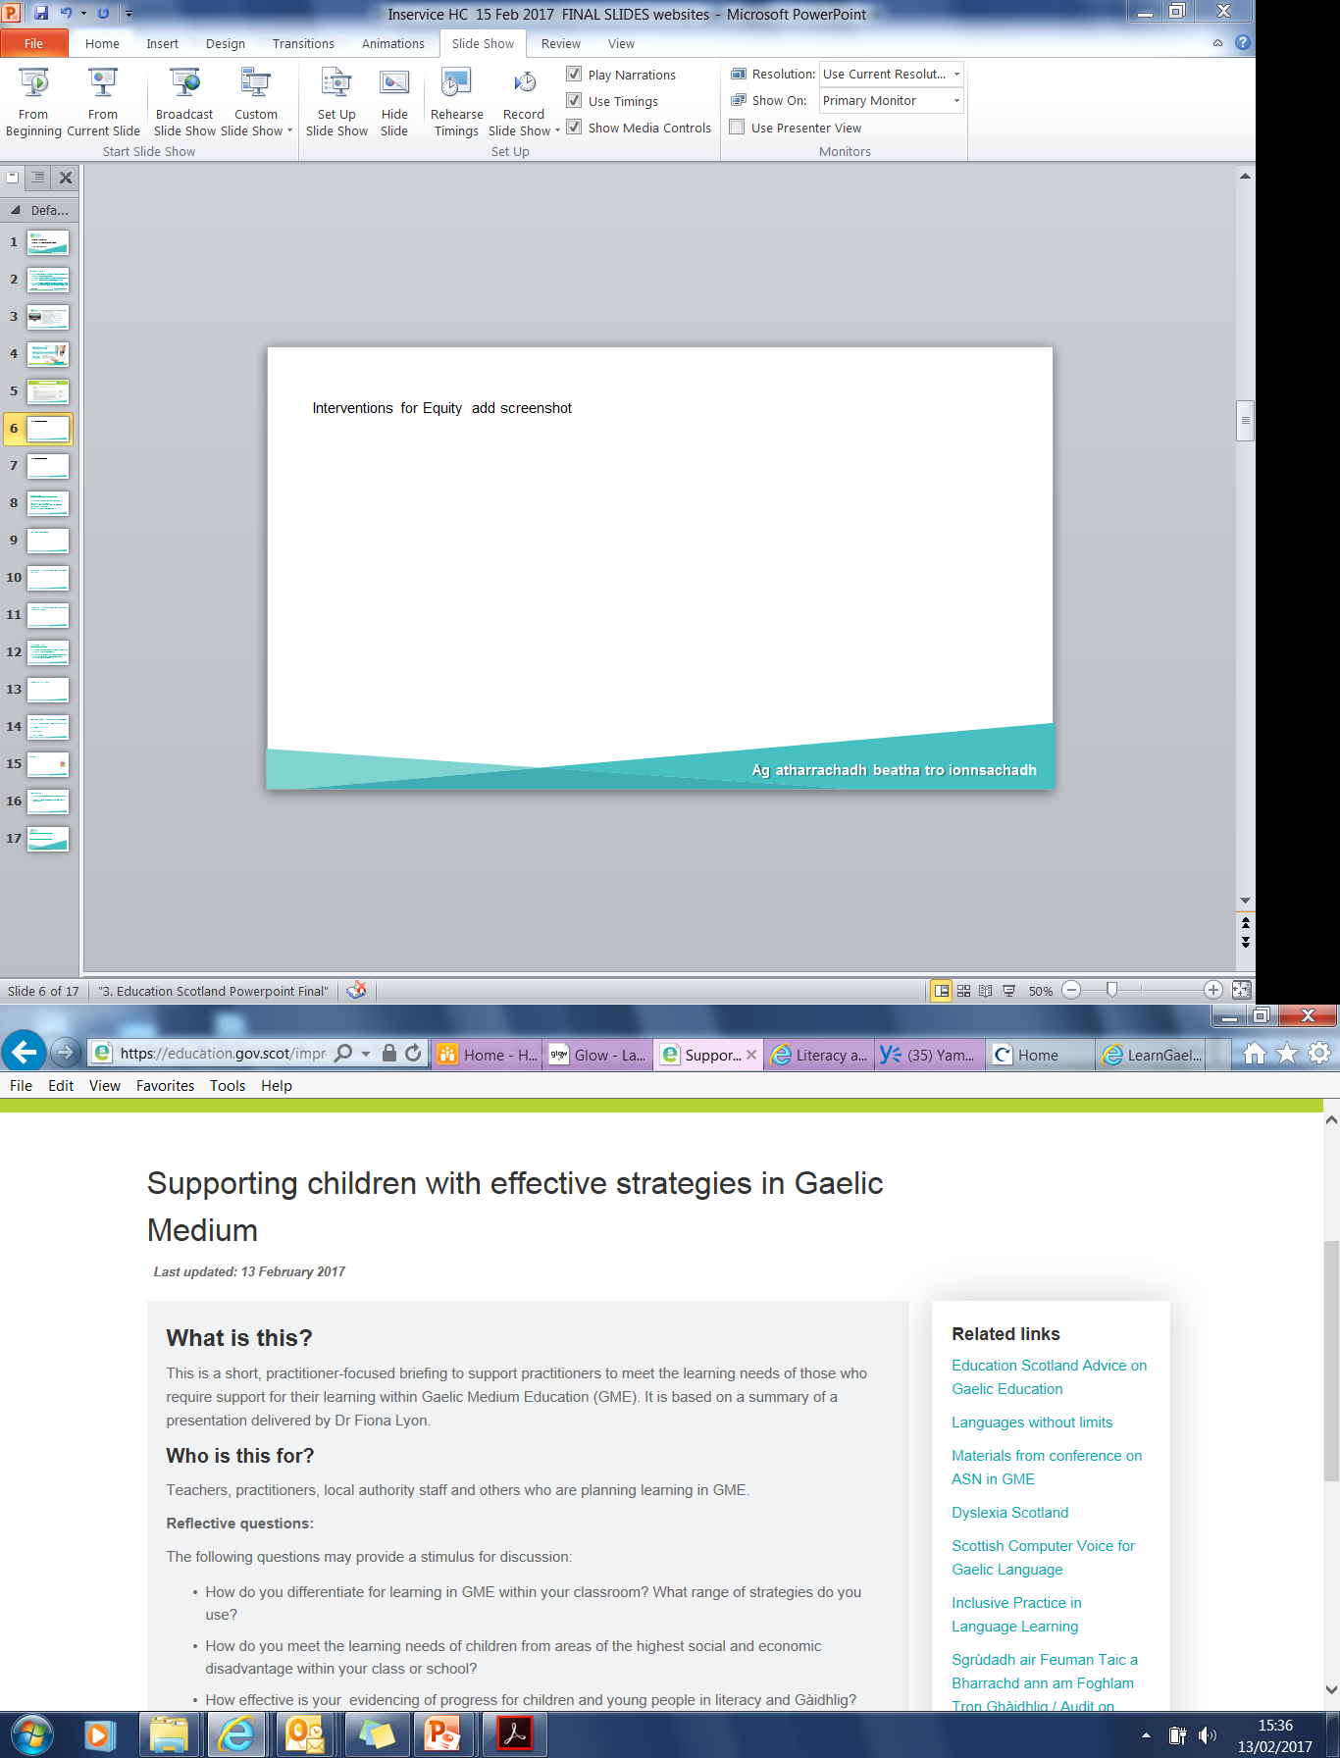
Ag atharrachadh beatha tro ionnsachadh

Slide 7
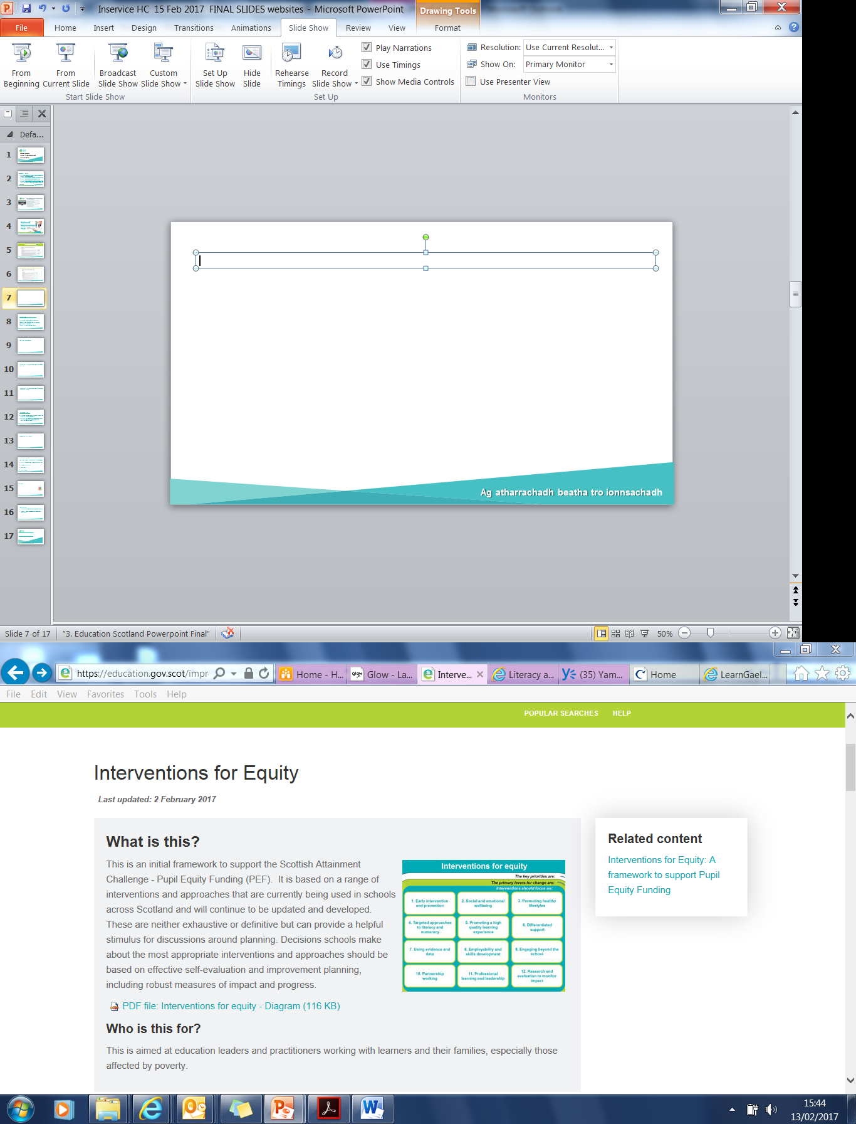
Ag atharrachadh beatha tro ionnsachadh

Slide 8

National Qualifications
Ag atharrachadh beatha tro ionnsachadh

Slide 9
Parentzone
www.education.gov.scot/ParentZone
Provides a wide range of information about:
education in Scotland-GME;
how parents and carers can support their child’s learning;
schools information;
how to get involved in education.
Ag atharrachadh beatha tro ionnsachadh

Slide 10
Corporate Site
www.education.gov.scot
Provides information about Education Scotland, major projects, policy and legislation.
For example: Inspection and review, Delivering the Scottish Attainment Challenge, Developing Employability and Skills.
Ag atharrachadh beatha tro ionnsachadh

Slide 11
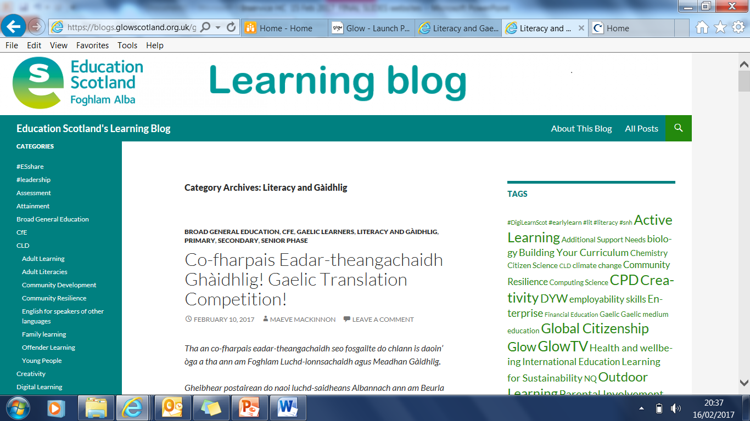
Education Scotland’s Learning Blog
Ag atharrachadh beatha tro ionnsachadh

Slide 12
Education Scotland’s Learning Blog
https://blogs.glowscotland.org.uk/glowblogs/eslb/
ES learning blog - Google
Ag atharrachadh beatha tro ionnsachadh

Slide 13

GLOW TV (login required)
Ag atharrachadh beatha tro ionnsachadh

Slide 14
National Gaelic Community on GLOW (login required)
(Please check with your school to ensure your SEEMiS details are up to date and then contact the Highland Council Service Desk on (0800 731) 2702 for account details.)
http://bit.ly/gaidhligyammer
PLC- Professional Learning Community
Closed group for teachers in Gaelic Education
Yammer- Conversations
Join today!
Ag atharrachadh beatha tro ionnsachadh

Slide 15
Update on CLPL audit:
Shared with partners, Stòrlann, E-stòras;
ES Digital Team - training on using Glow for E-sgoil;
Leadership Award- Partnership with Social Enterprise Academy;
Translations- eg. HGIOS 4, Advice on Gaelic Education;
Support materials for GME and GLE NQs – dedicated site;
Reading Materials-Giglets in Gaelic (coming soon);
Reflective Questions included with NIH resources;
ASN- Effective Strategies Paper and supporting links on NIH;
Health and Wellbeing resources on NIH;
Assessment materials- progression frameworks
Benchmarks, Advice on Data Collection in GME.
Ag atharrachadh beatha tro ionnsachadh

Slide 16
Gaelic in National Campaigns
Bookbug / Leugh is Seinn le Linda CnL
Read Write Count / Leugh Sgriobh Cunntais
Website, Additional Help page for parents of children in GME http://www.readwritecount.scot/gaelic-support-page/
First Minister’s Reading Challenge- CnL
Ag atharrachadh beatha tro ionnsachadh

Slide 17
Benchmarks
Literacy and Gàidhlig
Based on Learner Statements within the progression frameworks.
Benchmarks will be used to help monitor progress and support overall professional judgement of when a learner has achieved a CFE level. See GME Data Collection Advice on NIH
Gaelic (Learners)
Based on Learner Statements within the progression frameworks.
Monitor progress towards meeting the standards expected.
Ag atharrachadh beatha tro ionnsachadh

Slide 18
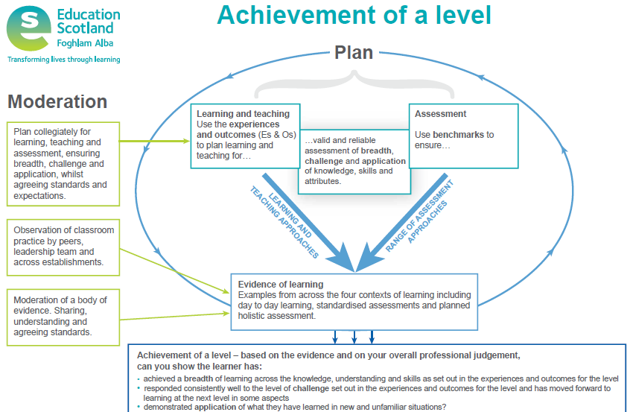

Slide 19
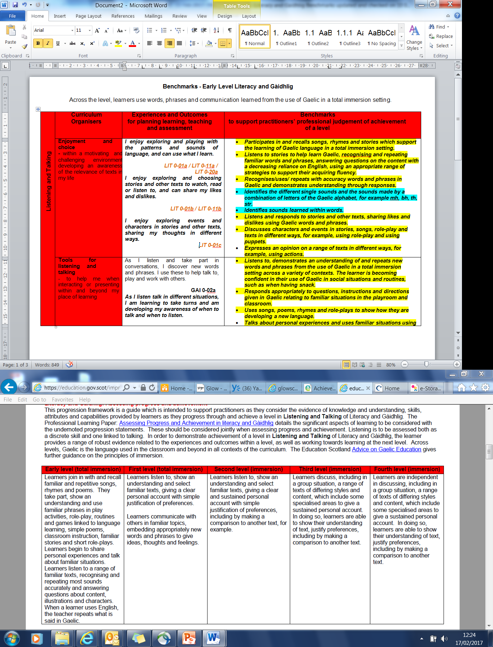

Slide 20
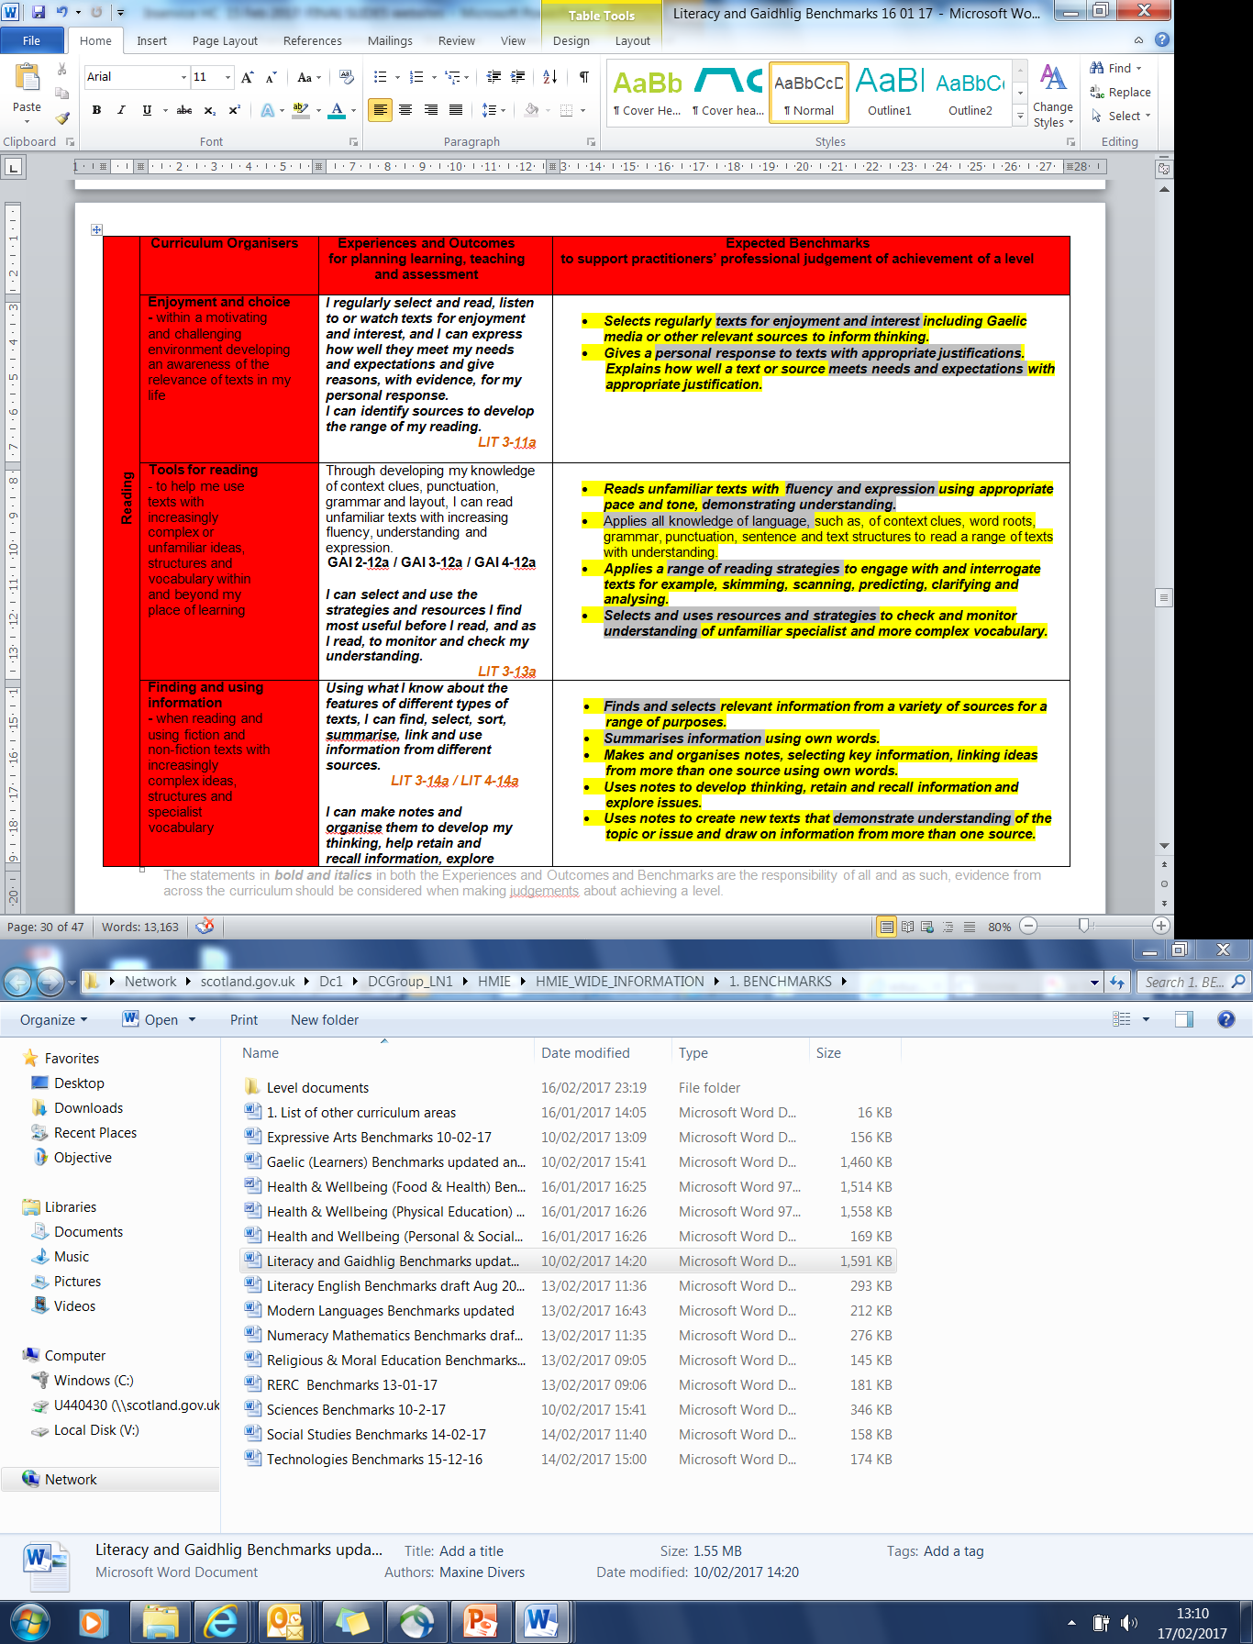

Slide 21
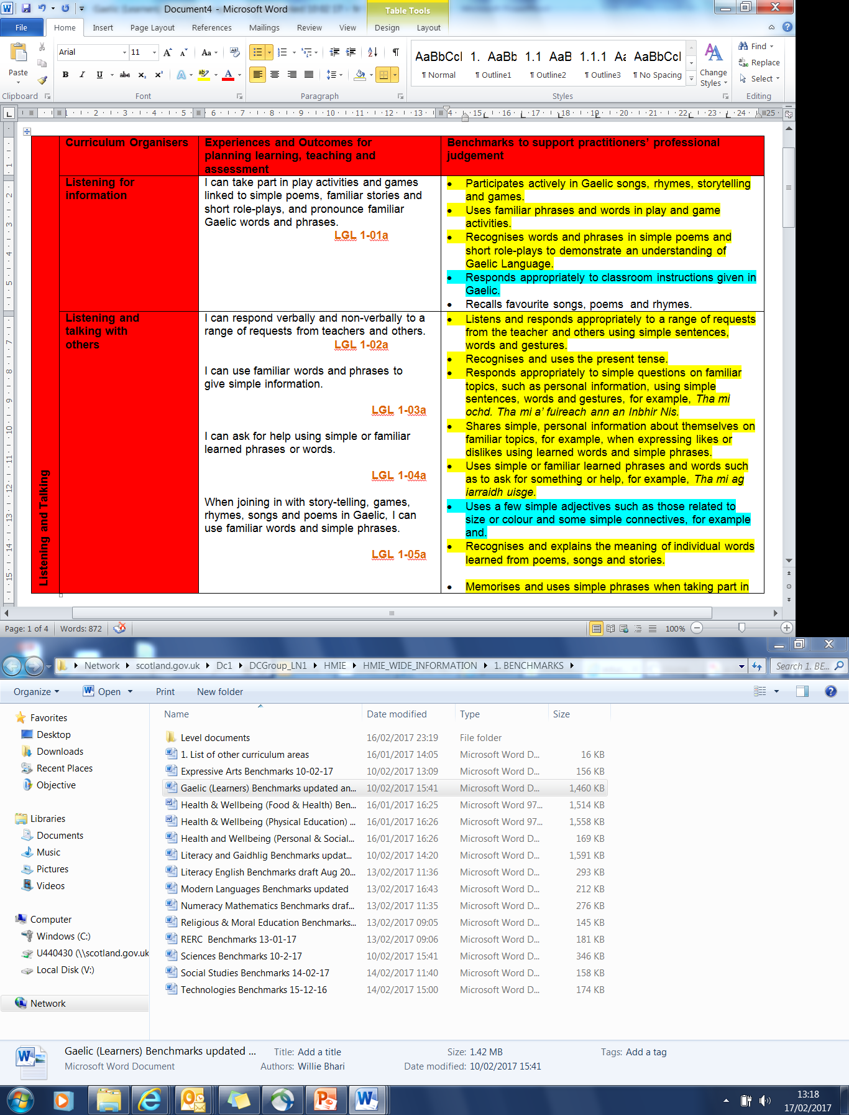

Slide 22
Tapadh Leibh!
Maeve.MacKinnon@educationscotland.gsi.gov.uk
Ag atharrachadh beatha tro ionnsachadh
Notes:
This is a back cover page in blue. You may edit the address if needed only. It can only be once and at the end of the PowerPoint presentation. Use the corresponding blue internal and back pages if you are using this page.

