Slide 1
Community Services: Education
Curriculum Design Day 3
Moving forward with Curriculum for Excellence
Anne Paterson Quality Standards Manager

Slide 2
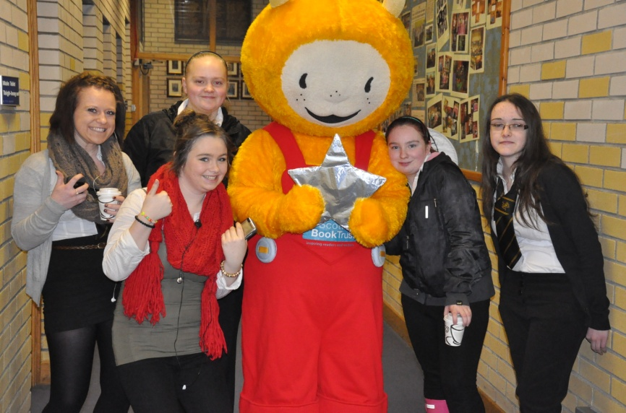
Curriculum for Excellence
  Entitlements:
  A coherent curriculum from 3 to 18
  A broad general education from age 3 to the end of S3
  A senior phase: opportunities for qualifications and other planned opportunities to develop the four capacities
  Opportunities to develop skills for learning, skills for life and skills for work
  Opportunities to achieve to the highest levels through personal support and challenge
  Opportunities and support to move into positive and sustained destinations beyond school
Notes:
Curriculum for Excellence 3 – 18
Curriculum for Excellence aims to achieve a transformation in education in Scotland by providing a coherent, more flexible and enriched curriculum from 3 to 18.
The curriculum includes the totality of experiences which are planned for children and young people through their education, wherever they are being educated.
The curriculum aims to help every learner develop knowledge, skills and attributes for learning, life and work.
Assessment
Curriculum for Excellence aims to raise standards of achievement for all from 3 to 18. This requires us to have effective quality assurance and moderation processes in place.
Development Assessment requires an appropriate focus on coherent planning, checking, sampling, reviewing and providing feedback for improvement. Appropriate target setting and monitoring and tracking of learners’ progress should be in place.
Broad General Education
Every child and young person in Scotland is entitled to experience a broad general education.
This broad general education takes place from the early years to the end of S3.
It is represented by learning across all of the experiences and outcomes to the third curriculum level together with those selected for study at the fourth, as far as is consistent with each child or young person’s needs.
‘Not expected that qualifications will feature at this stage’.....aspects of accreditation will
Providing a strong platform for later learning and qualifications.
Senior Phase
The senior phase, which takes place from S4 to S4 in schools and includes ages 16 to 18 out of school, is the phase when the young person will build up a portfolio of qualifications. It is the stage of education at which the relationship between the curriculum and National Qualifications becomes of key significance. The curriculum framework and the qualfications system will provide a range of opportunities to meet the needs of all learners.
Continued Professional Development
It is essential to sustain and extend quality professional development to develop knowledge, skills and confidence in Curriculum for Excellence.
We are committed to developing our workforce within 3 – 18 curriculum development and provide opportunities for training and professional dialogue.

Slide 3
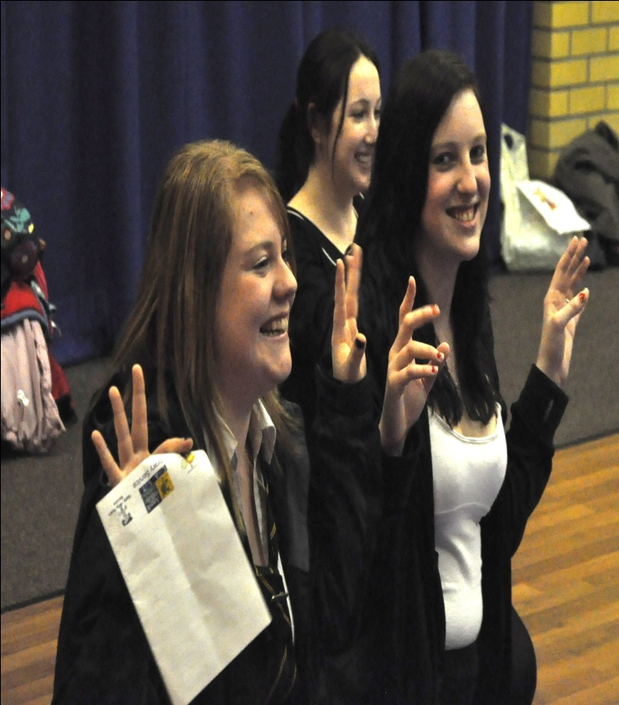
Opportunities for All
Skills based curriculum
Partnership working
Positive destinations for all our young people
Notes:
Skills based Curriculum
A 3-18 curriculum but working towards a 0-18 curriculum. Skills which progress from the most basic e.g talking to the higher order thinking skills such as synthesis and systems thinking. A broad general education until the end of S3 with opportunities for informed choice and some specialism. The senior phase from the beginning of S4. New qualifications, but not only Nationals, also the opportunity to gain wider accreditation – ASDAN, John Muir, Duke of Edinburgh, Millennium Volunteer, YASS, HNC, degree units.
More varied experiences for our young people : The Princes Trust; Champions in Schools, Columba 1400, Social Enterprise etc.
Wider opportunities for more work based, experiential learning through the use of extended placements and internships.
Partnership Working
Qualifications delivered by a range of partners – schools, CLD, colleges, universities, employers etc.
Information –collected and shared by a number of partner agencies e.g. SDS. labour market info etc (GIRFEC ) to ensure the most appropriate opportunities for each young person.
Positive Destinations for All
The offer of a place in Training, Education (FE or HE) or Employment for all our young people. Of key importance is the matching of the young person to the most appropriate offer and not simply to what is available.
Activity agreements for our most vulnerable young people.

Slide 4
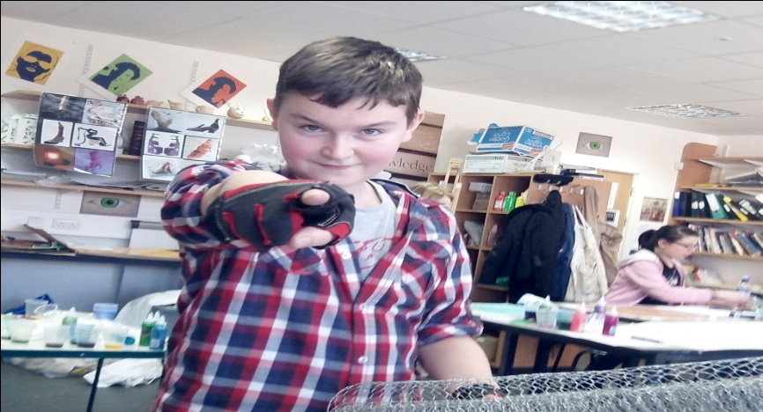
What is Expected?
The practitioners:
Have developed a clear vision and rationale for the curriculum taking account what the learner is entitled to;
have been supported by leaders to develop and share a strategy for the development of literacy and numeracy ensuring that it is everyone’s responsibility;
have developed or are actively developing a holistic approach towards health and wellbeing through the culture of the organisation.
Ensure that the health and wellbeing of young people is at the heart of everything we do.

Slide 5
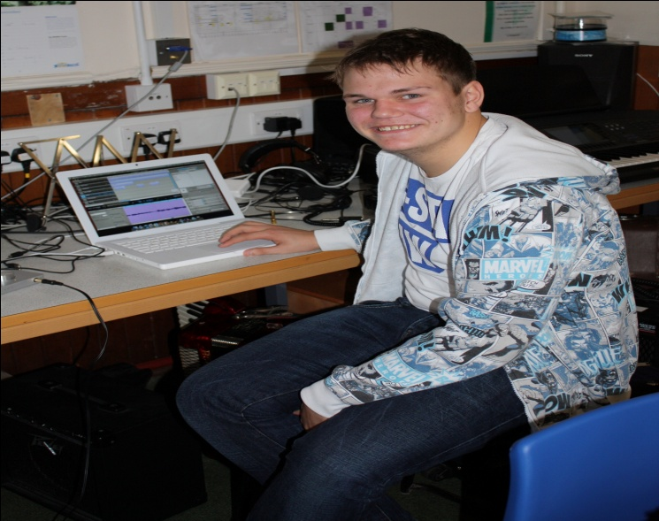
What is Expected?
Can talk about their role in curriculum innovation and to be engaging regularly in professional dialogue with other colleagues; and
are working with others to ensure the curriculum is relevant and meets the need of our young people.

Slide 6
6 Key Drivers
Increase the ambition, aspiration and expectations of every child and young person
Delivering excellent learning and teaching in every classroom, every day
Developing effective leadership at all levels
Engaging family and wider community
Focusing on literacy and numeracy as platforms on which to build future learning
Using information intelligently to understand progress
Notes:
Each of these drivers will form the developments for the next 5 years in Argyll and Bute Schools

Slide 7
Delivering Excellent Learning and Teaching in Every Classroom, Every Day
Sharing the standard
Assessment is for learning
Pilots of pedagogical developments – active learning, outdoor learning, technologies,
co-operative learning – what really works.
Share the excellent practice – authority and national
Raise expectation of teachers in their teaching
Effective use of learning technologies
Curriculum design meeting the needs

