Slide 1

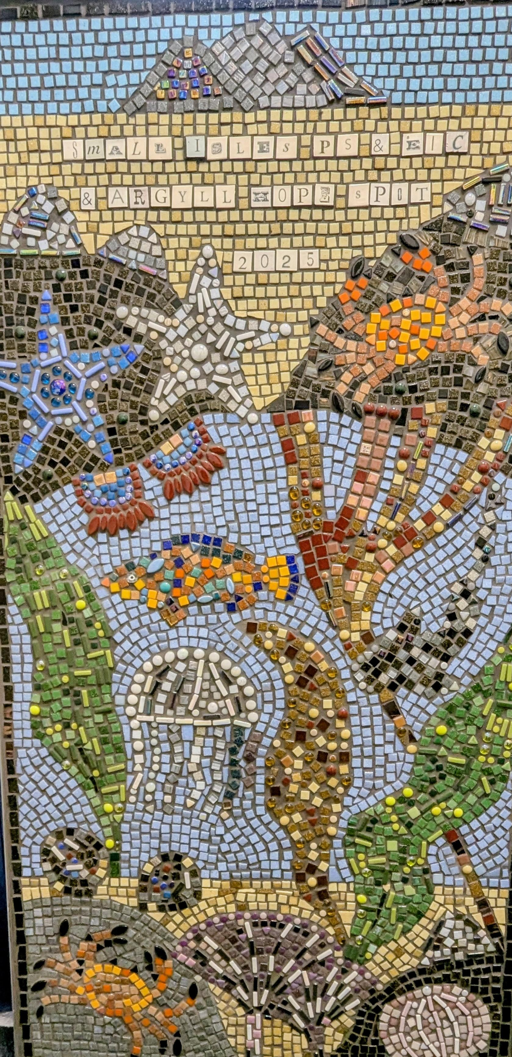
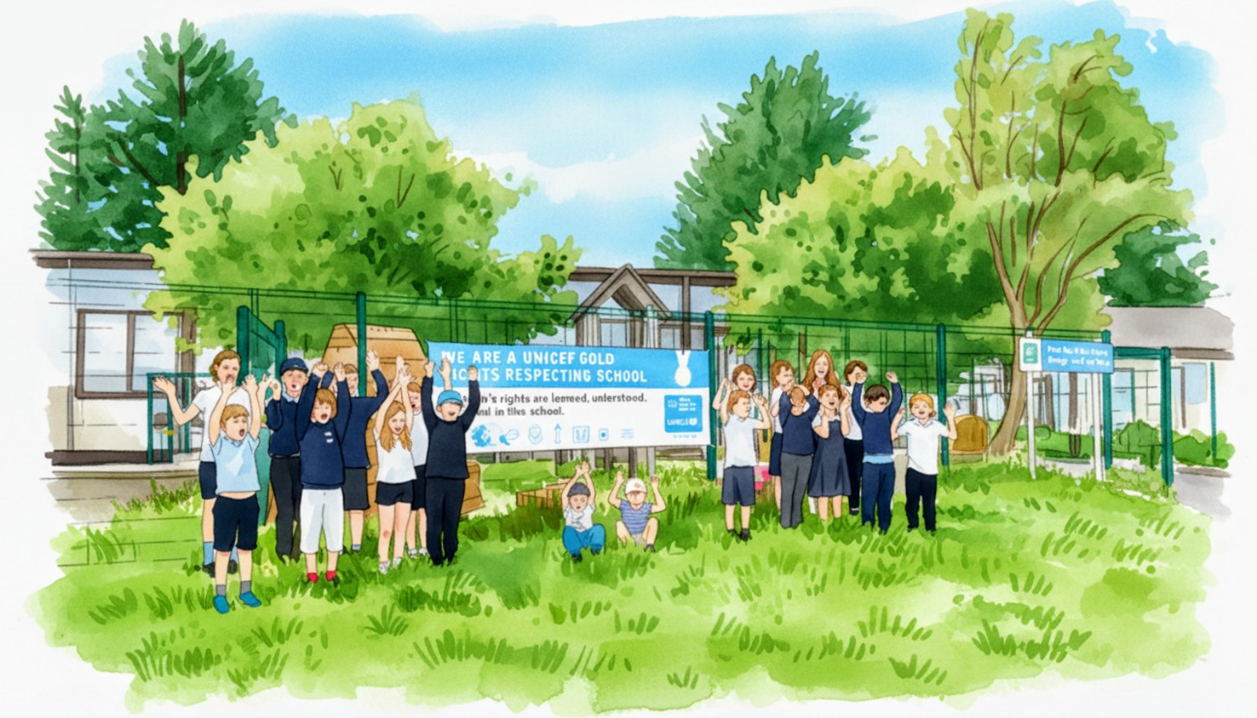
Small Isles Primary and ELC
Curriculum Rationale

Slide 2


Slide 3
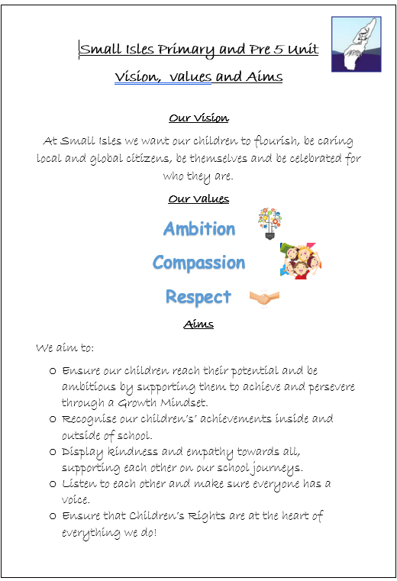
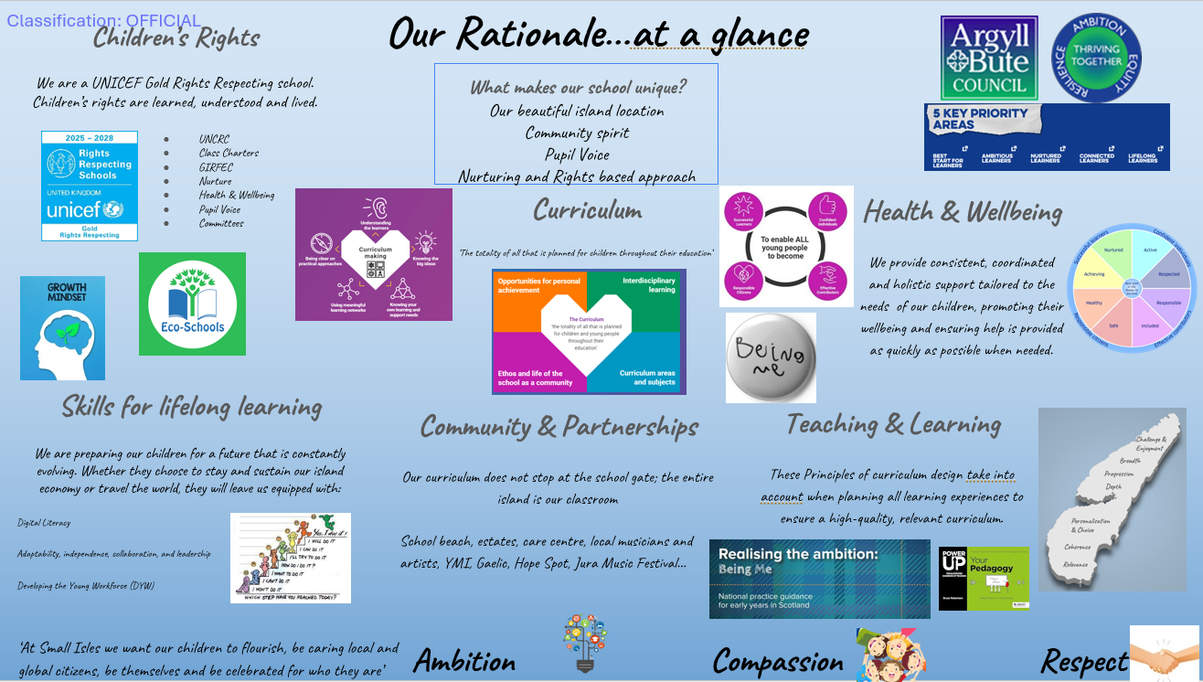
Our Vision, Values & Aims
Our Vision, Values and Aims were developed in 2024 following a consultation with all stakeholders.
This work establishes a clear, shared foundation that guides all decisions, actions and relationships within the school community.
We feel this defines who we are as a school, what we stand for and what we are striving to achieve.
Our Rationale
At Small Isles, our curriculum rationale is simply the "why" and "how" behind everything we teach. Developed alongside our parents, staff, and pupils, it ensures we are all pulling in the same direction for our children. While we deliver the standard 8 curricular areas required across Scotland, we tailor our approach to fit our community. Our goal is to provide a safe, nurturing environment where your child doesn't just memorise facts, but builds actual skills for life, learning, and work. We want every child to leave Small Isles confident, capable, and proud of what they have achieved.

Slide 4


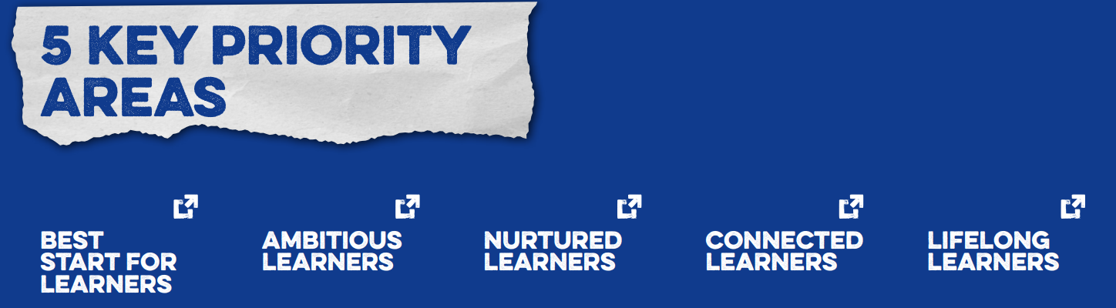

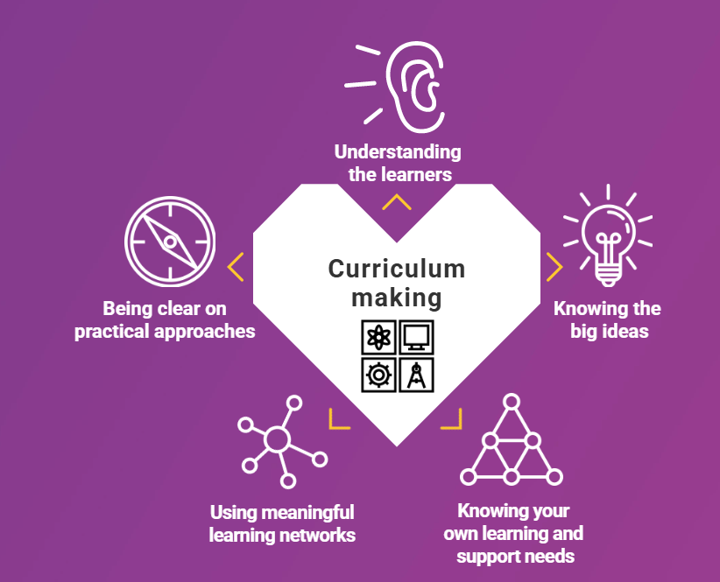
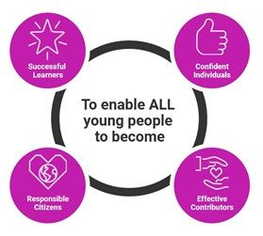
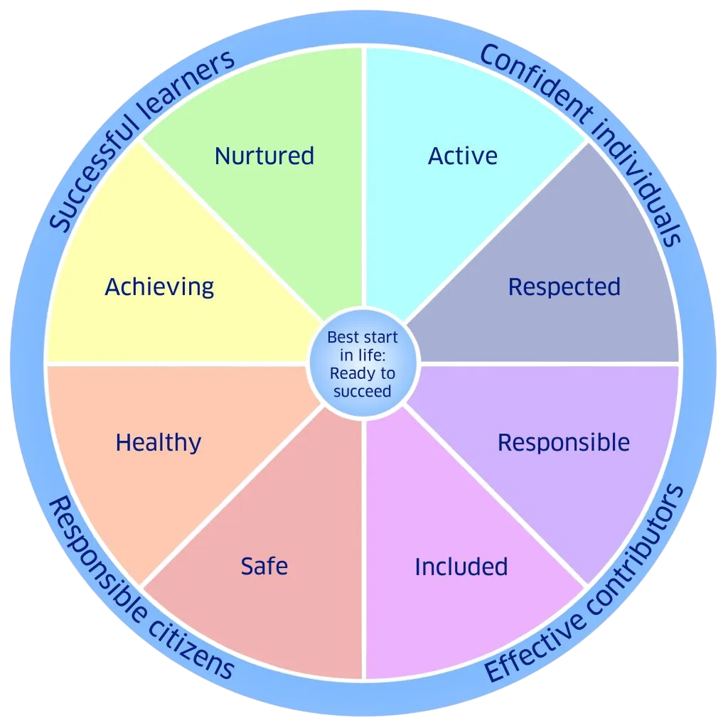

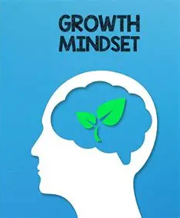
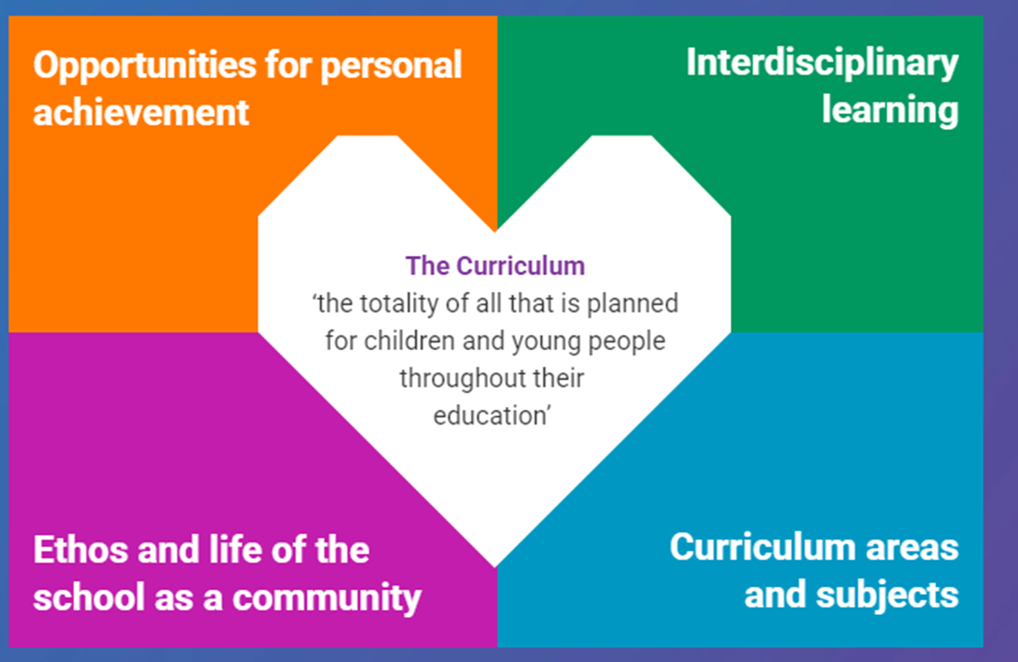

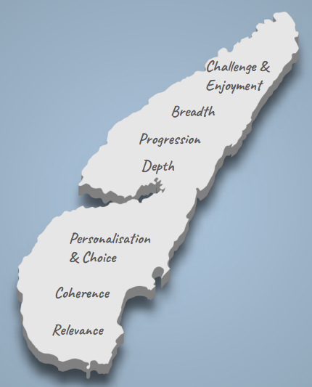
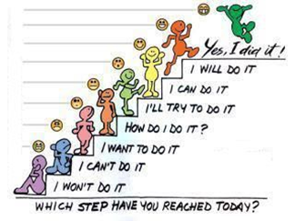

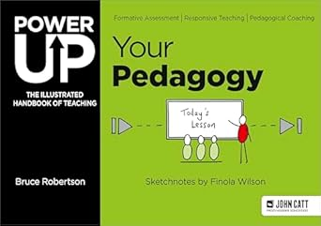



Our Rationale…at a glance
Children’s Rights
We are a UNICEF Gold Rights Respecting school. Children’s rights are learned, understood and lived.
What makes our school unique?
Our beautiful island location
Community spirit
Pupil Voice
Nurturing and Rights based approach
UNCRC
Class Charters
GIRFEC
Nurture
Health & Wellbeing
Pupil Voice
Committees
Curriculum
‘The totality of all that is planned for children throughout their education’
Health & Wellbeing
We provide consistent, coordinated and holistic support tailored to the needs of our children, promoting their wellbeing and ensuring help is provided as quickly as possible when needed.
Skills for lifelong learning
We are preparing our children for a future that is constantly evolving. Whether they choose to stay and sustain our island economy or travel the world, they will leave us equipped with:
Digital Literacy
Adaptability, independence, collaboration, and leadership
Developing the Young Workforce (DYW)
Community & Partnerships
Our curriculum does not stop at the school gate; the entire island is our classroom
School beach, estates, care centre, local musicians and artists, YMI, Gaelic, Hope Spot, Jura Music Festival…
Teaching & Learning
These Principles of curriculum design take into account when planning all learning experiences to ensure a high-quality, relevant curriculum.
‘At Small Isles we want our children to flourish, be caring local and global citizens, be themselves and be celebrated for who they are’
Ambition Compassion Respect

