Slide 1
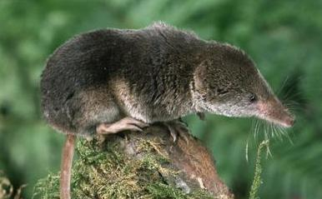

Slide 2
Shrew
Shrew
Shrew
Shrew
Shrew
Shrew
Shrew
Shrew
Shrew
Shrew
Shrew
Shrew
Shrew
Shrew
Shrew
Shrew

