Slide 1
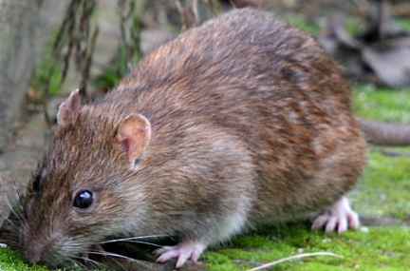

Slide 2
Brown Rat
Brown Rat
Brown Rat
Brown Rat
Brown Rat
Brown Rat
Brown Rat
Brown Rat
Brown Rat
Brown Rat
Brown Rat
Brown Rat
Brown Rat
Brown Rat
Brown Rat
Brown Rat

