Slide 1
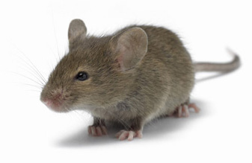

Slide 2
Field Mouse
Field Mouse
Field Mouse
Field Mouse
Field Mouse
Field Mouse
Field Mouse
Field Mouse
Field Mouse
Field Mouse
Field Mouse
Field Mouse
Field Mouse
Field Mouse
Field Mouse
Field Mouse

