Slide 1

The Moderation Process
Universal support for assessment and moderation
Notes:
Welcome to our presentation on the moderation process.

Slide 2
Aims
  To support local authorities, schools and practitioners in:
    Developing understanding of moderation as a process
    Identifying key features of effective moderation
    Exploring and understanding the importance of moderating teacher professional judgement
    Exploring ways to facilitate moderation activities
    Evaluating existing practice and identifying areas for improvement
Notes:
The aim of this presentation is to support local authorities, schools and practitioners in:
Developing understanding of moderation as a process
Identifying key features of effective moderation
Exploring and understanding the importance of moderating teacher professional judgement
Exploring way to facilitate moderation activities
Evaluating existing practice and identifying areas for improvement

Slide 3

What is moderation?
Extracts from the Statement for Practitioners:
‘Moderation is the way in which practitioners arrive at
a shared understanding of standards and expectations.’
Moderation is integral to planning learning, teaching and assessment
The process of moderation is not an activity that happens only at the end of a block or year
Notes:
This is an extract from the statement for practitioners. It states that moderation is integral to planning learning, teaching and assessment and is a process rather than a one-off activity or event. Moderation is on-going throughout the learning and teaching process.

Slide 4
CfE statement
Statement for Practitioners
Take a collegiate approach to moderation of planning learning, teaching and assessment
Work together with colleagues to review and reduce any unnecessary bureaucracy
Moderate assessment judgements by taking account of a sample of evidence from different sources to discuss standards and the progress of learners
Regularly discuss tracking information with colleagues to plan additional support and interventions to help improve learners’ progress
Notes:
Throughout the Curriculum for Excellence Statement there are direct references to effective moderation.
The importance of a collegiate approach to the process of moderation, using a range of assessment evidence and working together to review and reduce any unnecessary bureaucracy.

Slide 5
What is moderation?
Moderation takes place at local, regional and national levels, including:
  • Teachers and practitioners at the same curriculum level
  • Across a school or setting
  • Across a group of schools/settings
  • Within local authorities
  • Through regional groups
  • Via national groups
Notes:
In order to arrive at a shared understanding of standards and expectations, moderation should take place at a range of levels within school, locally and nationally.
Moderation should be ongoing within schools, for example through collegiate planning and ongoing conversation with colleagues. There should also be planned opportunities to moderate as a whole staff within the school, cluster and local authority.

Slide 6
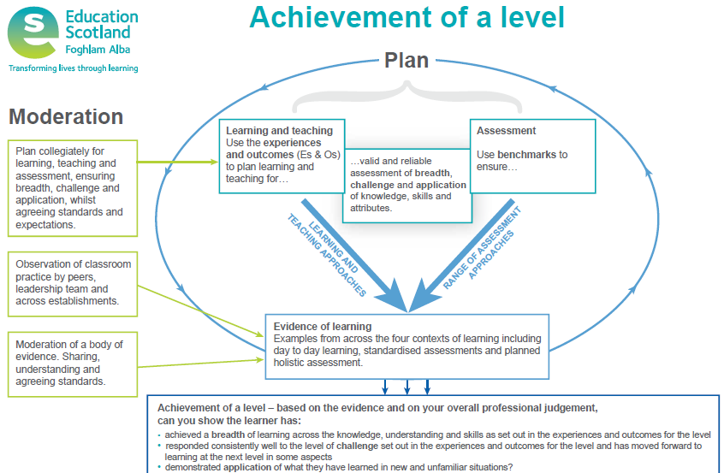
Notes:
The Achievement of a Level poster highlights the importance of moderation and highlights the process throughout planning, learning, teaching and assessment. It can be used to generate discussion and support moderation. The poster outlines that moderation involves:
1.) Collegiate planning
2.) Observation of classroom practice
3.) Reviewing and evaluating a body of evidence

Slide 7
Moderation…the process
Experiences and Outcomes
Learning Intentions
Success Criteria
Learning, Teaching and Assessment (breadth, challenge and application)
Evidence
Evaluation
Feedback
Next steps
Reporting
Notes:
These are the steps in the learning process that we have highlighted for moderation and professional dialogue. Using this process ensures professional dialogue takes place around planning, learning and teaching, assessment, evaluations etc.

Slide 8
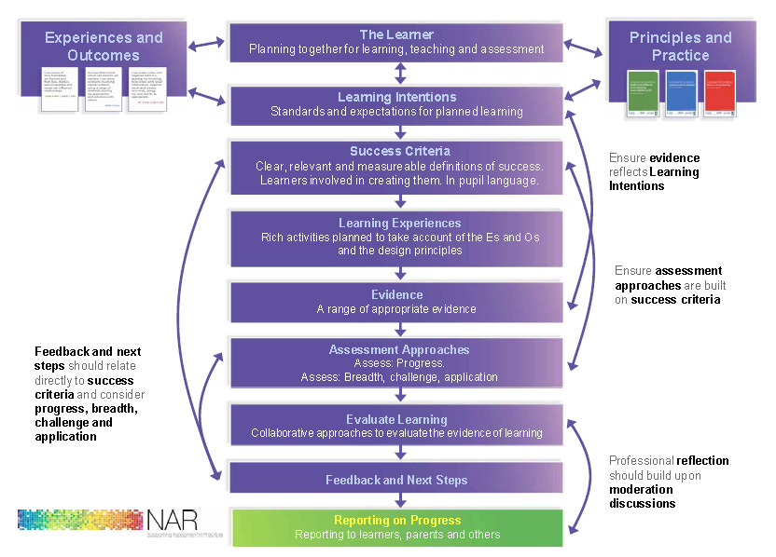
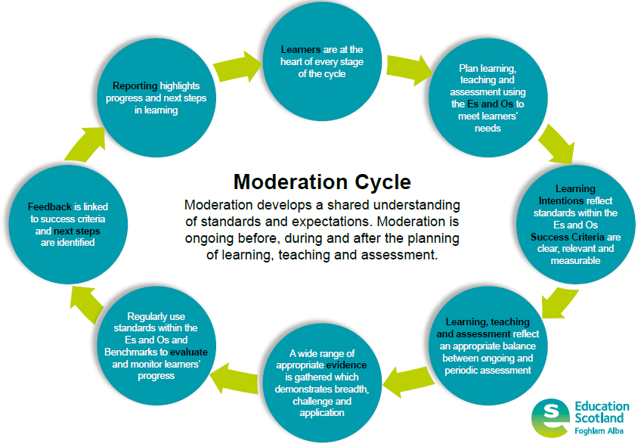
Moderation Cycle
The Moderation Cycle replaces the NAR Flowchart
Notes:
The moderation cycle replaces the NAR Flowchart. The NAR resource no longer exists, however the stages within the NAR flowchart remain valid and are reflected in the moderation cycle. The change to format is to emphasise the cyclical nature of moderation and the understanding of moderation as a process rather than a ‘one-off event’. There have been some slight changes to wording, for example learning intentions and success criteria have been drawn together into one stage within the cycle and learning experiences and assessment approaches have been drawn together as ‘Learning, Teaching and Assessment’.

Slide 9
Notes:
The moderation cycle should be used to structure moderation discussions around.

Slide 10
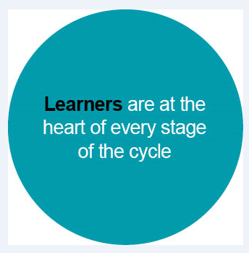
Learners should be actively involved at each stage of the cycle, from planning through to reviewing and evaluating evidence
Notes:
Learners should be involved at each stage of the cycle.
In which ways are your learners involved at each stage?

Slide 11
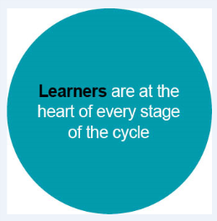
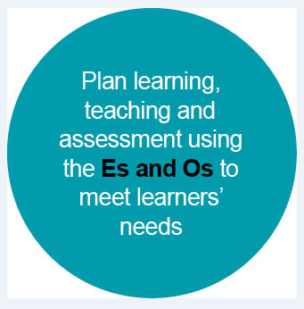
Es and Os should be bundled to link concepts appropriately
Learning, teaching and assessment should be planned together from the outset
Learning, teaching and assessment should be planned from the Es and Os
Notes:
Learning, teaching and assessment should be planned using the Es and Os. It is important to recognise that the Es and Os outline the experiences/pedagogy aswell as the intended outcomes.

Slide 12
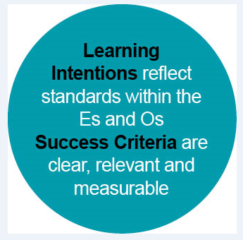
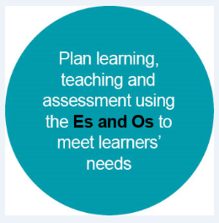
Learning intentions should clearly outline what the learner should know, understand or be able to do by the end of the lesson/series of lessons/
block of learning
Success criteria should:
  outline what the learner has to do
  to be successful in achieving the
  learning intention
  be clear, relevant and measurable
  be co-constructed with learners
Notes:
Learning intentions and success criteria have been drawn together into one stage within the cycle as they clearly link. It is important both to share the learning intention and to co-construct success criteria to ensure learners are clear about what they have to do to be successful. Success criteria should also provide the framework for feedback discussions.

Slide 13
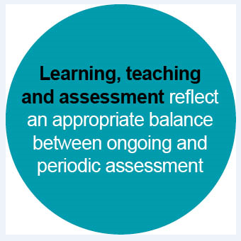
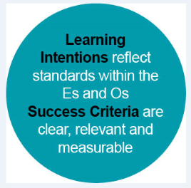
Learning, teaching and assessment should be:
  Planned together using the Es and Os
  Planned to allow opportunities
  for breadth, challenge and
  application
There should be an appropriate
balance between ongoing and
periodic assessment
Notes:
Learning, teaching and assessment draws together ‘learning experiences’ and ‘assessment approaches’. This reflects the Quality Indicator 2.3 in Hoe Good is our School 4 and also emphasises the importance of planning for learning, teaching and assessment together.

Slide 14
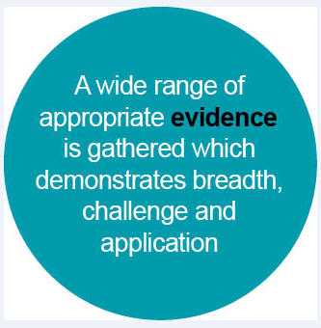
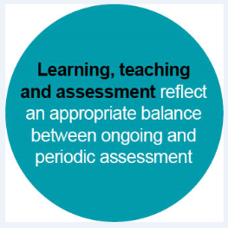
A wide range of evidence should be considered when making
judgements around progress towards or achievement of a level
The range of evidence will exist in different places (e.g. jotters,
displays, learner conversations, periodic assessments)
Evidence should
demonstrate breadth,
challenge and
application
Notes:
A range of evidence demonstrating breadth, challenge and application should be considered when reviewing and evaluating progress towards or achievement of a level. The evidence will come from a variety of different sources, for example classwork, jotters, displays, observations of learning, planned periodic assessments, standardised assessments.

Slide 15
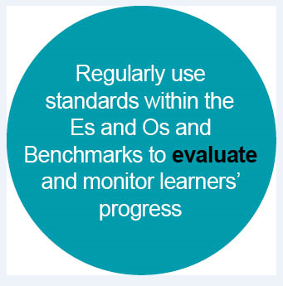
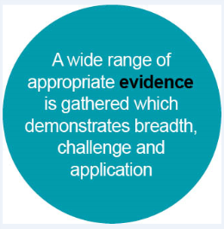
Standards within the Es and Os and Benchmarks should be used to
evaluate and monitor learners’ progress
Evaluation should be ongoing to inform short term planning
Practitioners should have opportunities to evaluate a range of
evidence together when considering progress towards or
achievement of a level to ensure consistency in teacher professional
judgement
Notes:
Practitioners evaluate learning all the time and this informs short term responsive planning.
It is also important that practitioners are given opportunities to evaluate together, particularly when coming to teacher professional judgements around progress towards or achievement of a level.

Slide 16
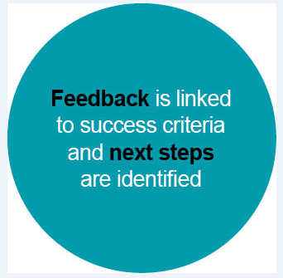
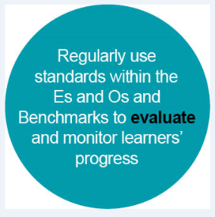
Feedback should be clearly linked to success criteria
Next steps in learning should be identified using success criteria
Feedback discussions should be ongoing throughout lessons
Learners should have opportunities to take part in feedback
discussions when reviewing learning over a period of time in order to
set longer term targets (e.g. as part of the Profiling/Personal learning
planning process)
Notes:
Feedback and next steps should be based on the co-constructed success criteria. Feedback should be ongoing throughout lessons as well as periodically to review a range of learning over time and to set longer term targets. Feedback and next steps identified should also inform teachers’ planning.

Slide 17



Reporting should highlight the learners most recent progress and next steps in learning
Further advice and guidance can be found in the document ‘Reporting to Parents and Carers Guidance for schools and ELC settings’
Notes:
Reporting should reflect most recent progress and next steps in learning. Reporting guidance is available on the National Improvement Hub.

Slide 19
What are the key features of effective moderation?
(5 minutes to discuss)
Notes:
What are the key features of effective moderation? Please pause the presentation and take 5 minutes to discuss this together.

Slide 20
What are the key features of effective moderation?
Moderation:
Is a process rather than a one-off event
Involves high levels of professional dialogue at every stage
Is an integral part of planning, learning, teaching and assessment
Involves discussions about breadth, challenge and application at every stage
Takes place at a range of levels (school, cluster, local authority and beyond)
Notes:
Effective moderation:
Is an on-going process rather than a one-off event
Involves high levels of professional dialogue at every stage
Is integral to planning, learning, teaching and assessment
Includes discussions focused on breadth, challenge and application at every stage
Takes place at a range of levels within school and beyond

Slide 21
What are the benefits of moderating teacher professional judgement?
(5 minutes to discuss)
Notes:
What are the benefits of moderating teacher professional judgement? Please pause the presentation and take 5 minutes to discuss this together.

Slide 22
What are the benefits of moderating teacher professional judgement?
  Improved planning
  Improved consistency in quality of learning and teaching
  Improved assessments
  Improved reliability of teacher professional judgements
  Improved pathways into the senior phase
  Improved attainment
  Reduced workload through fewer assessments
Notes:
Moderating teacher professional judgement can lead to:
Improved planning
Improved consistency in the quality of learning and teaching
Improved assessments
Improved reliability of teacher professional judgements
Improved pathways into the senior phase
Improved attainment
Reduced workload through less assessments

Slide 23
What does moderation look like in your context?
What are your next steps for improving opportunities for moderation?
(5 minutes to discuss)
Notes:
What does moderation look like in your context? What are your next steps for improving opportunities for moderation?
Please pause the presentation and take 5 minutes to discuss this together.

Slide 24
Evaluating moderation in your own context
How are you doing?
Is there a shared understanding of effective moderation?
Do you have a policy on assessment and moderation?
How do you know?
What evidence do you have?
Is time given for moderation?
What are you going to do now?
What networks do you already have that you could use?
How have you used your QAMSOs and Additional Practitioners?
Notes:
Now that you have thought about moderation within your own context, consider the following questions to help you identify your next steps.

Slide 25
Moderation - Collegiate planning
When planning takes place collegiately, moderation discussions become part of everyday practice.
Collegiate planning:
Ensures practitioners are discussing and agreeing the standards from the outset
Allows practitioners to discuss and plan opportunities for learners to demonstrate breadth, challenge and application in learning experiences and in planned assessments
Notes:
Collegiate planning is a key part of the moderation process.
When planning takes place collegiately, moderation discussions become part of every day practice. Collegiate planning allows practitioners to discuss and agree the standards from the outset. Collegiate planning ensures practitioners explicitly plan for breadth, challenge and application of learning. Assessments should be created at the planning stage.

Slide 26
Moderation - Collegiate planning
Collegiate planning can take place with colleagues:
At the same stage
At the same level
Across different levels
Within the same department/subject
Across departments/subjects
Across schools within the cluster or local authority
Notes:
Collegiate planning can take place with colleagues:
At the same stage
At the same level
Across different levels
Within the same department/subject
Across departments/subjects
Across schools within the cluster or local authority

Slide 27
Moderation - Collegiate planning
Planning discussions should involve:
Identifying bundles of Experiences and Outcomes
Creating Learning Intentions and Success Criteria based on the standards within the selected Experiences and Outcomes
Planning Learning Experiences and Assessment activities which provide opportunities for Breadth, Challenge and Application
Notes:
Planning discussions should involve:
Identifying bundles of Experiences and Outcomes
Creating Learning Intentions and Success Criteria based on the standards within the selected Experiences and Outcomes
Planning Learning Experiences and Assessment activities which provide opportunities for Breadth, Challenge and Application

Slide 28
Moderation - Observation of learning and teaching
Observing learning and teaching is part of the moderation process
Observation of classroom practice by peers, the leadership team and across establishments provides invaluable opportunities to discuss and moderate learning, teaching and assessment
Observing learning and teaching allows practitioners to share ideas and to moderate their judgements about learner progress together
Notes:
Observing learning and teaching is part of the moderation process. Observation of classroom practice by peers, leadership team and across establishments provides invaluable opportunities to discuss and moderate learning, teaching and assessment. It allows practitioners to share ideas and to moderate their judgements about learner progress together.

Slide 29
Moderation - Observation of learning and teaching
It is important to have a clear emphasis on the purpose of observing learning and teaching, for example by focusing on:
The progress of particular learners (e.g. if achievement of a level is borderline)
A particular aspect of the moderation process (e.g. learning intentions and success criteria)
Gathering evidence for assessment
Standards within a particular curriculum area or subject
Notes:
It is important to have a clear focus for the purpose of observing learning and teaching, for example:
To focus on the progress of particular learners (for example if achievement of a level is borderline)
To focus on a particular aspect of the moderation process (eg learning intentions, success criteria)
To focus on gathering evidence for assessment
To focus on standards within a particular curricular area or subject
As part of a larger moderation exercise following collegiate planning

Slide 30
Moderation – Reviewing evidence
Practitioners should have regular opportunities to moderate a body of evidence in order to share, understand and agree on standards
This includes ongoing discussions within stages, levels or departments as well as more organised opportunities to moderate with colleagues as a whole school, cluster or within local authority groups
It is particularly important to moderate samples of evidence when considering progress towards or achievement of a level.
Notes:
Practitioners should have regular opportunities to moderate a body of evidence in order to share, understand and agree on standards. This includes ongoing discussions within stages, levels or departments as well as more organised opportunities to moderate with colleagues as a whole school, cluster or within local authority groups.
It is particularly important to moderate samples of evidence when considering progress towards or achievement of a level.

Slide 31
Ideas for moderation activities
Moderating planning:
Identify a particular area (e.g. curriculum area/subject or IDL)
Plan in a trio with colleagues from different stages within the same level (using the same bundle of Es and Os)
Gather evidence from 2 learners
Bring along evidence from 2 learners
Review evidence against the standards within the Es and Os and Benchmarks with colleagues, focusing on standards and progression within the level
Notes:
Moderating planning:
Identify a particular area (eg subject or IDL)
Plan in a trio with colleagues from different stages within the same level (using same bundle of Es and Os)
Gather evidence from learners
Bring along evidence from 2 learners
Review evidence with colleagues, focusing on standards and progression within the level

Slide 32
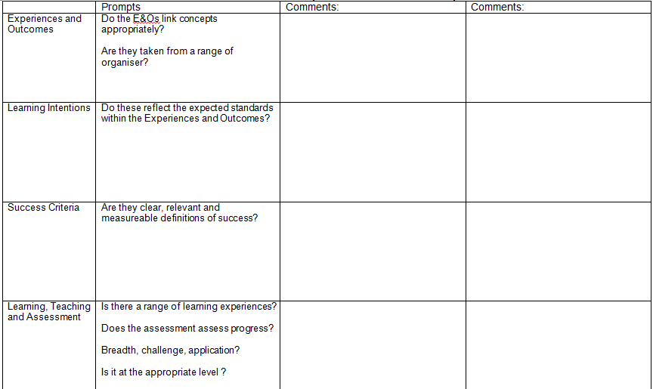
Moderation Comment Sheet
Notes:
This moderation comment sheet can be used when moderating each stage of the cycle.

Slide 33
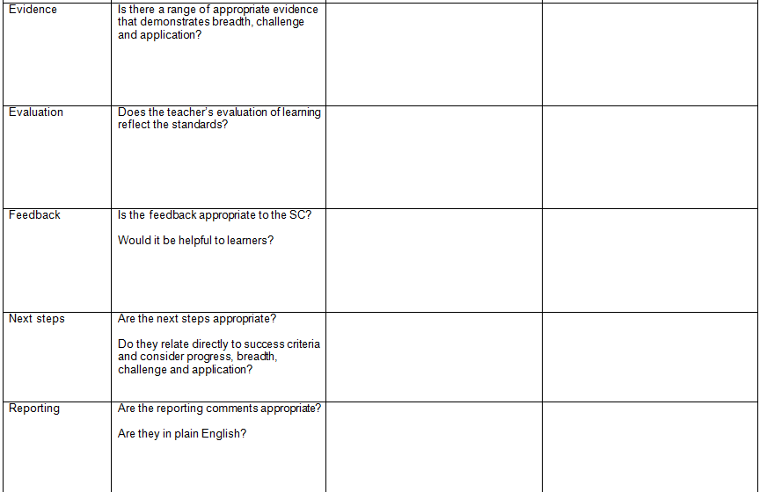
Moderation Comment Sheet
Notes:
This moderation comment sheet can be used when moderating each stage of the cycle.

Slide 34
Ideas for moderation activities
Moderating holistic assessments:
Identify a particular area (e.g. subject or IDL)
Create a holistic assessment together with colleagues at the same level (e.g. within school/cluster/local authority)
Moderate holistic assessments together to ensure quality
Gather evidence for the planned holistic assessment
Review and moderate evidence together against the standards within the Es and Os and Benchmarks
Notes:
Moderating holistic assessment:
Identify a particular area (eg subject or IDL)
Plan holistic assessment together with colleagues at the same level (eg within school/cluster/local authority)
Moderate holistic assessments together to ensure quality
Gather evidence for chosen holistic assessment
Review and moderate evidence together against the standards within the Es and Os and Benchmarks.

Slide 35
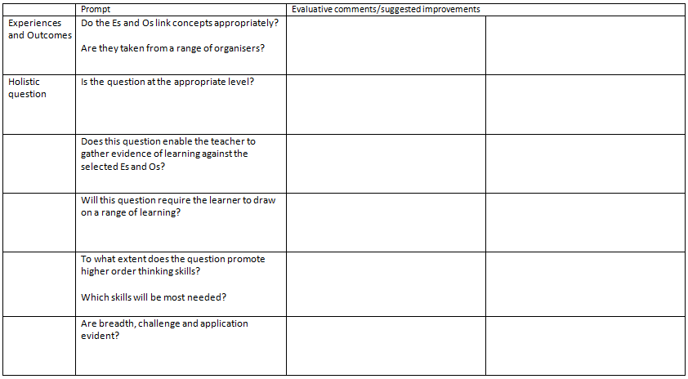
Moderation Comment Sheet – holistic assessment
Notes:
This moderation comment sheet can be used when moderating holistic assessments.

Slide 36
Ideas for moderation – progress towards or achievement of a level
Moderating progress towards or achievement of a level:
Identify a curriculum area or subject
Bring along samples of a range of learner evidence (1 or 2 learners)
Review and moderate evidence against the standards within the Es and Os and Benchmarks considering progress towards or achievement of a level
Notes:
Moderating progress towards or achievement of a level:
Identify a curricular area or subject
Bring along samples of a range of learner evidence (1 or 2 learners)
Review and moderate evidence considering progress towards or achievement of a level
Identify one or two samples to repeat the exercise with a wider group

Slide 37
Moderation Comment Sheet

Slide 38
Moderation Comment Sheet

