Slide 1

Maeve MacKinnon
Literacy and Gaidhlig Benchmarks and the moderation process
June 2017
Ag atharrachadh beatha tro ionnsachadh

Slide 2
Slatan-tomhais Litearrachd is Gàidhlig
Benchmarks for Literacy and Gàidhlig
Amasan/Aims
To provide an overview of the key messages in the use Benchmarks for literacy and Gàidhlig.
To promote greater understanding of the national standard the literacy and Gàidhlig Benchmarks provide practitioners.
To promote a deeper understanding of the relationship between the moderation process and the literacy and Gàidhlig Benchmarks.
Ag atharrachadh beatha tro ionnsachadh

Slide 3
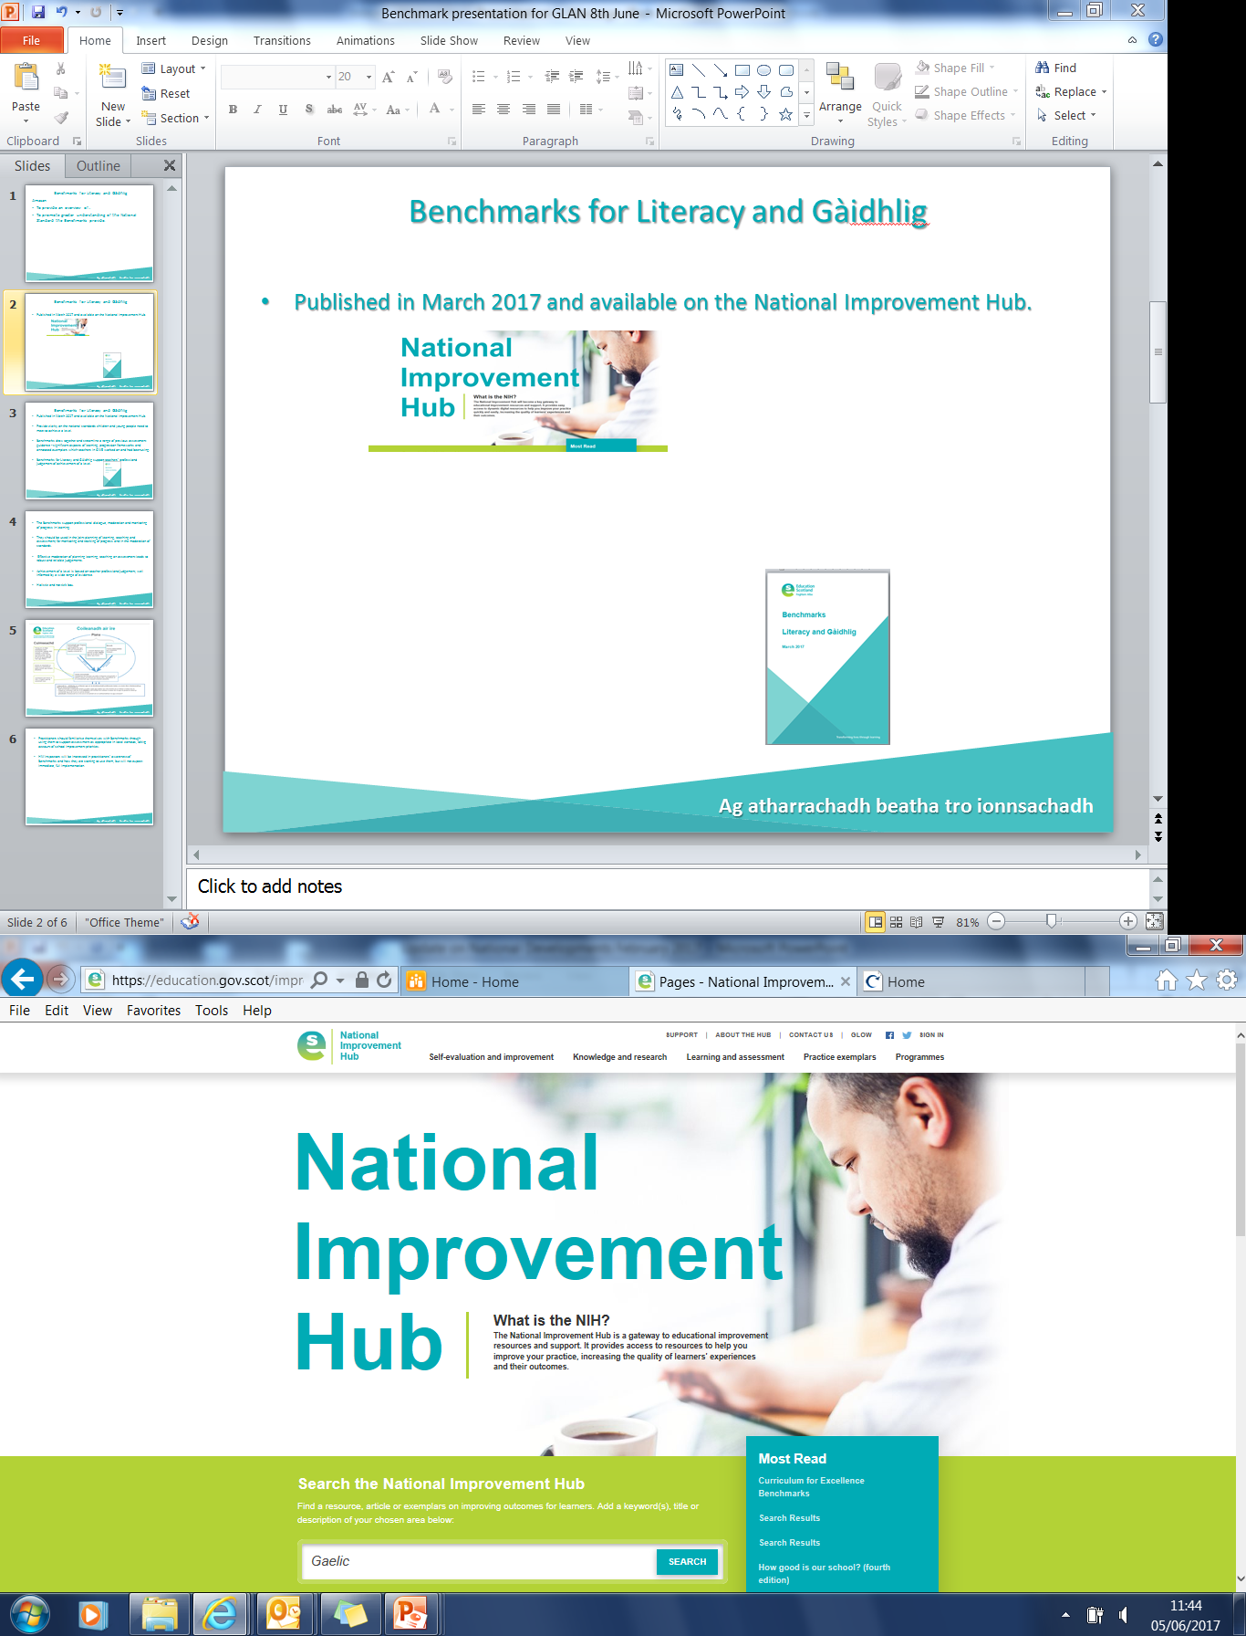
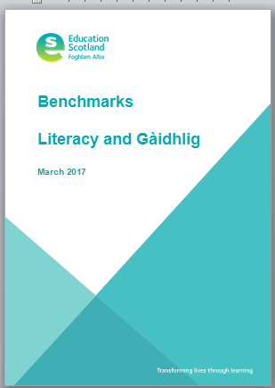
Slatan-tomhais Litearrachd is Gàidhlig
Benchmarks for Literacy and Gàidhlig
Published in March 2017 and available on the National Improvement Hub.
Ag atharrachadh beatha tro ionnsachadh

Slide 4
Slatan-tomhais Litearrachd is Gàidhlig
Benchmarks for Literacy and Gàidhlig
Provide clarity on the national standards children and young people need to meet to achieve a level.
Benchmarks draw together and streamline a range of previous assessment guidance - significant aspects of learning, progression frameworks and annotated exemplars which teachers in GME worked on and had been using.
Set out clear lines of progression. What learners need to know and be able to do to progress through the levels.
Benchmarks for Literacy and Gàidhlig support teachers’ professional judgement of achievement of a level.
Ag atharrachadh beatha tro ionnsachadh

Slide 5
Slatan-tomhais Litearrachd is Gàidhlig
Benchmarks for Literacy and Gàidhlig
The Benchmarks support professional dialogue, moderation and monitoring of progress in learning.
They should be used in the joint planning of learning, teaching and assessment; for monitoring and tracking of progress and in the moderation of standards.
Effective moderation of planning learning, teaching and assessment leads to robust and reliable judgements.
Achievement of a level is based on teacher professional judgement, well informed by a wide range of evidence.
Holistic assessment and not tick box.
Ag atharrachadh beatha tro ionnsachadh

Slide 6
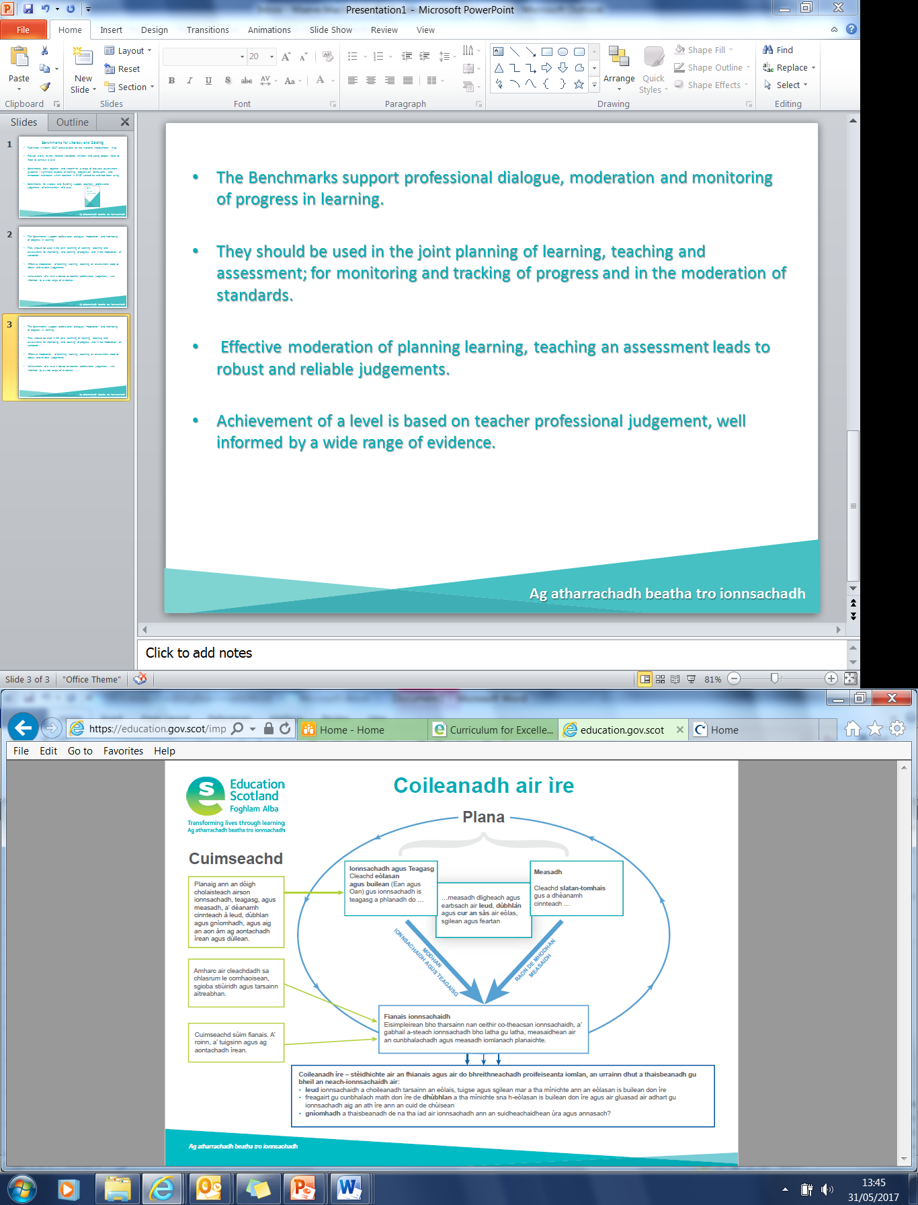
Ag atharrachadh beatha tro ionnsachadh

Slide 7
Slatan-tomhais Litearrachd is Gàidhlig
Benchmarks for Literacy and Gàidhlig
Practitioners should familiarise themselves with Benchmarks through using them to support assessment as appropriate in local contexts, taking account of school improvement priorities.
HM Inspectors will be interested in practitioners’ awareness of Benchmarks and how they are starting to use them, but will not expect immediate, full implementation.
A key purpose of the Benchmarks is to support professional dialogue and the moderation of learners progress.
Ag atharrachadh beatha tro ionnsachadh

Slide 8
Cuimseachd
Moderation
Moderation is the way in which practitioners arrive at a shared understanding of standards and expectations.
Moderation takes place at local, regional and national levels, including:
• teachers and practitioners at the same curriculum level;
• across a school or setting;
• across a group of schools/settings;
• within local authorities;
• through regional groups; or
• via national groups.
Ag atharrachadh beatha tro ionnsachadh

Slide 9
Cuimseachd…..am pròiseas
Moderation….the process
Starts with the planning of learning and teaching using the Es and Os;
Planning of learning in GME should be based on the principles of immersion. See Advice on Gaelic Education;
Learning intentions and success criteria;
A range of learning experiences need to be planned for to ensure breadth, challenge and application of knowledge, skills and attributes in Gaelic;
For example, at early level there is an emphasis on developing skills in listening and talking as children acquire Gàidhlig and develop fluency;
Gather evidence of learning from across the four contexts of learning including day to day, standardised assessments (Aug 2018 )and planned holistic assessment;
Use Benchmarks to support the monitoring of progress and overall professional judgement of when a learner has achieved a CfE level.
Ag atharrachadh beatha tro ionnsachadh

Slide 10
Coileanadh air ìre- A’cruinneachadh dàta
Achievement of a level- Data collection
Data is gathered for the National Improvement Framework on literacy through Gàidhlig as part of GME.
Schools who offer Gaelic Medium Education will use the Benchmarks for literacy and Gàidhlig initially and continue to do so throughout the broad general education.
From P4, practitioners will also engage with the Benchmarks for literacy and English.
Ag atharrachadh beatha tro ionnsachadh

Slide 11
Useful documents to engage with alongside the literacy and Gàidhlig Benchmarks
Comhairle mu Fhoghlam Gàidhlig / Advice on Gaelic Education
Stiuireadh Reachdail airson Foghlam Gàidhlig / Statutory Guidance on Gaelic education
Curriculum for Excellence Benchmarks
Coileanadh air ìre / Achievement of a level poster
Aithris CfE / CfE statement
Teacher Professional Judgement Data Collection GME
Ag atharrachadh beatha tro ionnsachadh

Slide 12
National Professional Learning Community for Gaelic Education…Please join!
Glow - (login required)
We would welcome your thoughts!
Ceud mìle taing!
Maeve.MacKinnon@educationscotland.gsi.gov.uk
Ag atharrachadh beatha tro ionnsachadh

