Slide 1
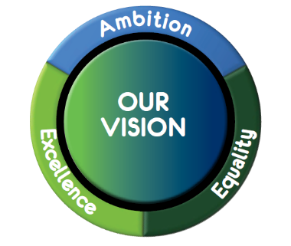
Creating effective holistic assessment tasks

Slide 2
What is your understanding of “holistic assessment task”?

Slide 3
Holistic assessment tasks
Demonstrate breadth of learning – they come from a range of Es and Os across different organisers
Demonstrate challenge – they ask pupils to use a range of higher order thinking skills such as analysis, creation, evaluation, problem solving, tackling multi step tasks, interpreting tasks
Demonstrate application of learning in new and unfamiliar situations
Come from one of the four contexts of learning:
Life and ethos of the school as a community
Curriculum areas and subjects
Interdisciplinary learning
Opportunities for personal achievement

Slide 4
When and how should we use holistic assessments?
As pre-assessment to ascertain levels of understanding and/or competency
As part of on-going learning and teaching approaches
To assess application of knowledge and skills in new and unfamiliar contexts
As part of the evidence base for making a professional judgement of achievement of a CfE level.

Slide 5
Why do we use holistic assessments?
Demonstrate genuine understanding of learning
Promotes whole school focuses on literacy and numeracy
Promotes pupil engagement
Gives pupils more independence as learners
Enables clearer identification of next steps
Fuller range of evidence
INCREASE ATTAINMENT

Slide 6
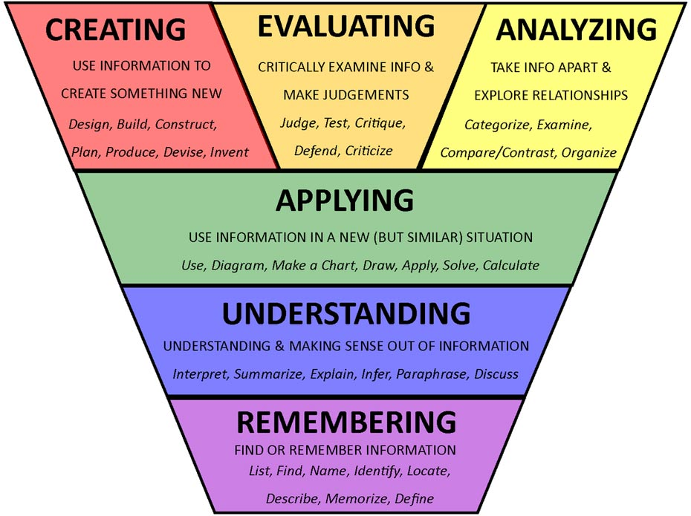
What kind of things might a holistic assessment contain?
Tasks which draw on learning from earlier in the year
Tasks which bring in elements of learning from more than one organiser
Multi-stage task
Tasks which require higher order thinking skills
Tasks without too much explicit instruction

Slide 7
Numeracy Example – St Columba’s
In June, P7/6 will be going to Iona for a day trip to learn about St Columba. There will be 23 children going and 3 adults. We must travel from Oban to Mull by ferry and then when we arrive on Mull, we must travel by bus from Craignure to Fionnphort before getting the ferry from Fionnphort to Iona. We must also have time to explore the Iona Abbey before returning to Oban.
You must plan our day. This should include when you get up, what time you need to leave your own house and you must ensure that we leave on the ferry from Oban no earlier that 8am and that we are back in Oban by 6pm. You must also calculate the average cost per person.

Slide 8
Demonstrates Breadth
MNU 2-10a
MNU 2-10c
MNU 2-09a
MNU 2-02a
MNU 2-03a.

Slide 9
Demonstrates challenge
Careful reading of the question to extract the relevant information
Problem solving
Multi-step question with evaluation
Drawing on a range of learning – possibly from throughout the year

Slide 10
Demonstrates Application
Relevant context – a trip that is happening
Elements of the question will have been covered previously but this format/combination will be new and unfamiliar.
Application of key number skills but without explicit instruction

Slide 11
Examples of holistic assessments Literacy
End of 1st Level
Create a game for the Christmas Fayre and write a clear set of instructions to help others play the game.
Design a poster to persuade visitors to the fayre that your game is worth playing!
Try each other’s games by reading the instructions provided and choose your favourite, giving a reason for your choice.

Slide 12
This is holistic because…
Breadth – comes from a range of organisers (writing and reading)
Challenge – requires learners to create, persuade and evaluate
Application – using the skills that they have learned in a new context

Slide 13
Group Task 1: Create holistic assessments
Select a bundle of Es and Os which reflect the learning happening in the classroom.
Create 2 holistic assessments which require:
The learner to draw on a range of learning
Appropriate level of challenge
Higher order thinking skills
Application of learning in a new and unfamiliar situation
Come from one of the four contexts of learning

Slide 14
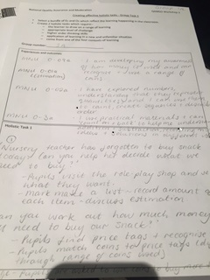
Group Task 2: Evaluation of holistic assessments
Now look at the task created by another group.
Using the evaluative comment checklist, moderate the effectiveness of this task as a holistic assessment.

