Slide 1
Moderation in Ardrishaig
Our Moderation Process

Slide 2
Important points to remember:
Moderation will work differently in different establishments/clusters.
It is about finding what works for you and your children.
But the key principles must be applied – you must be reaching a shared understanding of standards and expectations from the planning stages throughout.

Slide 3
Our Aims
To develop a whole school understanding of the progression of skills and knowledge in selected curricular areas from E – 2nd Level and beyond
To develop a sustainable and manageable model for moderating pupil attainment (from planning through to assessment) that can be applied to any curricular aspect
To ensure that assessment is fit for purpose (valid, reliable, robust)

Slide 5
Selection of theme/context
Literacy
Numeracy
Health and Well-being
Curriculum Areas
Leadership
Enterprise
Presenting
Linked To…
Notes:
Jay These themes were drawn from aspects of Ardrishaig Skill List, a document that was inspired by Govan High’s Skills agenda and made relevant for Primary Schools by members of staff at Ardrishaig. The four themes cover aspects of skills not explicitly part of Es and Os.

Slide 6
Identification key aspects of the skill area
Generate ideas that will be potentially profitable, fulfill a niche or provide a service.
Create a business plan – including market research and profit/loss forecasts.
Follow the plan using skills of self-management and teamwork.

Slide 7
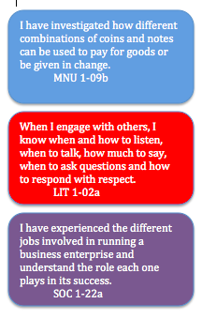
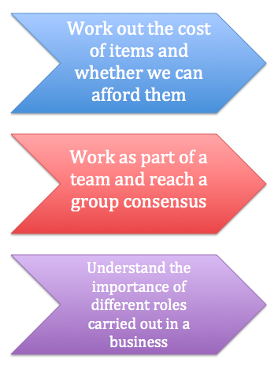
Identification of Es and Os and Learning Intentions in pairs

Slide 8
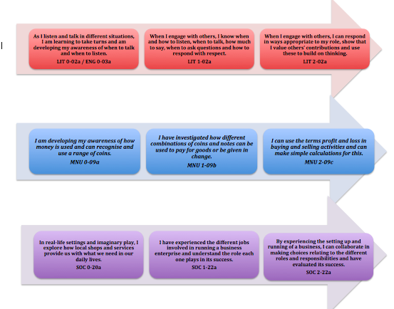
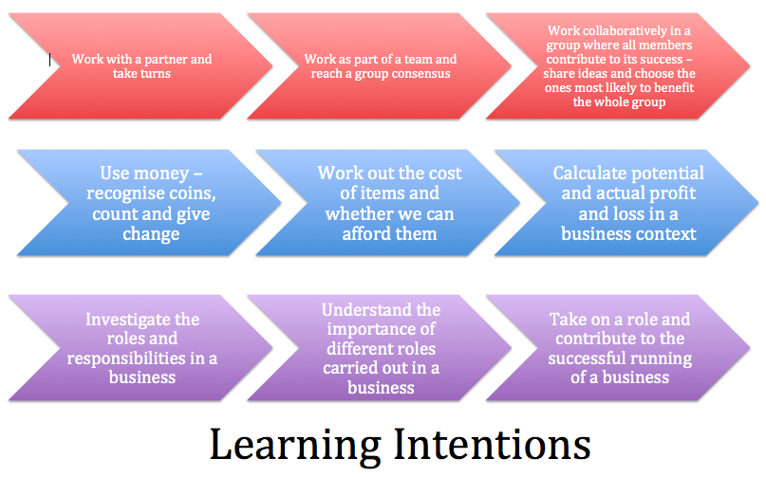
Understanding the progression
Of Es and Os Of LI’s

Slide 9
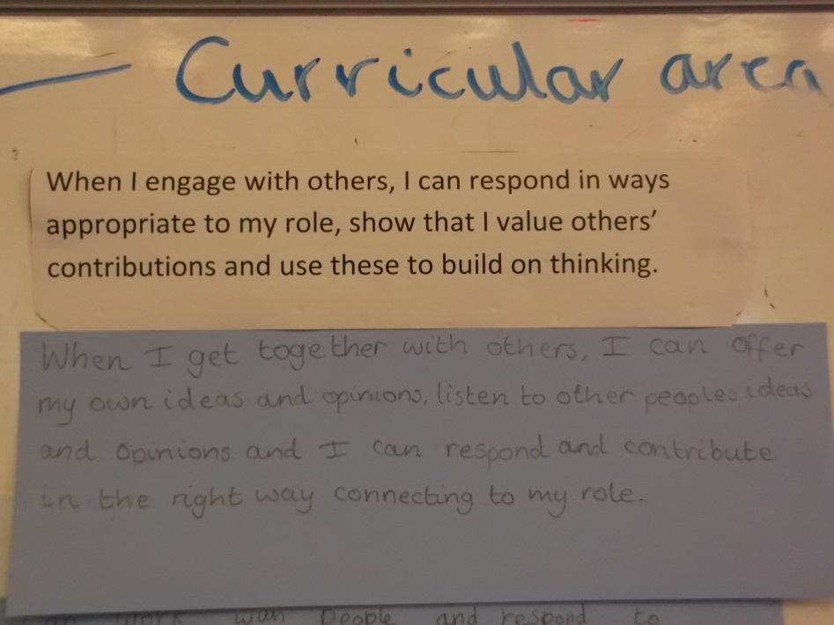
Working with Pupils in Class
We taught the Es and Os and Learning Intentions – build pupil understanding – very different at different stages.
Decide on what might be done to demonstrate learning
Draw out Success Criteria
Notes:
describe 1st lesson and how that was different from P1/2 through to P7 – what evidence might be gathered

Slide 10
Staff Moderate Success Criteria
Staff met again to moderate our understanding of Success Criteria, ensure rigor of SC and develop a progression of SCs ensuring we were ambitious and realistic at each level and that value was added
Value added = more sophisticated, more knowledge, more skills, more intellectual rigour = more challenge

Slide 11
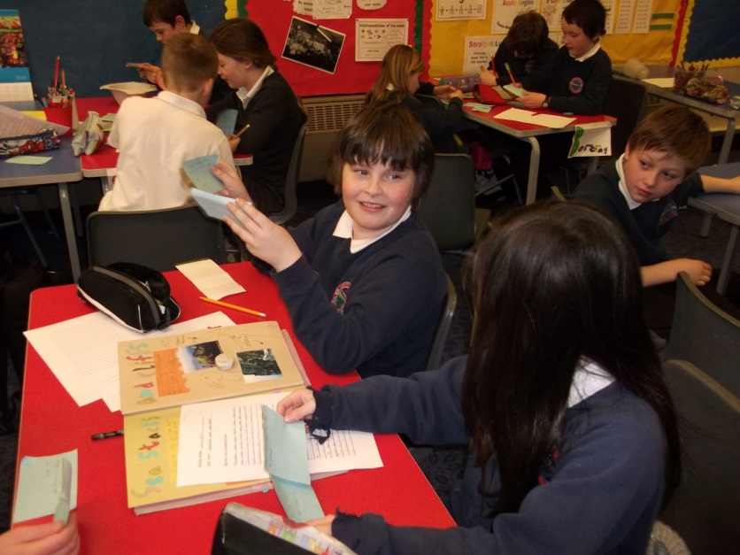
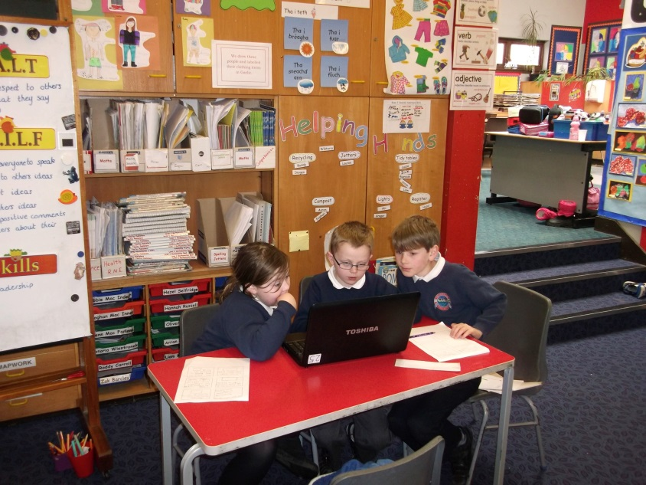
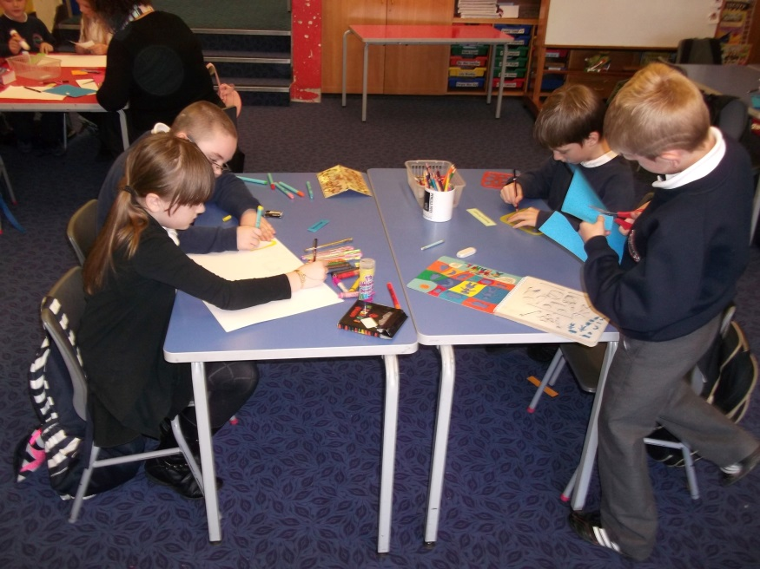
Teaching and Learning
Classes worked in mixed stage groups (early, middle and upper)
Notes:
Emma – how it was with P5-7
Jay – what exactly each class did

Slide 12
Meetings
Semi formal after school meetings between stage partners (roughly 1 hour per week)
Amend plans, discuss learning, share assessments and evaluations, discuss logistics, share next steps
No other staff meetings during this time
1 whole staff meeting to touch base and share learning so far
Notes:
Jay – what I asked staff to do
Emma details in practice

Slide 13
Assessment and Evaluation
Final Outcome and assessment (summary sheet)
Teachers and pupils reflect on learning
Evaluate skills and knowledge learnt – self and teacher including peer review
Evaluate the process – what are pupil views on how effective learning was
Teachers met, first in pairs and then as a staff to share assessment findings (against SC) and review the process
Notes:
Emma – when we evaluated it, the impact of CPD on practice was evident – How pupils understanding of learning improved

Slide 14
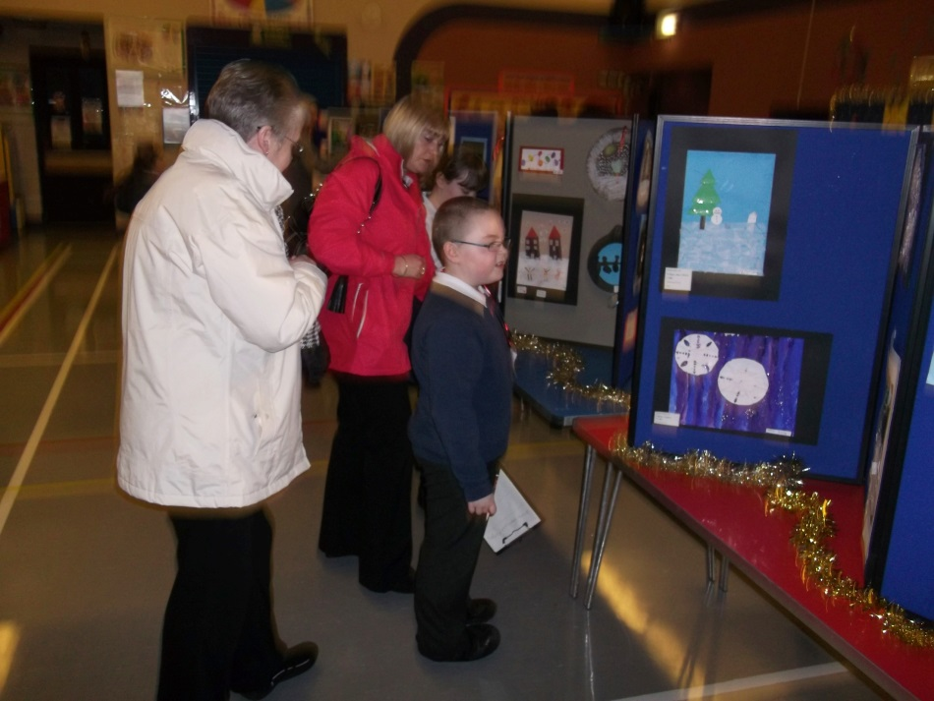
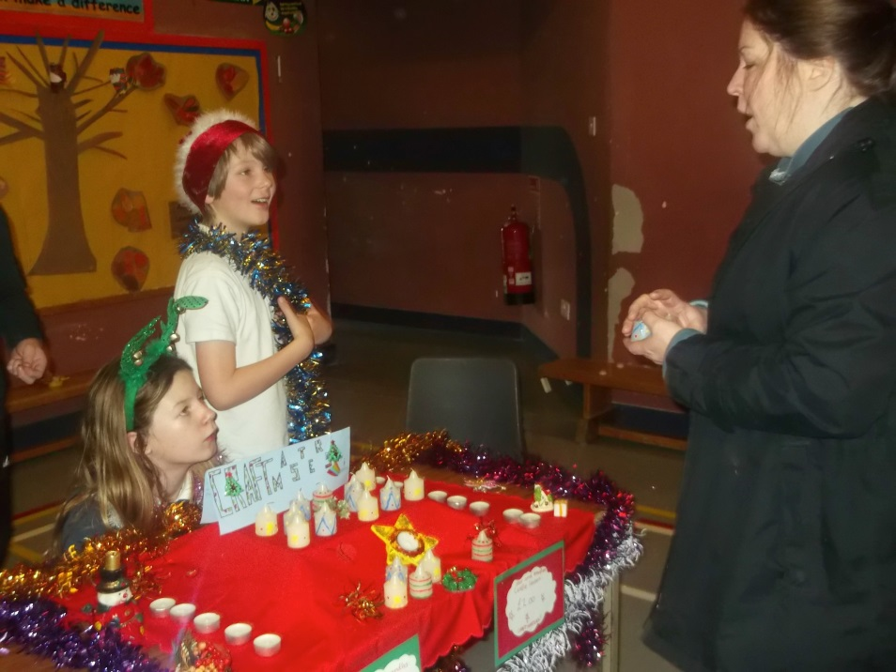
Reporting
Parents reported back to
Learning logs
Invitations to learning culmination events

Slide 15
Moving Forward
Whole staff together began process from step 1
This time we worked through steps of the process with partner primary school
Notes:
Sandbank links – Emma talk about supporting other clusters

Slide 16
Important Leadership Points
Time freed up from elsewhere
Time given to staff (use of CDP budget and cover budget for collegiate half days together)
Use of In-service time
Less detail required in initial plans at start of term
Plans as working docs

Slide 17
Learner Quotes – Enterprise Moderation Project
“We were learning how to count money to give the shop keeper and we put the prices for P1s under 10p and the prices for P2s between 1 and 20p so it was harder.” P2 girl.
“We know what you would need to do if you were the shopkeeper or the shop assistant, you have to be clear if you’re the shopkeeper and know where everything is.” P1 boy.
“We each had a job, so we had a host, a tour guide, a cashier and a registration person and we each had things to do. We practised our maths and talking and listening skills.” P4 boy.
“We were doing something we enjoy because we split up into groups and decided that we would like to do an art gallery.” P4 girl.
“We were developing our communication skills because people were coming to our stall and asking what our product did and if it was good and we needed to give reasons why it was good and why they should buy it.” P5 girl.

Slide 18
Cont…
“We were given our experiences and outcomes and learning intentions and with that we came up with our success criteria. It was cool to be part of what the teacher does. I liked the idea that we got to choose our own business idea and our own items to sell.” P7 girl.
“We developed our IT skills when we were researching our product and deciding what we would need for each product and we used our team work skills throughout the whole project because we had to learn to work together with different people or we wouldn’t be successful. We needed to be creative to design our products and we used our time keeping skills because if one week we were behind on something we would have to catch up. At the end we did an evaluation and we knew we were successful because not only had we sold out but we looked at our success criteria and we had achieved them all.” P7 girl.
“We were working from the same experience and outcome and the same learning intention but had different success criteria, different subjects and different styles of work. It was really interesting to see what another school did with the same thing.” P7 boy.
“I was impressed when she forgot what she was going to say but she didn’t stop and get embarrassed, she just carried on with the next bit. It makes you more nervous presenting to people you don’t know but you have to get over that and do the presentation you have practised.” P7 boy.

Slide 20
Sustainability
This process is manageable and sustainable for the following reasons:
Planning was less stressful as teachers are working collegiately, making it less time consuming and building confidence and capacity in practitioners to feel like they are ‘doing the right thing’.
The children were very much the leaders of their own learning meaning that plans were less detailed and much more of a working document.
By developing a process for moderation, teachers can gradually build this into all aspects of the curriculum, as and when they become more comfortable and familiar with it.
Having a clear structure allowed practitioners to feel a sense of security.
The process reflects the seven design principles and is compliant with the key messages of BtC5.

Slide 21
Easter term…
Focus was on non-fiction writing, working from just one E and O…

Slide 22
Report Writing Moderation: Jan-April 2016 Simple task Progression of Success Criteria – Early toward third level Complex task LIT 0-26a, 1-26a, 2-26a We are learning to….
share information in a way that communicates my message. | select information to create a report that communicates my message. | select information and organise it to create a report to communicate my message. | select relevant information to and organise it to create a report which is useful to others. | select relevant information from given sources to create a report for a specific audience. | select relevant information from a range of given sources to create a coherent report for a specific audience. |  | select relevant information taken from independently chosen sources to create a coherent, nonfiction, report containing subject specific vocabulary.
Success Criteria I can…
* present information that is true. * use my listening skills to find out information. *create a report that is neat, tidy and correct. * use new vocabulary related to my topic when I am talking. | * with support I can write about what I’ve found out in my own words. * select information about the topic from what I see and hear. * write a neat report with pictures and a title. * I can select topic words from a word bank to use in my writing. | * write about what I’ve found out in my own words. * select information about the topic from what read. * write a neat report with pictures, a title and subheadings. * I can select topic words from a range of resources to use in my writing. | * with guidance I can use the books and websites given to find information for each question. * choose information about my subject which answers a question. * I can use a writing frame to structure my report that includes headings and pictures. * I can use topic language to give information to others. | * use the books or websites given to find information for a research question. * choose information about my subject which answers the questions I have written. * I can organise my writing under subheadings and consider my layout so it makes sense. * I can use topic language which is suitable for my audience. | * choose sources from a given selection that are suitable for my needs. * record specific information and put it in my own words. * use the features of a report including a clear introduction and rounding off nicely. * write clear sentences using some technical language. | * use a range of independently selected sources (internet, books, people) to gather information on each of my subheadings. * gather relevant and concise information and demonstrate an understanding by discussing it in my own words. * organise my information into a coherent non-fiction report including (a suitable introduction explaining what will be in the report, a conclusion to sum up, chronological organization where possible, links) * include subject specific vocabulary and define this in my glossary. * Include my sources at the end – listing what websites or primary sources I used.

Slide 23
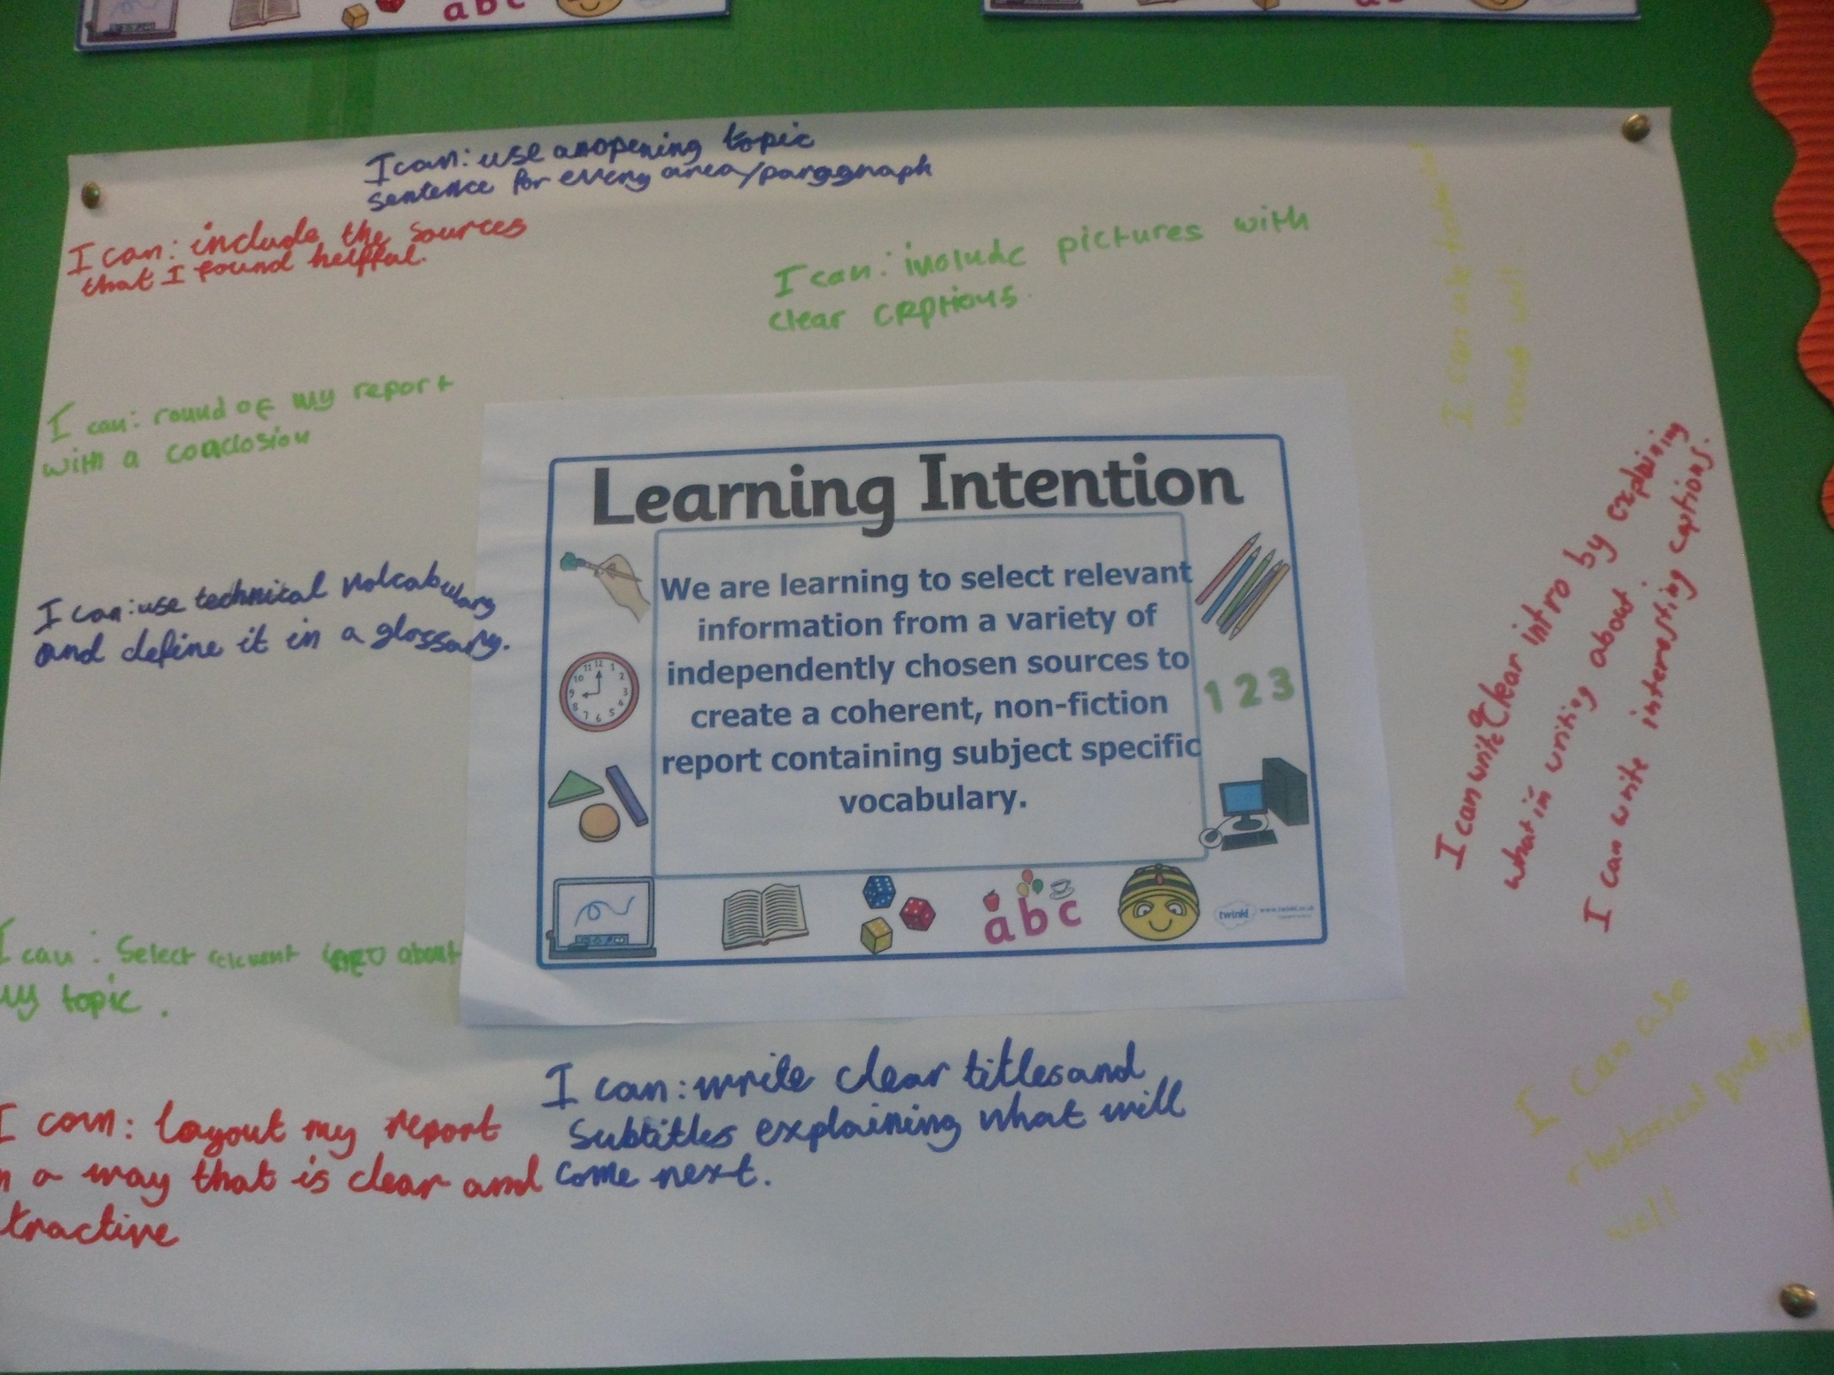

Slide 24
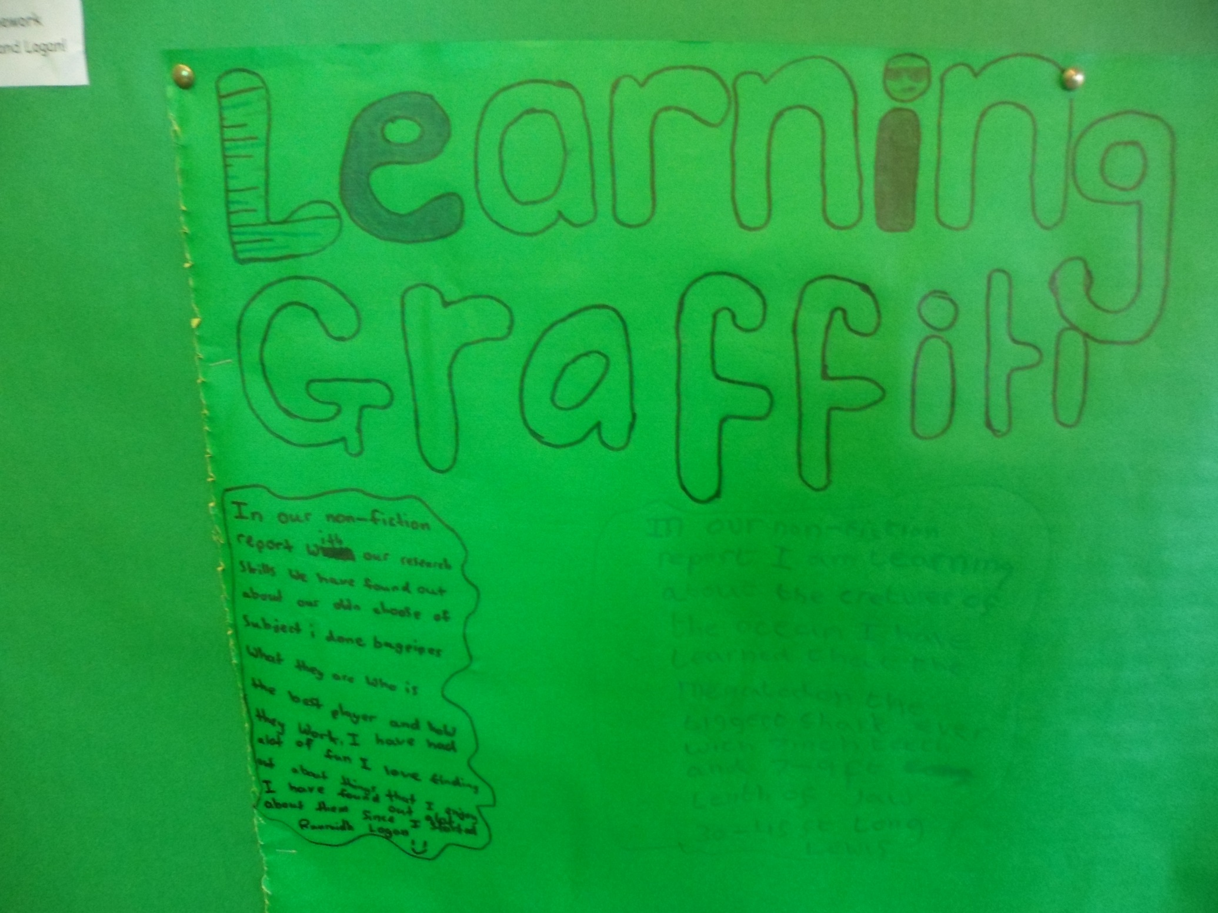

Slide 25
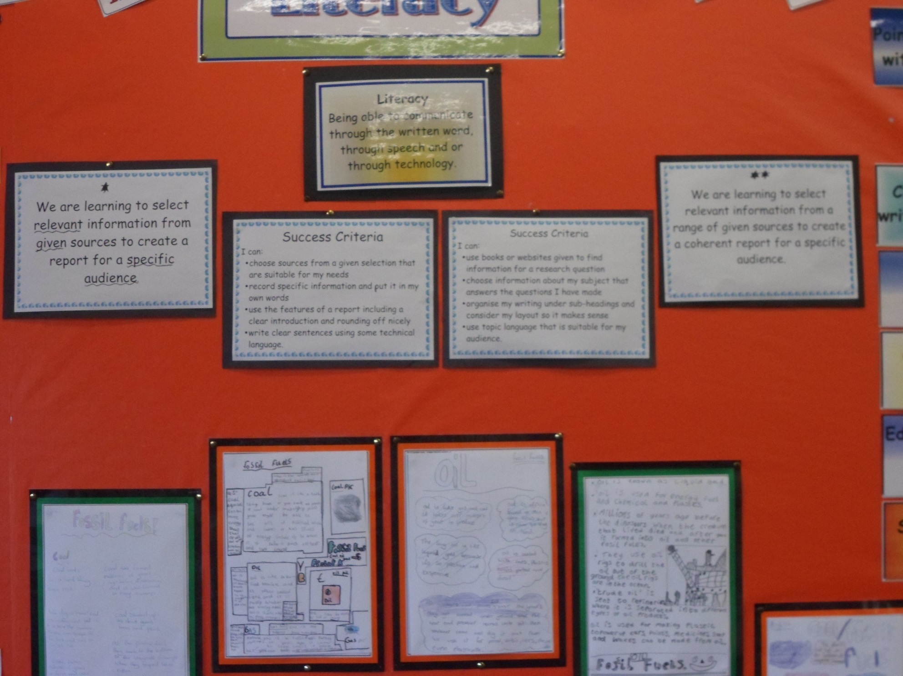

Slide 26
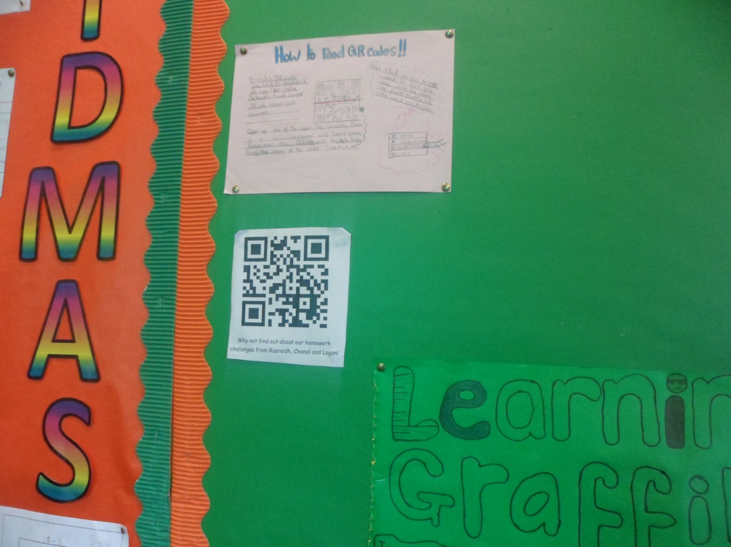

Slide 27
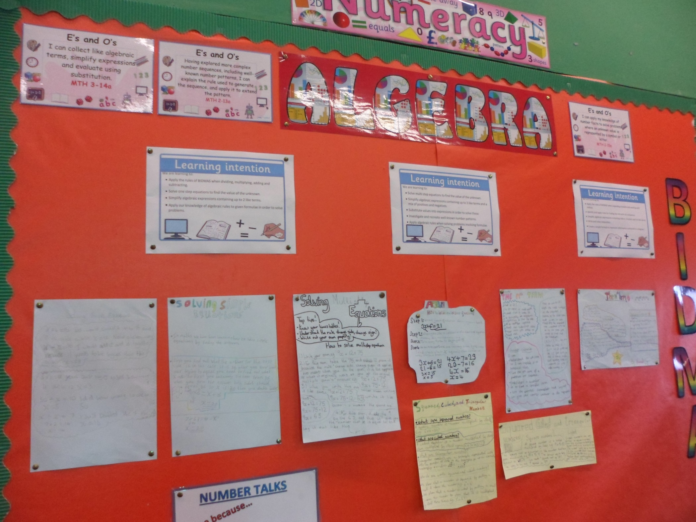

Slide 28
