Slide 1
The Planning, Assessment and Moderation Cycle
Notes:
‘Assessment practice will follow and reinforce the curriculum and promote high quality learning and teaching approaches. Assessment of children’s and young people’s progress and achievement during their broad general education to the end of S3 will be based on teachers’ assessment of their knowledge and understanding, skills, attributes and capabilities, as described in the experiences and outcomes across the curriculum.’
(Building the Curriculum 5: A Framework for Assessment, p. 8)

Slide 2
The NAR Flowchart
Where we began…

Slide 3
The Moderation Flowchart carried out within and across school and local authorities
The Learner
Planning together for learning, teaching and assessment.
Planning considers how best the needs of individual and groups of children and young people will be met.
The Ed Scot Updated version…
Experiences and Outcomes
Plan Es and Os, grouping as appropriate to the needs of learners.
Learning Intentions
Reflect the expected standards within the Es and Os
Success Criteria
Clear, relevant and measurable definitions of success.
Learners involved in co-creating them.
Learning Experiences
The range of planned learning experiences provides opportunities for breadth, challenge and application at the appropriate level.
Assessment Approaches
There is a balance between on-going and periodic holistic assessment.
The learner has opportunities to demonstrate breadth, challenge and application of their learning.
Evidence
A range of appropriate evidence is gathered which demonstrates breadth, challenge and application of learning.
Evaluate Learning
Teachers and practitioners use standards within the Es and Os and benchmarks to evaluate learners’ progress.
Feedback and Next Steps
Feedback is linked to the success criteria and the learner can talk about their next steps.
Reporting on Progress
The reporting process highlights progress and next steps in learning

Slide 4
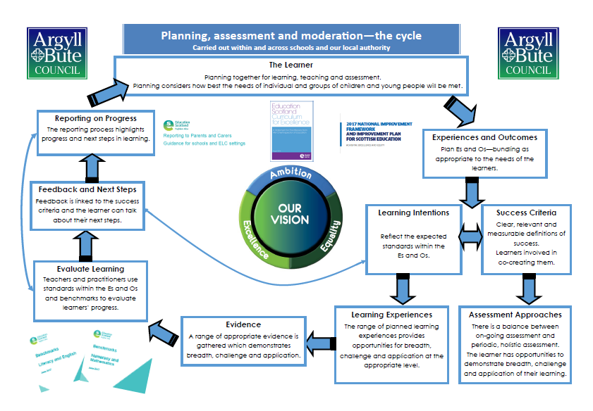
The Argyll and Bute Version…
All have the same key messages!

Slide 5
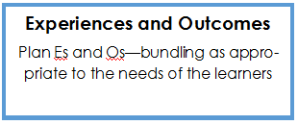
Planning the learning
Planning should be a collaborative process – the learner should be involved and where possible, other members of staff and partners.
Identify the Es and Os that will be the focus of the learning? Within your theme, bundle Es and Os as appropriate to the needs of your learners.
Planned learning may touch on several curriculum areas but focus the selection of Es and Os on the learning you plan to assess.
Step 1: Consider your learners – where are they on their learning journey? What do they need in order to progress? Where do their interests lie?
Step 2: Bundle Es and Os as appropriate to learners and learning.

Slide 6
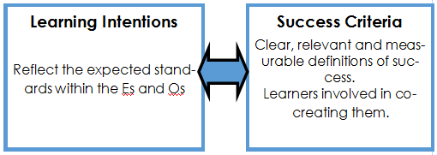
Planning the learning contd
Look at the selected Es and Os and consider the learning opportunities in each. Encourage practitioners to become skilled in breaking down Es and Os into planned learning.
Determine the Learning Intentions, keeping in mind the assessment evidence you plan to gather.
Ensure there is progression across your L.Is – it may be useful to consider a rubric within your class/across your department/school.
Be skilled in your questioning when devising Success Criteria with your learners.
Step 3: From your selected Es and Os, identify Learning Intentions.
Step 4: Work with learners to devise appropriate Success Criteria.

Slide 7
What is a learning intention?
What learners should know, understand or be able to do by the end of a learning experience.
The focus should be on what is to be learned
What makes a good Learning Intention?
set the learning intention in context
keep it focused
use language the pupils will understand
use words associated with learning

Slide 8
Why are learning intentions important?
Learners will be more focused and actively engaged in their own learning.
Sharing the learning intention makes it easier to give quality feedback specifically on what has been learned.

Slide 9
The first ‘active’ element of formative assessment in the classroom is the sharing of learning intentions with children…Without the learning intention, children are merely victims of the teacher’s whim. Unlocking Formative Assessment Shirley Clarke, 2001

Slide 10
What are success criteria?
Success criteria are suggested ways to achieve the learning intention. As you plan and consider your success criteria you should ensure that they are directly linked to your learning intentions and the evidence of learning which you will be aiming to collect.
Children should be co-constructing success criteria from early level onwards.

Slide 11
Guiding Questions to help…
What can you do to show me that you have learnt this?
What could we make?
What can you do to show me that you played a role?
How will we know if our __________ has been a success?
What roles are required for a successful ___________?
What skills would a person require to fill each of these roles?
How will you know that you have been successful as an individual and as part of a group?
How will we measure our success?
What evidence might you gather to show me that you were successful?
How will you record your evidence?
How will you tell your parents about our project and show them that you were successful in your role?

Slide 12
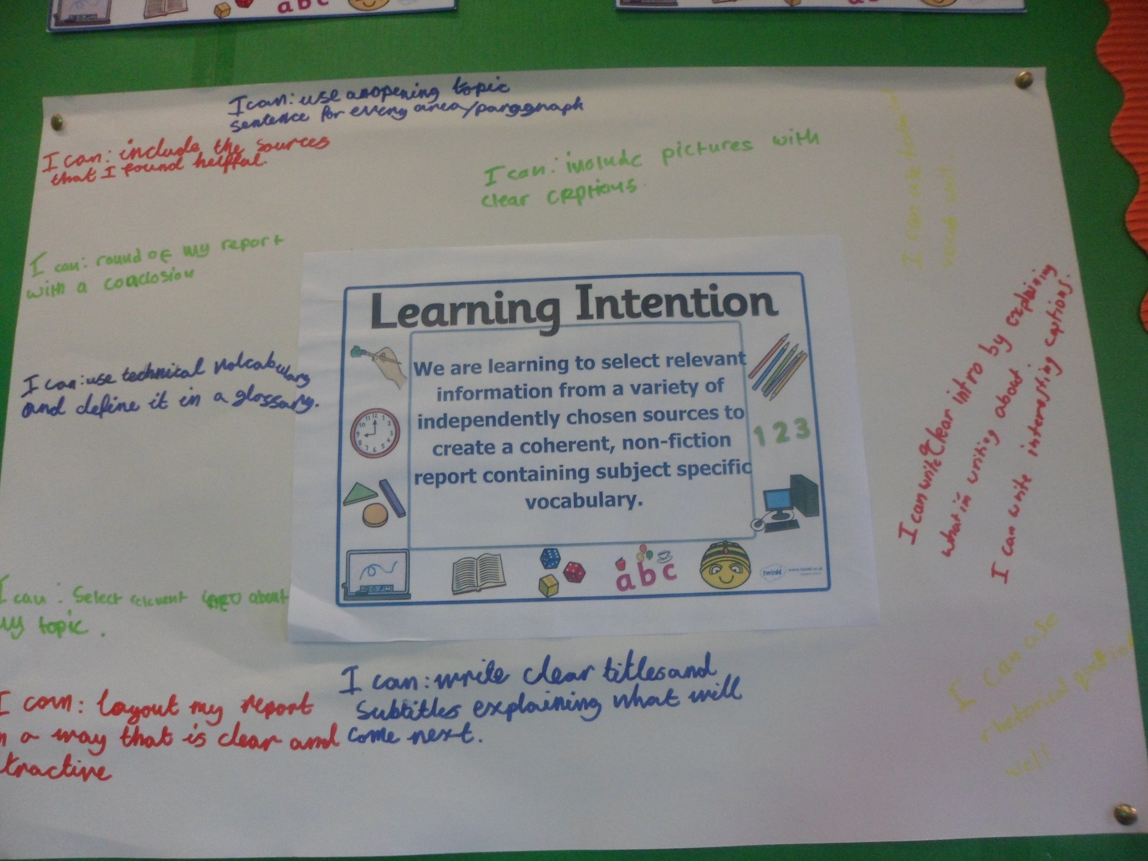

Slide 13
Report Writing Moderation: Jan-April 2016 Simple task Progression of Success Criteria – Early toward third level Complex task LIT 0-26a, 1-26a, 2-26a We are learning to….
share information in a way that communicates my message. | select information to create a report that communicates my message. | select information and organise it to create a report to communicate my message. | select relevant information to and organise it to create a report which is useful to others. | select relevant information from given sources to create a report for a specific audience. | select relevant information from a range of given sources to create a coherent report for a specific audience. |  | select relevant information taken from independently chosen sources to create a coherent, nonfiction, report containing subject specific vocabulary.
Success Criteria I can…
* present information that is true. * use my listening skills to find out information. *create a report that is neat, tidy and correct. * use new vocabulary related to my topic when I am talking. | * with support I can write about what I’ve found out in my own words. * select information about the topic from what I see and hear. * write a neat report with pictures and a title. * I can select topic words from a word bank to use in my writing. | * write about what I’ve found out in my own words. * select information about the topic from what read. * write a neat report with pictures, a title and subheadings. * I can select topic words from a range of resources to use in my writing. | * with guidance I can use the books and websites given to find information for each question. * choose information about my subject which answers a question. * I can use a writing frame to structure my report that includes headings and pictures. * I can use topic language to give information to others. | * use the books or websites given to find information for a research question. * choose information about my subject which answers the questions I have written. * I can organise my writing under subheadings and consider my layout so it makes sense. * I can use topic language which is suitable for my audience. | * choose sources from a given selection that are suitable for my needs. * record specific information and put it in my own words. * use the features of a report including a clear introduction and rounding off nicely. * write clear sentences using some technical language. | * use a range of independently selected sources (internet, books, people) to gather information on each of my subheadings. * gather relevant and concise information and demonstrate an understanding by discussing it in my own words. * organise my information into a coherent non-fiction report including (a suitable introduction explaining what will be in the report, a conclusion to sum up, chronological organization where possible, links) * include subject specific vocabulary and define this in my glossary. * Include my sources at the end – listing what websites or primary sources I used.

Slide 14
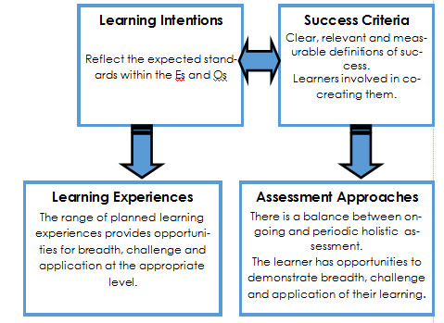
Planning the learning experiences
Plan learning experiences which match the learning intentions.
Consider the different needs in the classroom and the best tasks / activities to motivate and engage learners.
Will the learning experiences give learners the opportunity to develop and demonstrate their knowledge, understanding, skills, attributes and capabilities?
Reflect the 7 design principles.
Ensure you have planned for a range of assessment approaches that allow you to measure progress against agreed success criteria.
Step 5: Plan a range of learning experiences and assessment approaches that allow all learners to demonstrate breadth, challenge and application of their learning.

Slide 15
The principles of design
Challenge and enjoyment
Breadth
Depth
Progression
Personalisation and choice
Relevance
Coherence

Slide 16
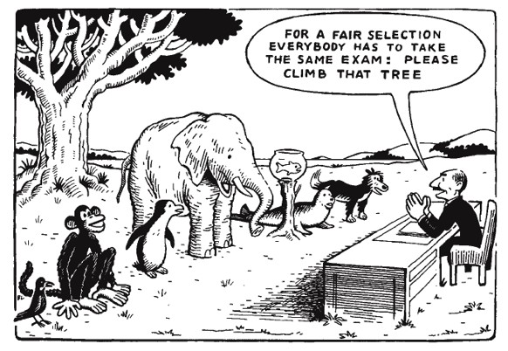

Slide 17
Holistic assessment tasks
Demonstrate breadth of learning
Require the learner to draw on a range of learning from a number of Es and Os across different organisers
Demonstrate challenge
Promote higher order thinking skills-analyse, evaluate & create
Demonstrate application of learning in new and unfamiliar situations
Come from one of the four contexts of learning
Tackling bureaucracy – reducing the time for assessment as focusing on bundles of Es and Os

Slide 18
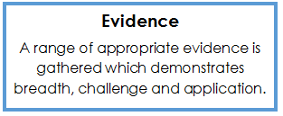
Planning assessment evidence
Consider the evidence you want to gather to best exemplify the learning that has taken place in relation to the agreed success criteria.
A range of evidence allows for a more holistic judgement to be made.
Step 6: Plan to gather a range of evidence.

Slide 19
Sources of Evidence
Observations of learners carrying out tasks and activities, including practical investigations, performances, oral presentations and discussions
Records (oral, written, audio-visual) created by children and young people which may include self assessment and/or peer assessment or may be assessed by the teacher
Information obtained through questioning in high quality interactions and dialogue
Written responses
A product, for example, a piece of artwork, a report or a project
Accounts provided by others

Slide 20
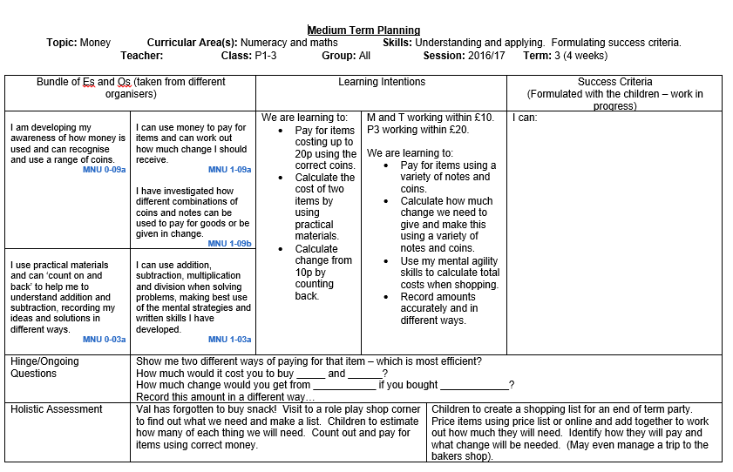

Slide 21
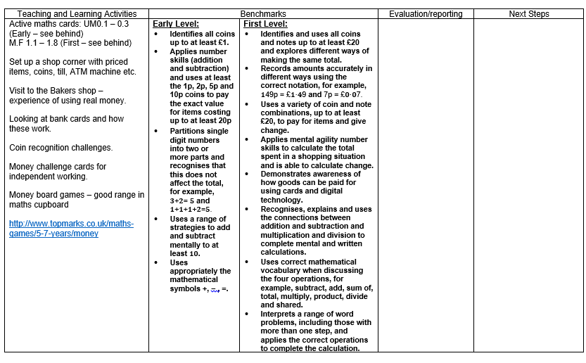

Slide 22
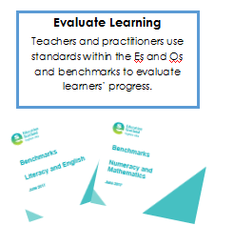
Evaluate the Learning
Did the learning and assessment approaches give learners the opportunity to develop and demonstrate their knowledge, understanding, skills, capabilities and attributes?
What does the assessment evidence tell you about each learner – evaluate learners’ progress within a level by referring the benchmarks.
This information should form part of tracking and monitoring.
Ensure children are given the opportunity to evaluate their own learning.
Step 7: Evaluate learning against standards within Es and Os and benchmarks

Slide 23
Evaluation of learning
Valid/reliable judgements are made when staff have been collaboratively planning at all of the steps in the process.
When learners reflect on their own learning, they come to understand what they have achieved, what they can do to improve and how to go about it.
Learners will need help and careful monitoring in the initial stages of introducing self assessment as it can prove difficult for some young people. They need to be trained, supported and encouraged to develop these skills.

Slide 24
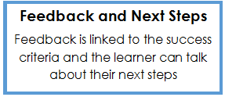
Feedback and Next Steps
Step 8: Provide effective feedback and appropriate next steps
Consider each learner’s progress and share feedback linking learning back to agreed learning intentions and success criteria
What are the next steps? Have these been recorded in language appropriate to the stage of development of the learner?
Has the learning experience been shared and understood by learners, parents and others?
What is the best approach to reporting in your context for your learners, parents and others? Have you referred to the recent guidance?
Step 9: Report on Progress

Slide 25
Reporting on Progress
Must be regular!
Child’s voice/teacher’s voice and opportunity for the parent voice
Reflect on learning that has taken place – successes/setbacks
Plan next steps together
KU, skills, attributes and capabilities – 4 contexts
Learning Logs
Learning overviews
End of year reports
Profiles

Slide 26
Reflect on the whole process…
Reflect on the whole process against your understanding of BtC 5 and the PAM cycle.
Identify strengths and areas for development before beginning the cycle again.
This a cyclical process – there is no ‘end point’. Return again to step 1 considering where you are now as a team/where your learners are on their journey.

Slide 27
NAR Planning Display
Notes:
NAR Flowchart Planning Displays do not need to be done all the time. However they are good for reviewing and discussing with the children what they have been learning, especially for younger pupils.

Slide 28
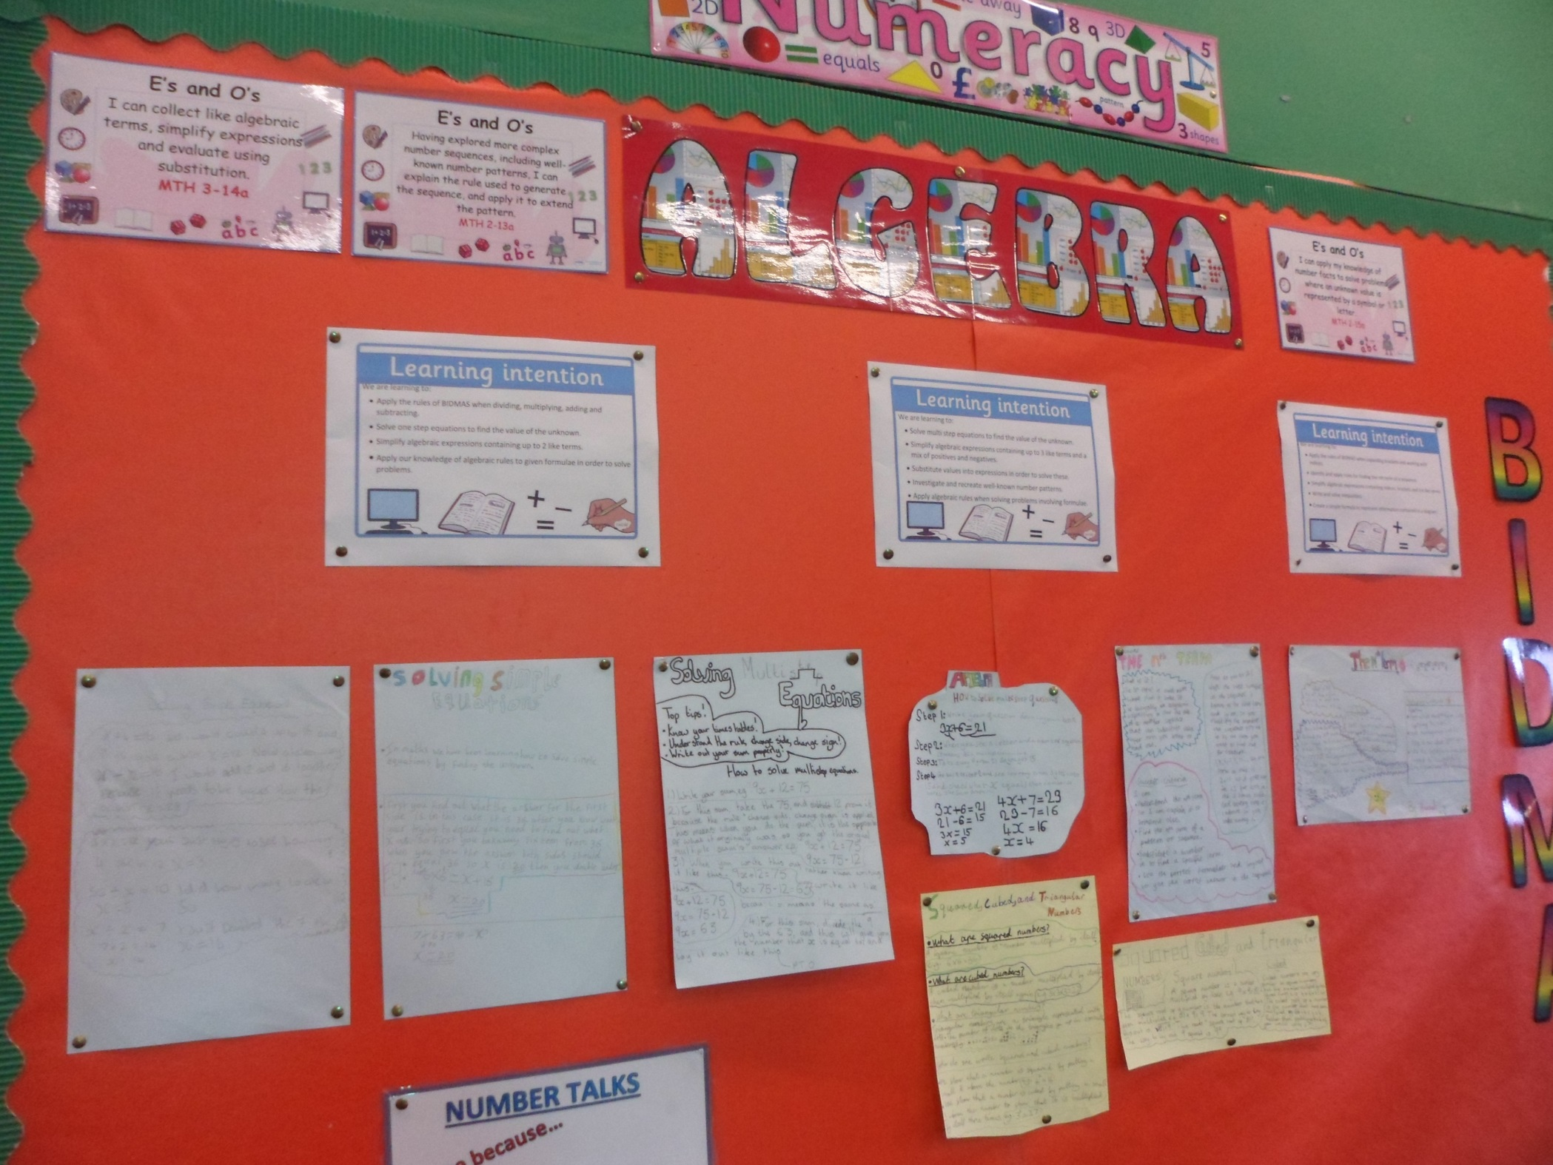

Slide 29
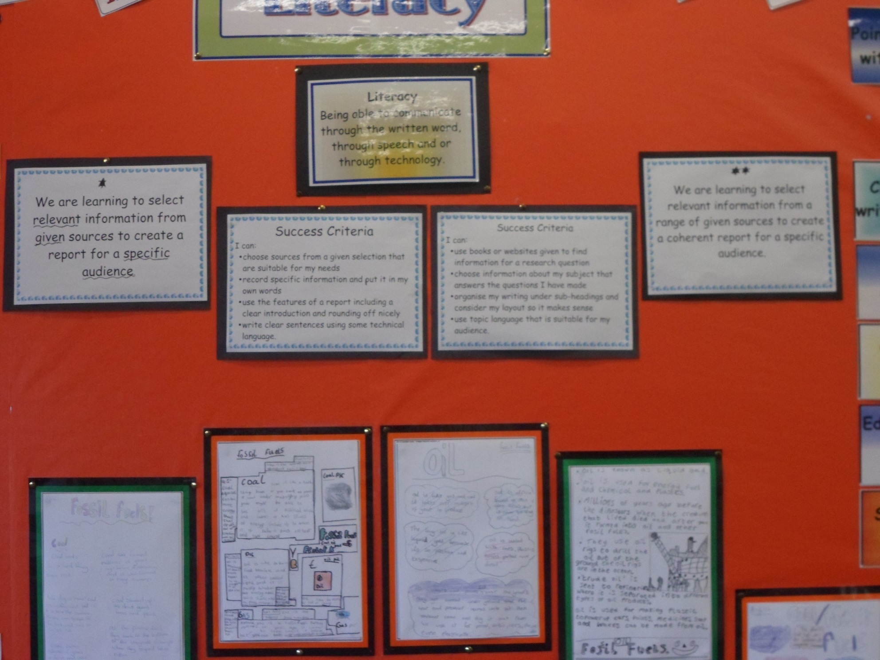

Slide 30
`

