Slide 1
Planning in the ELC
Carradale Primary School

Slide 2
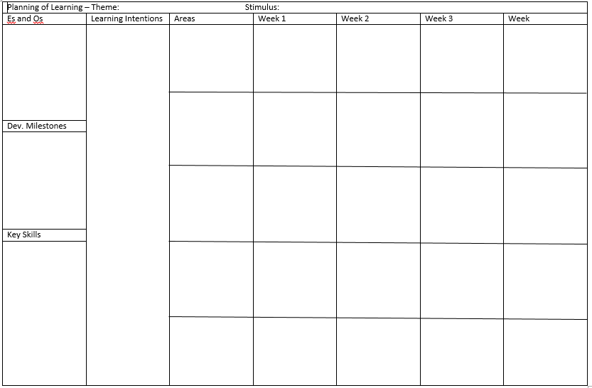

Slide 3
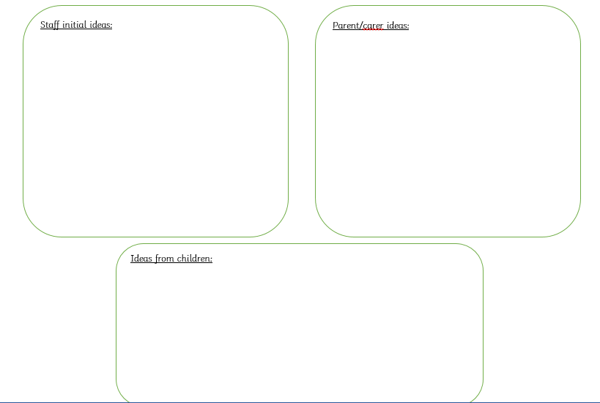

Slide 6
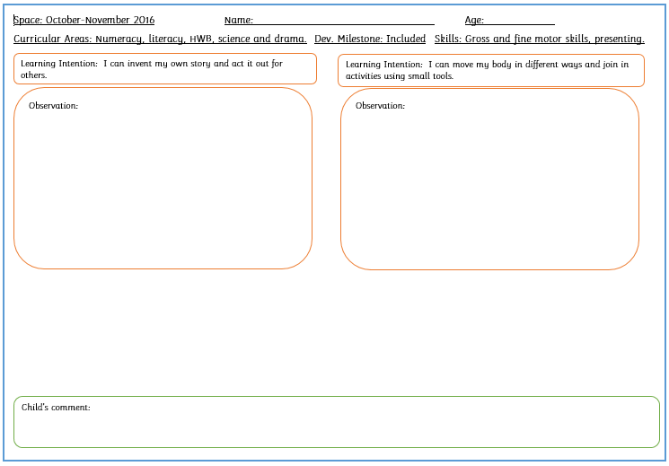

Slide 7
