Slide 1
Creating effective holistic assessment tasks
CEHAT

Slide 2
What is your understanding of “holistic assessment task”?

Slide 3
Holistic assessment tasks
Demonstrate breadth of learning – they come from a range of Es and Os across different organisers
Demonstrate challenge – they ask pupils to use a range of higher order thinking skills such as analysis, creation, evaluation, problem solving, tackling multi step tasks, interpreting tasks
Demonstrate application of learning in new and unfamiliar situations
Come from one of the four contexts of learning:
Life and ethos of the school as a community
Curriculum areas and subjects
Interdisciplinary learning
Opportunities for personal achievement

Slide 4
When and how should we use holistic assessments?
As pre-assessment to ascertain levels of understanding and/or competency
As part of on-going learning and teaching approaches
To assess application of knowledge and skills in new and unfamiliar contexts
As part of the evidence base for making a professional judgement of achievement of a CfE level.

Slide 6
Demonstrates breadth of learning:

Slide 7
Demonstrates challenge
Evaluation of what’s been read.
Selection of material to create an effective e-brochure
Tackling a multi stage task

Slide 8
Demonstrates application
Reading for information
Evaluating the information
Planning
Reporting

Slide 10
Demonstrates Breadth

Slide 11
Demonstrates challenge
Careful reading of the question to extract the relevant information
Problem solving
Multi-step question with evaluation
Drawing on a range of learning – possibly from throughout the year
Predicting and creating a plan to test

Slide 12
Demonstrates Application
Relevant context – school show
Elements of the question will have been covered previously but this format/combination will be new and unfamiliar.
Application of key number skills but without explicit instruction

Slide 13
Group Task 1: Create holistic assessments
Select a bundle of Es and Os which reflect the learning happening in the classroom.
Create 2 holistic assessments which require:
The learner to draw on a range of learning
Appropriate level of challenge
Higher order thinking skills
Application of learning in a new and unfamiliar situation
Come from one of the four contexts of learning

Slide 14
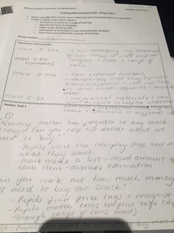
Group Task 2: Evaluation of holistic assessments
Now look at the task created by another group.
Using the evaluative comment checklist, moderate the effectiveness of this task as a holistic assessment.

