Slide 1

Assessment and Moderation in St. Columba’s Primary
Imogen McKenna

Slide 2
Timeline
August In-service Day on Assessment and Moderation
Choose 1 area of the Curricular Overview to plan together with a focus on planning for assessment
Consult children on Success Criteria
Complete evaluations of evidence and learning together
Evaluate the assessment and moderation process
Repeat for other curricular areas

Slide 3
August In-service Day
In-service Day
Refresh all staff on Building the Curriculum 5 and national guidance and expectations of Assessment and Moderation
Self evaluate against Journey to Excellence (Planning the outcomes of learning)
Choose one area of the curriculum to plan together, using NAR Flowchart
Staff to consult children on success criteria and bring results back to complete plan at next meeting

Slide 4
Planning together using NAR Flowchart - Es & Os
Interdisciplinary Learning – ‘Our Local Area’
Es & Os SOC 0-16a, 1-16a, 2-16a, 2-16b
RERC 0-08a, 1-08a
Which Es and Os will be the focus of the learning? Identify a theme and pertinent Es and Os.
Planned learning may touch on several curriculum areas but focus the selection of Es and Os on the learning you plan to assess.

Slide 5

Planning together using NAR Flowchart - Learning Intentions
Look at the selected Es and Os and consider the learning opportunities in each.
Determine the learning intentions, keeping in mind the assessment evidence you plan to gather.
Plan for differentiation within the level.
St Columba’s Primary School Progression Planner IDL Term 1 2016 ‘Our Local Area’ Experiences and Outcomes SOC 0-16a, 1-16a, 2-16a, 2-16b
Step 1 | Step 2 | Step 3 | Step 4 | Step 5 | Step 6 | Step 7
To talk about the roles of the different people in my local community | To create a text showing an understanding of the roles of different people in my local community | To analyse a community organisation, discussing their role in supporting people in our community | To compare two community organisations, comparing and contrasting the services provided. | To identify the needs of a group and describe how an organisation can support them | To identify the services required by a specific group with needs, explaining people’s perspectives | To analyse the support needs of an individual, explaining and justifying the support to be given to the individual.

Slide 6
Planning together using NAR Flowchart – Learning Intentions
Look at the selected Es and Os and consider the learning opportunities in each.
Determine the learning intentions, keeping in mind the assessment evidence you plan to gather.
Plan for differentiation within the level.
St Columba’s Primary School Progression Planner IDL Term 1 2016 ‘Our Local Area’ Experiences and Outcomes RERC 0-08a, 1-08a
Step 1 | Step 2 | Step 3 | Step 4
To be able to talk about the Church and the people in my local Church community | To be able to describe the roles of different people in my local Church community | To be able to describe how different churches in the local community come together to support others and celebrate together (Lord’s Larder, Hope Kitchen, St Vincent de Paul) | To be able to research two different church groups and explain the support they provide to the community (HCPT, St Vincent de Paul)

Slide 7
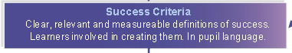
Planning together using NAR Flowchart – Success Criteria
What can you do to show me that you have learnt this?
What could we make?
What can you do to show me that you played a role?
How will we know if our __________ has been a success?
What roles are required for a successful ___________?
What skills would a person require to fill each of these roles?
How will you know that you have been successful as an individual and as part of a group?
How will we measure our success?
What evidence might you gather to show me that you were successful?
How will you record your evidence?
How will you tell your parents about our project and show them that you were successful in your role?

Slide 8

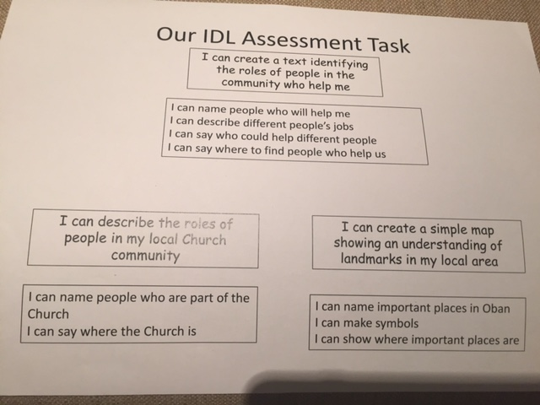
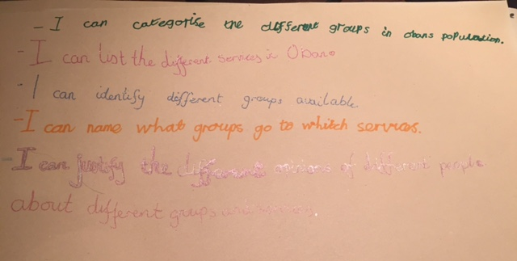
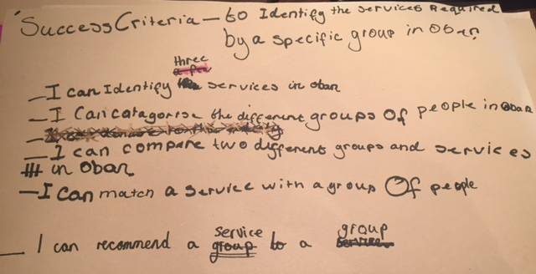
Planning together using NAR Flowchart
Learning Graffiti – L.I. in centre of page and children carousel around writing S.C. around the edges
Post It notes
Whole Class discussion – record on IWB
If you were the teacher…

Slide 9
St Columba’s Primary School Progression Planner IDL Term 1 2016 ‘Our Local Area’ Experiences and Outcomes SOC 0-16a, 1-16a, 2-16a, 2-16b
Step 1 | Step 2 | Step 3 | Step 4 | Step 5 | Step 6 |  | Step 7
To talk about the roles of the different people in my local community | To create a text showing an understanding of the roles of different people in my local community | To analyse a community organisation, discussing their role in supporting people in our community | To compare two community organisations, comparing and contrasting the services provided. | To identify the needs of a group and describe how an organisation can support them | To identify the services required by a specific group with needs, explaining people’s perspectives |  | To analyse the support needs of an individual, explaining and justifying the support to be given to the individual.
Success Criteria I can…
I can give examples of the emergency services in my local area I can talk about how they can support people in need | I can name people in my local area who can help me I can describe different people’s jobs I can select the correct person to help in a variety of scenarios | I can identify community organisations in my local area I can choose a community organisation and describe their role in my local community | I can identify community organisations in my local area I can describe the role these groups play in my local area I can compare the support these groups give to my local community | I can identify groups of people in my local area who require support I can identify and research groups that can help I can describe the types of support they offer | I can classify the people in Oban into 4 groups I can investigate 5 services in Oban I can assess the needs of these groups and identify appropriate services I can justify why certain groups of people need these services I can explain why some groups and services may face discrimination | I can classify the people in Oban into 4 groups I can investigate 5 services in Oban I can assess the needs of these groups and identify appropriate services I can justify why certain groups of people need these services I can explain why some groups and services may face discrimination

Slide 11
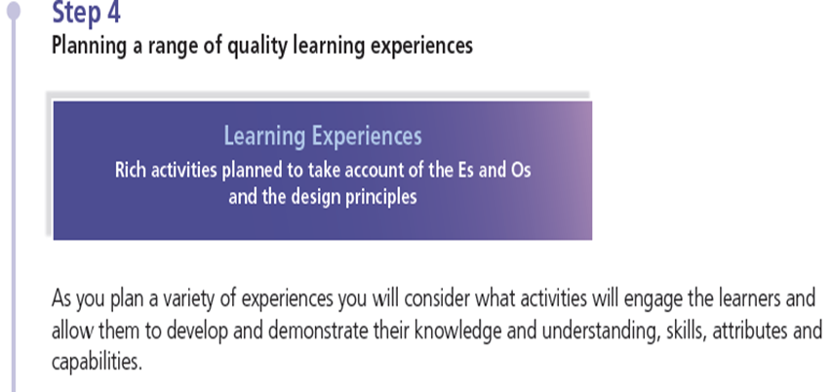
Planning together using NAR Flowchart
Plan learning experiences which match the learning intentions and provide breadth, challenge and application of learning.
Consider the different needs in the classroom and the best tasks / activities to motivate and engage learners.
Will the learning experiences give learners the opportunity to develop and demonstrate their knowledge, understanding, skills, attributes and capabilities?
Reflect the 7 design principles.
Discussed as a whole staff as many children from varying “steps” in different classes
Ensured experiences were tightly tied into L.I.
Freedom for teachers to play to their own strengths/ideas/needs of their learners
Focus on challenge and using skills

Slide 12
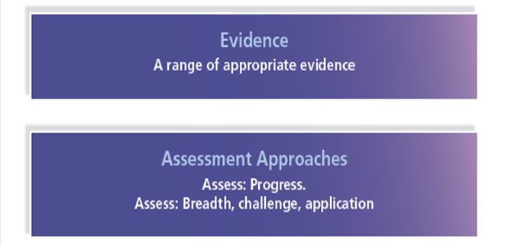
Planning together using NAR Flowchart
Consider the evidence you want to gather to best exemplify the learning that has taken place in relation to the agreed success criteria.
Plan to gather a range of evidence as appropriate to the learning and the learner.
A range of evidence allows for a more holistic judgement to be made.
Discussing how we would assess breadth, challenge and application
Ensuring assessment is rigorous and gives learner the opportunity to showcase what they have learned
Set a date to bring back assessment evidence 70% of the way through the learning (speech marks)

Slide 13
Moderating together
Did the learning and assessment approaches give learners the opportunity to develop and demonstrate their knowledge, understanding, skills, capabilities and attributes?
What does the assessment evidence tell you about each learner?
Consider each learner’s progress and share feedback linking learning back to agreed learning intentions and success criteria
What are the next steps?
Staff brought back assessment evidence for relevant “steps” (3 from each class) and we discussed how well children had achieved the learning intentions
Doing this 70% of the way through the learning allowed us to ‘mop up’ any areas required or provide more challenge
Feedback to children and parents in PLPs

Slide 14
Why we feel it works
Planning was much more manageable and less time consuming as we are all planning together rather than going away to all separately plan similar learning
Plans are now working documents rather than folders sitting on a shelf!
Resourcing/weekly and daily planning was reduced as there is such a tight focus on what the important learning is and what you will assess
Having a clear structure allowed teachers to feel a sense of security and build confidence

Slide 15
Teacher Feedback
“Having so much professional dialogue is really helpful in teasing out what is important for the children to learn.”
“The planning process is so much less time consuming as we are all working together to complete forward plans rather than going away separately trying to plan. My forward plans feel really valuable now.”
“We now have a shared understanding of what good progress and attainment looks like and that makes me feel confident that I am doing the right thing.”
“I feel like the assessment information I gather now is reliable and for a purpose rather than to fill tick sheets.”
“The challenge of what I am teaching, and therefore, what the children are producing is now of a totally different standard compared to before because of our focus on rigorous, robust assessment and ensuring value added at each stage.”

