Slide 1

Numeracy
Argyll and Bute Council
Maria McArthur
Acting PT for Numeracy

Slide 2
To face the challenges of the 21st century, each person needs to have confidence in using mathematical skills, and Scotland needs both specialist mathematicians and a highly numerate population.
Building the Curriculum 1
Notes:
For Curriculum for Excellence, numeracy is defined as
Being numerate involves developing a confidence and competence in using number that allows individuals to solve problems, interpret and analyse information, make informed decisions, function responsibly in everyday life and contribute effectively to society. It gives increased opportunities with the world of work and sets down foundations which can be built upon through life-long learning.
The Scottish Government wants a highly numerate population – indeed it has the ambitious aim of eradicating innumeracy by the year 2017, and educators are the people who are responsible for achieving that aim.

Slide 3
Improving confidence and fluency
in maths for children, young people,
parents and all those who deliver
maths education to raise attainment
and achievement across learning.
Making Maths Count – published in September 216
All schools and nurseries should use
a wide range of effective learning
and teaching approaches to promote
positive attitudes and develop
high expectations, confidence and
resilience in maths.
Notes:
To that aim, the Scottish Government has published the document Making Maths Count. It was published in September of this year and one of its 3 key areas focuses on is the ability of Scotland to improve confidence and fluency in math for children, young people, parents and all those who deliver maths education to raise attainment and achievement across learning.
The fourth recommendation it makes is that all schools and nurseries should use a wide range of effective learning and teaching approaches to promote positive attitudes and develop high expectations, confidence and resilience in maths.
The resources that we are providing you with today are to help support our schools to achieve this recommendation. One of the main features of effective learning and teaching in mathematics is the developing of mental agility. All of us practitioners include mental maths activities in our daily maths planning, and the importance of this has been drummed into us since our teacher training days!

Slide 4
Notes:
As part of A and B’s overall vision I see my role as helping to support staff members as we seek to raise educational attainment and achievement for all.
The importance of improving the overall quality of learning experiences cannot be underestimated, and we all as educators seek out constantly new ways to improve. Indeed every time we are in some one else’s classroom, or a new school, we are looking round and seeking out different methods.
Number Talks, Sumdog, SALi are all methods that we are using to help our staff achieve this.
The quality of the learning experience directly links to improving, particularly for me, the numeracy outcomes for our children and young people.

Slide 5
Notes:
It is important that in all of our planning we are thinking of how we are building up the four capacities. Mental Agility has clear links to these:
Adds confidence – no answer is seen as wrong – leads to open discussion.
Contributors – everyone feels they can contribute to the discussions – a feeling of mutual learning.
Successful – all answers are seen as contributing to the discussions and learners are provided with a variety of strategies, they can choose which one they feel is successful for them.
Citizens – preparing our learners for the fact that mathematics is an important part of our every day life.

Slide 6

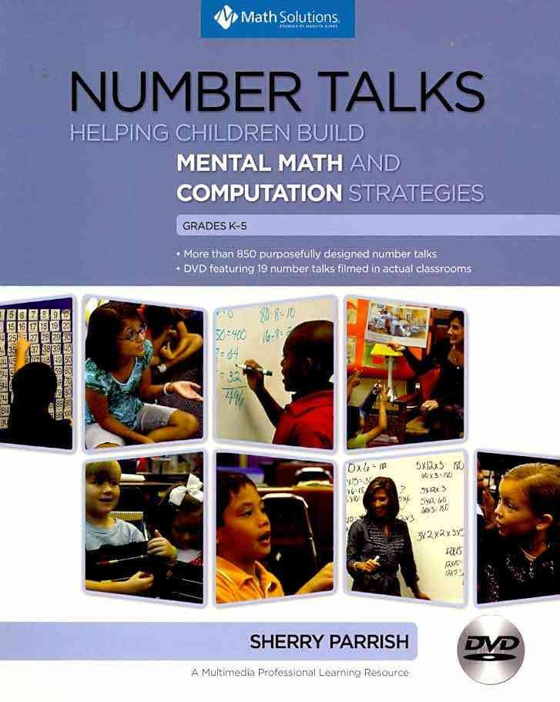

What have we been doing?
https://blogs.glowscotland.org.uk/ab/sali/
Notes:
Developed a Mental agility framework;
Numeracy and Mathematics progression framework
Sumdog subscription
Number Talks resource
SALi – videos, resources, tips

Slide 8
SSLN results for 2015
Notes:
However, despite this the SSLN results from 2015 clearly highlights that although scores sit above 60% in addition and multiplication, results rapidly fall off within subtraction and division. It also highlights that there is a fall off in skills from primary to secondary.
As a result of this, the Argyll and Bute Mental skills progression framework focuses on Addition and Subtraction and Multiplication and Division from Early Level through to Fourth Level. So many of these basic numeracy skills are necessary to understand and develop skills in all areas of Mathematics and Numeracy, and without them learners often find themselves unable to access so many other areas of the curriculum.
To that end, we have also not linked these to any specific experiences and outcomes, as Mental strategies bridge many of the Maths and Numeracy Es and Os. However there are clearly strong links with the following organisers: Estimation and Rounding, Number and the Number Processes and Fractions, Decimals and Percentages.

Slide 9
Notes:
The Framework lays out
The key number facts that learners should be able to derive and recall;
The mental calculations skills that are required;
The mental methods or strategies they can draw upon to complete these mental calculations.
The table is shaded to indicate progression within each of the levels. Roughly, light grey in the example shown would be about P2, the darker shade would be P3, whilst the darkest is P4. Obviously, as with everything in Scottish education, these levels should be seen as guidance and learners should move through them at an appropriate pace and with an appropriate level of challenge.
Also, it is important to remember that this should not be viewed as a programme of study, but rather a guide to support practitioners in their own thinking.
It is also important to reinforce the message that we have not plucked these skills from thin air – they reflect the benchmarks and the expectations that Education Scotland have created for each level.
EVIDENCE
Take photos of their board – evidence of a child’s thinking

Slide 10
www.sumdog.com
http://www.sumdog.com/en/How_to_use_Sumdog%27s_teacher_dashboard/

Slide 11
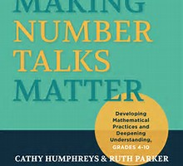
www.mathsolutions.com/documents/NumberTalks_SParrish.pdf

Slide 12
“Far too many students hate maths and for many it is a source of anxiety and fear. This is particularly true for girls.”
Jo Boaler – Stanford Graduate School of Education

Slide 13
What are Number Talks?
Number Talks rationale
Number Talks format
The role of the teacher
Classroom environment

Slide 14
What are Number Talks?
Classroom conversations based around carefully planned problems that are solved mentally;
5 - 15 minutes as part of your number daily routine

Slide 15
Number Talks Rationale
Accuracy
Efficiency
Flexibility

Slide 16
Teacher’s Role
Plans carefully selected problems
Facilitator
Records all answers
Makes effective use of questioning
Read situations – keeps lesson flowing
Allows concrete materials (infants)
Allows thinking time
Accepts all answers – values everyone’s thinking

Slide 17
Key language to be used during Number Talks in the classroom
Display this language
clearly in the classroom.
Notes:
To start your Number Talk each day:
Paper and pencils away and fists onto chests to show teacher they are ready,
Teacher writes a problem on the board – generally, teacher writes problem horizontally to discourage use of rote procedures,
Teacher watches while students solve problem mentally and put up their thumbs when they have had enough time to think,
When most thumbs are up, teacher asks if anyone is willing to share what they think the answer is and in a non committal manner records just the answer on the board, asking if anyone has a different answer. Record each answer that is given. Important that at this point students are not indicating whether or not they think the answer is right or wrong.
Volunteers then share their strategies with the class, identifying first the answer that they are defending.
Teacher role here is to encourage other answers, and discussions through question prompts such as Can you say more about….?Can someone explain Bob’s strategy in their own words? What connections do you notice among the strategies?
Number talk can go on for as long as you wish

Slide 18




Number Talks Format

Slide 19
Classroom Environment
A safe environment
Think first, then check
Interaction
Self correction

Slide 20
“I have not failed. I’ve just found 10,000 ways that won’t work.”
Thomas A. Edison

Slide 21
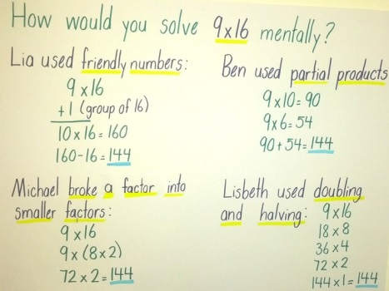

Slide 22
Video - Early Level through to Second Level

Slide 23
Video – pupils lead the learning

Slide 24
Video – secondary pupils talking about number

Slide 25
Planning for Number Talks
Will your Number Talks be a stand alone unit or a series of lessons? Does your problem allow for mental maths?
Are your numbers friendly? Will children be able to retain them?
Are there multiple strategies that children can use?
Are you providing opportunities to build on previously used strategies?

Slide 26
35 + 77 = 112
Notes:
Developed to be used as a classroom activity or as a homework activity.
Provide pupils with the sum AND WITH THE ANSWER.
Their task is then to come up with different ways to arrive at that answer, and to record them on the sheet i.e. rounding, partitioning etc.

Slide 27

Planning for Number Talks
Class: Primary 3 | Focus: Most children could not accurately carry out (mentally) a subtraction calculation involving numbers bridging across 10
Number Talk Problem 34 – 16 | Possible strategies: Counting on +1 +1 +1 +1 +10 +4 = 18 16 17 18 19 20 30 34 +4 +14 = 18 16 20 34 Counting back -4 -10 -2 34 30 20 18 Partition Bar Models 34 – 10 = 24 24 – 4 = 20 20 – 2 = 18 Round and Adjust 30 – 16 = 14 34 – 20 = 14 14 + 4 = 18 14 + 4 = 18 | Question Prompts: How did you solve this problem? Did anyone use a different strategy? Can someone else explain …….’s strategy in their own words? Who would like to piggy back on to …….’s strategy?
Series of Problems: 35 – 17 34 – 18 32 – 16 36 – 19 |  | Which strategy do you think is most efficient? Can you explain why it is the most efficient?

Slide 28
Task – Plan a Number Talk to use
Use the DVD to help you – gives examples of lessons.
Early Level – Page 73, Classroom Clip K1: Ten frames and Dot Cards
First Level – Page 195, Classroom Clips 2.3 and 3.1: Addition
Second Level – Page 245, Classroom Clip 3.5: Multiplication
Third Level and beyond – Chapter 8 of “Making Number Talks Matter”

Slide 29
Assessing Number Talks
Post-it notes
Explain Everything – app for iPad
Filming children in groups
Jottings children have made
Flip chart paper
Mental strategy assessments

Slide 30
Number Talks Progressions
Importance of Developing Number Sense
Importance of teaching mental maths strategies, for example subitising, doubling, arrays etc.
Useful learning resources for number sense and computation:
http://learn.district196.org/course/view.php?id=1482

Slide 31
Notes:
One of the most important messages I have come across whilst researching and writing this mental agility skills of progression, is that learners should not be exposed to standard written methods until they have had appropriate experience of using mental strategies.
Too often, children are learning the written methods and becoming reliant upon these to solve problems. The focus, particularly in the early stages, should be on developing their mental agility BEFORE they move on to the written methods.
The following teaching principles should play an important role:
Every day should be a mental maths day – 5 to 15 minutes;
Provide practice time and model for children the different strategies they can use for answering each question;
This modelling can be done through the use of jottings, images, on the whiteboard, using Explain Everything and so on:
The evidence you can gather does not need to be pages and pages but simply a photograph of your whiteboard at the end of the session;
Engage the learners in discussion – it is not enough for them to know the correct answer, they need to explain HOW they arrived at the answer.

Slide 32

Feedback welcome!
Please provide feedback to: Maria.Mcarthur2@argyll-bute.gov.uk
Or, join us on yammer:
Use your Glow log-in, install the Yammer tile and search for Numeracy and Mathematics in Argyll and Bute

