Slide 1
Curriculum Design Day 3
May 2014
Inveraray Conference Centre

Slide 2
Aims of the day
To share progress on curriculum design and learn from each other
To provide the opportunity to audit the quality of your curriculum
To identify priorities for next steps
To identify any support required for further developments

Slide 3
Aims of the day
Talking
Arguing
Debating
Thinking deeply
Tearing apart done
Putting back together again done
Gnashing teeth done
Wailing done
Groaning done
And being open, honest and positive

Slide 4
Where are you with curriculum design?
A ‘final’ curriculum design
or
An ‘emerging’ design
or
In need of further support

Slide 5
The three ‘W’ questions
What are we doing?
Why are we doing it?
Where is taking our children in their learning?

Slide 6
Moving forward . . . The ‘H’ questions
How are we doing?
How do we know?
How are we going to improve?

Slide 7
The Curriculum
“The totality of learning experiences, irrespective of where the learning takes place.”

Slide 8
Curriculum Design – the journey
Curriculum Design Day 1
Developing understanding, Jigsaw audit,
Question time debate
Curriculum Design Day 2
Optional support days, workshop activities,
Consultation
Curriculum Design Day 3
Sharing examples of ‘completed’ plans, moderating,
evaluating, setting target, consultation

Slide 9
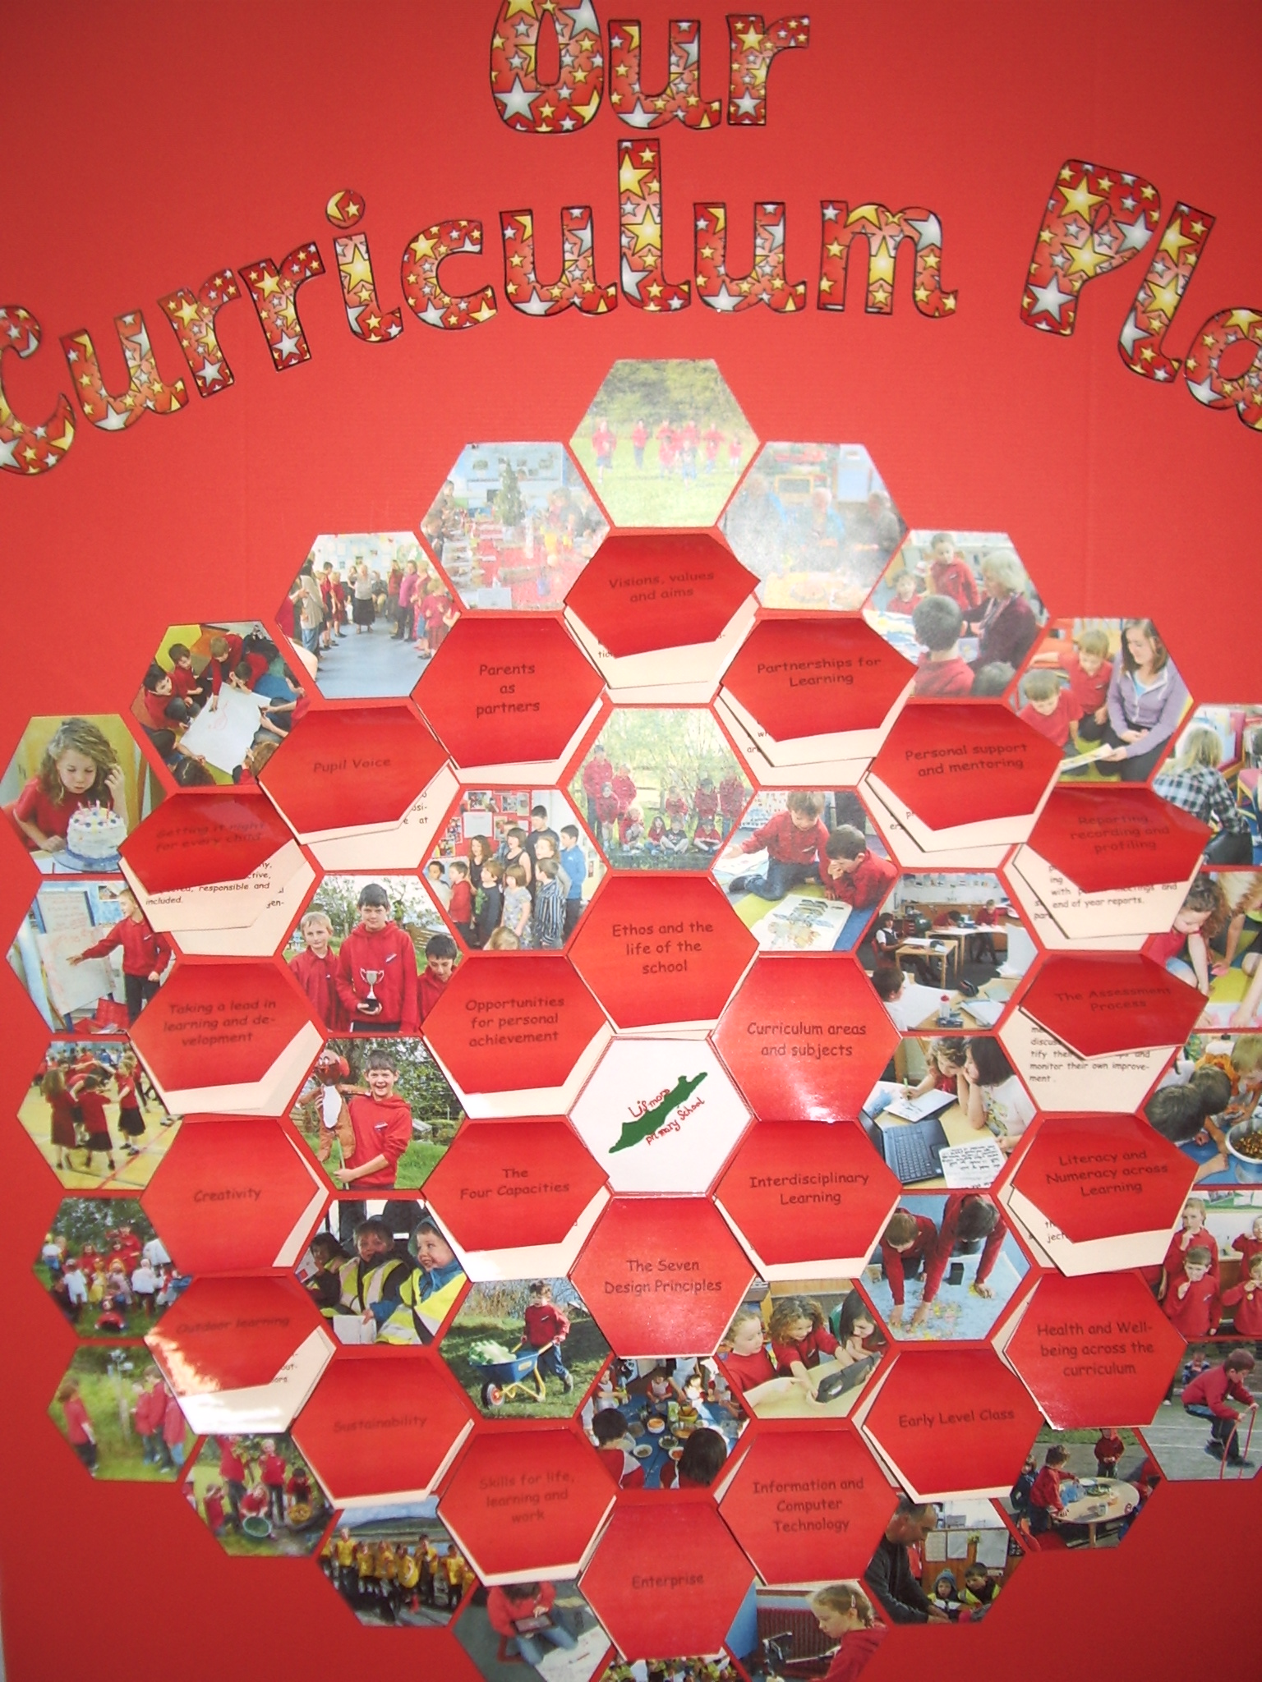

Slide 10
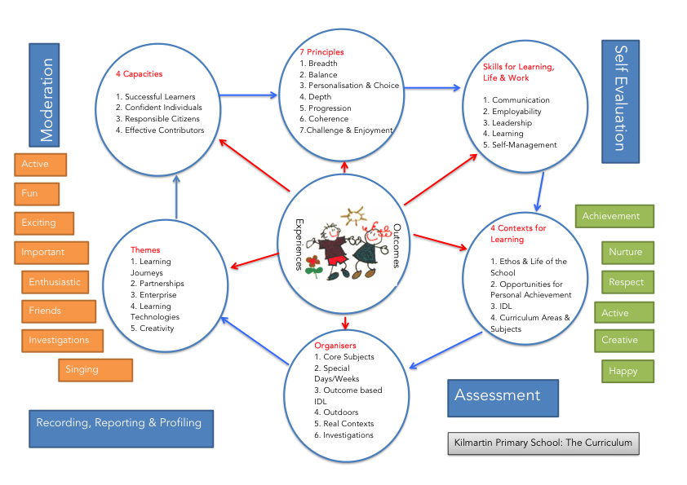

Slide 11
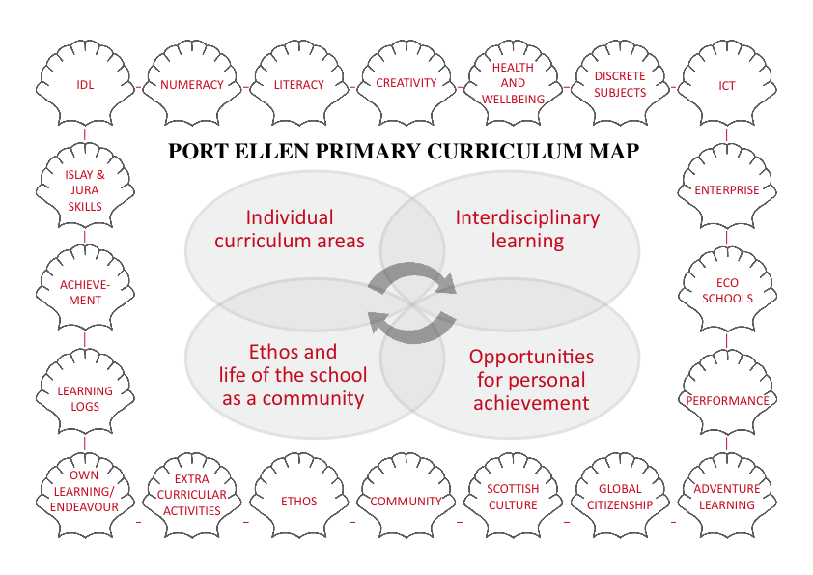

Slide 12
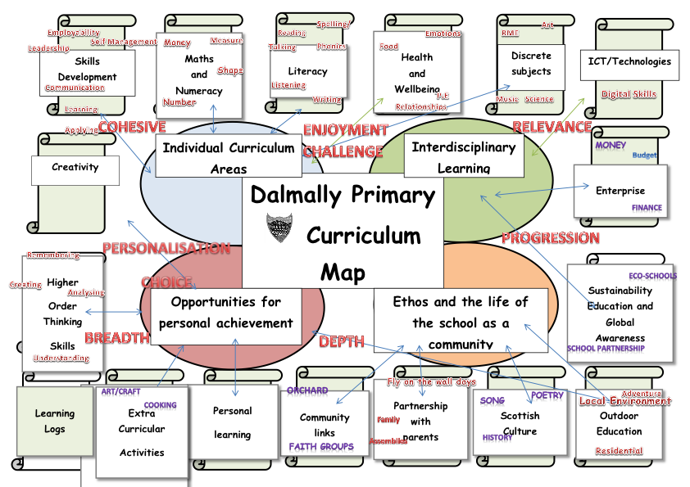

Slide 13
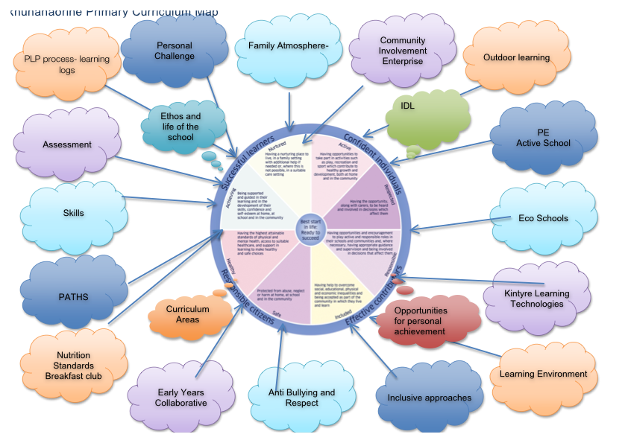

Slide 14
The Near Future . . .
Aspiration of a ‘world class’ curriculum for Argyll and Bute, unique to each school and its community
Confidence that we as an authority have real capacity to improve
Learners who are achieving as a result of a high quality curriculum

Slide 15
“Regularly reviewing and improving your
curriculum is a ‘catch all’ task.”
HM Inspector, March 2014

Slide 16
What next?
Continued engagement on authority wide basis
Individual support for individual establishments
Multi media pack of curriculum materials

