Slide 1

Interesting changes and their impact
Alison Drever, Senior Education Officer

Slide 2



GTCS standards
Notes:
This is an internal page and can be duplicated to create additional pages. Always keep the heading and footer as shown. To edit the document title in the footer, go to Themes and Edit Master in the ribbon menu.

Slide 3

Familiarity
Engagement
Buy in to school improvement
Quality of PRD
Notes:
This is an internal page and can be duplicated to create additional pages. Always keep the heading and footer as shown. To edit the document title in the footer, go to Themes and Edit Master in the ribbon menu.

Slide 4
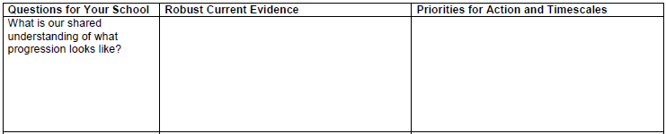
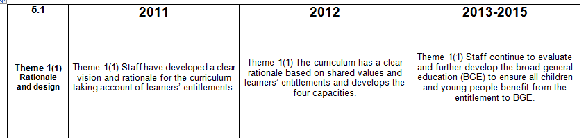
Take 1 question

Slide 5
Big picture understanding
Engagement in self-evaluation

Slide 6







What makes us unique?

Slide 7







What makes us unique?

Slide 8
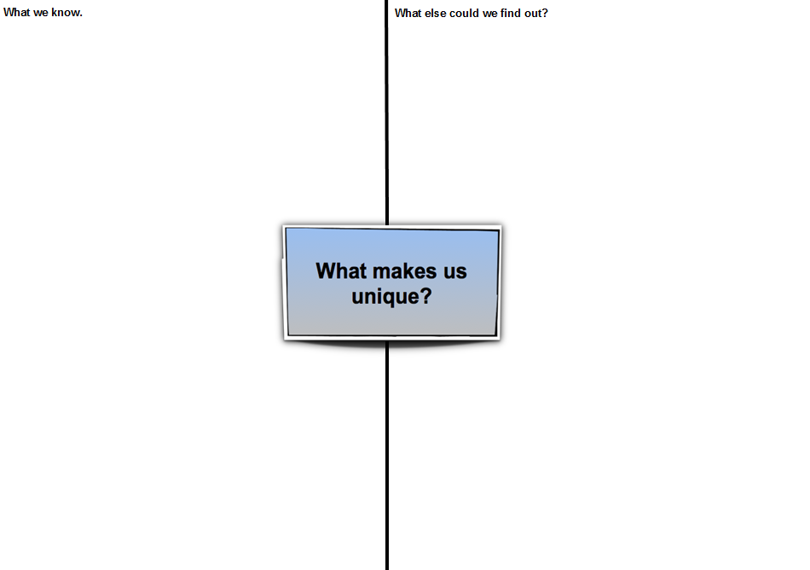
What makes us unique?
What we know
What we need to find out

Slide 9
Shared knowledge and understanding
What isn’t known
Relevance to context

Slide 10
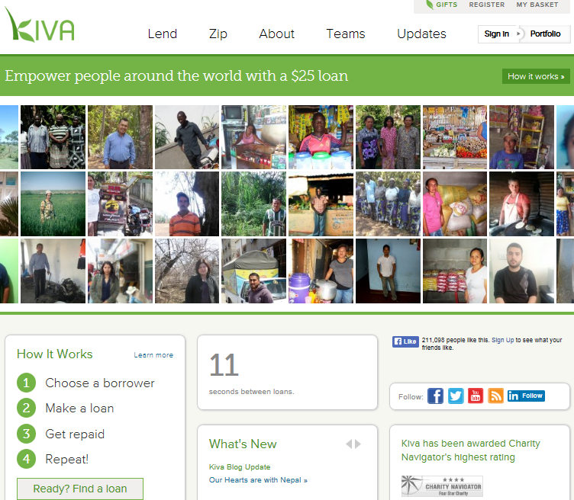
Developing global citizens

Slide 11

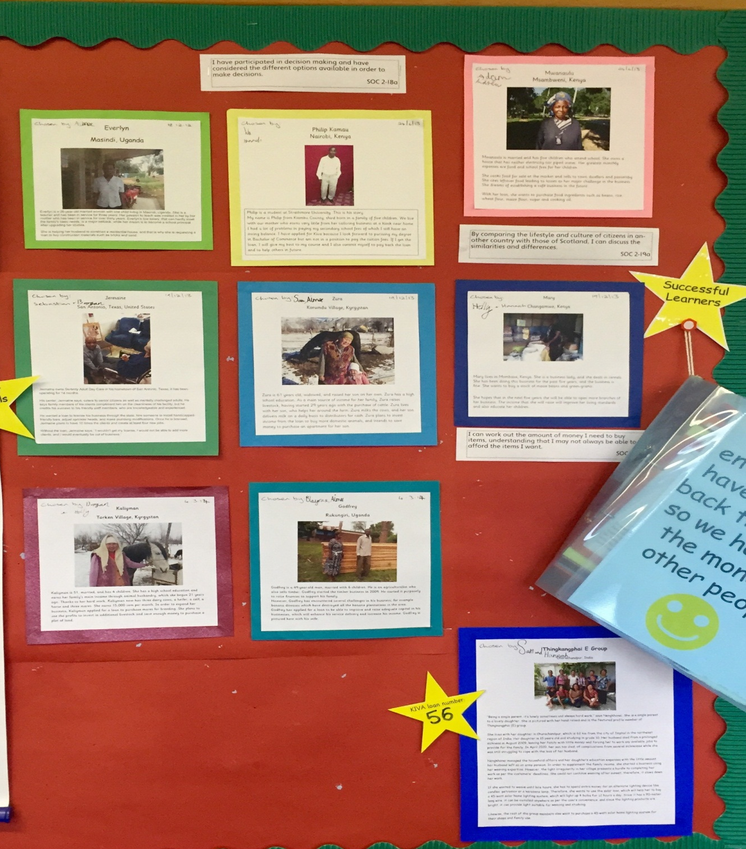
Developing global citizens

Slide 12
Understanding of complex global events
Global perspective
Empathy for others
Challenging decision making
Responsibility to others

Slide 13
Tracking and accrediting progress in wider achievement
4 areas-
  Effective contributors- kindness and sharing
  Successful learners- leadership and learning
  Responsible citizens (LfS)- proactive citizens of our world
  Confident individuals- staying healthy, staying safe
Organised under Bronze, Silver and Gold
Bronze represents the entitlement to a BGE
Successful Kind Individual Lovers of Learning Awards
Staff team, children and parents involved
Certificated

Slide 14
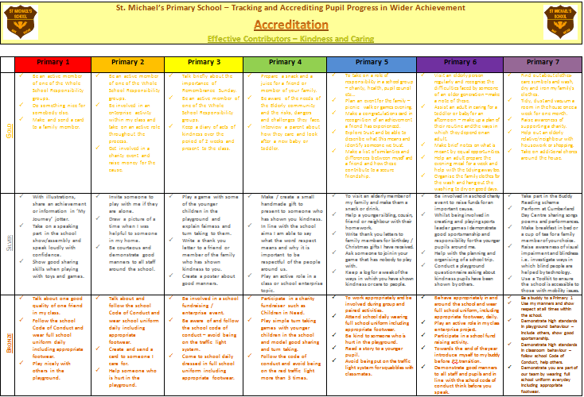
Evidencing progress in wider achievement

Slide 15
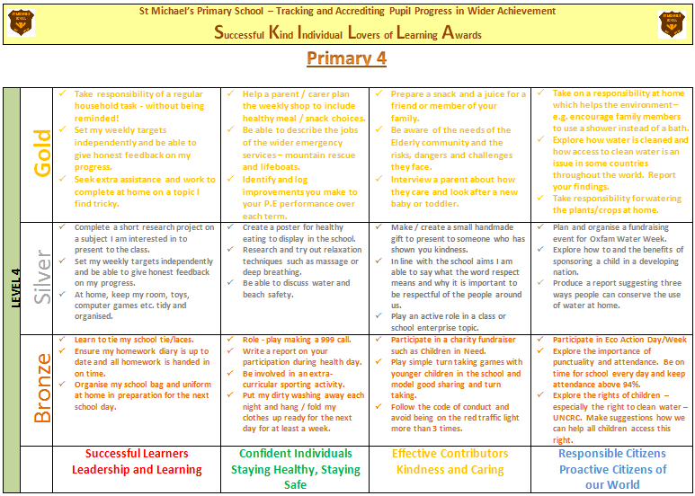
Evidencing progress in wider achievement

Slide 16
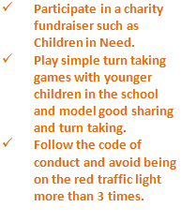
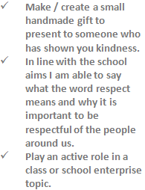
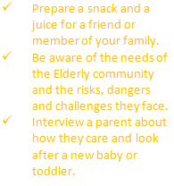
Evidencing progress in wider achievement

Slide 17


Evidencing progress in wider achievement

Slide 18
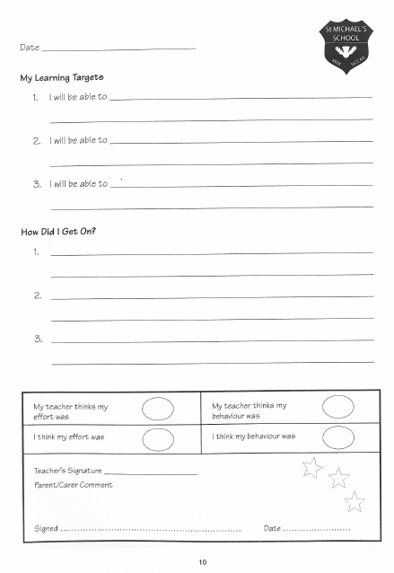


Evidencing progress in wider achievement

Slide 19
Next steps
Review and tweak contents
Work with associated secondary
Align with other award schemes (D of E, JASS)

Slide 20
Children able to describe progress
Children taking responsibility
Recognition of ALL learning
Parental involvement and partnership
Enthusiasm all round

Slide 21
Professional learning- Lesson Study
Identify focus
Plan lesson
Decide on teacher and observer(s)
Identify children
Observers record all evidence of learning
Children asked for their views about lesson
Data is analysed and actions agreed, shared, acted upon

Slide 22

Professional learning- Lesson Study
www.lessonstudy.co.uk

Slide 23
Forensic analysis of learning
Use of information generated to impact on learners
Clearer focus on impact

Slide 24
Planning meetings
Teachers were asked to analyse their attainment data
They presented the information to the senior leadership team twice a year at planning meetings
Outlined how they were addressing all children’s needs through their planning
Around 2 years to develop skills with analyses of data

Slide 25
Improved outcomes and attainment
Shifted responsibility for attainment
Increased shared understanding of standards
Increased understanding and skill in data analysis
Better use of wider range of data

Slide 26
School review process
BEFORE
Organised by the school team
Focus agreed by team (learning and teaching, curriculum, meeting needs)
Team members identified and invited for short periods of time (ed pysch, SfL teacher, behaviour support teacher, QIOs, parent, headteachers)
Timetable drawn up
Rolling programme of staff involvement
Evidence team to consider and collect agreed

Slide 27
School review process
DURING
Class visits 10 minutes, team member and staff member, several visits each
Different focus each day, l&t throughout
Feedback meeting every night- main strengths and issues seen
Detailed feedback meeting with ht and QIO

Slide 28
School review process
AFTER
End of review feedback- issues
Points for action- build on and develop
POTENTIALS TO EXPLORE
Associate Assessors
Partners
Community

Slide 29
Buy in from staff team
Shared responsibility
Shared improvement agenda- multiple perspectives
Robust improvement plan
Manageable time commitment

Slide 30

zero
capital i
ow.ly/L8c0I
Quarterly Primary e-bulletin sign-up page
or
link at bottom of the Education Scotland homepage

Slide 31
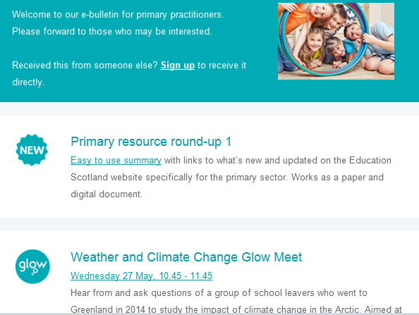


Slide 32


