Slide 1
Standards and Quality and
Improvement Planning
for
Session 2014/15
Anne Paterson
Education Manager
Notes:
Anne

Slide 2
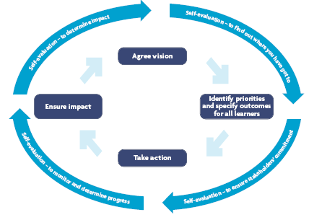
Standards and Quality Report
Function of the report?
Timing of the report….
As part of cyclical development- a logical time for the SQR as part of self evaluation
It should be part of the Improvement Plan
Notes:
Elaine

Slide 3
Standards and Quality Report
Based on the dimensions of JtE, provide evidence of impact of:
High quality learning and teaching.(1)
Success for all learners.(2,10)
The school’s shared vision. (3)
High quality leadership at all levels. (4)
Partnership with parents, community and others.(5,6)
Self evaluation.(7)
Valuing and empowering staff and young people.(8)
Ethos – well being, respect.(9)
Notes:
Elaine

Slide 4
Standards and Quality Report (cont.)
Provide clear evidence to answer the key questions. The evidence must include impact for children, young people and staff.
How well do our children and young people learn and achieve?
How well do our staff work with others to support the children and young people’s learning?
How well are our staff, children and young people actively involved in improving the school community?
How does this school demonstrate high expectations for all its children and young people?
How does this school demonstrate a clear sense of direction?
Notes:
Elaine

Slide 5
Standards and Quality Report (cont.)
The report must reflect on the following key high level questions -
What have we achieved in the past year?
How well do we meet the needs of our school community?
How good is the education we provide?
How good is our management?
How good is our leadership?
What is our capacity for improvement?
Notes:
Elaine

Slide 6
Standards and Quality Report (cont.)
How good is our learning, teaching and achievement?
Learners’ experiences (Learning and Teaching)
Improvements in performance (Attainment and Achievement)
How well do we meet pupils’ learning needs?
How good is our environment for learning?
How good is our leadership?
What do we aim to do next to improve?
Notes:
Elaine

Slide 7
Visions, Values and Aims
‘to encourage the development of the personality, talents and mental and physical abilities of the young person to their fullest potential.’ Standards in Scotland’s Schools etc Act 2000
Notes:
Anne

Slide 8
The core features of the Improvement Plan
A High Level, Focused Plan - fewer adjustable priorities over a longer timescale.
Relates to the core business of the school - learning and teaching.
Priorities are expressed as outcomes for learners.
Priorities arise from the schools’ view of its vision, values and aims.
Priorities MUST impact on the classroom.
It builds on strengths.
Planning is flexible as long as the outcomes are delivered.
Self-evaluation and audit are ongoing processes.
IMPACT: The effectiveness of the planning is apparent in the extent and quality of its outcomes for children.
Notes:
Elaine

Slide 9
The Maintenance Agenda
= the normal work of the school / “day to day business”.
Responsibility of named members of staff / teams, built into their remits and ongoing responsibilities.
Staff review / self evaluation will monitor ongoing quality.
Notes:
Anne

Slide 10
Tackling Bureaucaracy
Forward Planning
Assessment
Self-Evaluation and Improvement Planning
Monitoring and Reporting

Slide 11
Improvement Planning in a nutshell
The most effective planning is proportionate.
It builds on strengths.
It has children at it’s heart.
The effectiveness of the planning is apparent in the extent and quality of its outcomes for children.
Notes:
ELAINE

Slide 12
Authority Priorities
2014 - 2015
Raising Attainment
and
Promoting Achievement
Through
Curriculum for Excellence
•moderation, assessment and reporting
• literacy
• numeracy
• health and wellbeing
Raising Attainment
and
Promoting Achievement
through
broad general education
senior phase models
Developing Young Workforce
Raising Attainment
and
Promoting Achievement
through
Children, young people and families
In the
the wider community
Raising Attainment
and
Promoting Achievement
through
the development of
effective leadership of learning
for all levels

Slide 13
Improvement Planning for 2014 – 15 in Argyll and Bute Schools
4 Points to note
• Assessment approaches must be agreed and implemented at cluster level.
• Curriculum design must continue to be a priority including reference to Developing Young Workforce.
• Improvement plans must have a focus on raising attainment in literacy and numeracy at all levels.
• Improvement plans must include Health and Wellbeing developments and implementation across the curriculum.

Slide 14
Priorities 2014/15
Assessment and Skills
Curriculum Design including Developing Young Workforce
Raising Attainment – Literacy, Reading, Languages 1+2
Raising Attainment - Numeracy
Health & Wellbeing across the curriculum

Slide 16
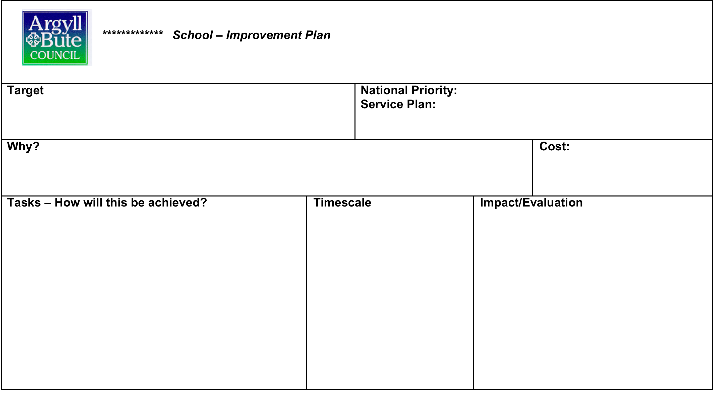

Slide 17
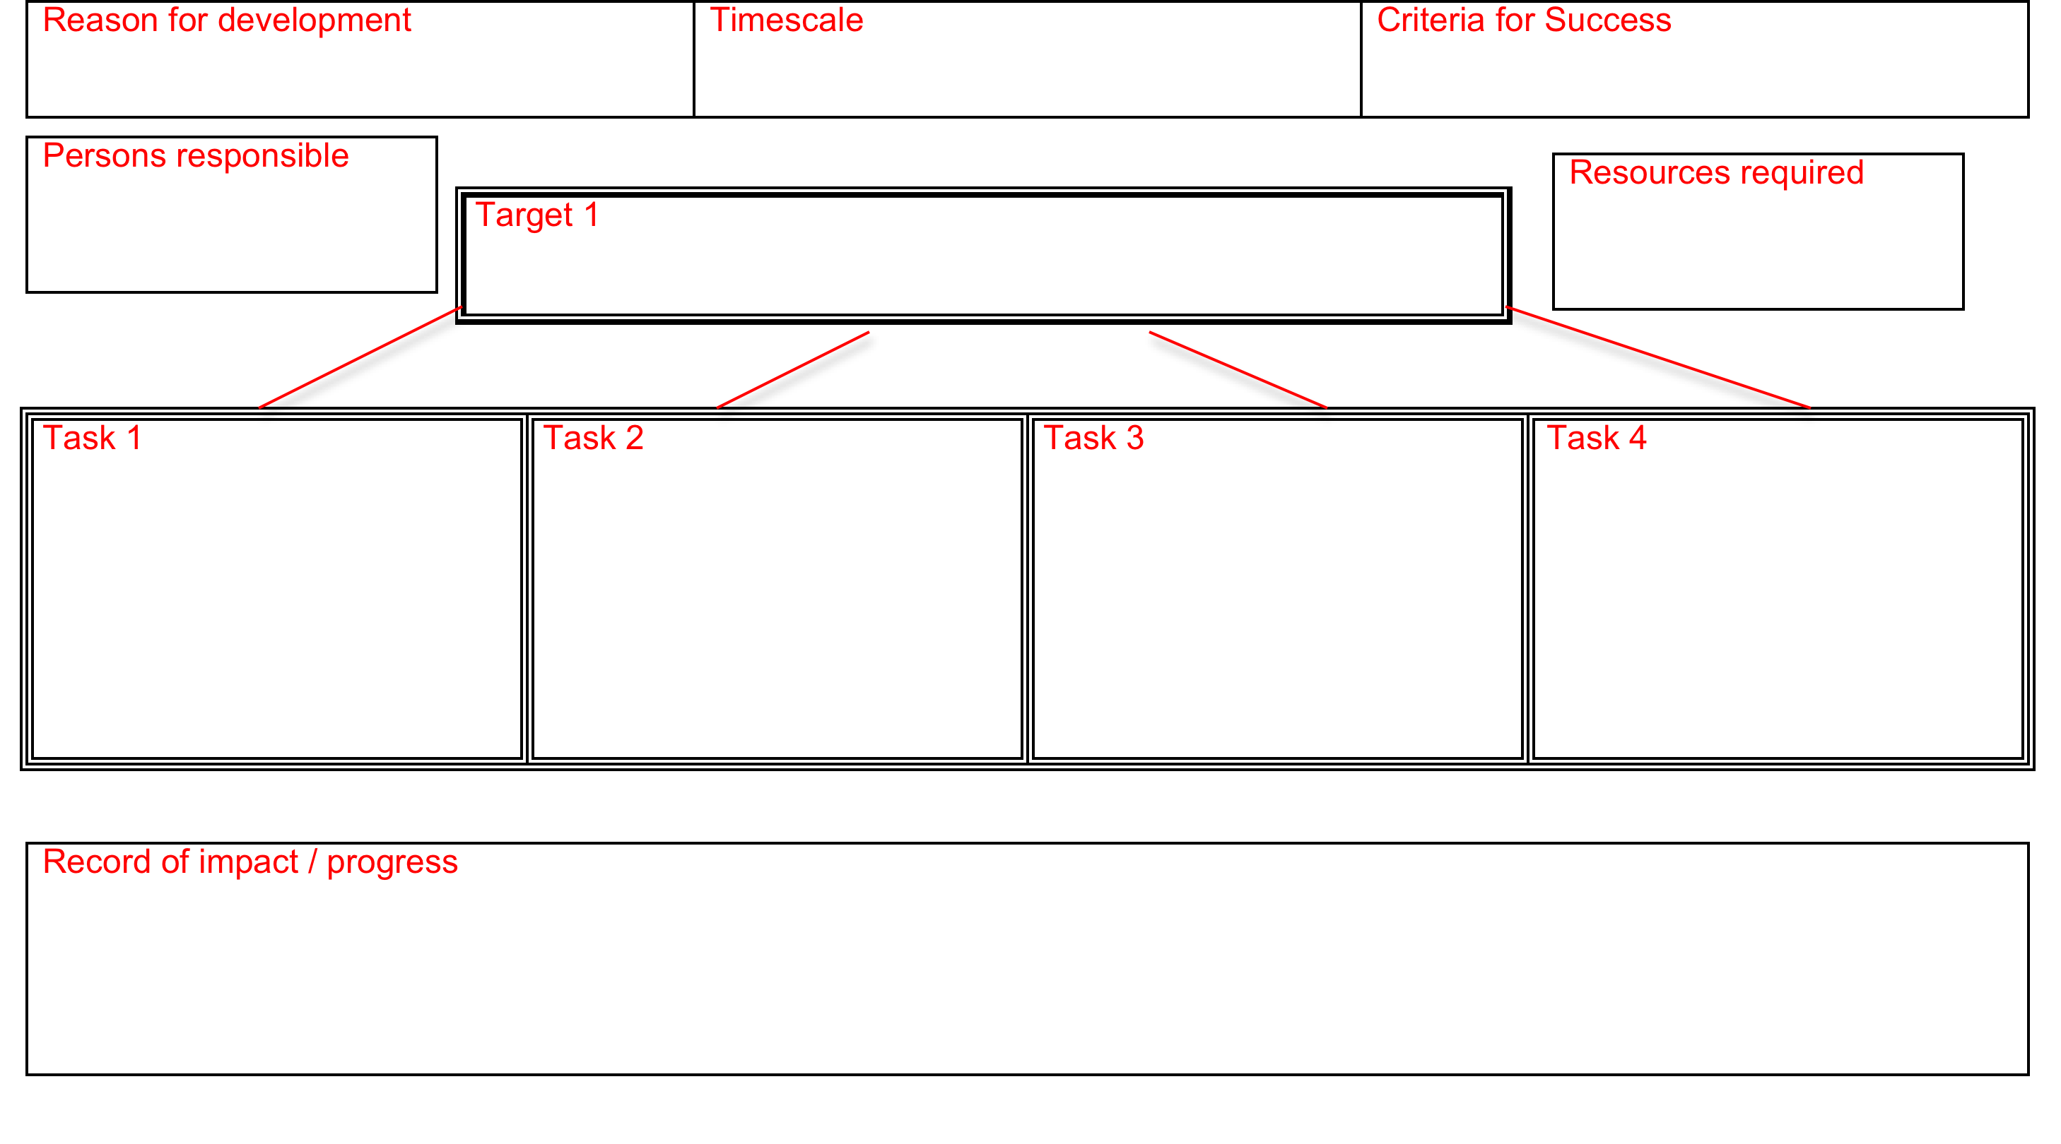

Slide 18
Priority Number One
What do we need to change? (Focus)
How do we know this needs to change? (Evidence)
How will this benefit pupils? (Impact)
How will we make this change? (Process)
(Name) leading Resources Key Milestones
The main links to HGIOS3 are...

