Slide 1
Welcome
Quality Improvement Throughout a Child’s Journey

Slide 2
Our Shared Vision for the Children’s Collaboratives Scotland : The best place in the world to grow up where every child has the best start in life and is ready to succeed

Slide 3
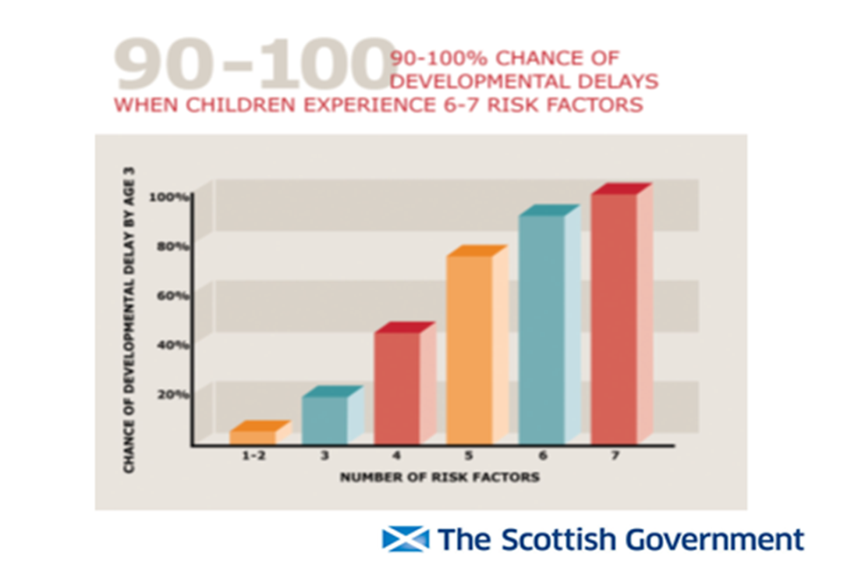
Social Determinants of Health and Wellbeing
Sir Harry Burns. Kilbrandon Lecture: Healthier Lives Better Futures 2011

Slide 4
Impact of Poverty Poverty damages. It damages childhoods; it damages life chances; and it damages us all in society…
There were 3.7 million children living in poverty in the UK in 2013-14.
That’s 28 per cent of children, or 9 in a classroom of 30
CAPG 2016

Slide 5
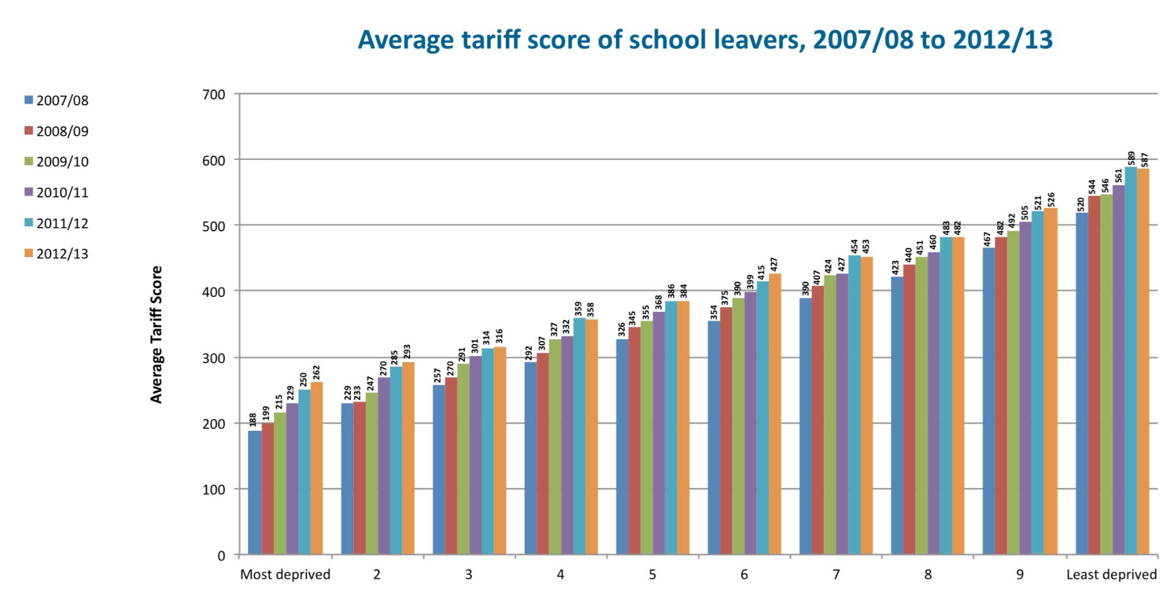
Gap between the most and least deprived
587
Attainment gap
262
Deprivation decile
Notes:
inequity in Scotland’s education system
Importance of addressing health and wellbeing inequalities to drive improvement – physical and mental health, resilience and growth mindset, engaging parents and communities to support the work

Slide 6
The Children’s Improvement Collaboratives
Excellence and Equity
Deliver both excellence, in terms of ensuring children and young people acquire a broad range of skills and capacities at the highest levels, whilst also delivering equity so that every child and young person should thrive and have the best opportunity to succeed regardless of their social circumstances or additional needs*
* National Improvement Framework, 2016

Slide 7
Achieving Excellence & Equity – Policy Context
Universal HV Pathway
Poverty related attainment gap
Early Learning & Childcare
Scottish Attainment Challenge
Realigning
Children’s Services
National Improvement Framework
PACE
(Permanence)
Employability DYW / YES
Improvement in Child Protection
Family Nurse
Partnership
Education Bill (inequalities)
GIRFEC
Children & Young Person Bill
Notes:
How QI Fits with the National Context
Policy
PHILOSOPHY – CHILD AT THE CENTRE IN ALL THAT WE DO
BACKED UP BY THE LEGISLATION OF C&YP ACT – NAMED PERSON BIGGEST THING FOR EVERYONE AND STRONGLY CONNCTS THE QI WORK ACROSS THE CHILD’S JOURNEY.
Sharing experiences across the community will help
Universal pathway and services – there has been significant investment – aim for 500 additionl HVs by 2018 and will be key to delivery of the universal pathway. Acknowledge the local challenges faced by LA/HB teams.
Early learning and childcare – doubling entitlement of childcare places by 2020 – huge job for all re workforce – flexibility of work etc.
Keen to test out solutions to deliver this and a clear role for national partners who will be very helpful in supporting delivery
KEY – new focus on improvement on child protection processes and practice of practitioners. Cab sec announced an improvement intent.
PACE RCS FNP

Slide 8
Reflections on Achievements and Progress
Do you recognise in your work:
Engaged and active teams?
Effective projects ready for spread to all who would benefit?
Data and improvement stories giving confidence that interventions work?
Confidence in improvement methods through successful activity?

Slide 9
Reflections on Achievements and Progress
What could be going better?
Pace of progress?
Having difficulty spreading good work?
Unclear of shared local priorities?
Is there need for focus?
Improvement capability of teamds to support local progress?

Slide 10
Why Review and Refresh the Outcome Aims ?
Policy context providing focus for impact on excellence and equity
Ability to measure local and national progress to improve outcomes at scale over time
Aligning the focus for improvement across the child’s journey from birth to adulthood

Slide 11
QI and Achieving Excellence & Equity
Universal HV Pathway
Poverty related attainment gap
Early Learning & Childcare
Scottish Attainment Challenge
Realigning
Children’s Services
National Improvement Framework
PACE
Employability skills / DYW
Improvement in Child Protection
Family Nurse
Partnership
Education Bill (inequalities)
GIRFEC
Children & Young Person Act
Notes:
How QI Fits with the National Context
Policy
PHILOSOPHY – CHILD AT THE CENTRE IN ALL THAT WE DO
BACKED UP BY THE LEGISLATION OF C&YP ACT – NAMED PERSON BIGGEST THING FOR EVERYONE AND STRONGLY CONENCTS THE QI WORK ACROSS THE CHILD’S JOURNEY.
NEED TO GET THOSE THINGS RIGHT – LOCAL PRIORIITY FOR ALL
Sharing experiences across the community will help
Universal pathway and services – there has been significant investment – aim for 500 additionl HVs by 2018 and will be key to delivery of the universal pathway. Acknowledge the local challenges faced by LA/HB teams.
Early learning and childcare – doubling entitlement of childcare places by 2020 – huge job for all re workforce – flexibility of work etc.
Keen to test out solutions to deliver this and a clear role for national partners who will be very helpful in supporting delivery
KEY – new focus on improvement on child protection processes and practice of practitioners. Cab sec announced an improvement intent.
PACE RCS FNP

Slide 12
What makes a good aim
Clearly defined
Measurable
Time specific
Unachievable by hard work alone
What, How Much, By When?

Slide 13
Draft aims focus on prevention, early intervention & achievement
Work needs to be multi-professional and multiagency; applying interventions that support child development towards successful developmental and achievement outcomes
- Build on the successful work that may be scaled up to many children and families
- Focus on priorities for local improvement that reaches all who can benefit

Slide 14
Draft Aims
AIM 1
By 2019 ……. % of Children in each CPP will have no developmental concerns identified at time of their 13 -15 month Child Health Review
(compared to 30 month review what does specialist experience tell us about the % of children with developmental delays picked up at 15 months?)

Slide 15
Draft Aims
AIM 2:
By 2019, 85 % of children in each CPP will have no developmental concerns identified at the time of their 27 – 30 month child health review
(Based on 14/15 data: 62% of all eligible children had no concerns,
12% of child reviews carried out were not meaningful and
72% of those reviewed had no concerns)

Slide 16
Draft Stretch Aims
AIM 3:
By 2019, 85% of children across each SIMD decile have successfully achieved early level literacy, numeracy and progressing in health & wellbeing by the end of primary 1.
Future capture of data from 4-5yr child health review will contribute as outcome data as the child progresses towards primary school

Slide 17
Draft Stretch Aims ………
AIM 4:
By 2019, 85% of children, across each SIMD decile have successfully achieved CfE First level literacy and numeracy and are progressing in health and wellbeing by the end of primary 4
AIM 5:
By 2019, 85% of children, across each SIMD decile have successfully achieved CfE Second level literacy & numeracy and are progressing in health and wellbeing by the end of primary 7

Slide 18
Draft Stretch Aims ………
AIM 6:
By 2019, 85% of children, across each SIMD decile have successfully achieved CfE Third level literacy and numeracy and are progressing in health and wellbeing by the end of secondary 3
AIM 7:
By 2019 ensure that 95% of young people across each SIMD decile go on to positive participative destinations when leaving school.

Slide 19
QI draft stretch aims across the child’s journey
In each Community Planning Partnership…
0-15mths
15-30mths
36mth-5yrs
P2-4
P5-7
S1-3
S4-S6+
By 2019 ……. % of Children in each CPP will have no developmental concerns identified at time of their 13 -15 month Child Health Review
By 2019, 85 % of children in each CPP will have no developmental concerns identified at the time of their 27 – 30 month child health review
By 2019, 85% of children across each SIMD decile will have successfully achieved early level literacy, numeracy and progressing in health & wellbeing by the end of primary 1.
By 2019, 85% of children, across each SIMD decile will have successfully achieved CfE First level literacy and numeracy and are progressing in health and wellbeing by the end of primary 4
By 2019, 85% of children, across each SIMD decile will have successfully achieved CfE Second level literacy & numeracy and are progressing in health and wellbeing by the end of primary 7
By 2019, 85% of children, across each SIMD decile will have successfully achieved CfE Third level literacy and numeracy and are progressing in health and wellbeing by the end of secondary 3
By 2019 ensure that 95% of young people across each SIMD decile go on to a positive participative destinations on leaving school

Slide 20
Common themes that could apply throughout a child’s journey:
Parental Engagement & Involvement
Attendance
Early language & literacy skills
Nurture
Child Poverty
Generic interventions with measures

Slide 21
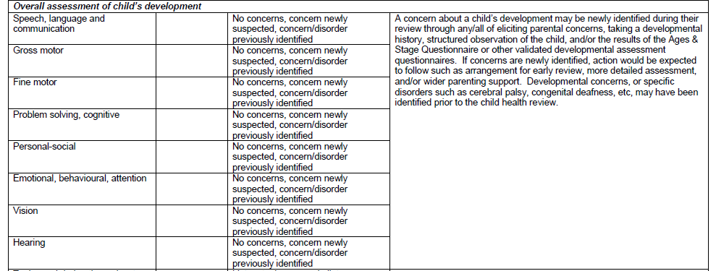
Universal CHR - Child Development

