Slide 1
The Early Years Service

Slide 2
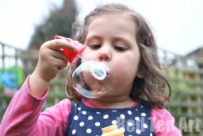
Working with the Early Years Service
Structure of the Early Years Service
Regulatory Bodies
Early Learning and Childcare and Primary 1
Developmental Milestones
How to Access Support

Slide 3
Structure of the Early Years Service 2015-16
Education Manager
Learning & Achievement
Education Officer
Early Years
Early Years &Family Support Workers – 1 for each locality
Principal Teachers – Early Years – 1 for East and 1 for West A&B
Early Years Worker
Community Childminding
Early Years Development Officer - 1
Early Years Helpline, NAMS, FIS – 3
Principal Officer Early Years - 1
Heads of Centre – Clyde Cottage & Campbeltown - 2
The Head of Service for Education has over all responsibility for the Service

Slide 4
Regulatory Bodies- The Care Inspectorate
What are the responsibilities of a manager?
Day Care of Children
National Care Standards
Annual Return
Self Assessment
Registration Certificate
E-forms
The Hub
Policies and Procedures
http://hub.careinspectorate.com/

Slide 5
Regulatory Bodies – SSSC Scottish Social Services Council
What are the responsibilities of a manager?
Requirement for all staff to be registered
Qualifications and standards
Learning and development
http://www.sssc.uk.com/
http://workforcesolutions.sssc.uk.com/nos/

Slide 6
Regulatory Bodies - HMIe
What are the responsibilities of a manager?
Child at the Centre 2 Quality Indicators with a particular focus on self evaluation and the curriculum
Curriculum for Excellence
Building the Ambition
Learning Through Play
http://www.educationscotland.gov.uk/learningandteaching/earlylearningandchildcare/index.asp

Slide 7
Early Level – Early Learning and Childcare & Primary 1
What should the environment look like, sound like and feel like?
What should the role of the adult look like, sound like and feel like?
What should children’s experiences look like, sound like and feel like?

Slide 8
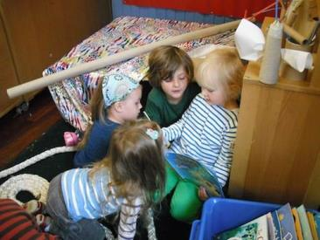
Environment BtA Audit- Environment Young Child
Is well organised to allow young children the freedom to select equipment and materials that they wish and also appreciate they need to accommodate the choices of others
Encourages inquiry and invites discussion and exploration with interesting objects to talk about and explore, stimulating curiosity.
Uses technologies to widen children’s experiences of different methods of communication.
Provides a balance of both being inside and outside experiences to increase children’s confidence in a variety of environments
Has a library rich in books, favourite stories, fiction and non-fiction books, books children have made themselves, recordings of experiences
and stories they want to share and tell.
Uses environmental print recognisable to children to help a growing understanding that print has meaning.

Slide 9
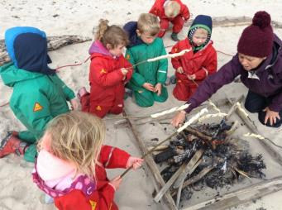
Role of the Adult BtA Audit- Staff Young Child
Involve children in making sensible choices about their own learning by helping them to plan and evaluate their own experience.
Create opportunities for children to “write” in different play situations and for different purposes without this being conducted in a formal way.
Not afraid to change their own plans and take the lead from the child and who are able to act as a support to the young child when needed.
Help model techniques and strategies with children and encourage this new learning in the child’s new challenges or suggest a new context.
Give time for children to explain their interests in a calm unhurried manner and pose questions which encourage inquiry such as, I wonder if, why do you think that, to extend the young child’s ability to verbalise their thoughts and actions.
Encourage children to talk together with their friends and create situations where children take turns and listen in small groups.
Provide a range of resources to talk about which encourages children to be creative.

Slide 10
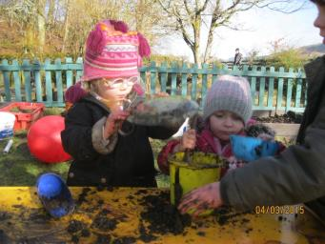
Allow opportunities to play and learn together, to share ideas and interests, to reconcile differences and to begin to develop a sense of fairness.
Experiences BtA Audit- Experiences Young Child
Provide opportunities which encourage children’s understanding of living things and the local and natural environment.
Help children remember how they have solved a problem in the past and how this learning links to a current challenge.
Engage children in daily energetic play, which supports and extends their developing physical skills, stamina and strength.
Give the young child experience of how materials change, by heating, dissolving, freezing, mixing etc.
Use real tools and equipment to help coordination of fine movements; for example, combining items together using different fasteners, preparing snack, using a camera or keyboard.
Draw children’s attention of words, both verbal and in print, and helps them realise print has meaning; for example, labelling their own pictures, writing during shop or home play, writing cards and letters and signs or labels on resources.
Encourage children to play with rhyme and rhythm, songs and silly words to have fun and enjoy.

Slide 11
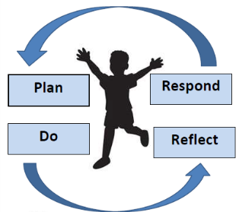
What’s the Learning?
Effective next steps to meet the needs of the child – taking the learning forward
Consider how the learning can be taken forward within the environment
Consider how you are going to ‘scaffold’ the learning
Share appropriate next steps and achievements in PLP
Engage parents
Voice of the Child
Prior Learning
Experiences & Outcomes/
Significant Aspects of Learning
Developmental Milestones
Learning Overview
Floorbook
PLP
Learning environments – inside and outside
Promote Independent learning, curiosity, creativity
Role of the adult – facilitator, effective interventions, open ended questions
Effective Observations – check with ‘so what’ question
Evidence of learning
Team meetings
Professional dialogue
Shared understanding
Parents

Slide 12
Developmental Milestones
Building the Ambition
GIRFEC
Moderation and Assessment
Professional Dialogue
Tracking & Monitoring
Family Engagement

Slide 13
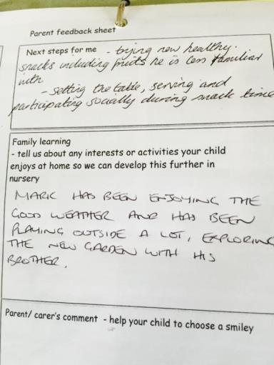
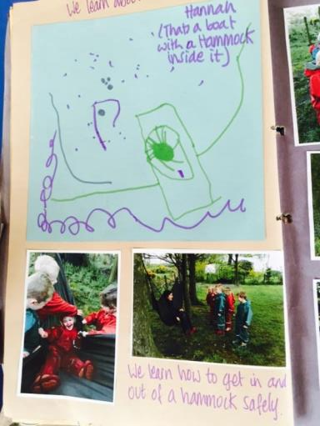
Meeting Individual Needs

Slide 14
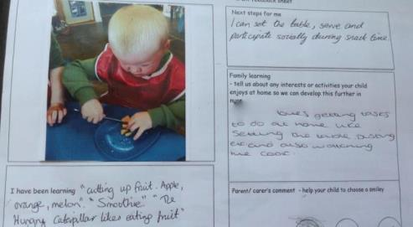
Engaging Parents

Slide 15
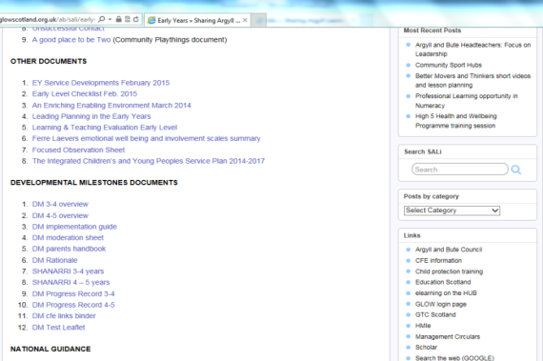
https://blogs.glowscotland.org.uk/ab/sali/early-years/
Early Years Service Online Resources

Slide 16
01369704000 – ask for Early Years
earlyyears@argyll-bute.gov.uk
kathleen.johnston@argyll-bute.gov.uk
Argyll and Bute Early Years
@EYArgyllBute

