Slide 1
Katie’s Journey on the
Argyll and Bute Family Pathway

Slide 2
Stretch Aim 1—pregnancy and birth
This is me when I was born. My mum met with a midwife called Jane when she was pregnant with me and she became my named person. She talked with mum about how to stay healthy and to how keep me healthy too. If my mum had any questions, Jane helped her. When I was born, Jane helped my mum to breastfeed me and told our health visitor all about me.
Notes:
Insert data in next slides

Slide 3
Due to the small numbers involved there are huge month to month variances, however work is in progress to test and make changes

Slide 4
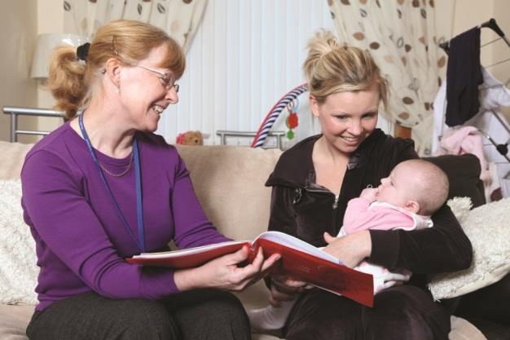
Stretch Aim 2: 3-4 month check
This is me when I was 3 months old. Our health visitor came to visit us to talk with mum about how I was doing. Her name was Fiona and she was my new named person. She told mum all about how I grow and develop and about the importance of preparing for weaning. Mum said I needed lots of kisses and cuddles as well as songs and rhymes too!

Slide 5
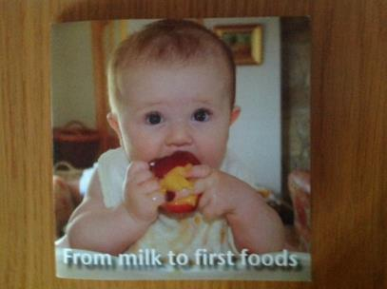
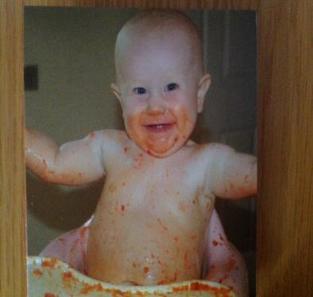
Weaning DVD
When, How, What?
Baby Led Weaning
Good Feeding Practices
What about drinks?
What should I avoid?
Food Allergies
How Much do I give him?

Slide 6
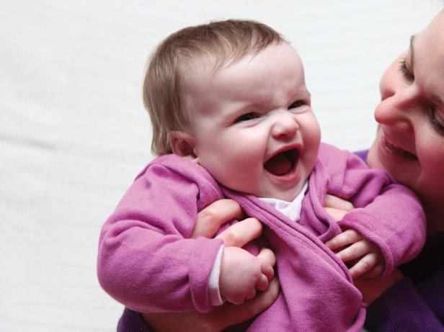
Stretch Aim 2: 12-15 month check
When I was 12 months old, our health visitor Fiona came to visit us again. She talked with mum about all the healthy food I was eating and all the new sounds I was making as I developed my speech. They also talked about me going to the dentist and how well I was sleeping. I was a very cheeky baby!

Slide 7
12-15 month Core Careplan
Safe Home and car safety
Healthy Nutrition, Oral Health, Immunisations, Minor ailments
Achieving Gross & Fine motor skills Growth, Language development
Nurtured Bookbug, Maternal Mood
Active Behaviour, Sleep, Play
Respected & Place in family/siblings
Responsible
Included Socialisation, Family Support

Slide 9
Stretch Aim 2: 27-30 month check
Just after I turned 2 our health visitor Fiona carried out my ‘27-30 month check’. This is just a wee check to see how I was doing. Sometimes kids like me need an extra wee bit of help with walking, talking or other ways we grow and develop. Mum and Fiona had a good chat about how I was doing!

Slide 10
Notes:
Data tells us there are fewer cancellations and more people turning up for appointments
Parents tell us they have a clearer understanding of what the appointment is about and they have an opportunity to ask questions about their child’s development

Slide 12
Stretch Aim 3: Nursery – Primary One
Now I’m 3, I go to nursery! Our health visitor Fiona told my nursery manager how I was doing. I love playing with my friends every day. My key worker called Sally talks to me about my learning and then we write about it in my personal learning plan. Mum can read about it and we do lots of activities to help me grow and develop at home. We are all learning together! When I go to school, my new named person will be my head teacher, and she will know all about me when I start Primary One!

Slide 13
Argyll & Bute Developmental Milestone Tool

Slide 14
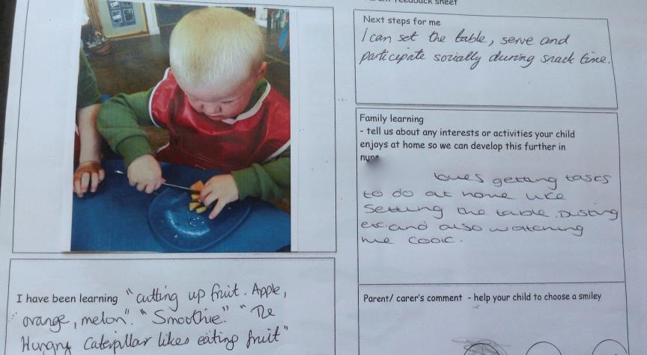
Engaging Parents

Slide 16
Primary One in Kintyre – October 2015
Transition to P1
Information has been successfully passed on to all receiving schools from ELCC settings.
What are we doing about it?
P1 teachers have been looking at innovative ways to scaffold next steps for children.
“Watchful waiting” for our youngest learners who will be 5 in February
Using “Better Movers and Thinkers” to address specific issues
Building targets from the milestones tool into PLPs.
Using milestones tool to form outcomes in Child's Planning process where applicable
Using milestones to support referrals to PPP/ POPP.

Slide 17
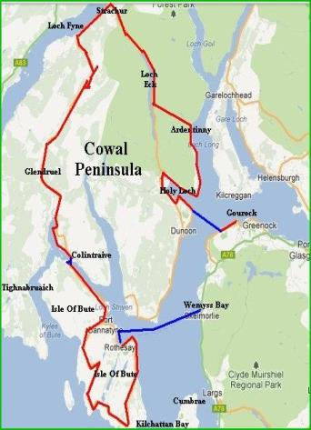
Why Cowal?
Similar SIMD area to Campbeltown
The Cowal Peninsula is another geographical area which is an obvious choice for population segmentation
Local ‘Buy-in’ for development of the ‘Cowal Family Pathway’

Slide 18
Scaling Up in Cowal
Engage staff teams through Cowal practitioners forum
(Midwives, Health Visitors and Early years Staff)
Ensure parental involvement and engagement from the outset through consultation
Involve staff in developing services to meet the needs of the Cowal community
Incorporate the ‘Psychology of Parenting Programme’ into the ‘Cowal Family Pathway’
Notes:
A&B Children structure

Slide 19
”This is not something that is going to change overnight. It will take stick-ability and doing it for five to 10 years, and then we will see a difference.” – Sir Harry Burns, Former Chief Medical Officer for Scotland

