Slide 1
Early levels concept Colgrain Primary/Pre-5 Unit
Jenni Curson (DHT)
Nazim Bhuiyan (TEP)

Slide 2
Concept
Transition
Co-constructionism
Attachment and nurture
Notes:
Naz

Slide 3
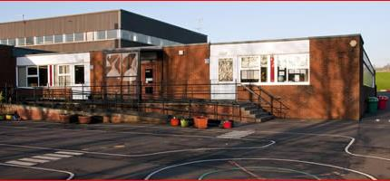
Colgrain Primary School

Slide 4
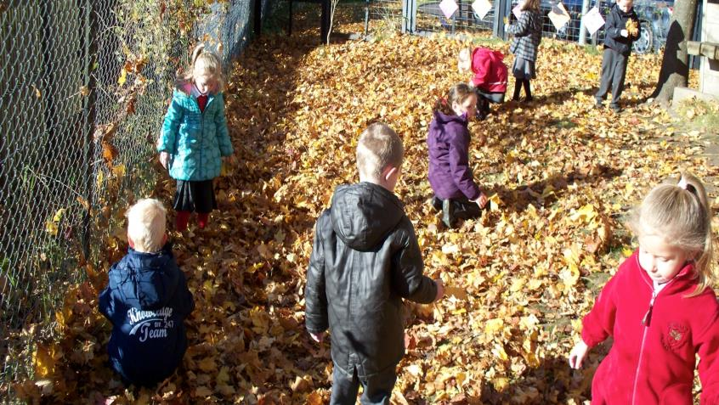
Colgrain Primary School

Slide 5
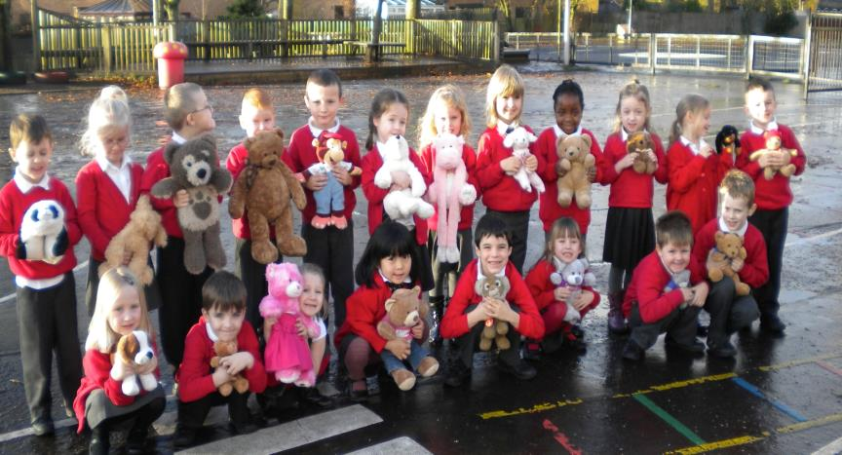
Some of our young people getting ready for their teddy bears pic-nic

Slide 6
Colgrain primary
The following schools implement an Early Levels class in the LA:
Kilmartin Primary School (49 pupils)
Luing Primary School (21 pupils)
Colgrain Primary School (380 pupils)
Notes:
Jenni

Slide 7
Colgrain – School context
Large School, although role fluctuates
50% of pupils are from MOD families (transient population.)
A mixture of local authority and private housing
Many families on significant benefits

Slide 8
Why an early level class?
Curriculum for Excellence
Free-flow
Some children would benefit from a less structured play environment.

Slide 9
What has been completed
Meetings with SMT in Colgrain primary
Contact with other agencies outwith Colgrain
Parental focus group
Contextual observations
Appreciative Inquiry activity with Early years staff (Discovery, dream, design and destiny)
Presentation and SWOT analysis of early levels working with p2-p7 teaching staff
Notes:
Jenni
Naz

Slide 10
Pre-Implementation
Gathering key information
Meetings with SMT in Colgrain primary
Meetings with APT and Early Years Development Officer
Contextual observations
Appreciative Inquiry activity with Early years staff (Discovery, dream, design and destiny)
Notes:
Naz

Slide 11
Implementation
Presentation and SWOT analysis of early levels working with p2-p7 teaching staff
All early years educators were involved
Development of short term and long term goals (Appreciative Inquiry)
Free flow sessions
Goldilocks transition planning
Notes:
Jenni
Naz

Slide 12
Development of Short term goals
Nursery and p1 staff planning curriculum once a week
Implement four shared early level class learning experiences
Using child led planning to inform activities for the shared learning experiences
Investigate current transition policy and working
Notes:
Naz

Slide 13
Free-flow sessions
Breaking down the walls
Collaborative planning – (Timetabling ☹)
Real transition – A process NOT an event!

Slide 14
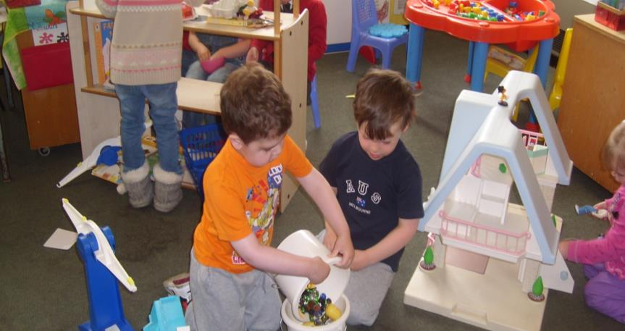
Co-operative learning

Slide 15
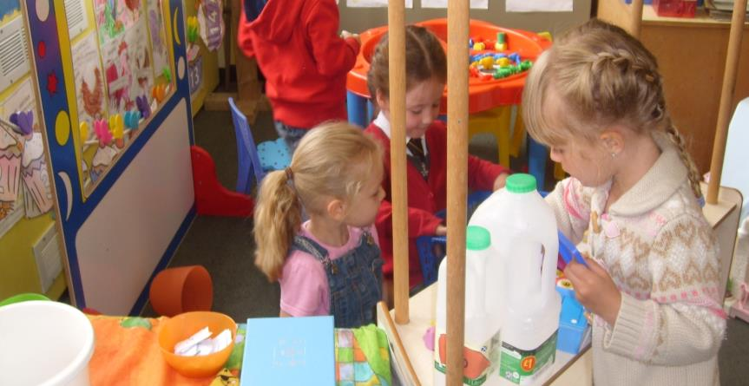
All early years pupils playing together

Slide 16
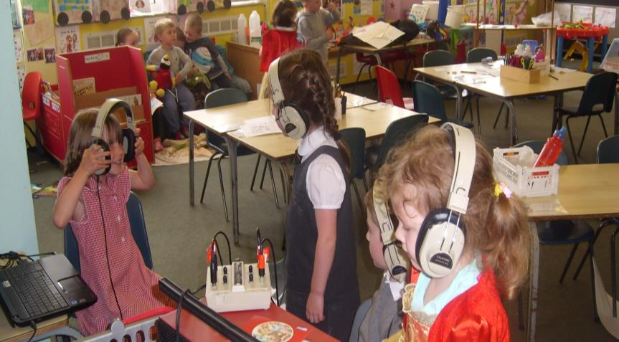
Different activities – Facilitating learning.

Slide 17
Post-implementation
Parental focus group
Transition audit
Early years staff experience of early levels concept
Evaluation of long-term goals
Notes:
Jenni

Slide 18
Pit falls and Bear traps
Classes become too structured.
Strategies are useful for older children are inappropriately applied to younger children
Too often distinct learning areas are set up which are discrete and which do not facilitate enquiry based learning.
Effective nursery practice is replaced with teacher led learning.
Notes:
Jenni

Slide 19
Progression of Long-term goals
Develop outdoor learning (forest schools)
Having a continuous assessment tool to evidence pupil progression (learning stories and QR codes).
Develop and use a PLP (SHINNARI wheel)
Developing closer links with parents and the community
Notes:
Jenni
nAZ

Slide 20
Reflections
Would it have been better if parents were apart of the pre implementation phase.
More planned time for the early educators to be together (p1 and nursery staff).
Having early levels experiences that encouraging children to move between activities.
Improved planning for children attending p1 from other nursery provision.
Notes:
Jenni

Slide 21
Questions?

