Slide 1
Building the Ambition – National Practice guidance on Early Learning and Childcare

Slide 2
Section 1: Why do we need this?
Why the terminology early learning and childcare?
“Early learning and childcare is defined as service, consisting of education and care, of a kind which is suitable in the ordinary case for children who are under school age, regard being had to the importance of interactions and other experiences which support learning and development in a caring and nurturing setting.” CYP Act –Scotland (2014)
Who needs to take account of this change?
‘It is for use by local authority personnel, regulatory bodies, training providers and practitioners in all ELCC settings throughout Scotland.’ Building the Ambition

Slide 3
The earliest years of child’s life represent the single greatest chance to make a lasting impact on a child’s future

Slide 4
Introduction
Build confidence and capability for those who work with young children from birth to starting school.
Make links between practice, theory and policy guidance to reinforce aspects of high quality provision and the critical role played by early years practitioners.
Clarify some aspects of current practice and provide a reference which practitioners can easily use.
Support improvement and quality by encouraging discussion and reflective questioning about practice relevant in each setting.
Provide advice on achieving the highest quality ELCC possible to allow our youngest children to play their part in the Scottish Government’s ambition of Scotland being the best place in the world to grow up.

Slide 5
Section 2: What we know from policy and research
Getting it Right for Every Child - GIRFEC
Growing up in Scotland - GUS
The Early Years Collaborative - EYC
Review of the workforce

Slide 6
Section 4: What do we mean by play and learning?
How are play and learning connected?
‘Some theorists emphasise that when playing, children try out ideas and come to a better understanding of thoughts and concepts as they play; others see play as a means of children coping with reality through using their imagination; and, others see play as a means to practise new skills. All of which are valid.’

Slide 7
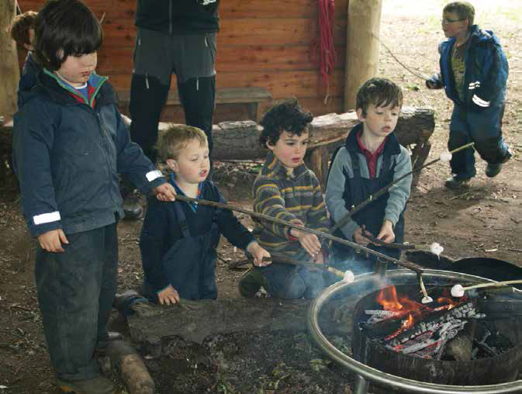
Section 5: Understanding attachment
Attachment theory – a definition
‘Although the terms “bonding” and “attachment” are sometimes used interchangeably to describe love and affection from parents or a caregiver, attachment theory describes “attachment” as the quality of the relationship from the child`s perspective i.e. the enduring relationship which develops between a child and their caregiver pre-natally and during the first two years of life.
“Bonding” tends to be used to describe the parent`s relationship to the child.’

Slide 8
Section 6: Early Learning and Childcare – what do children need?
The question of developmental stages
What are the key characteristics of being a baby, toddler and young child?
The importance of transition

Slide 9
Section 7: Putting pedagogy into practice
What do we mean by pedagogy?
Essential aspects which drive early learning
A focus on babies – what do they need?
A focus on toddlers – what do they need?
A focus on the young child – what do they need?

Slide 10
Section 8: What are the key elements of quality in a setting?
What do we mean by quality?
What does quality mean for children?
What does quality mean for practitioners?
Quality matters
Quality assurance and improvement
External quality assurance and regulation

