Slide 1
Tobacco Strategy Group Statistics Update
Eve MacLeod
December 2019

Slide 2
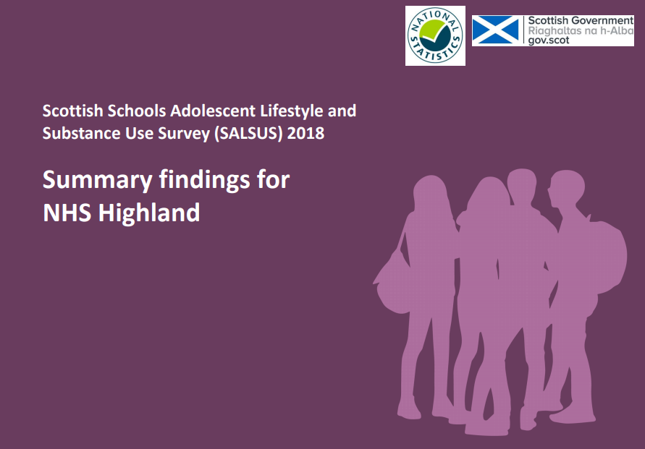

Slide 3
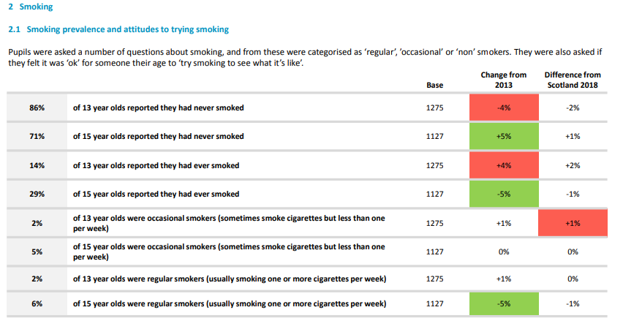
Smoking

Slide 4
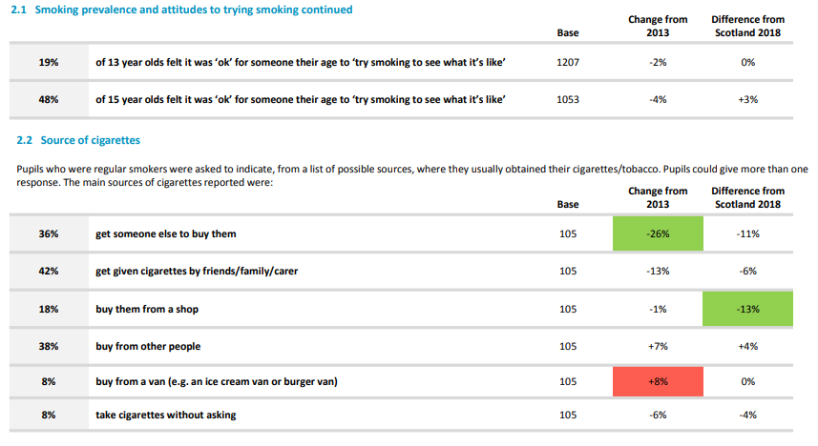

Slide 5
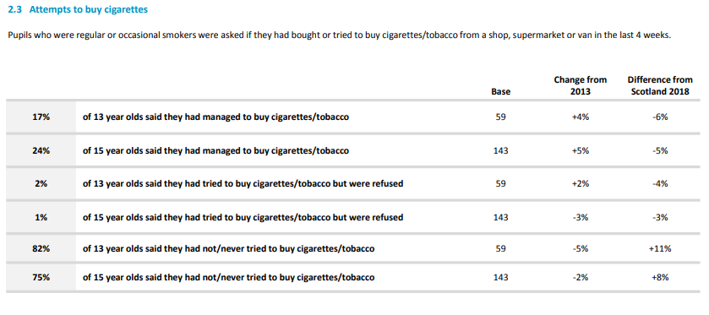

Slide 6
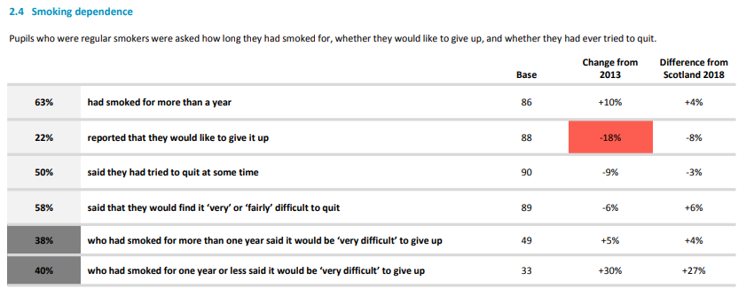

Slide 8
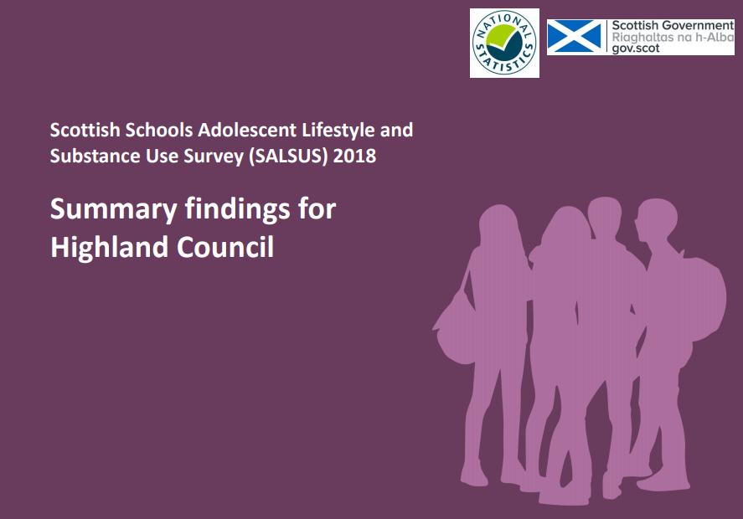

Slide 9
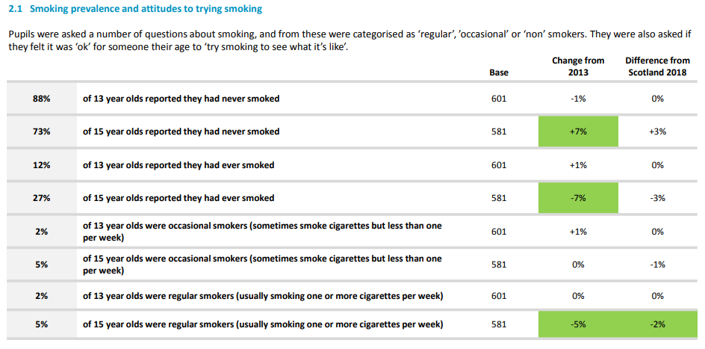
Smoking

Slide 10
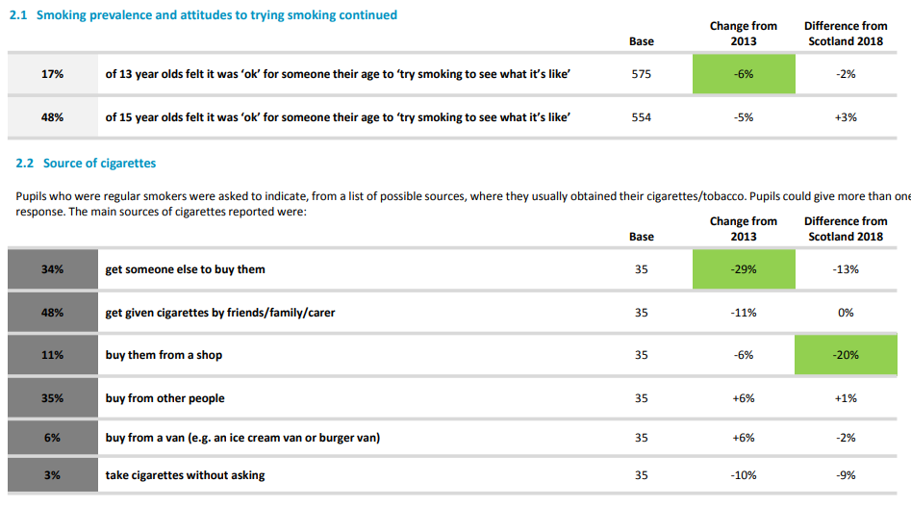

Slide 11
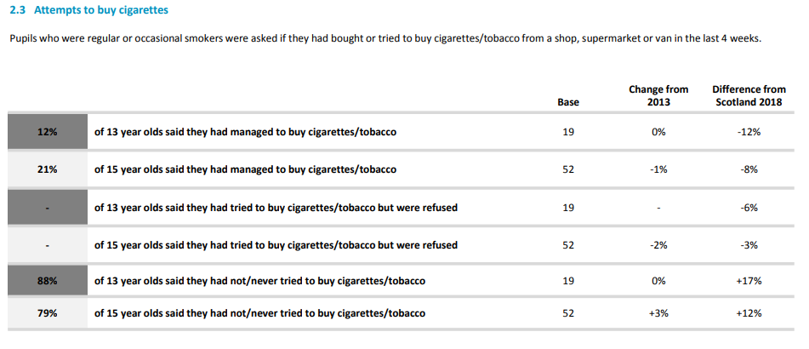

Slide 12
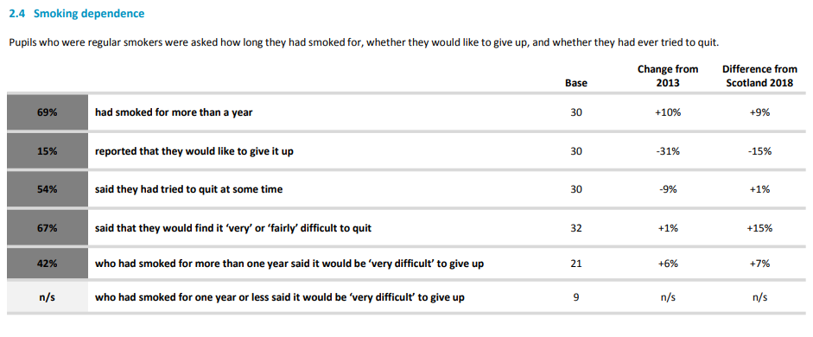

Slide 14
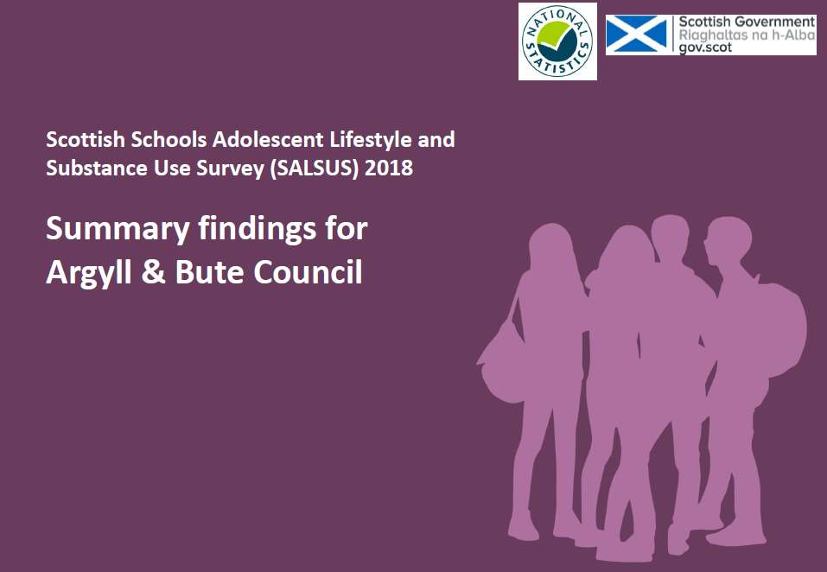

Slide 15
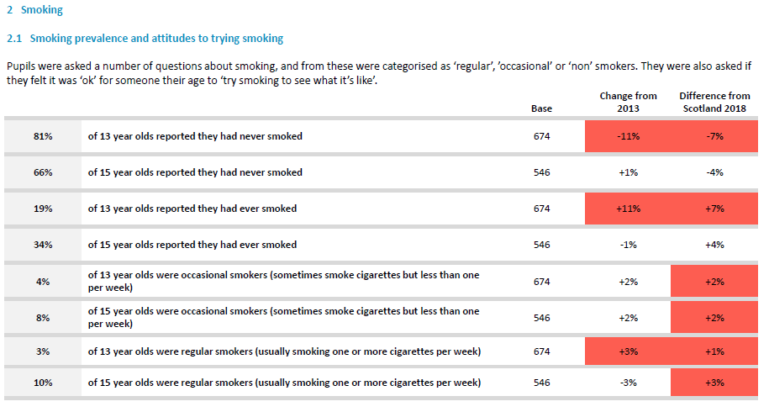

Slide 16
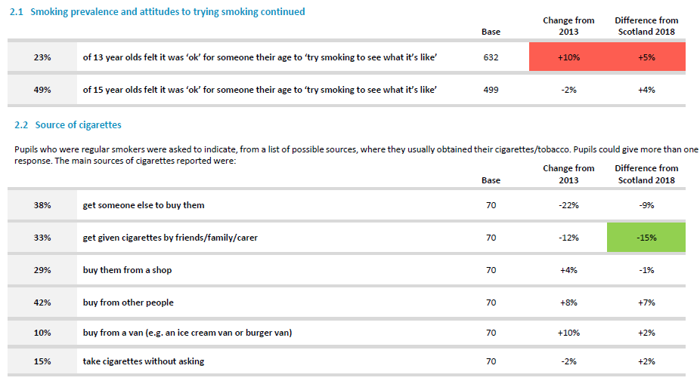

Slide 17
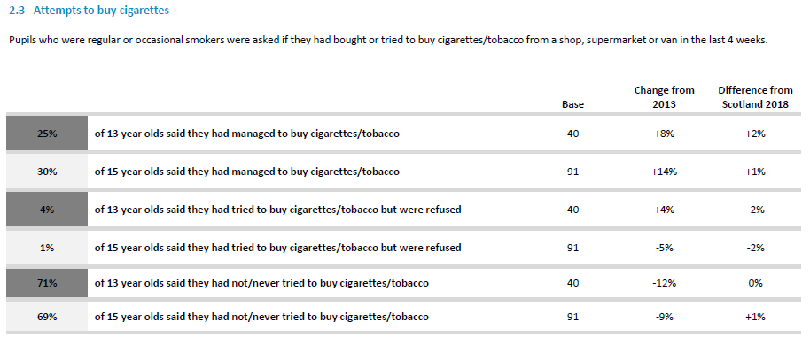

Slide 18
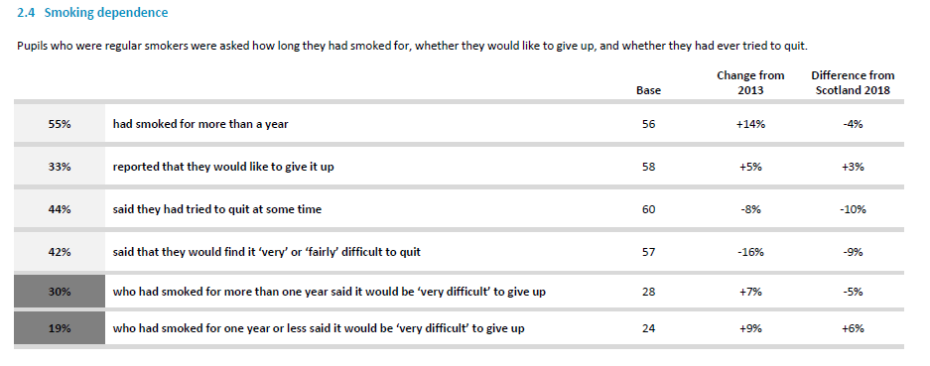

Slide 20
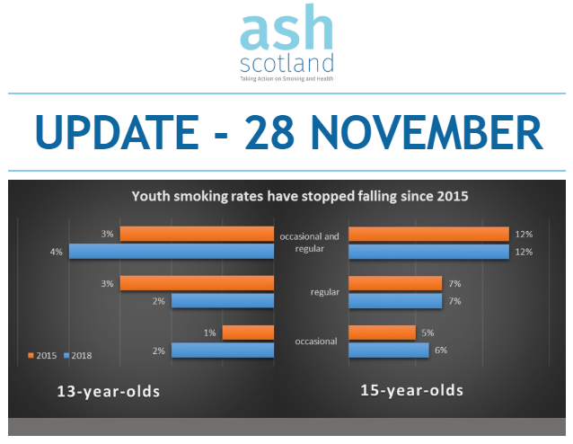
Notes:
This week Scottish Government published the Scottish Schools Adolescent Lifestyle and Substance Use Survey (SALSUS) 2018 which shows that smoking prevalence rates amongst 13 and 15 year olds have flatlined since 2015. These figures suggest that Scotland is in danger of missing its target for a tobacco-free generation by 2034 and that urgent action is required to tackle youth smoking.
In their Tobacco Action Control Plan 2018, Scottish Government set a target for the proportion of reported regular smokers among 13-15 year olds combined to be 3% or less by 2022 and today’s figures suggest that this target may be missed.

Slide 21
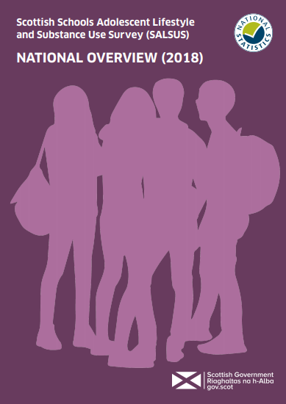
SALSUS

Slide 22
13 year olds
15 year olds

Slide 23
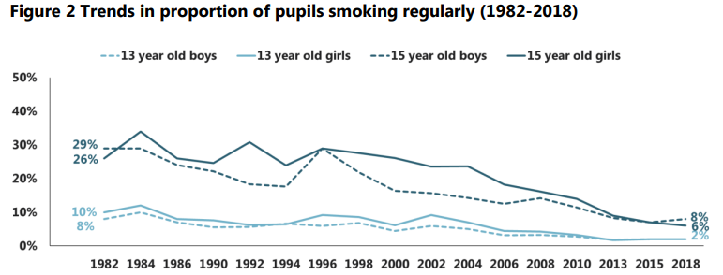

Slide 24
Average age 15 year olds first...

Slide 25
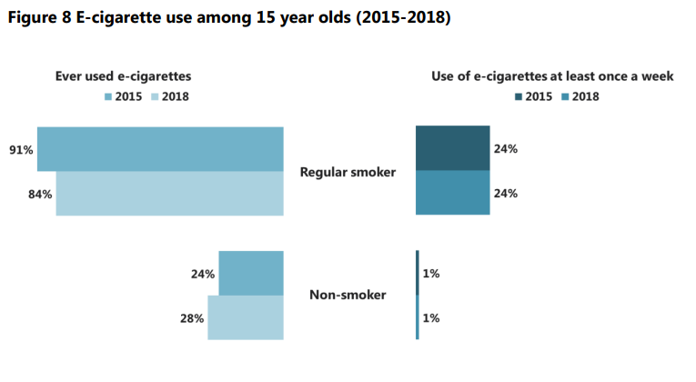

Slide 26
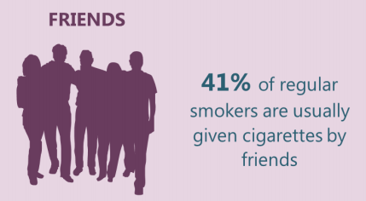
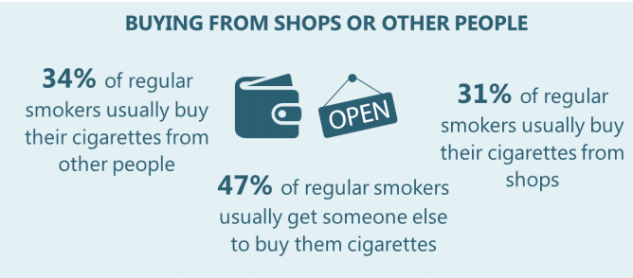
Most common sources

Slide 27
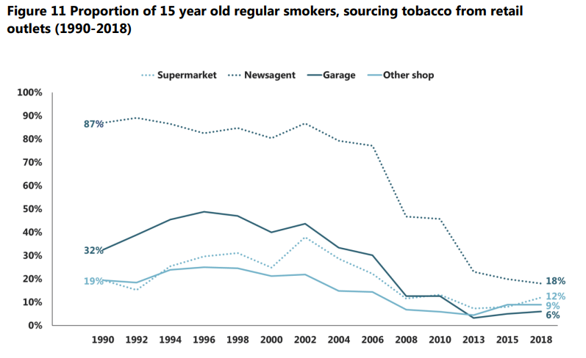

Slide 29
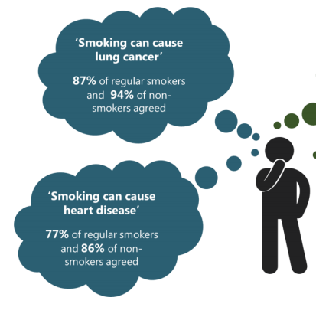

Slide 30
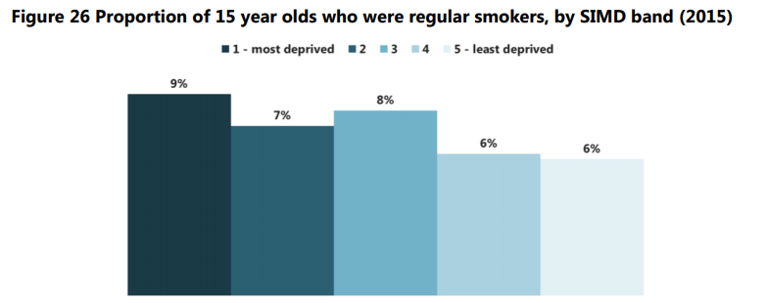

Slide 31
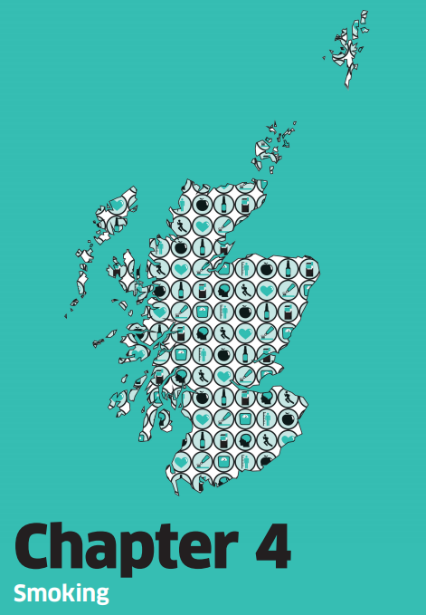
Scottish Health Survey

Slide 32
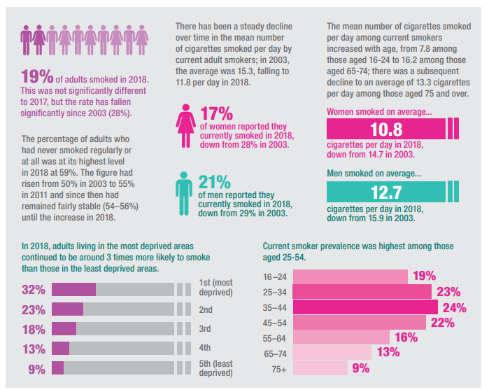
Notes:
In 2017 – prevalence 18%; has increased but not significantly

Slide 33
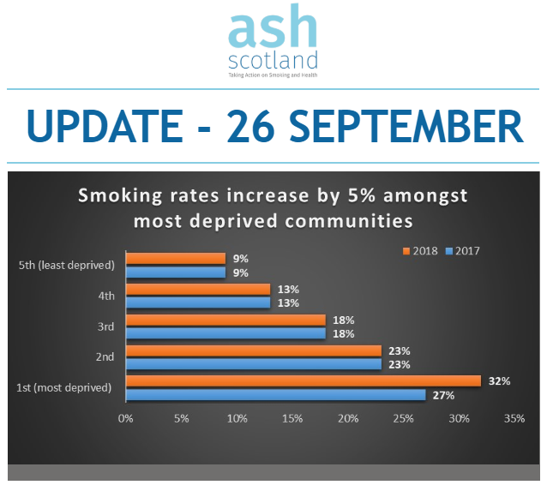
Notes:
Earlier this week Scottish Government published the Scottish Health Survey 2018 which shows that smoking prevalence rates across Scotland have flat-lined at 19% of the adult population (up 1% from 2017). However, there has been a concerning increase (5%) in the number of smokers in Scotland’s most disadvantaged communities. This means that people living in the most difficult circumstances are increasingly burdened by the health and financial harms caused by tobacco.

Slide 35
