Slide 1
Rainbow Laces 2019 a lesson pack from Stonewall
Reception and Key Stage 1 – England and Wales
P1 to P3 - Scotland
Notes:
Visit our website for the lesson plan to accompany this PowerPoint.

Slide 2
LO: To take turns in asking relevant questions

Slide 3
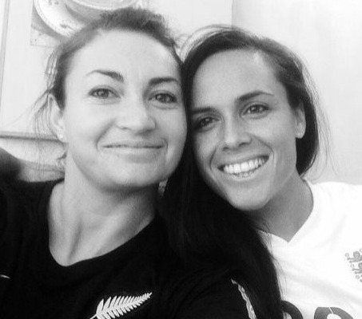
LO: To take turns in asking relevant questions
Emma
Jodie
Notes:
Show children a photo of Jodie Taylor and Emma Kete. Tell children that not only are they married, they do the same job as each other.

Slide 4
LO: To take turns in asking relevant questions
Can you guess what we both do for a job?
Notes:
Play ‘20 questions’ with the children. They should ask questions that help them work out what job Jodie Taylor and Emma Kete do.

Slide 5
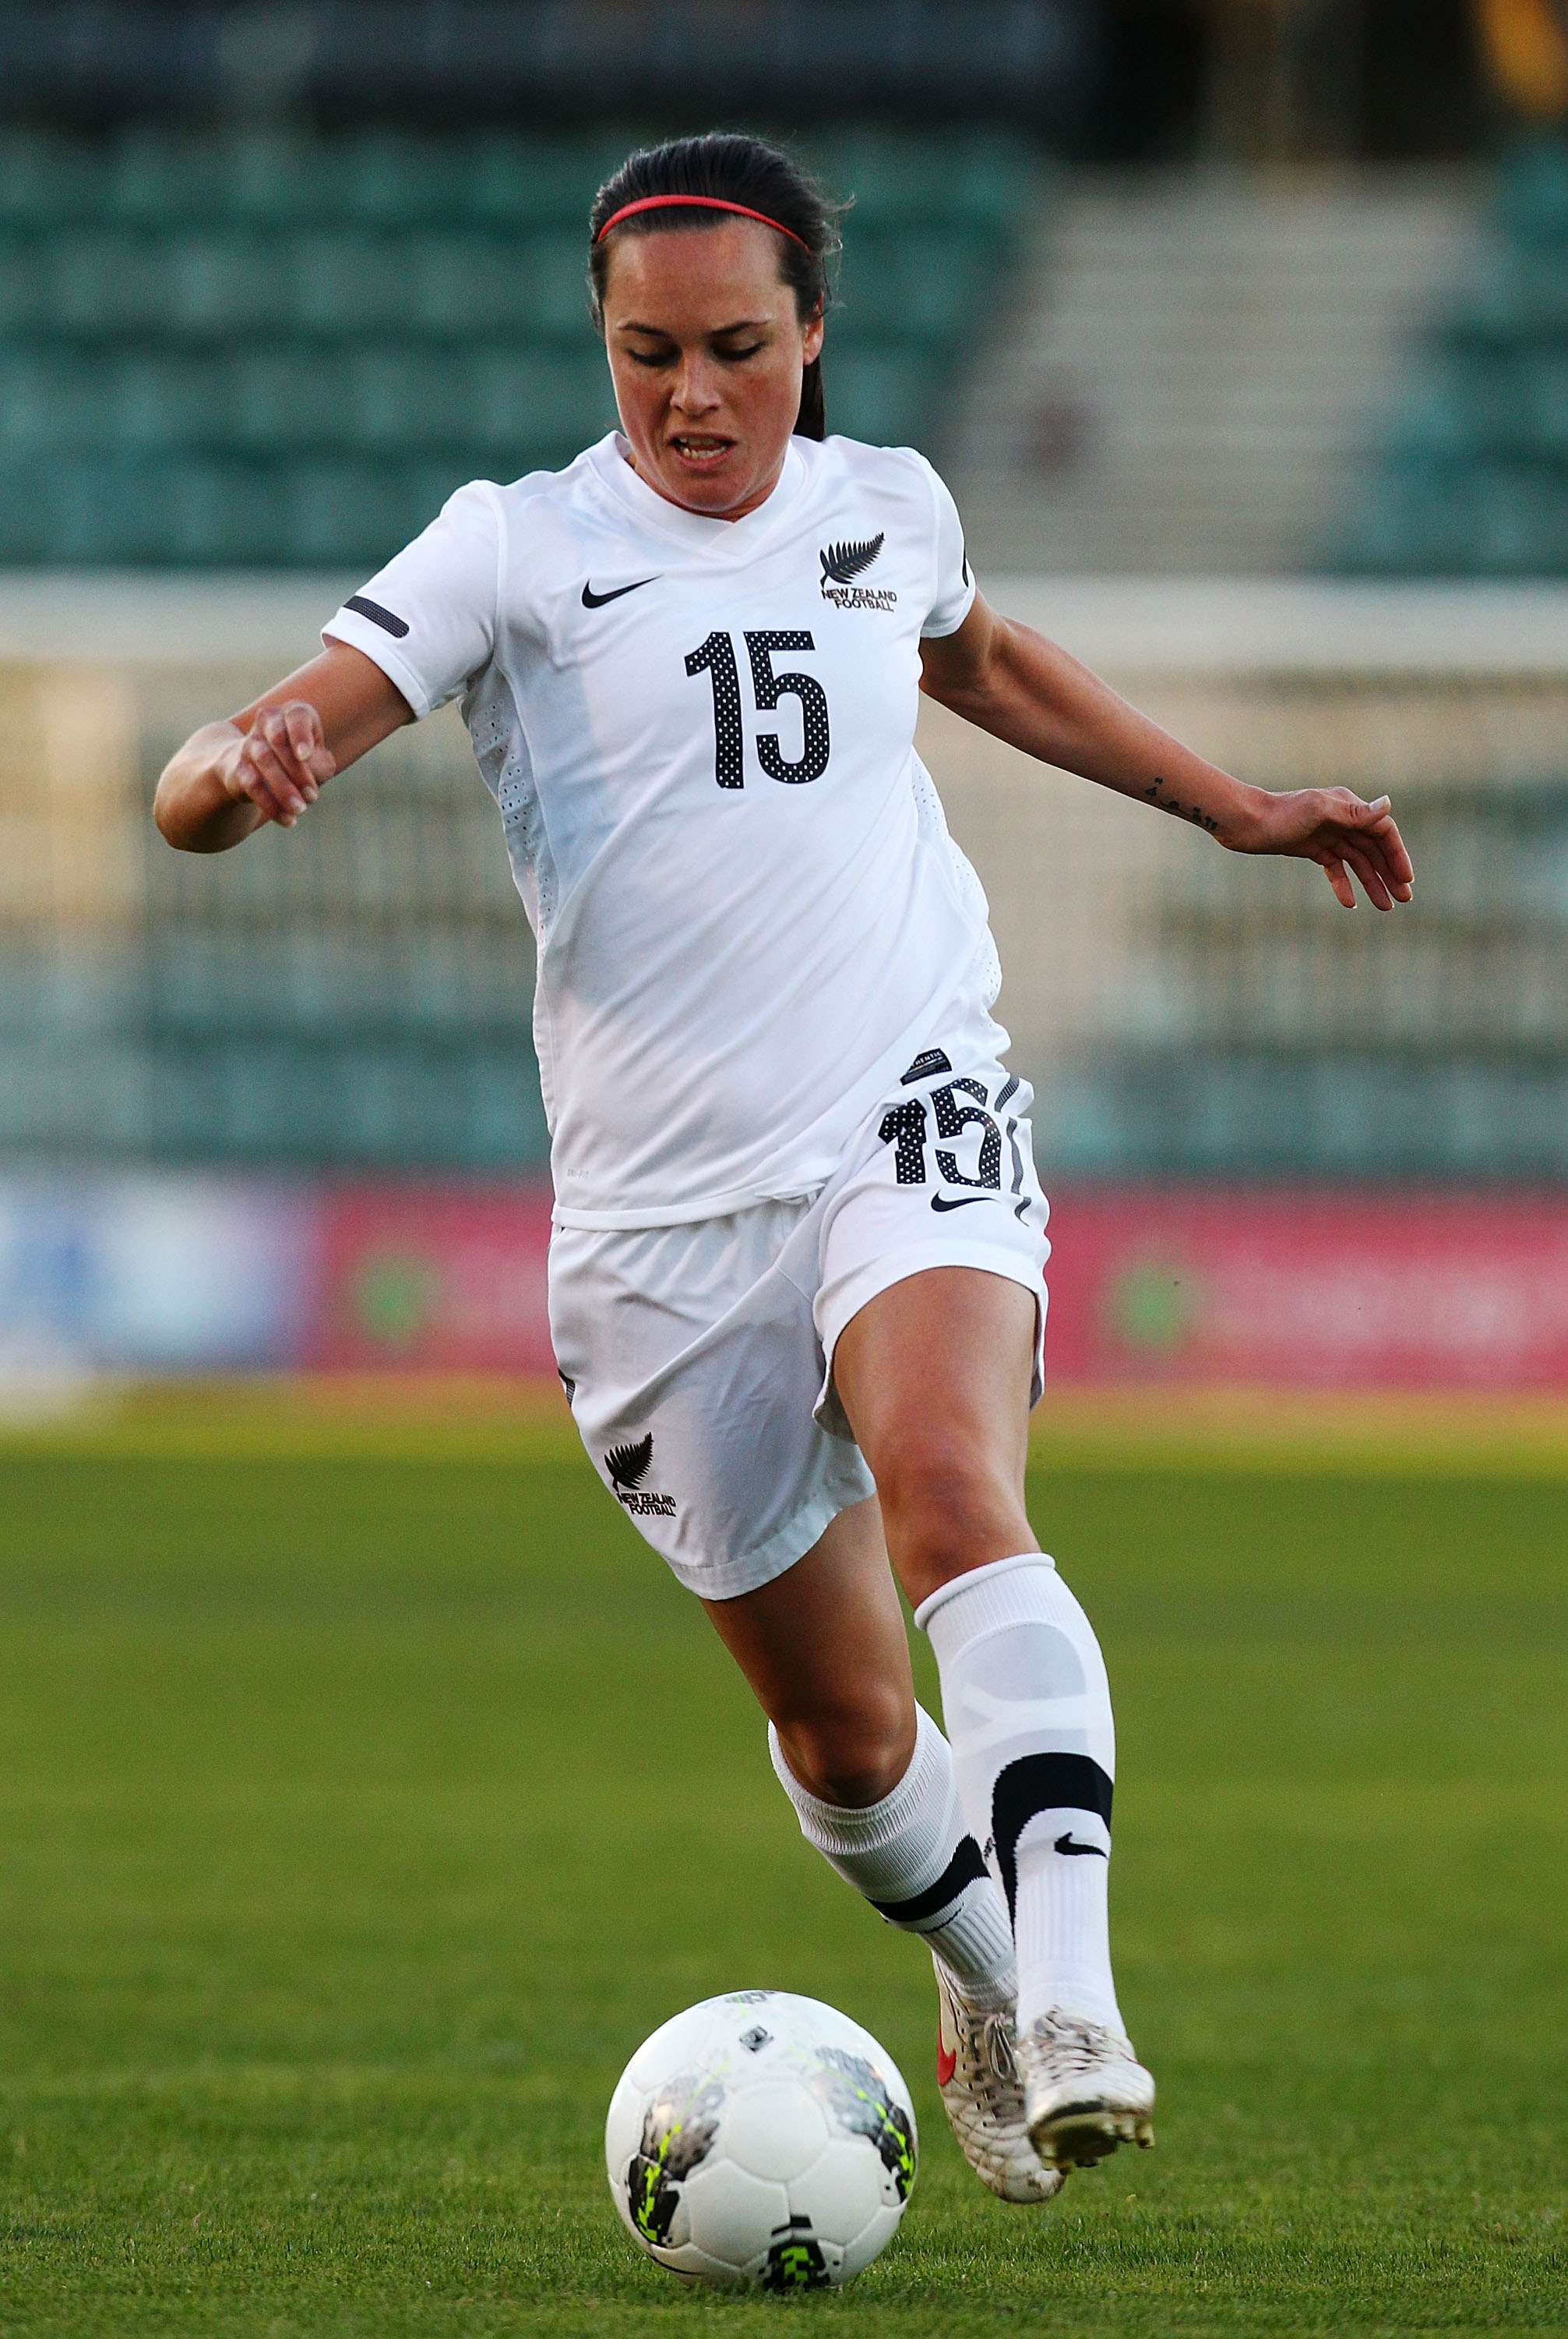
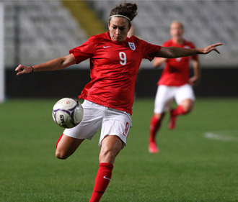
Emma Kete
Jodie Taylor
Notes:
Discuss that Jodie plays football for England and Emma plays football for New Zealand.
Explain that today we’re going to be like Jodie and Emma and practice our football skills.

Slide 6
Notes:
Children get changed for PE.

