Slide 1
S1 describing people
To be able to describe your personality
To be able to describe your hair and eyes
To be able to describe someone else – personality
To be able to describe someone else
hair and eyes
To be able to describe yourself and others –
Personality, hair and eyes
To use little important words like ‘very’
Notes:
1

Slide 2
S1 describing people
Today
revise talking about your eye/ hair colour
revise talking about hair length
3 reading skills – decoding with familiar and unfamiliar sentences
Notes:
2

Slide 3
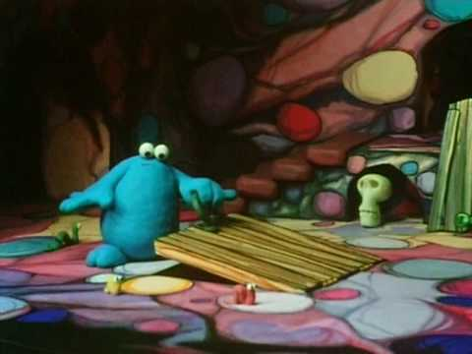
bleus
verts
gris
marron
La trappe
J’ai les yeux
J’ai les cheveux
blonds
noirs
bruns
roux
et
longs
courts
mi-longs
et
raides
frisés
Notes:
trap door activity – do as paired activity or whole class

Slide 4
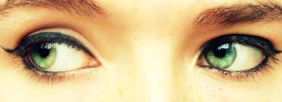
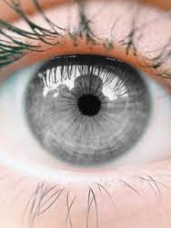
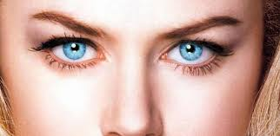
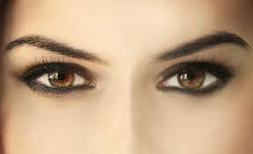
Tu as les yeux de quelle couleur?
a J’ai les yeux verts
b J’ai les yeux gris
c J’ai les yeux bleus
d J’ai les yeux marron
a
b
c
d
Notes:
revise so far

Slide 5
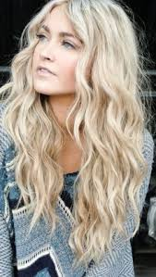
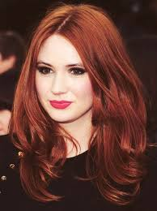
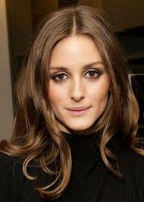
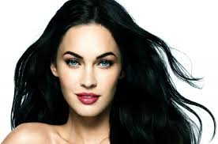
Tu as les cheveux de quelle couleur?
J’ai les cheveux blonds
J’ai les cheveux roux
J’ai les cheveux bruns
J’ai les cheveux noirs
a
b
c
d
Notes:
revise again

Slide 6
J’ai les yeux
J’ai les cheveux
6. longs
7. courts
mi-longs
blonds
raides
Frisés
Noirs
Roux
bruns
bleus
verts
noirs
marron
gris
Notes:
revise long/ short etc

Slide 7
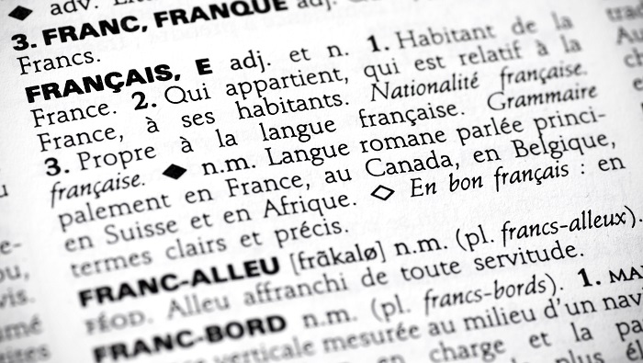
Reading skills

Slide 8
Reading skills
Aims of activity
To understand familiar language
To understand unfamiliar language using strategies
To create a glossary of useful new words in French and English in your jotter

Slide 9
Tu es comment?
Instructions
With your partner, work out what your text box means in English
With your partner, make up a glossary of useful new phrases you have learned to share with others in your group
With your group, make sure you have all the new phrases your group has discovered in your jotter in French and English
Draw the faces that your group has worked on
Notes:
Give out a text box per pair. Class follows the instructions above

Slide 10
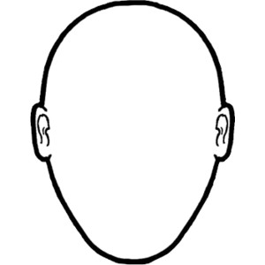
Tu es comment?
J’ai les cheveux longs, blonds et raides et j’ai les yeux bruns. J’ai un grand nez pointu et une assez grande bouche.
J’ai des taches de rousseur sur les joues.
J’ai les cheveux raides, mi-longs et marron et j’ai de grands yeux verts. J’ai un petit nez rond et une assez grande bouche.
J’ai les cheveux courts, noirs et bouclés et j’ai de petits yeux bleus. J’ai un nez moyen et une assez petite bouche. Je porte de grands boucles d’oreille en or.
J’ai les cheveux très courts et gris et j’ai de grands yeux noirs. J’ai une petite barbe grise et j’ai des lunettes noires. J’ai aussi un bouton sur le nez.
Notes:
Go over text boxes in English

Slide 11
S1 describing people
Today
revise talking about your eye/ hair colour
revise talking about hair length
3 reading skills – decoding with familiar and unfamiliar sentences
What skills have you used today?
What have those skills helped you to do?
Notes:
11

