Slide 1

S1 describing people
To be able to describe your personality
To be able to describe your hair and eyes
To be able to describe someone else – personality
To be able to describe someone else
hair and eyes
To be able to describe yourself and others –
Personality, hair and eyes
To use little important words like ‘very’
Notes:
1

Slide 2
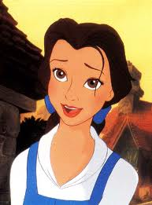
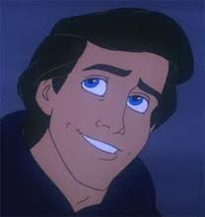
Tu as les yeux de quelle couleur?
J’ai les yeux bruns. Et toi?
J’ai les yeux bleus.

Slide 3
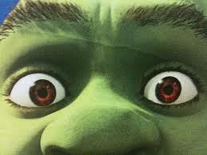
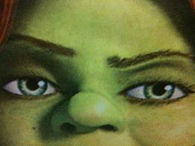
Tu as les yeux de quelle couleur?
J’ai les yeux marron.
J’ai les yeux verts.

Slide 4
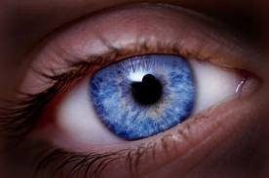

Slide 5
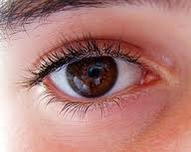

Slide 6
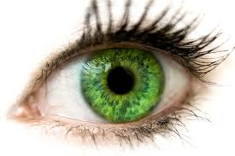

Slide 7
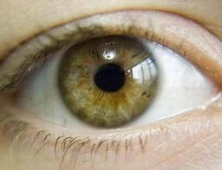

Slide 8
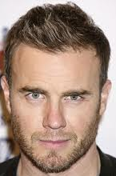
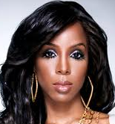
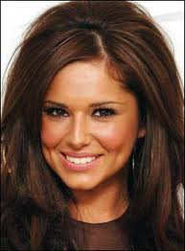
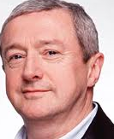
Tu as les cheveux de quelle couleur?
J’ai les cheveux bruns. Et toi Kelly?
J’ai les cheveux noirs. Et toi Cheryl?
J’ai les cheveux bruns. Et toi Louis?
J’ai les cheveux gris.

Slide 9
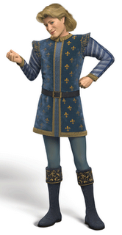
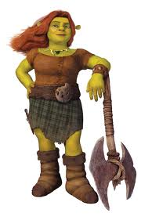
Tu as les cheveux de quelle couleur?
J’ai les cheveux roux. Et toi?
Moi, j’ai les cheveux blonds.

Slide 10
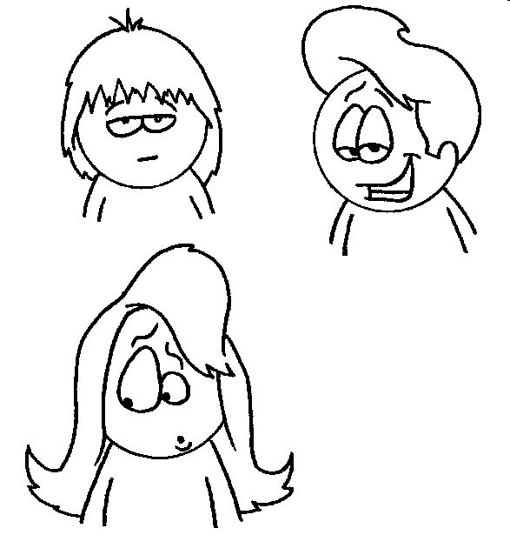
Styles
J’ai les cheveux…
Mi-longs
Courts
Longs

Slide 11
Styles
Mi-longs
Courts
Longs

Slide 12
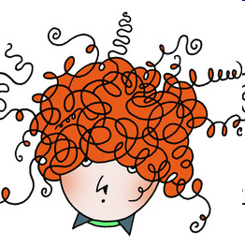
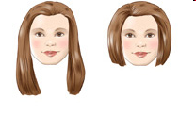

Styles
Raides
Ondulés
Frisés
/
Bouclés

Slide 13
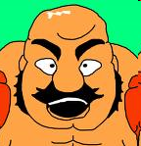
Styles
Je suis chauve
/
Je n’ai pas de cheveux

Slide 14


How do we describe other people?
We use he/ she
J’ai
I have
Il a
He has
Elle a
She has

Slide 15
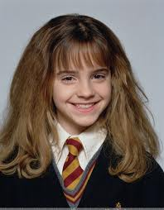
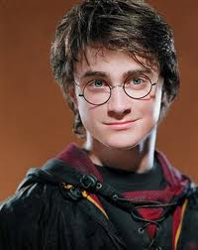
Elle a les cheveux bruns
Et les yeux marron.
Il a les cheveux bruns
et les yeux verts.

Slide 16







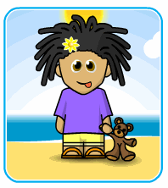
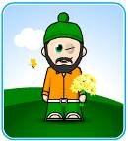

Describing people
These sentences say what someone looks like, but the words are in the wrong order. Can you put them right?
e.g. cheveux il bruns les a → il a les cheveux bruns
1. elle yeux a les bleus
2. cheveux les roux a il
3. j’ai les verts yeux
4. il a cheveux courts les bruns et
5. elle longs les cheveux et noirs a
6. cheveux il mi-longs et raides les a blonds

Slide 17
Corrigez!
1. Elle a les yeux bleus.
2. Il a les cheveux roux.
3. J’ai les yeux verts.
4. Il a les cheveux courts et bruns.
5. Elle a les cheveux longs et noirs.
6. Il a les cheveux mi-longs raides et blonds.

Slide 18






Hair & eye colour
Pick at least 3 of these people and write a sentence to say what their hair & eyes are like
Extension:
Can you add some more details (which you invent) to work on a higher level?
Exemple: Il a les cheveux bruns et les yeux bleus. Il est anglais. Il a un chat noir.

Slide 19
Hair & eye colour
Pick at least 3 of these people and write a sentence to say what their hair & eyes are like
e.g. il a les cheveux bruns et les yeux bleus
e.g. il a les cheveux courts, raides et bruns et les yeux bleus
bruns marron
noirs gris
verts bleus
il a = he has les cheveux = hair
elle a = she has les yeux = eyes

Slide 20


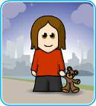

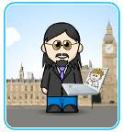
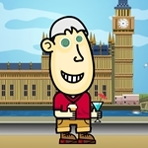



A
B
C
D
E
F
1
2
3
4
Notes:
Play guess who – someone chooses a person but doesn’t say who. The class ask questions to narrow it down to one person.

Slide 21
S1 describing people
To be able to describe your personality
To be able to describe your hair and eyes
To be able to describe someone else – personality
To be able to describe someone else
hair and eyes
To be able to describe yourself and others –
Personality, hair and eyes
To use little important words like ‘very’
Notes:
21

