Slide 1
Concrete materials
Wednesday 28th November 2018

Slide 2
Making maths count
Transforming public attitudes to maths;
Improving confidence and fluency in maths;
Promoting the value of maths as an essential skill for every career.

Slide 3
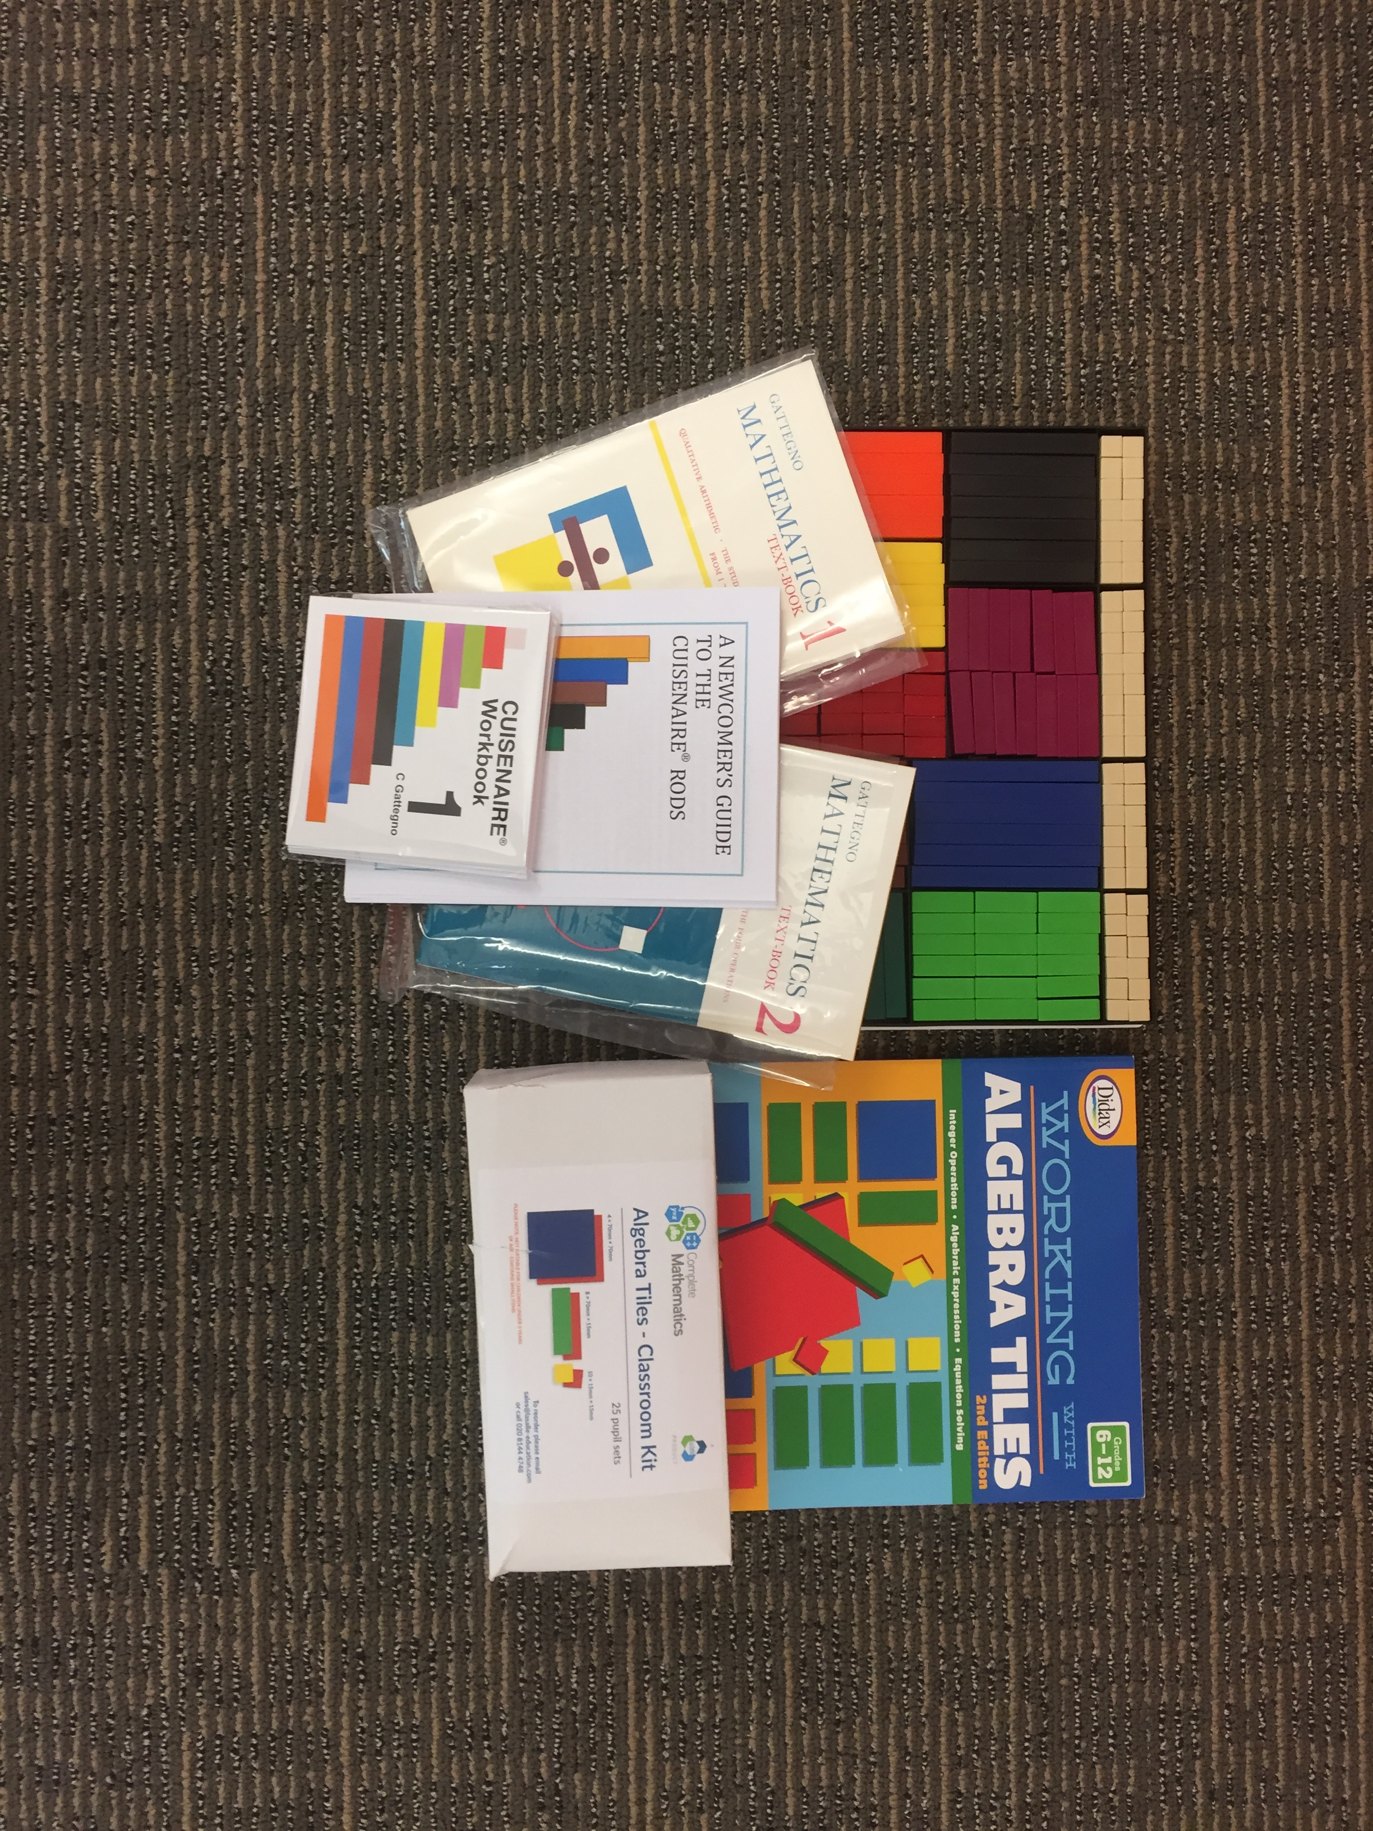
National Numeracy hub champion action plans
Project Rationale:
Using concrete materials to enhance the teaching and learning of numeracy and mathematics at the secondary stage.
Aims:
Practitioners in our secondary schools will engage with current research into the benefits of using manipulatives at all stages of learning in numeracy and mathematics and use this
knowledge to enhance their teaching practices with pupils in S1 and S1. Additionally, there will be an increase in engagement and enjoyment of numeracy and mathematics as a result of this project.

Slide 4
Northern alliance numeracy – key aims
1. Develop teacher confidence, professional understanding and leadership in relation to numeracy and secondary maths attainment;
2. To improve the numeracy levels of pupils and improve attainment in S4 maths.

Slide 5
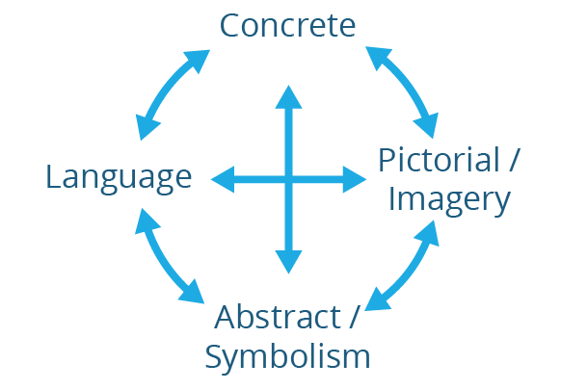
Connecting the learning

Slide 8
Application
Conceptual
Understanding
Procedural
Fluency

Slide 9
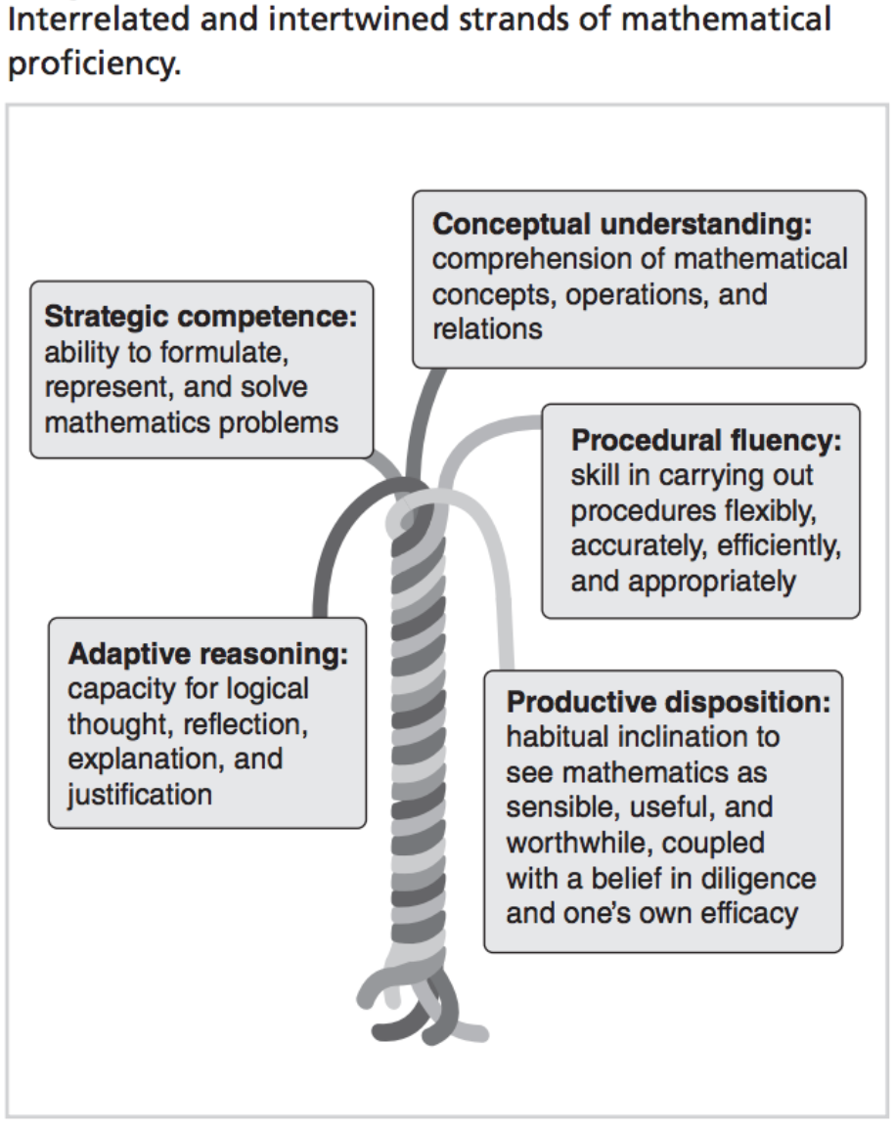
Kilpatrick, Swafford, Findell - 2001 - Adding It Up Helping Children Learn Mathematics

Slide 10
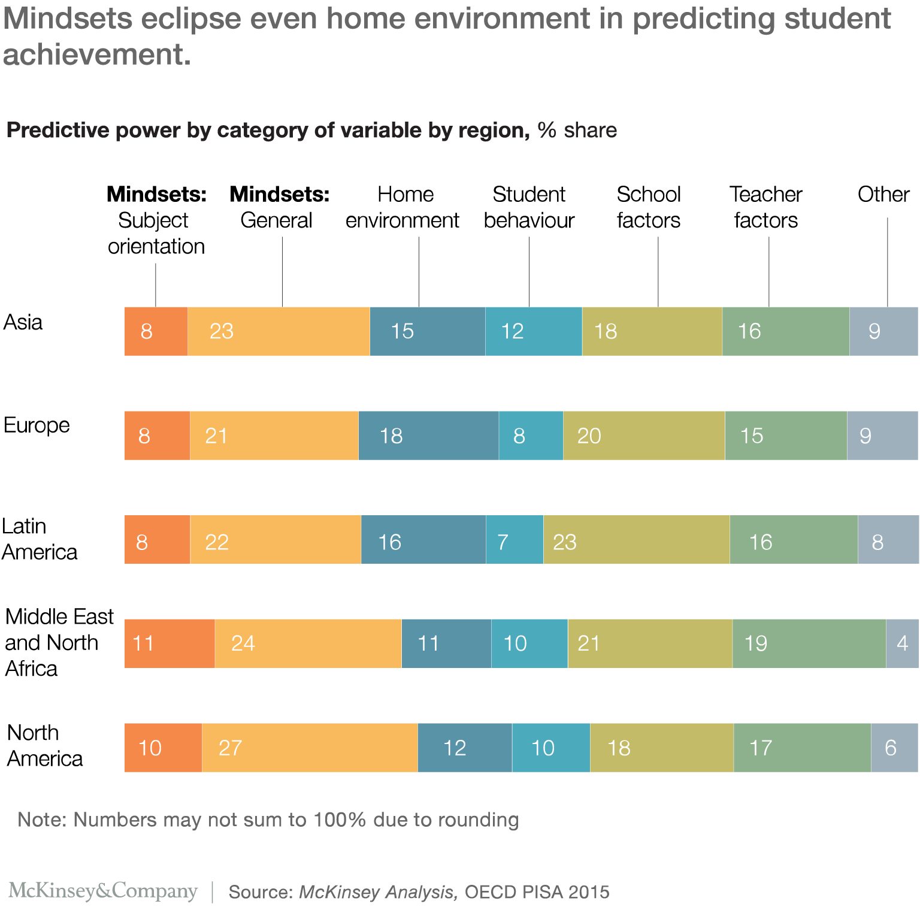

Slide 11
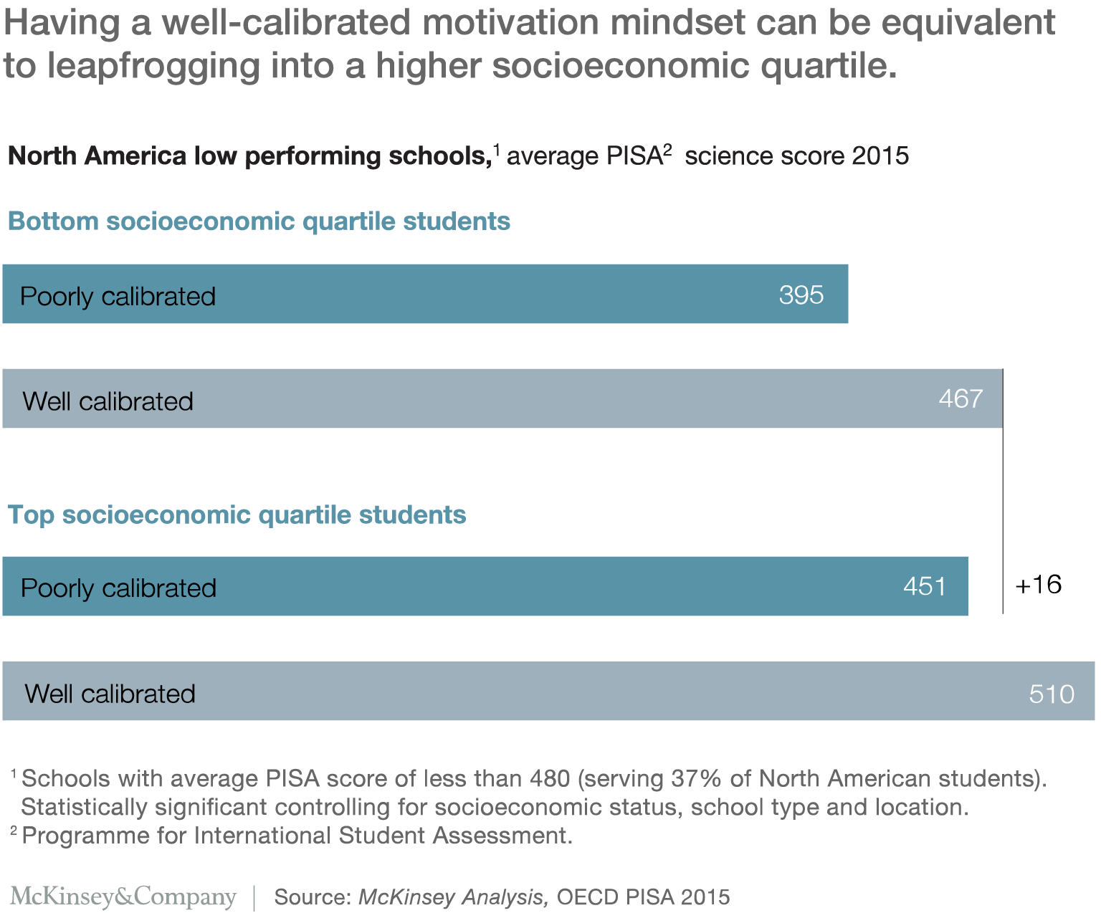

Slide 13
Cuisenaire Rods

Slide 14
Cuisenaire Rods
b = g + y
o = 5r

Slide 15
Cuisenaire Rods
7 + 3 + 4
10 + 4

Slide 16
Cuisenaire Rods
4 + 8 + 3
4 + 8 + 3 = 4 + 6 + 2 + 3
= 10 + 5 = 15

Slide 17
Cuisenaire Rods
9 – 4 = 5
or
What is the difference?

Slide 18
Cuisenaire Rods
6 × 4 = 4 × 6

Slide 19
Cuisenaire Rods
12 × 4 = 48

Slide 20
Cuisenaire Rods
12 × 13 = 156

Slide 21
Cuisenaire rods and fractions
Another approach could be to call a different rod to the white rod “one”.
This is one of the powerful things about Cuisenaire rods, that “the white rod isn’t always, and shouldn’t always be, one”.
Lets designate the pink rod as “one”: What will all of the other rods be equal to?

Slide 23
Cuisenaire Rods
Notes:
Which triangles can be made? Which ones can’t? Why? Is there a rule? Which ones make right angles? Are the lengths connected?

Slide 24
Cuisenaire Rods
Notes:
Pythagoras Theorem.

Slide 26
Learning Intention
Success Criteria
Today we are going to be learning about:
Introducing algebra tiles into maths lessons.
I can use algebra tiles to:
Model integer problems; and
Solve equations.

Slide 27
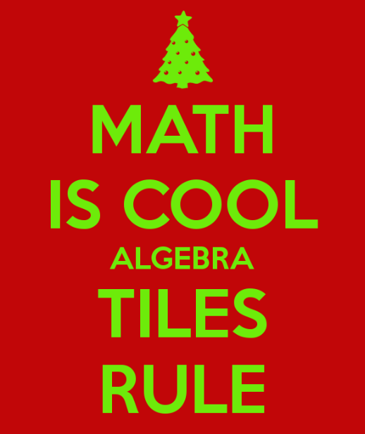

Slide 28
Yellow is positive 1
Red is negative 1

Slide 29
Yellow and red together eliminate each other, become zero, explode!
Yellow + Red = 0

Slide 30
Modelling Numbers

Slide 31
Model the number 7 with your tiles

Slide 32
Model the number 7 with 9 tiles

Slide 33
Adding ‘zero’ does not change a value.

Slide 34
Adding Numbers

Slide 35
3 + 2
= 5

Slide 36
5 + 4
= 9

Slide 37
(-3) + 6

Slide 38
(-3) + 6
= 3

Slide 39
(-4) + 3

Slide 40
(-4) + 3
= -1

Slide 41
Subtracting Numbers

Slide 42
Subtracting is addition of directed numbers
4 – 5
= 4 + (-5)

Slide 43
4 – 5 = 4 + (-5)

Slide 44
4 – 5 = 4 + (-5)
= -1

Slide 45
Always add in, never take anything out.

Slide 46
5 – 2 = 5 + (-2)

Slide 47
5 – 2 = 5 + (-2)
= 3

Slide 48
-6 – 5 = (-6) + (-5)
= -11

Slide 49
-3 – 4 = (-3) + (-4)
= -7

Slide 50
5 – (-2) =

Slide 51
5 – (-2)
= 7

Slide 52
2 – (-3) =

Slide 53
2 – (-3)
= 5

Slide 54
Multiplying Numbers

Slide 55
2 x 3
Means
Add 2 groups of 3 yellow tiles

Slide 56
2 x 3
= 6

Slide 57
2 x (-3)
Means
Add 2 groups of 3 red tiles

Slide 58
2 x (-3)
= -6

Slide 59
(-2) x 3
Means
Remove 2 groups of 3 yellow tiles
Or
2 groups of 3 yellow tiles flipped

Slide 60
(-2) x 3

Slide 61
(-2) x 3
= -6

Slide 62
(-2) x (-3)
Means
Remove 2 groups of 3 red tiles
Or
2 groups of 3 red tiles flipped

Slide 63
(-2) x (-3)

Slide 64
(-2) x (-3)
= 6

Slide 65
Solving One-Step Equations

Slide 67
Green is positive x
Red is negative x

Slide 68
Green and red together eliminate each other, become zero, explode!
Green + Red = 0

Slide 69
2x = 4

Slide 70
x = 2
x = 2

Slide 71
3x = -9

Slide 72
x = -3
x = -3
x = -3

Slide 73
-4x = 8
-x = 2
-x = 2
-x = 2
-x = 2

Slide 74
Flip the tiles
x = -2
x = -2
x = -2
x = -2

Slide 75
x + 4 =
7

Slide 76
x = 3

Slide 77
Keep the equation balanced
Whatever you do to one side you do to the other

Slide 78
x - 5 =
-4

Slide 79
x = 1

Slide 80
Solving Two-Step Equations

Slide 81
Keep the equation balanced
Whatever you do to one side you do to the other

Slide 82
2x - 1 = 5

Slide 83
2x = 6

Slide 84
x = 3
x = 3

Slide 85
-3x + 2 = -4

Slide 86
-3x = -6

Slide 87
-x = -2
-x = -2
-x = -2

Slide 88
Flip the tiles
x = 2
x = 2
x = 2

Slide 89
Solving Multi-Step Equations

Slide 90
Keep the equation balanced
Whatever you do to one side you do to the other

Slide 91
3x + 1 = x + 5

Slide 92
3x = x + 4

Slide 93
3x = x + 4

Slide 94
2x = 4

Slide 95
x = 2
x = 2

Slide 96
Other Modelling with Algebra Tiles

Slide 97
Place Value
124 =
Hundreds
Tens
Units
1 Hundred
2 Tens
4 Units

Slide 98
Long Division
1 x 100
2 x 10
4 x 10
8 x 1
168 $÷$ 12
= 14

Slide 99
Substitution
2x – 4 when x = 3
= 2

Slide 100
Factorising Trinomials
3x² + 8x + 4 =
(3x + 2) (x + 2)

Slide 101
Completing the Square
(x + 2) ² - 1
x² + 4x + 3 =

Slide 102
Dividing Polynomials
2x² + 5x + 3 $÷$ (x + 1) =
(2x + 3)

Slide 103
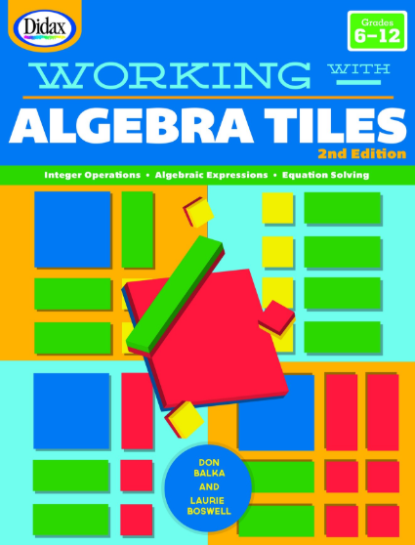
Help and ideas…..

Slide 104
Any questions?

