Slide 1



Concrete, Pictorial, Abstract, Language
A CPD day from

Slide 2
Mark McCourt
@EmathsUK
La Salle Education
@LaSalleEd

Slide 3
Six interconnected, though not dependent, days…
Mastery in Mathematics
Concrete, Pictorial, Abstract, Language
Bar Modelling
Deeper Understanding in Mathematics
Embedding Problem Solving in Mathematics
Making Maths Memorable - Lessons for Cognitive Science

Slide 4
0930 - 1030 Welcome, Introduction and Cuisenaire Rods
1030 - 1115 Bar modelling
1115 - 1130 Coffee break
1130 - 1230 Algebra tiles
1230 - 1315 Lunch
1315 - 1415 Approaches to equations
1415 - 1515 Using paper
1515 - 1530 Any questions and farewells

Slide 5
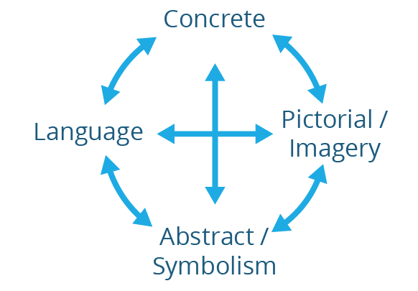
Connecting the learning

Slide 6
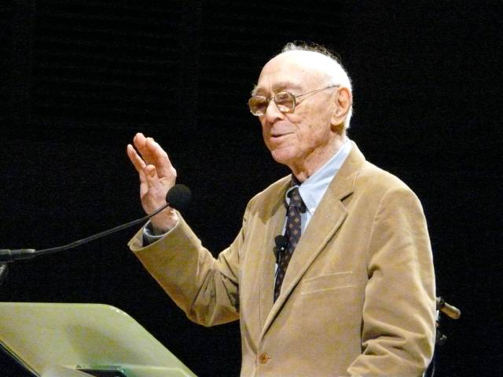
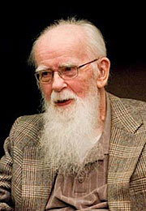
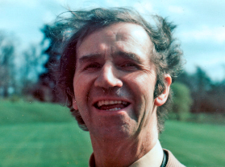
Jerome Bruner American (1915 –2016)
Concrete – Pictorial – Abstract (E-S-I)
Zoltan Dienes
Variation Theory Hungarian (1916– 2014)
Richard Skemp
Conceptual and procedural understanding British (1919 – 1995)
Notes:
Only briefly mention these theories as we will work on each in more depth illustrating with hands on activities.
Children need to be both procedurally and conceptually fluent – they need to know both how and why. Children who engage in a lot of practice without understanding what they are doing often forget, or remember incorrectly those procedures. Further, there is growing evidence that once students have memorised and practised procedures without understanding, they have difficulty learning later to bring meaning to their work (Stigler. Hiebert 19990

Slide 7
Application
Conceptual
Understanding
Procedural
Fluency

Slide 8
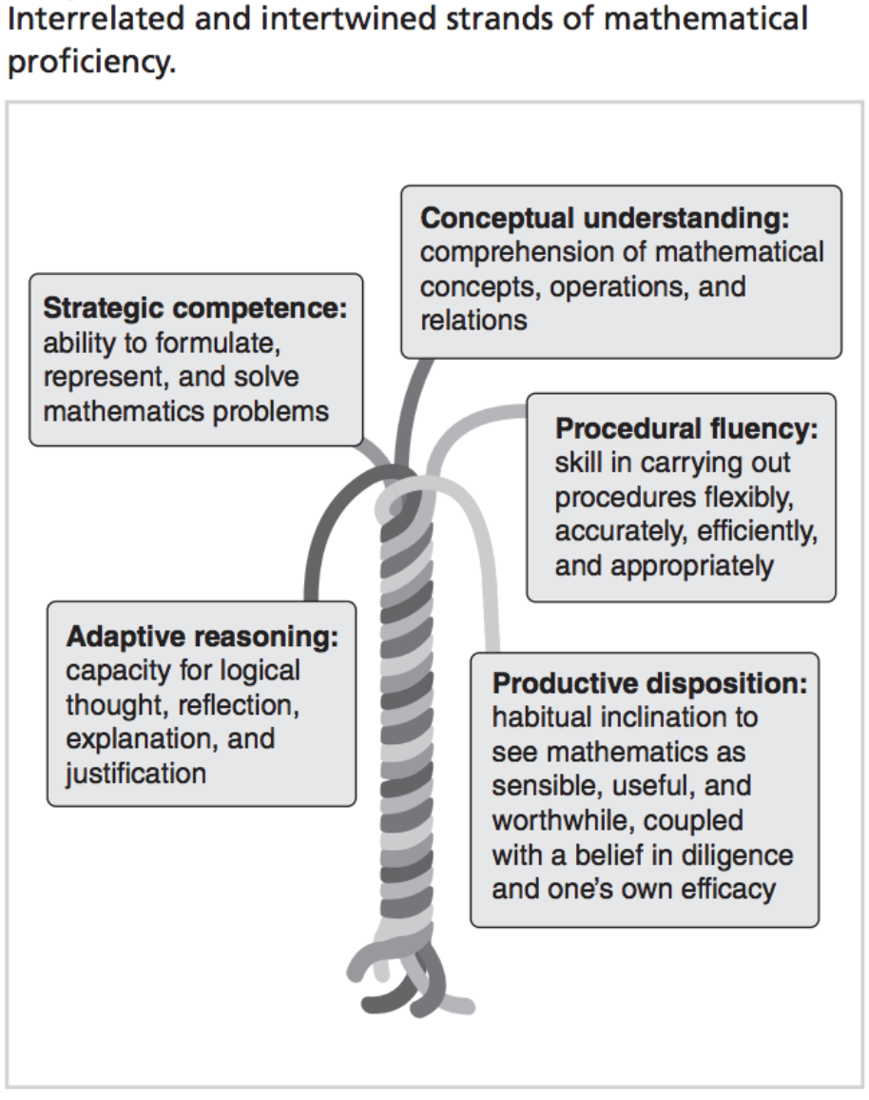
Kilpatrick, Swafford, Findell - 2001 - Adding It Up Helping Children Learn Mathematics

Slide 9
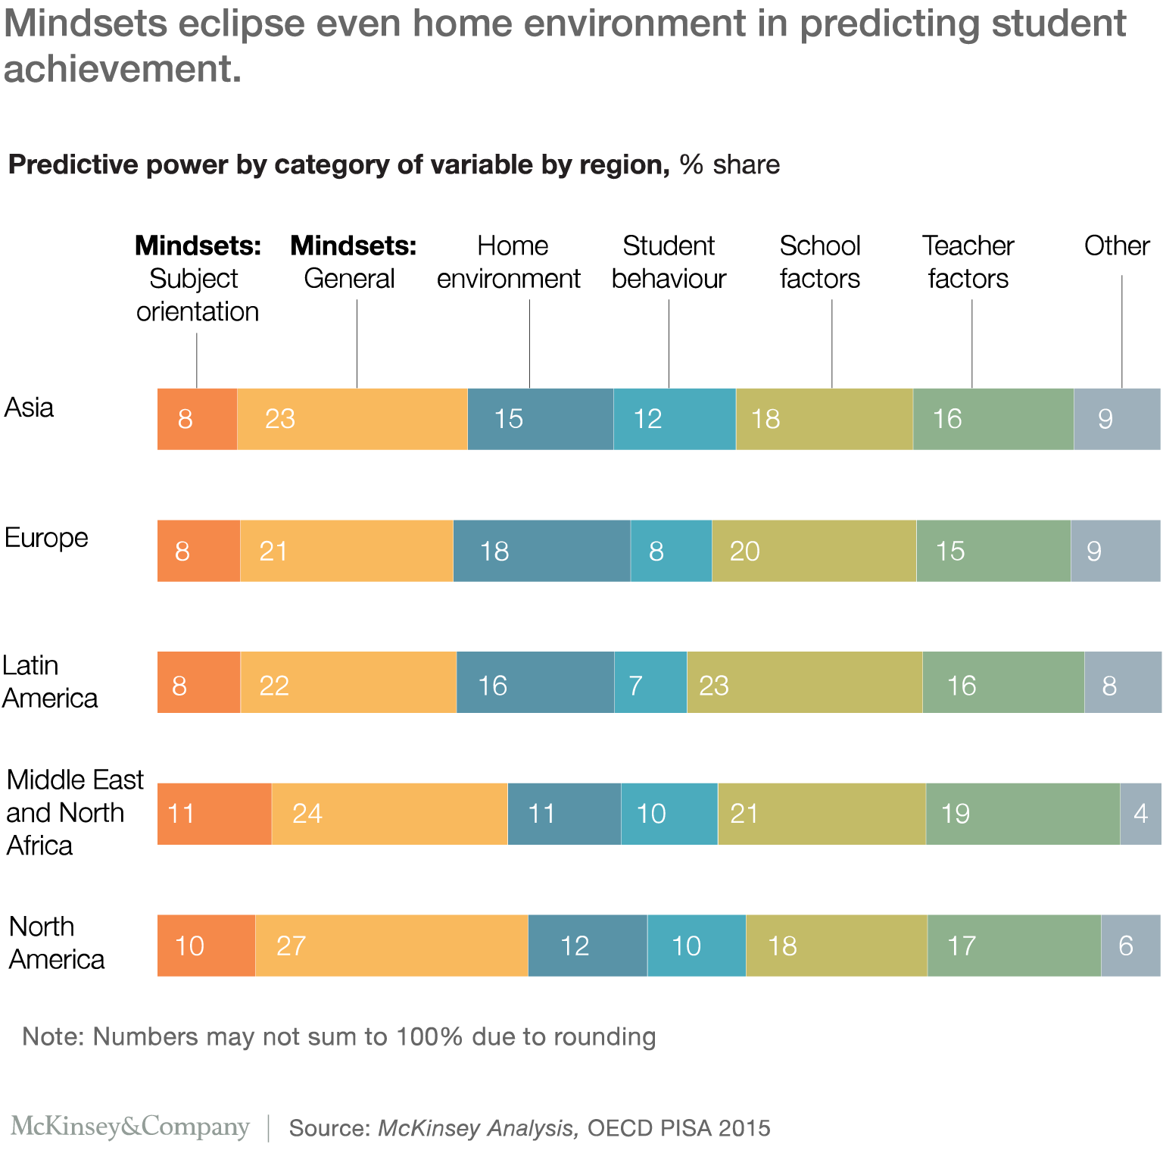

Slide 10
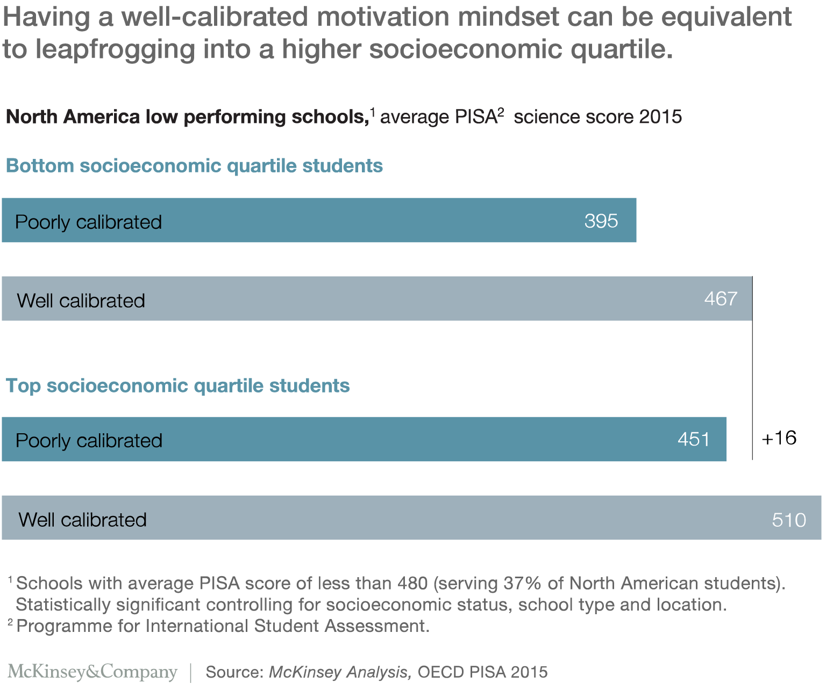

Slide 11
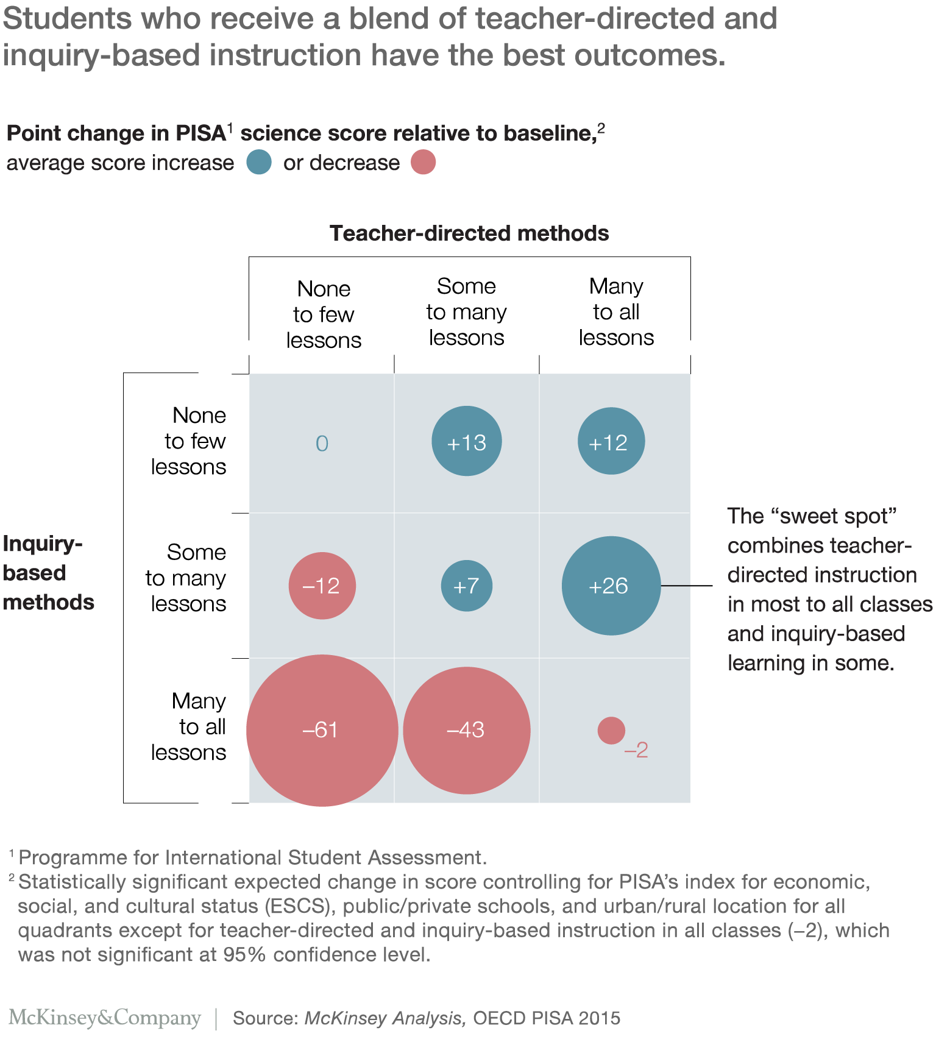

Slide 12
Cuisenaire Rods
22
12
10
6
4

Slide 13
Cuisenaire Rods

Slide 14
Cuisenaire Rods
b = g + y
o = 5r

Slide 15
Cuisenaire Rods
7 + 3 + 4
10 + 4

Slide 16
Cuisenaire Rods
4 + 8 + 3
4 + 8 + 3 = 4 + 6 + 2 + 3
= 10 + 5 = 15

Slide 17
Cuisenaire Rods
9 – 4 = 5
or
What is the difference?

Slide 18
Cuisenaire Rods
6 × 4 = 4 × 6

Slide 19
Cuisenaire Rods
12 × 4 = 48

Slide 20
Cuisenaire Rods
12 × 13 = 156

Slide 21
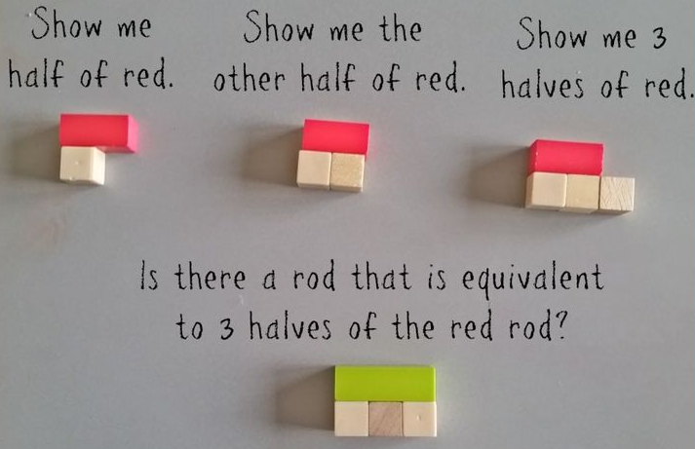
Cuisenaire Rods

Slide 22
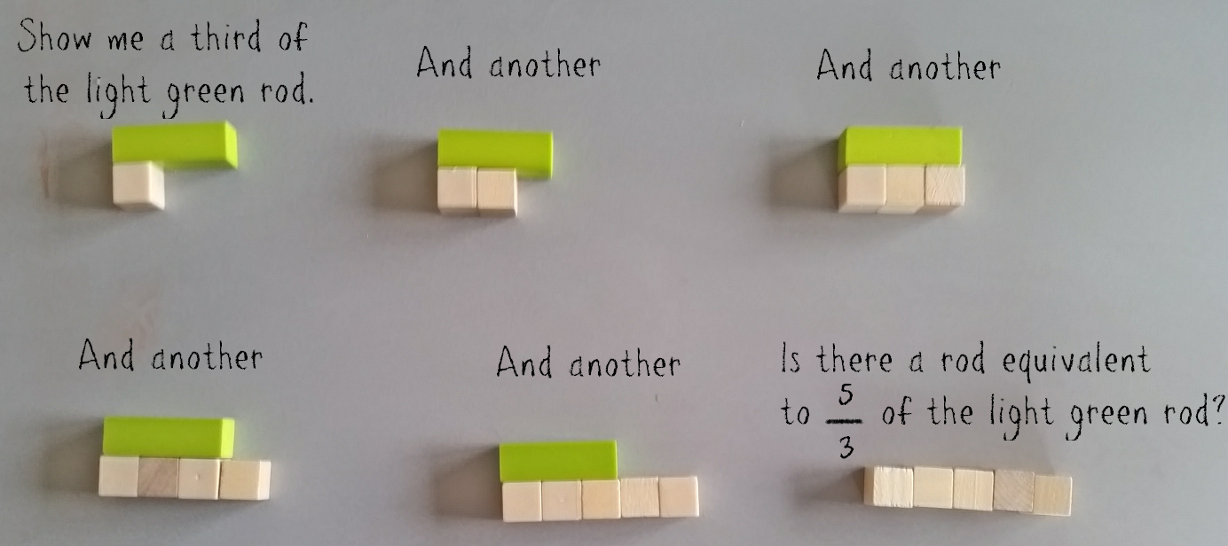
Cuisenaire Rods

Slide 23
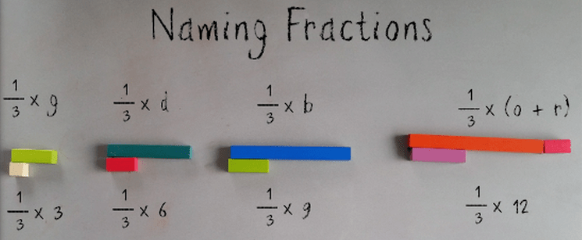
Cuisenaire Rods

Slide 24
Cuisenaire Rods
¹/₃ × ¹/₄ =

Slide 25
Cuisenaire Rods
²/₃ × ¹/₄ =

Slide 26
Cuisenaire Rods
²/₃ × ¹/₄ =

Slide 27
Cuisenaire Rods
³/₄ ÷ ¹/₂ =

Slide 28
Cuisenaire Rods
Using each number once, place the numbers 11, 12, 13, 14, 15 and 16 in the circles, such that the sum of the three numbers on each side of the triangle is 40.

Slide 29
Cuisenaire Rods
Notes:
Which triangles can be made? Which ones can’t? Why? Is there a rule? Which ones make right angles? Are the lengths connected?

Slide 30
Cuisenaire Rods
Notes:
Pythagoras Theorem.

Slide 31


Bar modelling
Nick has 3 apples and Becky has 5 apples. How many apples do they have altogether?
?
3
Nick
Becky
Nick
Becky
?
8
3
5
Nick
Becky
Nick
Becky
?
3 + 5 = 8
Nick
Becky

Slide 32
Bar modelling
Solve… Matthew has a 300g block of cheese. He eats $\frac{2}{5}$ of the cheese and puts the rest back in the fridge.
How much cheese did Matthew put back in the fridge?
Model
Calculations
300g
300 ÷ 5 =
60
60
60
60
60
60
3 x 60 = 180
Eats
Put back
?
180

Slide 33
Bar modelling
3a + 4 = a + 8
Model
Calculations
3a
+ 4
=
a + 8
a
a
a
4
-a
-a
2a + 4 = 8
a
8
-4 -4
4
2a = 4
÷2 ÷2
a = 2

Slide 34
Bar modelling
Solve 2a + 3 = a + 7
2a + 3 = a + 7
a
a
3
-a
-a
a + 3 = 7
-3
-3
a
7
4
a = 4

Slide 35
Word Problems
Raju had 3 times as much money as Gopal. After Raju spent $60 and Gopal spent $10, they each had equal amount of money.
How much money did Raju have at first?
Model
Calculations
$10
$50
$75
50 ÷ 2 = 25
?
Raju
$25
$25
$25
3 x 25 = 75
$60
Gopal
$10
Primary Mathematics volume 6B

Slide 36
Show using different manipulatives
Naomi has 85p
She has 20p less than her sister
How much money do Naomi and her sister have altogether?
Notes:
IM PB 2B year 2 question
Draw Wms bar to represent Wm
And the brother underneath
Brothers bar has to be longer chn use key words auto pilot 115 p altogether
95
95 plus a bit on the side worth 20p Wm has 95 and his brother has 115p altogether they have 95 +115 = 210p
OR 190 + 20=210p
What are we doing? COMPARING so model is called comparison model for adding and subtracting. As long as you know 2 you can get the third.
Keep modelling mastery. Chn encouraged to ask other questions

Slide 37
Bar modelling
Sarah was given a gift of £240. She spent ³/₈ of the money and put the rest in savings. How much did Sarah save?
£240
£30
£30
£30
£30
£30
£30
£30
£30
spends
saves
£90
£150

Slide 38
Tom has half as much money as Amit. Amit has £30 less than Nihal but £40 more than Ben. If the mean amount of money the four people have is £120, how much money does Ben have?
Ben has £_____.
IM Assessment Book 5 P.70
Notes:
Tom has 70, Amit has 140, Nihal has 170 Ben has 100. Start with Ben then Amit has this plus 40. Nihal has Bens amount plus 30. Tom has half of Amit’s
The mean is 120 so the total is 480. 7 eqaul parts plus 130 = 480 so 7x = 350 each part is 50.

Slide 39
There are 1250 marbles in a box. There are 150 more red marbles than blue marbles. There are twice as many green marbles as red marbles. There are only three different colours of marbles. How many blue marbles are there in the box?
There are _____ blue marbles in the box.
IM Assessment Book 4 P. 74
Notes:
Blue 200
Red 350
Green 700

Slide 40
Comparison multiplicative models
The difference between two numbers is 285.
If the larger number is 4 times the smaller number, find the sum of the two numbers.
Notes:
Question: Is this part whole for addition and subtraction? It has multiplication involved as well. Or multiplicative comparison model?
124 and 372 sum is 496
Move onto more challenging questions now. No right or wrong method. Models is to support YOUR thinking
Where are you putting your question mark focuses where the answer is needed

Slide 41
Algebra Tiles

Slide 42
Connecting the learning
Which question is hardest?
168 ÷ 12
Factorise x² + 5x + 6
Factorise 2x² + 5x + 2
Write x² + 4x + 3 in completed square form
Divide (2x² + 5x + 3) by (x + 1)

Slide 43
Connecting the learning
168 ÷12
12
168

Slide 44
Connecting the learning
168 ÷12
12
168
120
48

Slide 45
Connecting the learning
168 ÷12
14
12
168
120
48
48
0

Slide 46
Connecting the learning
Factorise x² + 5x + 6
(x + 2)
(x + 3)

Slide 47
Connecting the learning
Factorise 2x² + 5x + 2

Slide 48
Connecting the learning
Factorise 2x² + 5x + 2
(2x + 1)
(x + 2)

Slide 49
Connecting the learning
Write x² + 4x + 3 in completed square form

Slide 50
Connecting the learning
Write x² + 4x + 3 in completed square form
(x + 2)²
– 1

Slide 51
Divide (2x² + 5x + 3) by (x + 1)
2x + 3
x + 1
2x² + 5x + 3
x² + x
x² + 4x + 3
x² + x
3x + 3
3x + 3
0

Slide 52
Explain why
168 ÷ 12
is the same as
(x² + 6x + 8) ÷ (x + 2)

Slide 53
Simultaneous Equations

Slide 54
2a + t = 5
a + 2t = 7
2a + c = 4
a + c + t = 6
2t + c = 8
3c = 6

Slide 55



 |  |  | 5
 |  |  | 6
 |  |  | 7
4 | 6 | 8

Slide 56
 |  |  | 5
 |  |  | 6
 |  |  | 7
4 | 6 | 8

Slide 57
 |  |  | 5
 |  |  | 6
 |  |  | 7
4 | 6 | 8

Slide 58
 |  |  | 5
 |  |  | 6
 |  |  | 7
4 | 6 | 8

Slide 59
 |  |  | 5
 |  |  | 6
 |  |  | 7
4 | 6 | 8

Slide 60
 |  |  | 5
 |  |  | 6
 |  |  | 7
4 | 6 | 8

Slide 61
 |  |  | 5
 |  |  | 6
 |  |  | 7
4 | 6 | 8

Slide 62
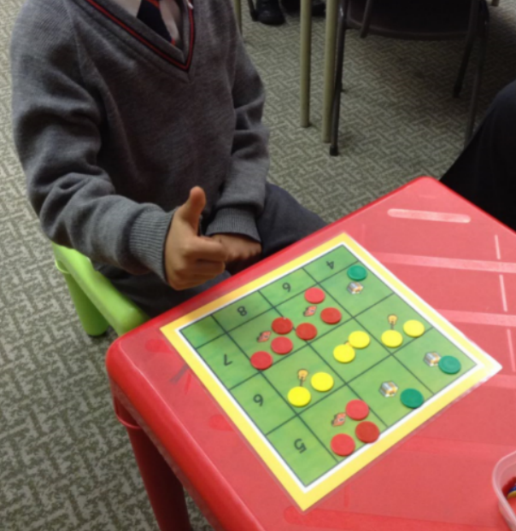

Slide 63
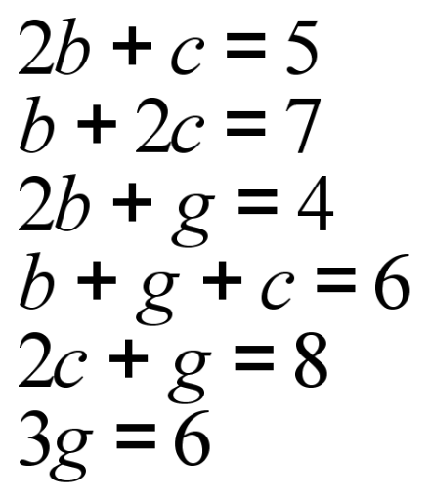
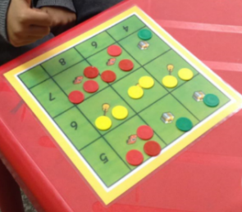

Slide 64
o + 3b = 76
2b + 3o = 84
2p + o + b = 94
o + b + p = 68
2b + p = 60
b + 2o = 67
2b + o = 59

Slide 65



 |  |  |  | 76
 |  |  |  | 84
 |  |  |  | 94
68 | 60 | 67 | 59

Slide 66
In mathematics, a Diophantine equation is a polynomial equation, usually in two or more unknowns, such that only the integer solutions are sought or studied (an integer solution is a solution such that all the unknowns take integer values). A linear Diophantine equation equates the sum of two or more monomials, each of degree 1 in one of the variables, to a constant. An exponential Diophantine equation is one in which exponents on terms can be unknowns.

Slide 67
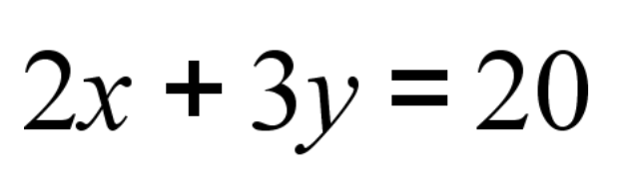

Slide 68
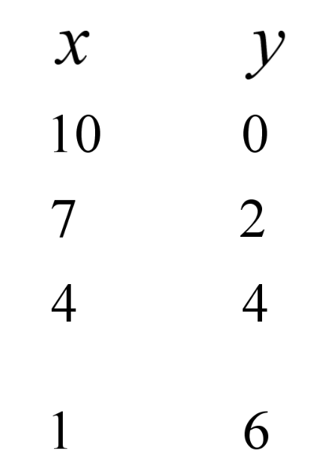


Why?

Slide 69
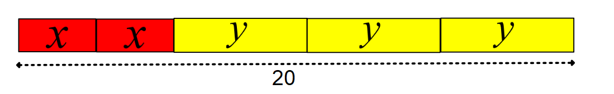
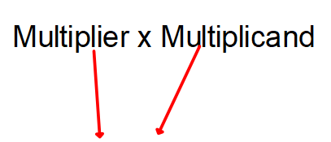
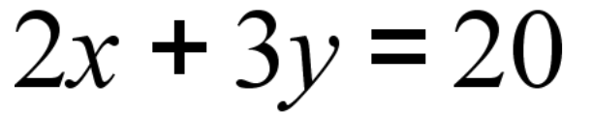

Slide 70
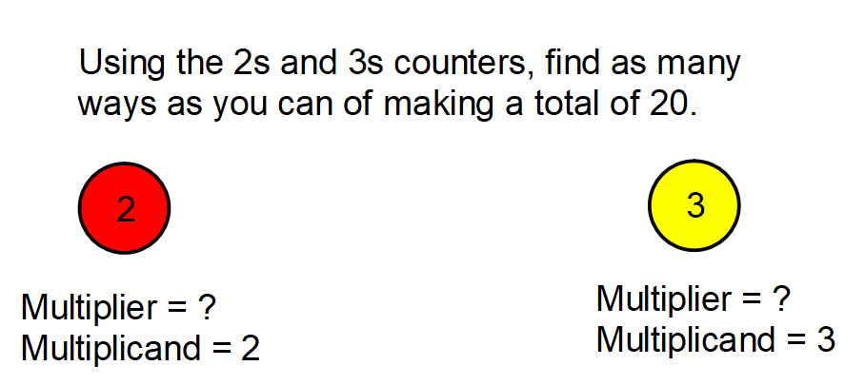

Slide 71
Using the 2s and 3s LEGO bricks, find as many ways as you can of making a total of 20
2
2
2
2
2
2
2
2
2
2
3
3
2
2
2
2
2
2
2
3
3
3
3
2
2
2
2
3
3
3
3
3
3
2

Slide 72
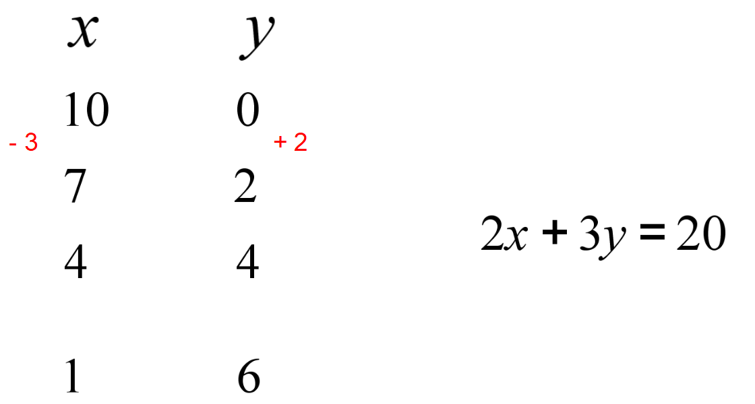

Slide 73
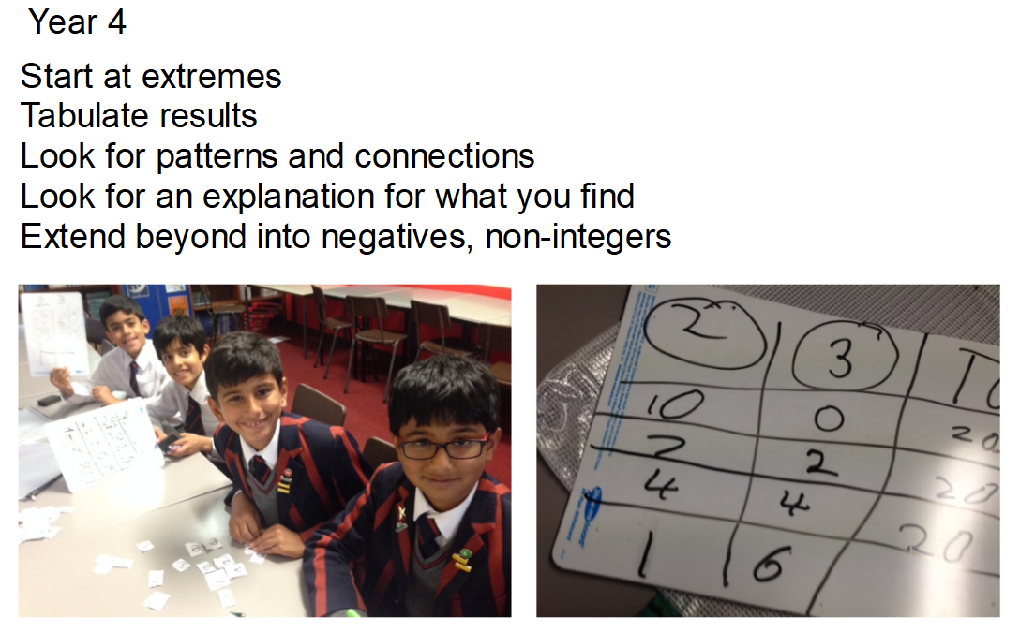

Slide 74
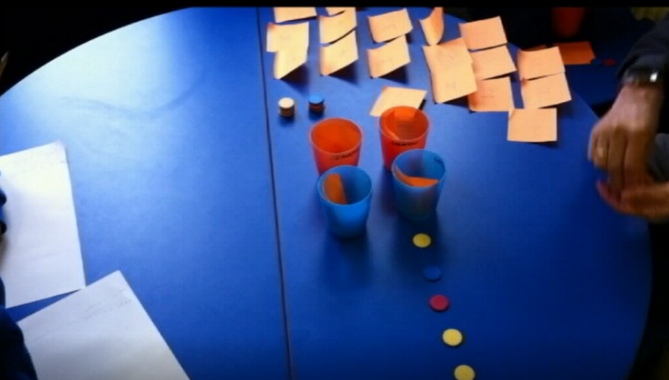
x + y = 5
2x + y = 7

Slide 75
Using cups and counters, teach…
x + y = 6
x + 3y = 10
2x + y = 7
2x + 3y = 13
3x + y = 18
3x + 4y = 27
x + 7y = 17
x + 3y = 9

Slide 76

7
33
26

Slide 77
= 7
33
26

Slide 78
4x + 2y = 26
8x + 4y = 52
26
?
Notes:
Scaling

Slide 79
6x + 2y = 48
3x + y = ?
48
?
Notes:
Scaling

Slide 80
3x + y = 22
3x + 3y = 30
22
30
Notes:
Scaling

Slide 81
3x + 2y = 26
2x + 3y = 24
26
24
Notes:
Scaling

Slide 82
4x + 2y = 26
2x + 4y = 22
26
22
Notes:
Scaling

Slide 83
r + y = 12
r + g = 16
y + g = 20
4
12
R
Y
4
8
4
16
R
12
G
8
Y
8
G
Y
4
20

Slide 84
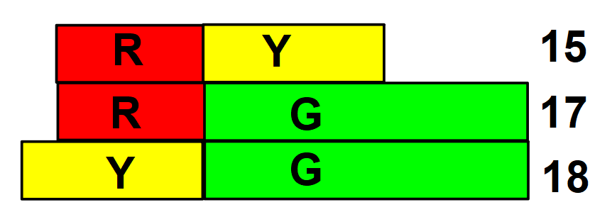
r + y = 15
r + g = 17
y + g = 18

Slide 85
Anna and Beth together have £57. Anna and Charlie together have £131. If Charlie has three times as much money as Beth, how much money does Anna have?
Notes:
This is from a Grade 5 Singapore text book
https://www.youtube.com/watch?v=fBP328qBMEY

Slide 86
Alex and Becky had a total of £240. Alex spent 2/3 of his money and Becky spent 3/5 of her money. As a result, Becky had £8 more than Alex. How much did they spend altogether?
Notes:
https://www.youtube.com/watch?v=wskxzaApiH4

Slide 87
Using Paper Folding for Geometric Proof

Slide 88
Take a rectangle of A4 paper

Slide 89
Now fold it like this.

Slide 90
You should get this. This shape is called a trapezium.

Slide 91
Now fold along the red dotted line.

Slide 92
What shape is this?

Slide 94
Now it looks like a kite.
By measuring and folding it, find out as much as you can about a kite shape. Write down what you find out.
Don’t forget symmetries and diagonals and tessellations.
How do the diagonals cut the angles?
Try again with an A5 and an A3 size
piece of paper. What do you notice?

Slide 95
Take a rectangle of A4 paper

Slide 96
Now fold it like this.

Slide 97
You should get this. This shape is called a trapezium.

Slide 98
Now fold along the red dotted line.

Slide 99
You should get this.
Turn it clockwise until one side is horizontal.

Slide 100
This shape is an isosceles triangle.
Measure it and fold it to find out about its sides, angles and symmetries.
What about tessellations?
Write down what you find out.
Try again with an A5 and an A3 size
piece of paper. What do you notice?

Slide 101
Take a rectangle of A4 paper

Slide 102
Fold it in half like this.

Slide 103
You should now have another rectangle.
Unfold the rectangle.

Slide 104
You now have this.

Slide 105
Tricky fold!!!!!!!!!
You need to fold along the red dotted line so that the bottom left corner exactly meets the half line you folded earlier.

Slide 106
Like this.
This shape is a trapezium.

Slide 107
Now fold along the dotted line.

Slide 108
Like this.

Slide 109
Now fold back the small triangle.

Slide 110
You should have this shape.
Which you can rotate to get the next slide.

Slide 111
This is an equilateral triangle.
By measuring and folding it find out as much as you can about the shape. Write down what you find out.
Don’t forget symmetries and tessellations.
Try again with an A5 and an A3 size
piece of paper. What do you notice?

Slide 112
Notes:
These patterns show similarity. Use A4, A5 and A6 paper to create.

Slide 113
Notes:
These patterns show similarity. Use A4, A5 and A6 paper to create.

Slide 117
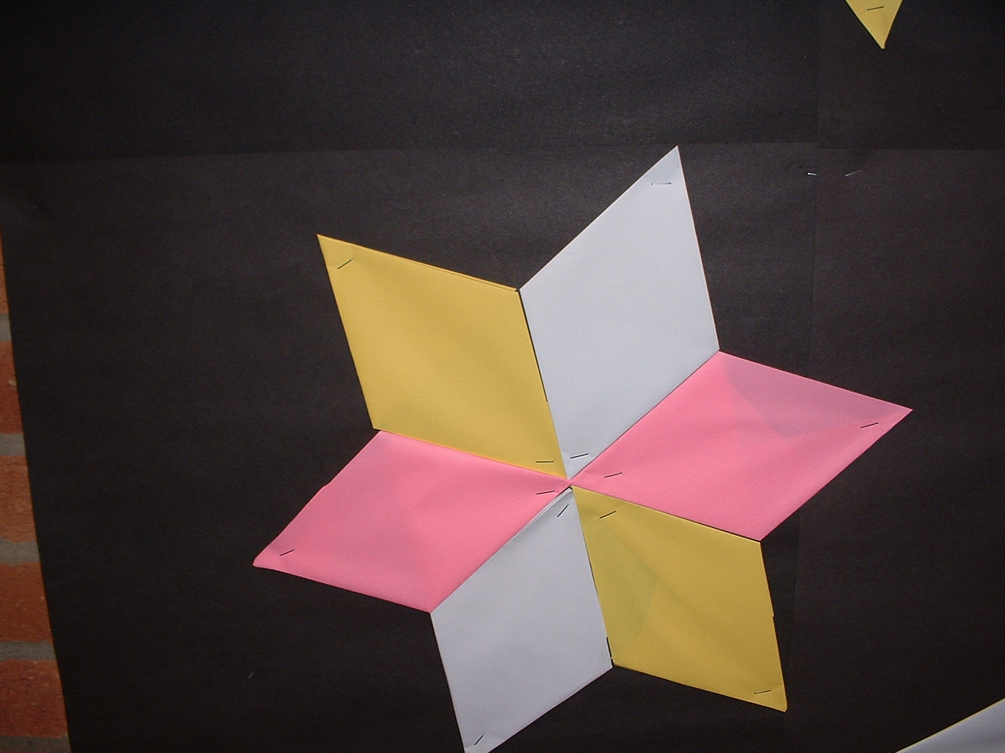

Slide 118
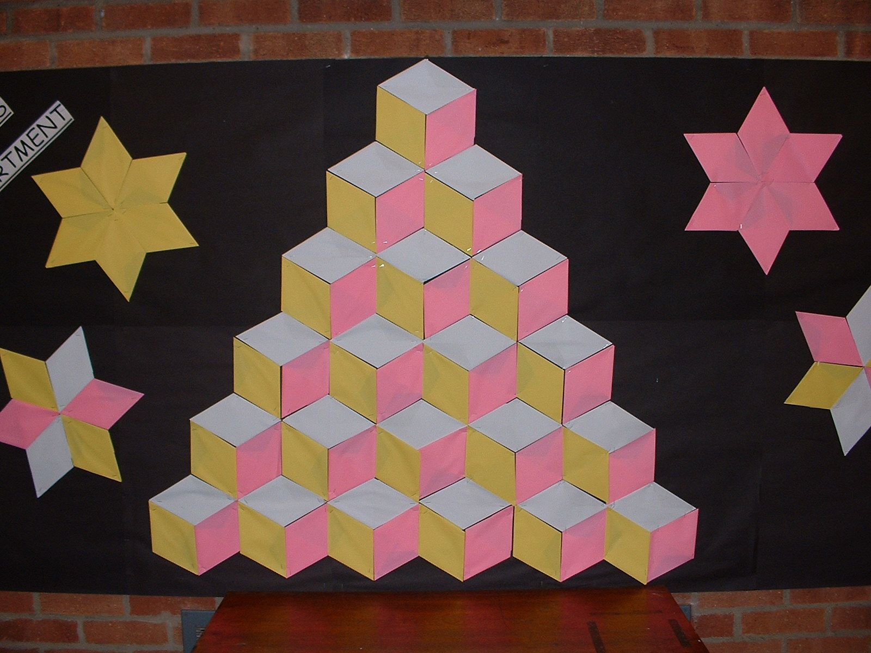

Slide 119
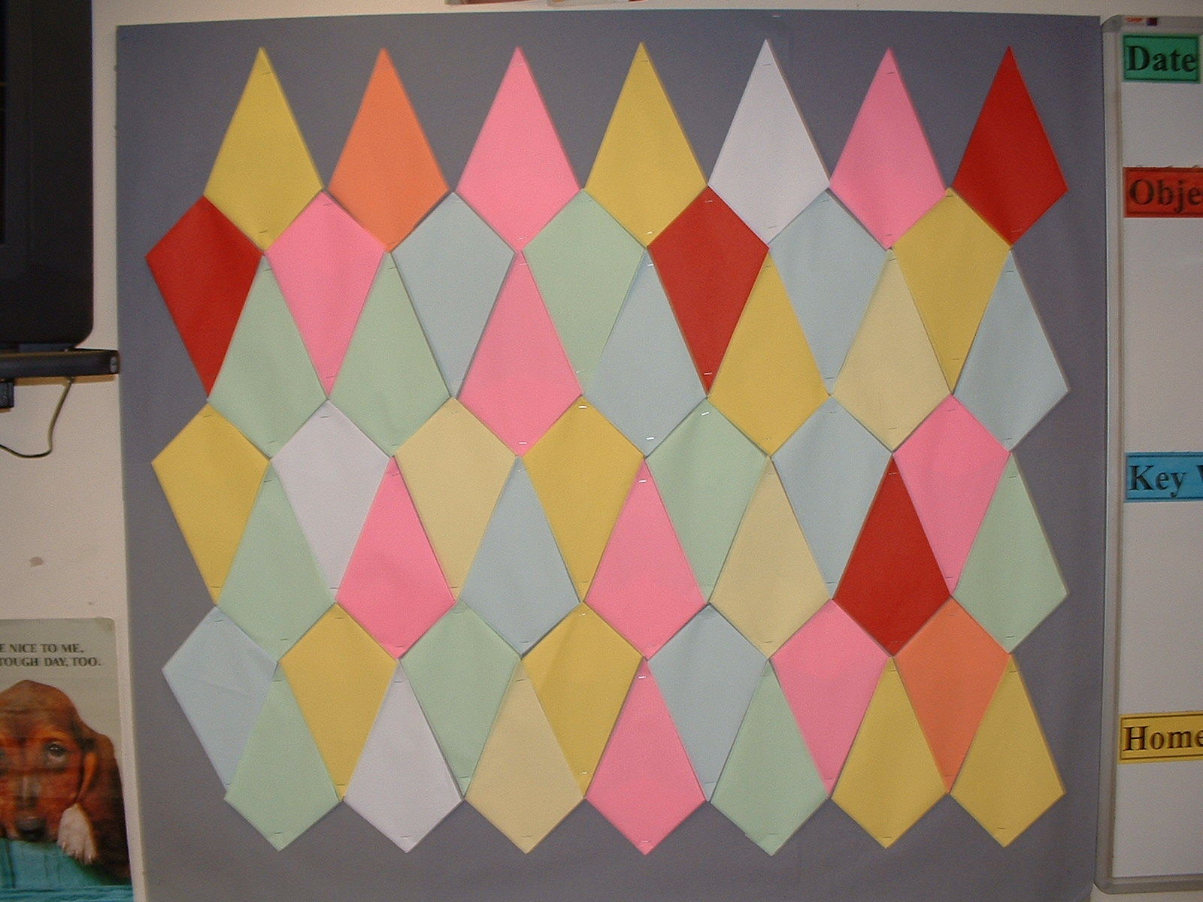

Slide 120
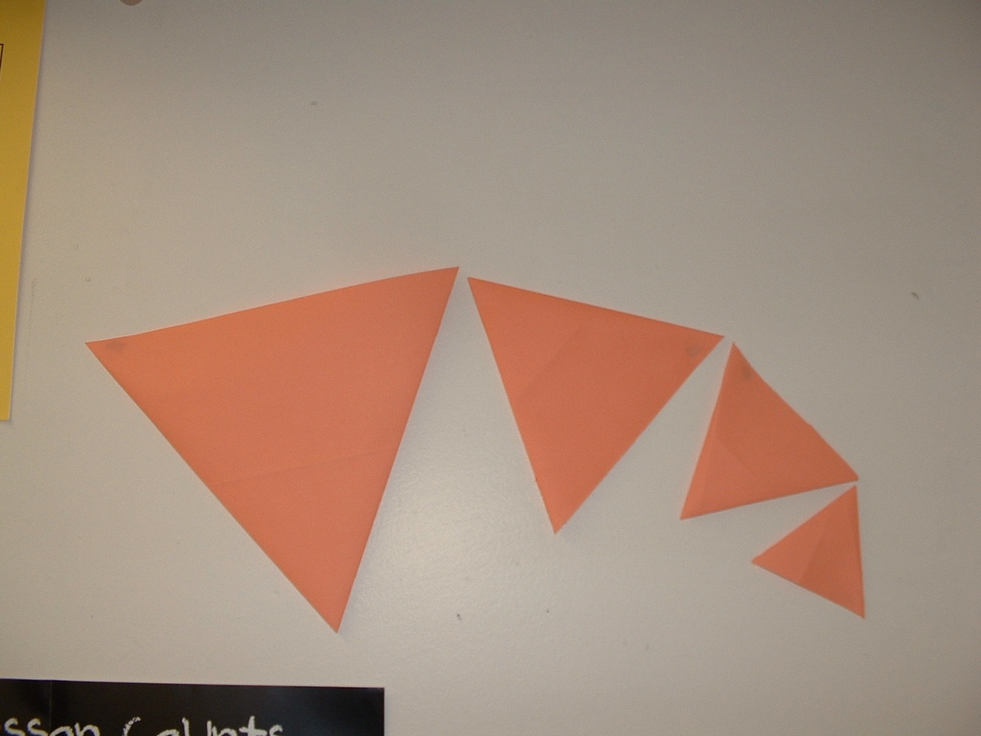

Slide 121
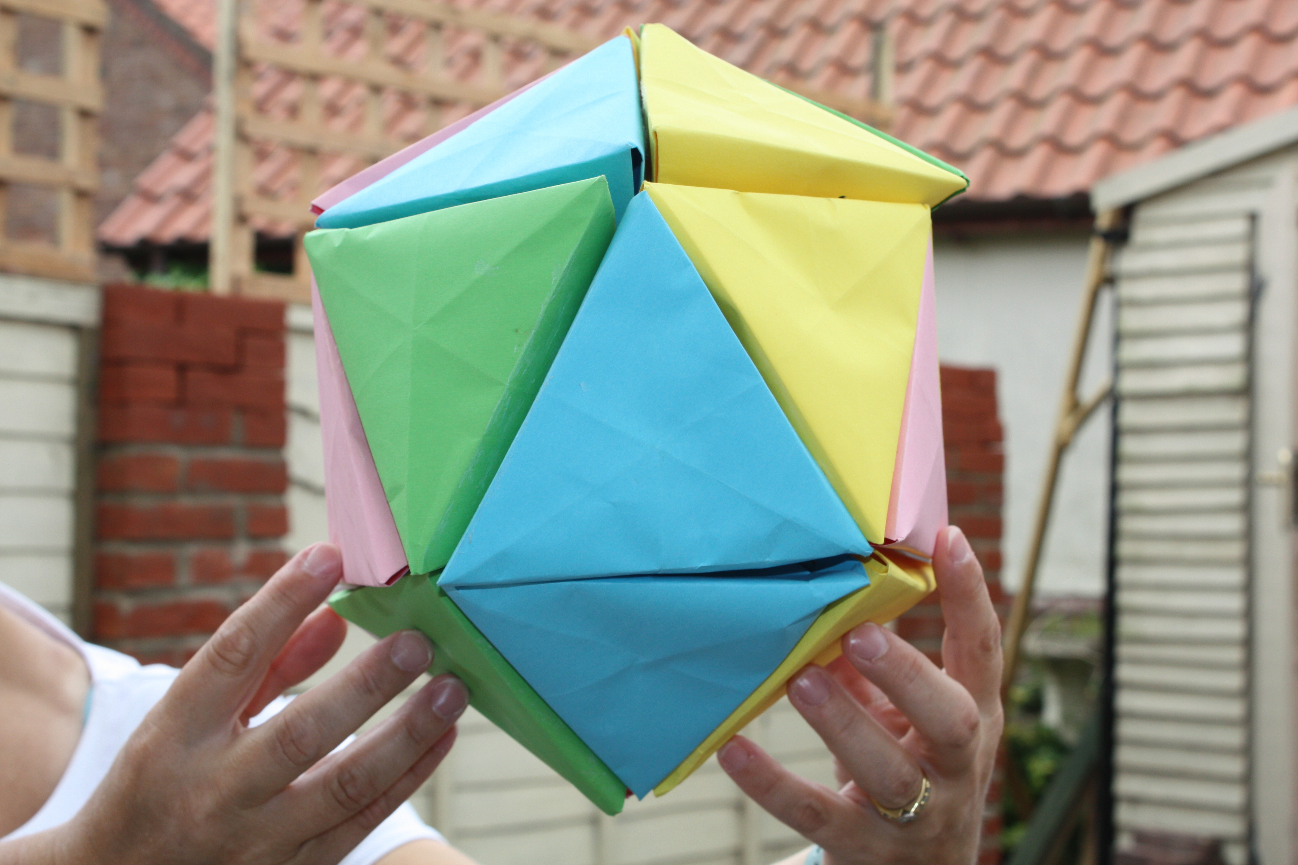
The Icosahedron Challenge

Slide 122
Metric Paper

Slide 129
w
L

Slide 130
w
0.5L
L
w

Slide 131
w
0.5L
L
w
W : 0.5L = L : W

Slide 132
Remember our kite?

Slide 133
Here was our first fold.

Slide 136
Remember our isosceles triangle?

Slide 138
Metric Paper
w
Size
A 1
Size
A 1
Size
A 1
Size
A 0

Slide 139
?
Size
A 0
w
Size
A 1
Size
A 1
?
1m²

Slide 140
Size
A 0
1m²
1 000 000 mm²

Slide 141
1m² = 1 000 000 mm²
841mm
w
Size
A 0
√2 x 841mm
= 1189mm
1m²
1 000 000 mm²

Slide 142
Metric Paper Sizes
Half the old length x the old width.
Is this an iterative process?
Size Name | Measurements
A0 | 841 x 1189
A1
A2
A3
A4
A5
A6

Slide 143
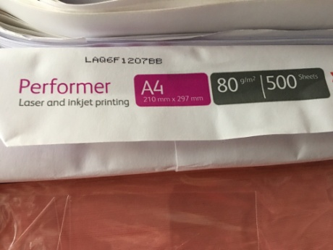
Metric Paper Sizes
Size Name | Measurements
A0 | 841 x 1189
A1 | 594 x 841
A2 | 420 x 594
A3 | 297 x 420
A4 | 210 x 297
A5 | 148 x 210
A6 | 105 x 148

Slide 144


Slide 145
5 National Conferences
Termly CPD events in your region
A full Teaching for Mastery model for all year groups
Great teaching and learning resources
Extensive support for teachers and non-specialists
Monitoring and tracking of all your students

Slide 146
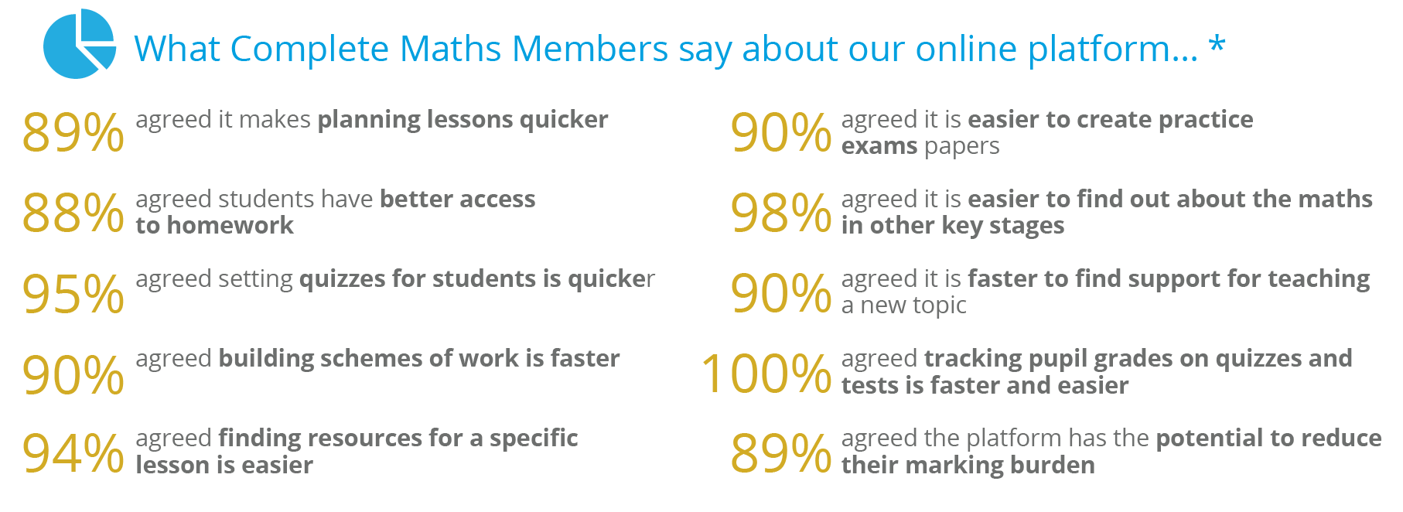

Slide 147

Notes:
LiveSlide Site
https://youtu.be/WXHlOBFv2Pw

Slide 148

Thank you

