Slide 1
Achievement of a level – Early/first
Tuesday 26th March 2019

Slide 2
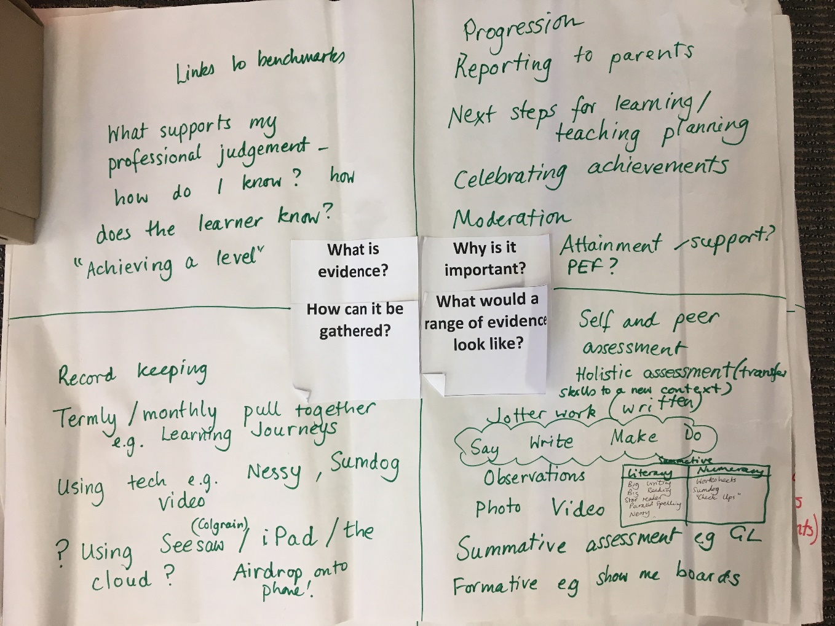
We asked you …
What is evidence? Why is it important?
How can it be gathered? What would a range look like?

Slide 3

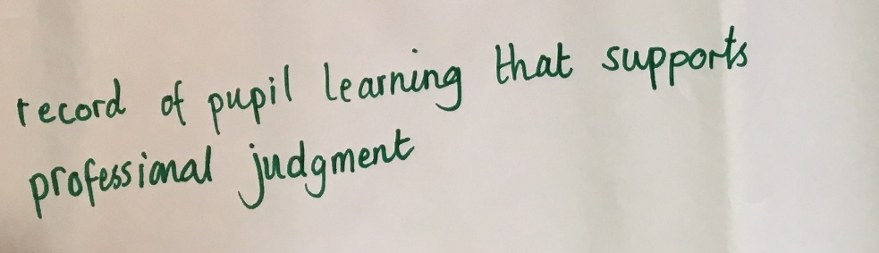
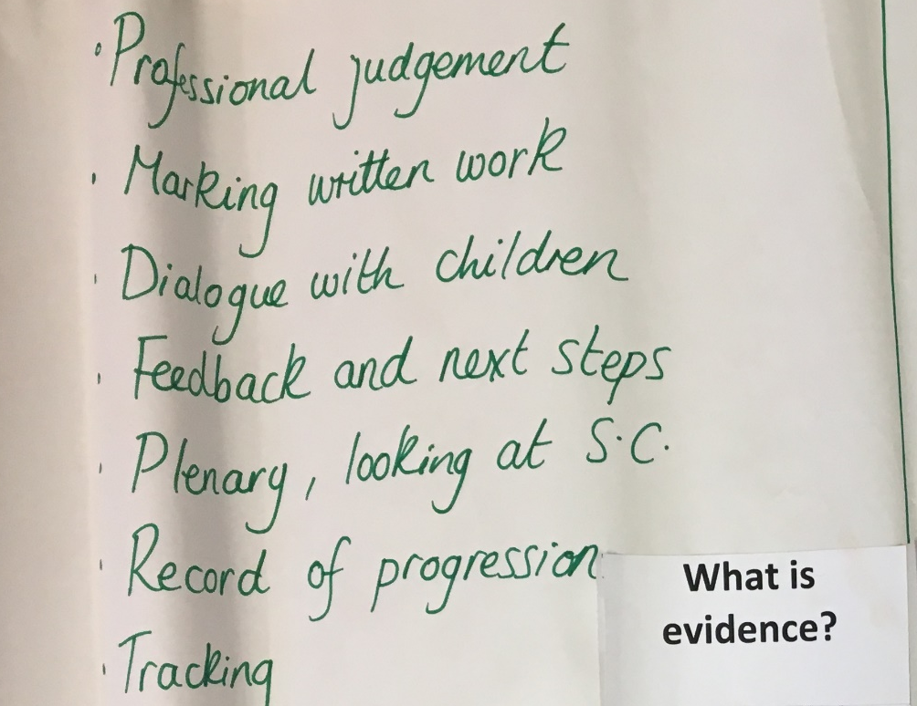
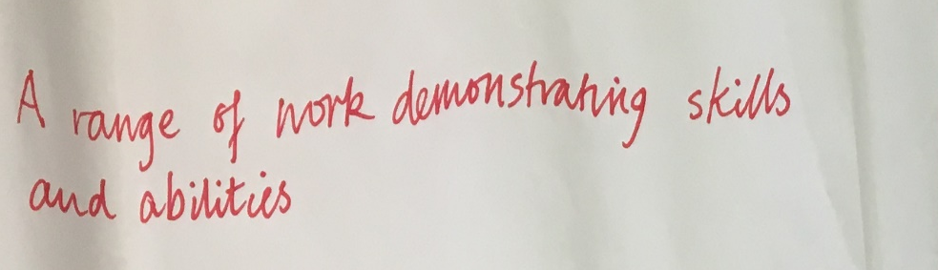
What is evidence?
Professional Judgement - a record that supports this;
Record of pupil’s learning journey and where they are;
A range of different types of work over a period of time;
Moderation;
Pupil’s voice;
Examples of achievement;
Links to benchmarks;
Supports my professional judgement.

Slide 4
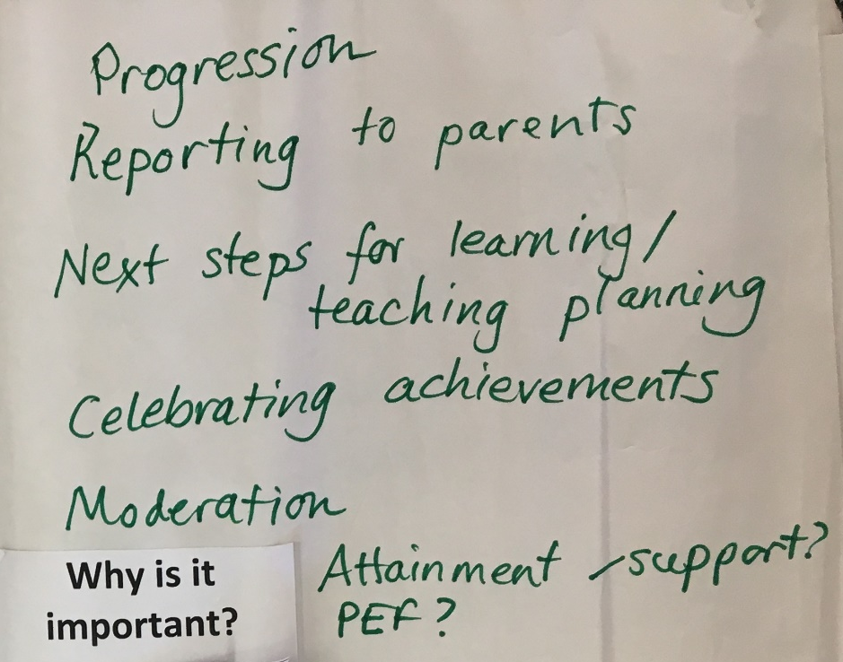
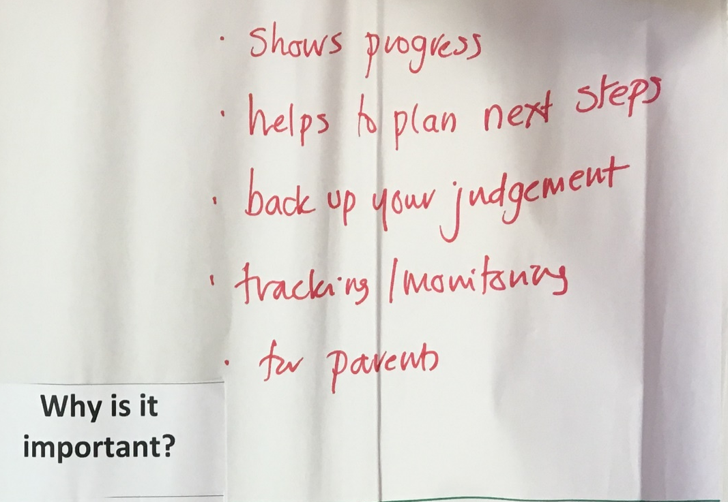
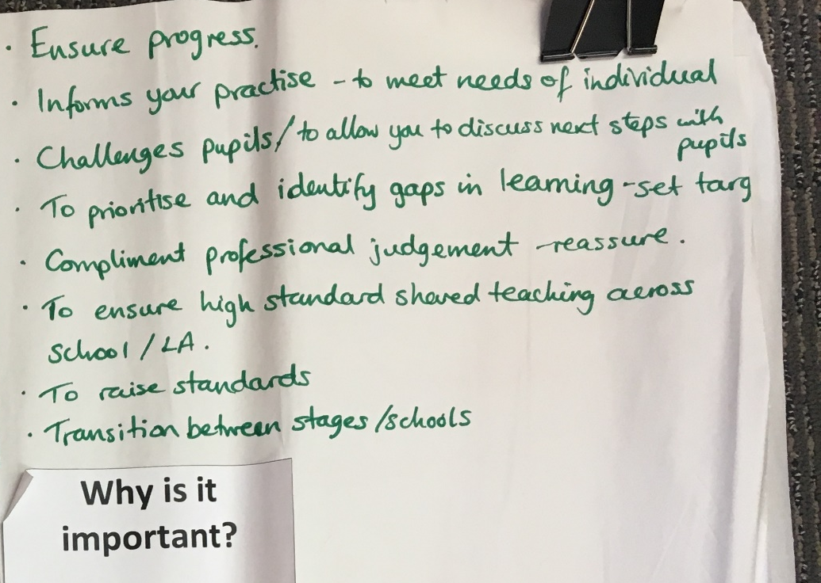
Why is it important?
Supports professional judgement;
Show progression in learning;
Provides and informs next steps;
Indicates a need for intervention;
Information on where the gaps are;
For planning purposes;
Transition between classes, schools and settings;
For tracking and monitoring purposes;
Ensure high standards across schools/cluster/authority.

Slide 5

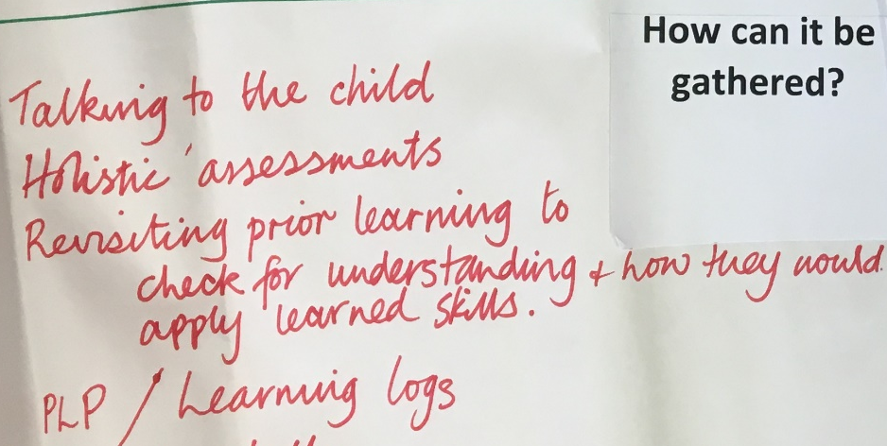
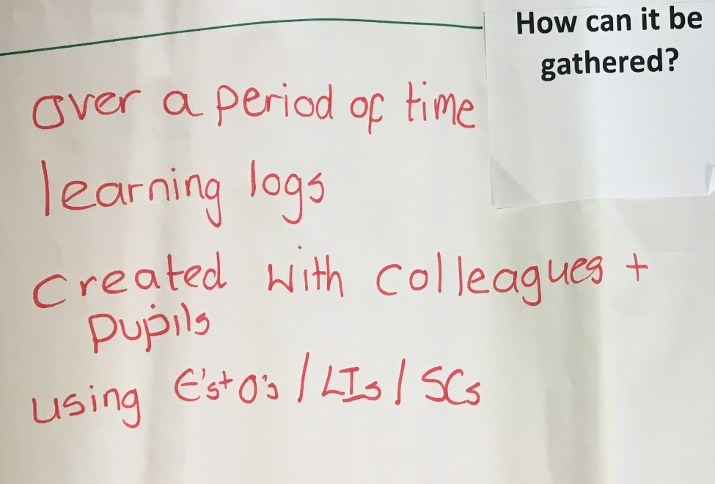
How can it be gathered?
Over time i.e. termly, monthly, weekly, daily;
Through learning logs with pupil involvement;
Using a range of curricular areas;
Through tracking and monitoring meetings;
Floorbooks with pupil involvement;
Using Es and Os/Lis/SCs;

Slide 6

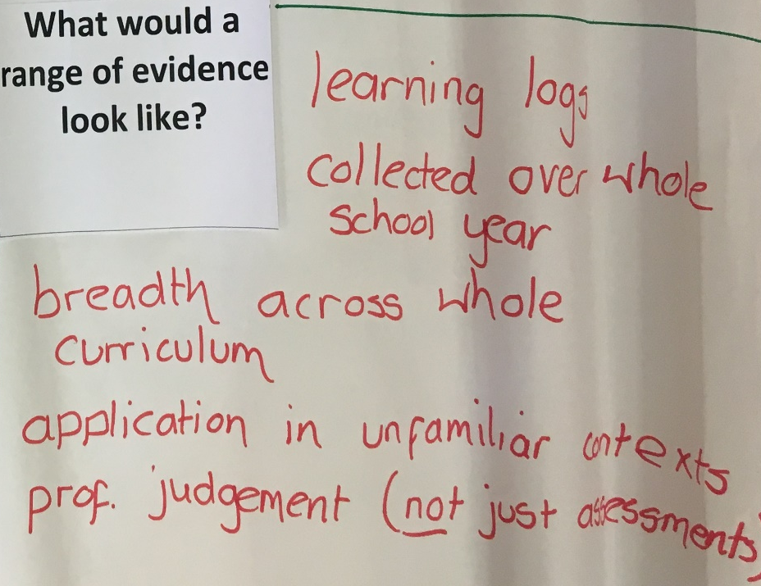
What would a range of evidence look like?
Individual tasks;
Group tasks;
Different examples of work across the curriculum;
Diagnostic assessments i.e. GLs/SNSAs;
Holistic assessments;
Videos i.e. Number Talks;
Formative and summative assessments;
Ongoing class work i.e. jotters, floorbooks, posters etc.;
Application of skills in unfamiliar contexts;
Collected over a period of time.

Slide 7
Do you still agree with this?
1. Do you still agree with this?
2. Do you have anything to add?
Discuss for 2 minutes and share …
Notes:
We can record the answers to this on flipchart paper as answers are provided.

Slide 8
Specifically ….
Consider Listening and Talking and Reading
1. What would a range of evidence look like in these curricular areas?
2. How could you gather this evidence effectively?
3. How would you ensure shared understanding of standards within school/cluster/authority?
DISCUSS FOR 5 MINUTES AND RECORD FINDINGS ON FLIPCHARTS PROVIDED

Slide 9
In summary … a body of evidence
Evidence is what practitioners gather when learners’ demonstrate their progress in learning. It will come from a wide range of sources and will be gathered over time. The evidence will vary depending upon the learning being assessed, the learning activity and learners’ preferences for how to show what they have learned.
Notes:
Practitioners gather huge amounts of information about a learner through their day to day interactions. Some of this may be formally recorded, but some of it will not.

Slide 10

Evidence is not ….
Notes:
Evidence should be proportionate and manageable. There is no requirement for files and files of paper based evidence. Practitioners should be clear about the evidence they are gathering and what it demonstrates.
There should be a clear and shared understanding of the purpose of the evidence and the need to be selective so that it is useful. Learner evidence informs professional judgement of progress and achievement, feeding into tracking and monitoring systems and processes.

Slide 11
How to collate evidence

Slide 12
Break time … have a kit kat …

Slide 13
A numeracy body of evidence – what could it include?
  Observations of learners carrying out tasks and activities, including practical investigations, performances, oral presentations and discussions and their day to day learning;
  Information obtained through high quality interactions and dialogue;
  Day to day learning and classwork such as written responses, jotter work, workbooks, notes;
  Records of learning (oral, written, audio-visual) created by learners which may include self and/or peer assessment or may be assessed by the practitioner;

Slide 14
A numeracy body of evidence – what could it include?
  Photographs or video clips – often annotated;
  A product, for example, a piece of artwork, a PowerPoint presentation, a poster, a project or a report which may have been created as part of interdisciplinary learning;
  Accounts provided by others (parents, other learners, colleagues, partners) about what learners can do;
  Results from Scottish National Standardised Assessments, other diagnostic assessments and ongoing class assessments;
  High quality holistic tasks.
Notes:
An example of a numeracy portfolio may include a dated photo/video of a Number Talk; an example of a think board; a Sumdog report for that pupil; an example of problem solving in context; an example of numeracy being applied in another curricular area, along with samples of classwork which clearly demonstrate the learning that has taken place. It may also include examples of both holistic and summative assessment which have been completed by pupils, like GL or SNSA reports. There may also be some pages from pupils’ learning logs which are relevant to numeracy and show self or peer evaluations.

Slide 15
observations
Instead of working this out abstractly, the practitioner
allowed the pupils to work on this concept using concrete materials,
making their assessment decisions based on observations.

Slide 16
Observations and interactions

Slide 17
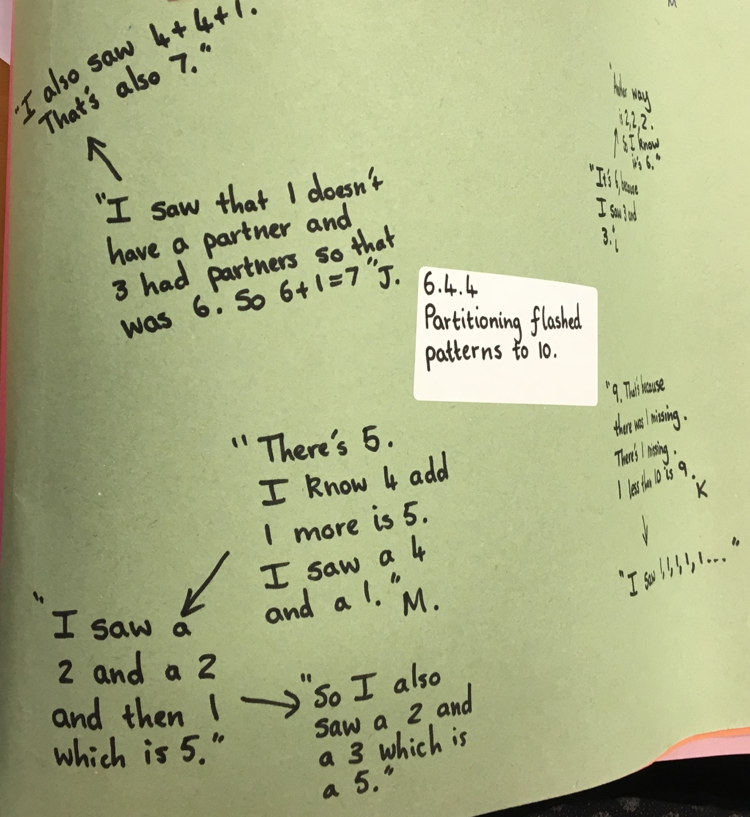
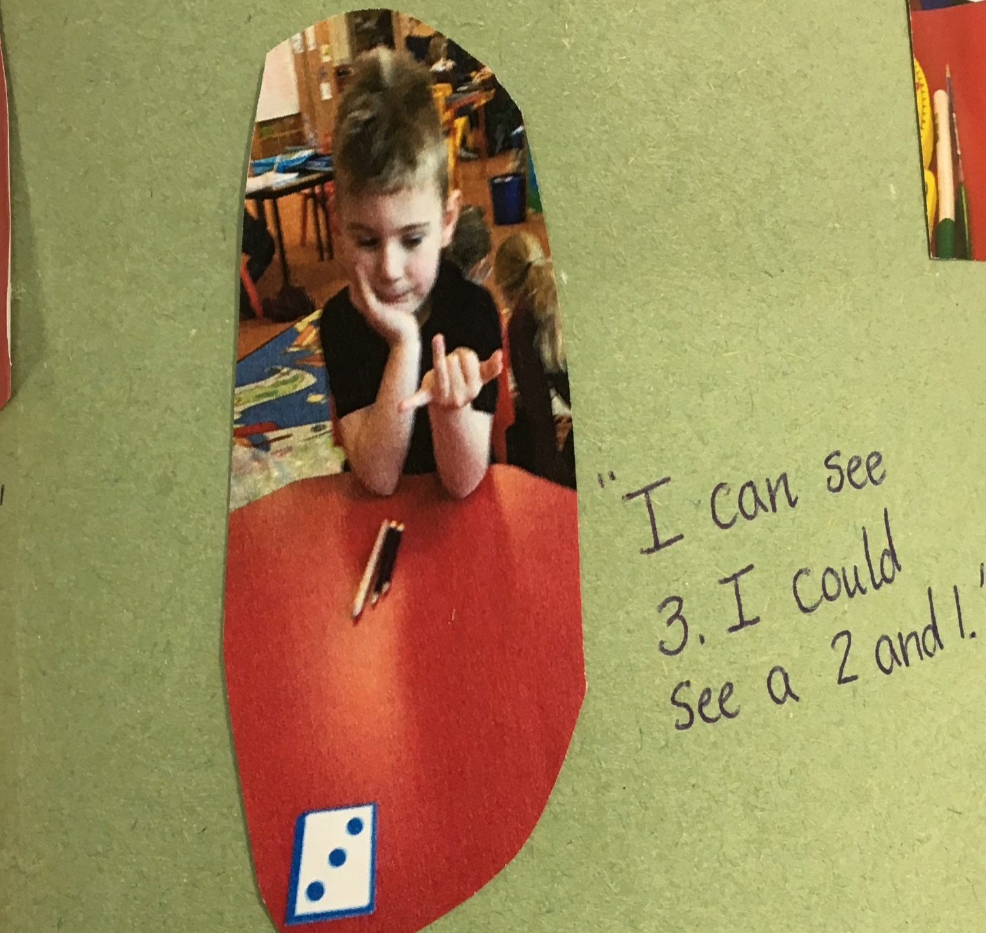
Observations and interactions

Slide 18
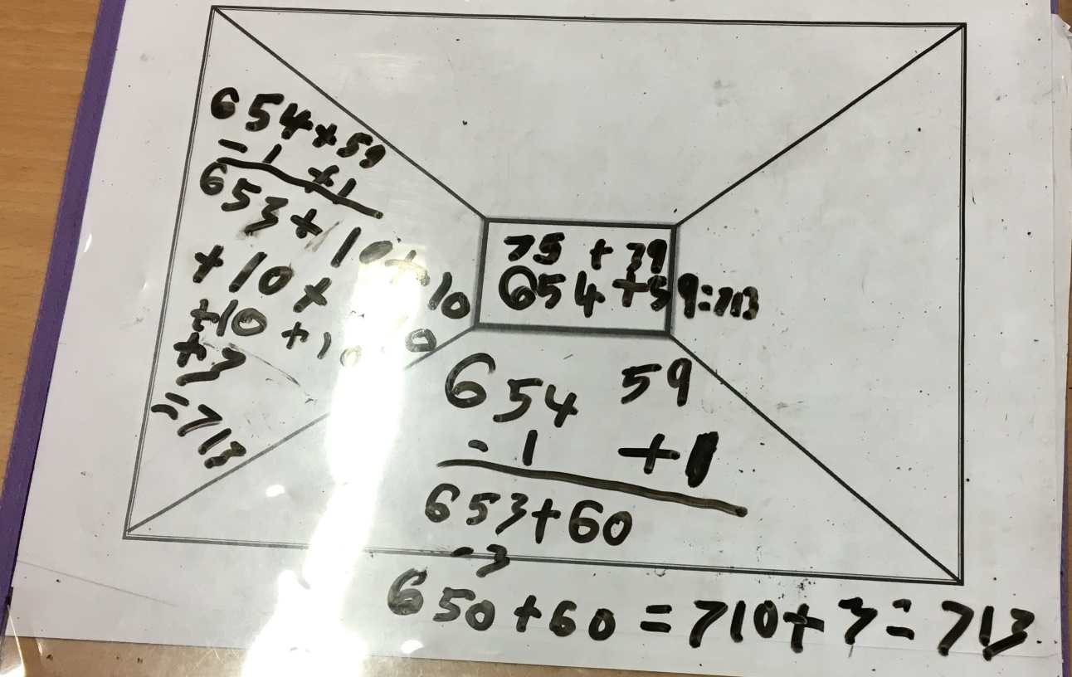
Day to day learning
Worksheets
Thinkboards
Pictorial representations

Slide 19
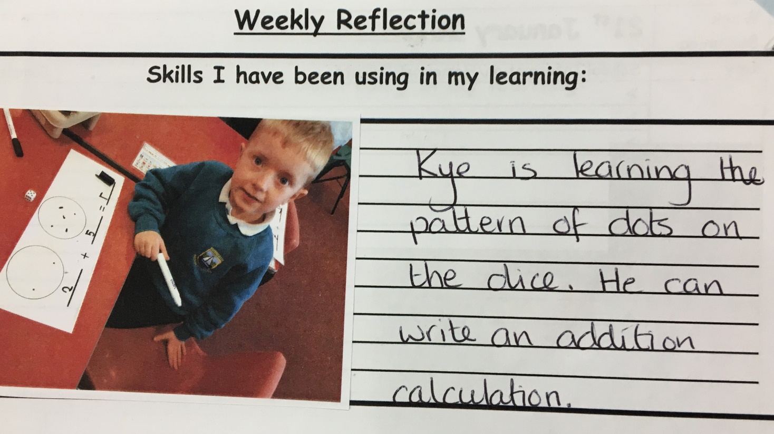
Learning records self/peer assessment learning logs

Slide 20
Interdisciplinary learning
Bob the alien has come to visit your class. Bob is very confused
because on bob’s planet everything is flat – he has no idea what 3D
shapes are – can you help him?
Use your iPad to create an instructional video for Bob explaining which 2D shapes can be found in 3D objects – this will help him feel more at home;
Find a picture of Oban online and explain, using an app of your choice, which 3D shapes can be found within the picture.

Slide 21
Interdisciplinary learning

Slide 22
Accounts provided by other stakeholders

Slide 23
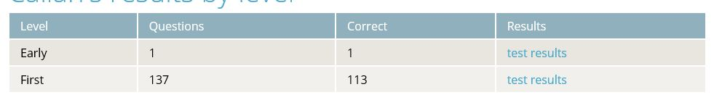
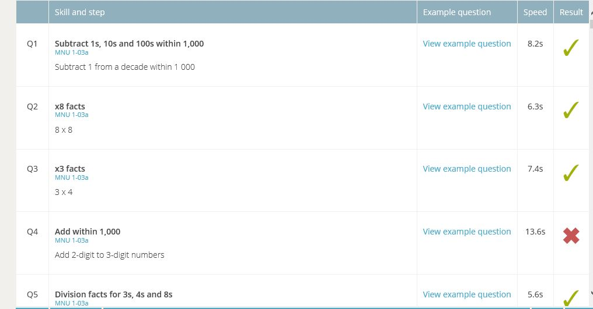
Diagnostic assessments
Taken from Sumdog teacher portal,
reviewing the diagnostic tests, showing where there could be gaps in understanding.
Other diagnostic tests would include GL Assessments (completed in P2 and P3) and SNSAs (completed in P1 or P4).

Slide 24
Holistic tasks

