Slide 1
Assessment is for Learning
Self and peer assessment

Slide 2
Formative Assessment
Effective questio-ning
Self and peer assessment
Effective feedback
Sharing learning goals
Underpinned by a belief that all learners can make progress; that achievement comes from effort not just ability – growth mindset.
Notes:
Formative Assessment – all about using assessment to make adjustments to support pupils; literally to support learning, to see what needs to be retaught, to see what can be moved on from

Slide 3
Formative Assessment
Effective questio-ning
Self and peer assessment
Effective feedback
Sharing learning goals
Notes:
Today’s focus

Slide 4
Learning Intentions
We will know how to make effective use of self and peer assessment
Notes:
How will we know we can do these?
- Be able to explain strategies to others; be able to use one tomorrow

Slide 5
HGIOS 4
‘Learners receive high-quality feedback and have an accurate understanding of their progress in learning and what they need to do to improve’
‘Learners are able to give effective feedback to peers on their learning and suggest ways in which they can improve’

Slide 6
HGIOS 4
‘Learners receive high-quality feedback and have an accurate understanding of their progress in learning and what they need to do to improve’
‘Learners are able to give effective feedback to peers on their learning and suggest ways in which they can improve’

Slide 7
‘We want students to use self-evaluation continually, so that reflection, pride in successes, modification and improvement become a natural part of the process of learning.’ (Shirley Clarke)

Slide 8
T-P-S
What issues may arise in self and peer assessment?

Slide 9
Common issues
Too harsh
Too lenient
Focus on admin, like handwriting
Don’t want to offend
Can’t see the strengths or areas for development of something they have produced

Slide 10
Pupils must be gradually trained in how to assess their own or others’ work
Begin with them assessing their own, then move to peer assessment
With Success Criteria and good modelling, pupils can make independent improvements to their work in all curricular areas
Notes:
Too early, they will focus on

Slide 11
Training pupils
Shifting power from teacher to student with “success and improvement” marking strategy (three stage process)
Use of Success Criteria
Use of Traffic Lights

Slide 12
success and improvement marking strategy
Stage 1: Students identify own successes
With clear Learning Intentions (like ones based on knowledge, skills or concepts) pupils can identify their own strengths by circling or highlighting
This can be shared with their partner or group
Boosts self esteem and gives motivation for improvement
Notes:
Age dependent on how long you stay at each stage
Sel

Slide 13
LI – to be able to write a balanced argument
Highlighted:
linking phrases
emotive word choice (mainly against zoos)

Slide 14
success and improvement marking strategy
Stage 2: Students identify a place for improvement
Pupils can now be asked to identify a place in their work which could be improved against the Learning Intention
Identify with a wiggly line or certain colour highlighter
Teacher then gives suggestion for improvement, which pupils act on next lesson
Notes:
Age dependent on how long you stay at each stage

Slide 15
success and improvement marking strategy
Stage 3: Students identify successes and make an “on the spot” improvement
Pupils now identify successes and improvements, and act upon the improvements themselves
The first time the teacher sees the work, now, it has already been edited and up-levelled by the pupil
Improvements can be written at the side, the end, or on a page left purposely blank
Notes:
Age dependent on how long you stay at each stage
Once these stages have been established individually, can try them for peers

Slide 17
Use of Success Criteria
Closed skills (eg. using capital letters, finding area, etc.)
Pupils tick off each step as they follow it
Colour code each SC and then highlight the various element of their work which corresponds
Anything missed? Easy to spot and fix.
Notes:
Self or peer

Slide 19
Use of Success Criteria
Open skills (eg. persuasive writing, summarising, comparing, debating, performing, etc.)
Pupils can easily say whether each SC has been included…
Quality is harder to judge
This is where peer assessment and using exemplars help
Notes:
Quite tricky – most pupils will have done the best job they can; unlikely they’ll be able to look at their work immediately after they’ve finished it and realise lots of “better ways” they could have put it together, or else they’d have done that the first time…
Exemplar – pupils write opening paragraphs to a persuasive essay. Next lesson, teacher shows four examples of persuasive intros, pupils put them in order and discuss their strengths/weaknesses as a class. Pupils can then compare their own paragraphs to these, see where they come on the continuum, and improve their work accordingly
Similarly, they could compare their finished work to a completed exemplar and the Success Criteria. Using a Learning Log, pupil can make note of their strengths and what they can see they’ve done well, and what they could work on in future in order to make it as good as the exemplar

Slide 20
Practical uses
Stopping pupils mid-lesson, drawing attention to the Success Criteria and asking them to traffic light their work; greens can then work with ambers and the teacher can work with reds to improve work
Selecting one pupil’s work at random and stopping the whole class to discuss it; discuss the best parts and have pupils make specific suggestions on how to improve it. The rest of the class can then use the remaining time to assess their own work in the same way (https://www.shirleyclarke-education.org/video/literacy-arrival-writing-feedback-3/)
Notes:
1 – better for closed skills
2 – better for open skills

Slide 21
Use of Traffic Lights
If being used to assess against Success Criteria, best to be done during learning / working process – not at end
Before end of work (ie half way through, not immediately before handing in), have pupils traffic light Success Criteria; this gives teacher a chance to refocus certain learners on certain criteria

Slide 22
Use of Traffic Lights
Effective to use as a prior and post knowledge task, when dealing with definite knowledge and facts, rather than more open skills

Slide 23
Notes:
Traffic light at start; then traffic light at end
Gives pupils clear revision guide

Slide 24
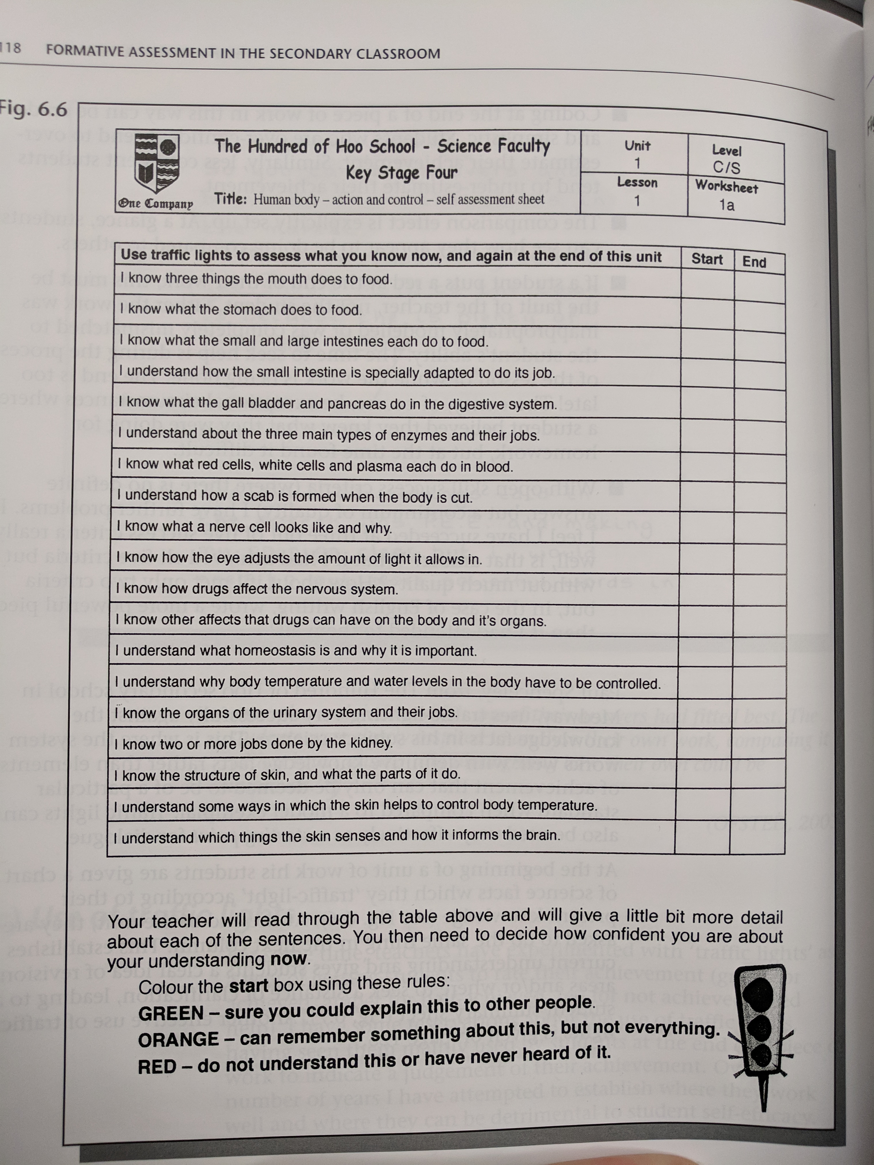
Notes:
Traffic light at start; then traffic light at end
Gives pupils clear revision guide

Slide 26
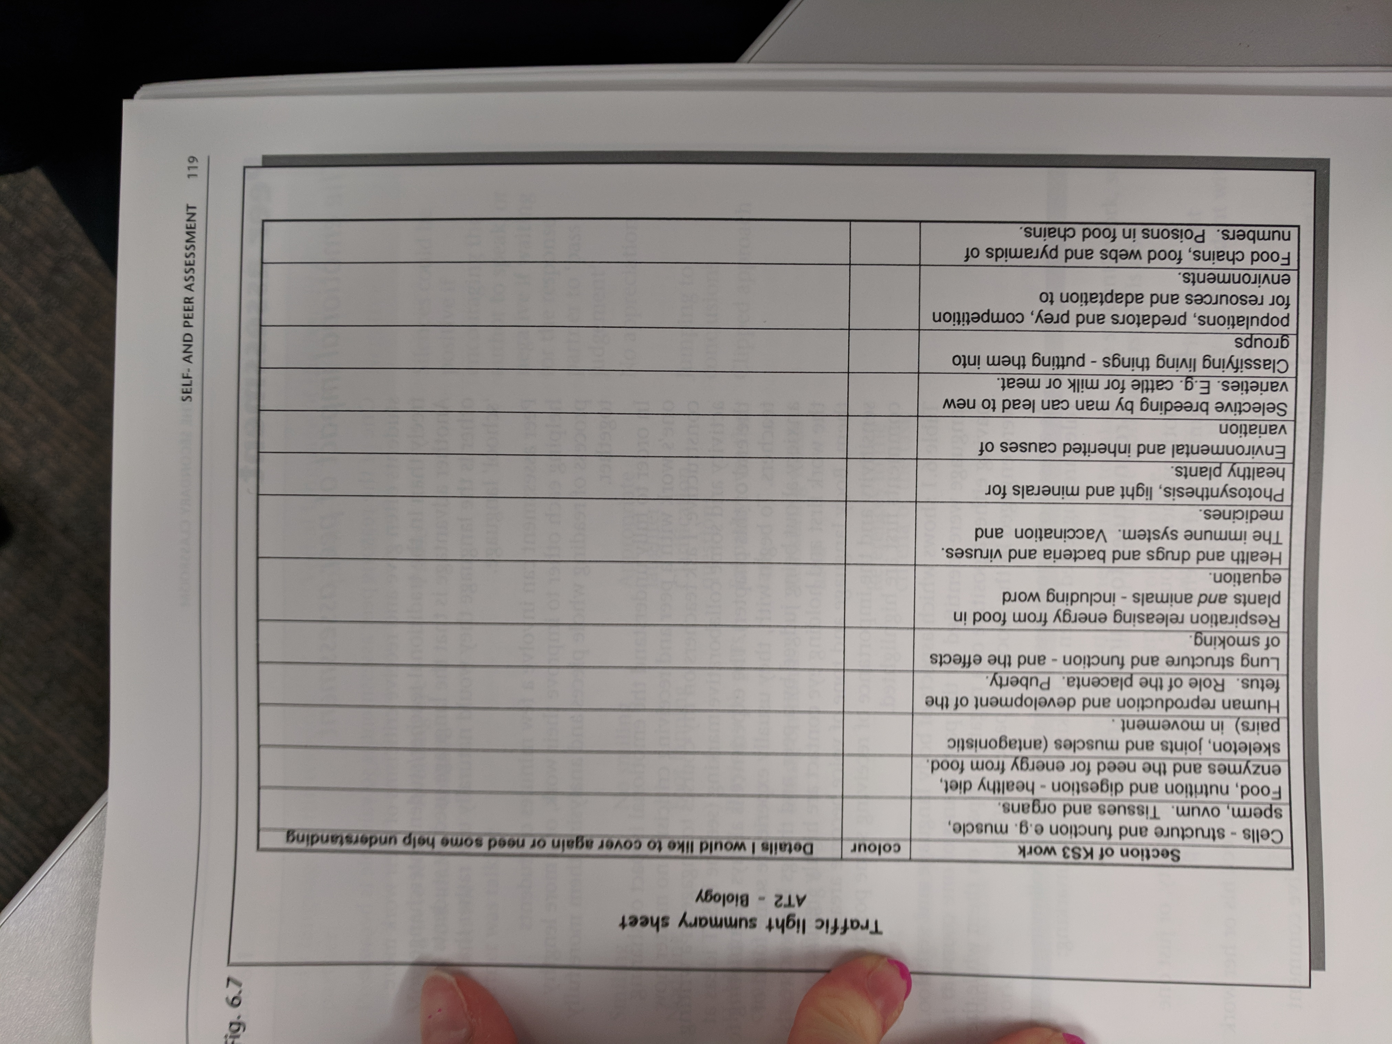

Slide 27
Peer assessment
Can be intimidating
Body language and tone are important
Again, pupils need to be trained in this
Some general rules for peer assessment:
Notes:
Scary to be judged
Shirley Clarke makes her learning teams do an exercise first where they write something and then in a trio, have it peer assessed by someone while another person watches and makes notes of their interactions

Slide 28
Pupils should have time to check their own work before their partner reads it
Partners should be of roughly the same ability, or just a bit ahead or behind
To help the listener take the work in, the writer should read their work aloud to begin
Pupils must be trained in “success and improvement” marking first
Start with a positive comment
Both pupils agree about any changes
The partner should ask for clarification before jumping to conclusions

Slide 29
Self and United Improvements
Having pupils work in pairs to assess their work (sometimes called Self and United Improvements).
Author reads their work aloud
Both pupils suggest corrections or improvements
Author holds the pen and actually makes the changes
Pupil indicates where they made changes by putting “SI” or “UI” (self or united improvement) next to it
https://www.shirleyclarke-education.org/video/literacy-speech-writing/ (exemplar)
https://www.shirleyclarke-education.org/video/literacy-speech-writing-6/

Slide 30
Peer feedback
Some practical means of using peer assessment include:
Pupils going around the room putting post its with comments on each other’s work – this means each pupil receives a large amount of feedback from a variety of pupils, while also ensuring every pupil gets to read a range of responses and learn from their peers
Pupils using Success Criteria as a “checklist” on a peer’s work, in order to point out anything they have missed
Pupils giving two stars and a wish to each other’s work, after using Success Criteria and exemplar work to ensure all pupils understand what makes a good piece of work

Slide 31
Collaborative Learning
When pupils work together in a small group where everyone participates in a collective task – pupils either:
do a joint task where different members do different aspects of the task but contribute to a common overall outcome, or
a shared task where group members work together throughout.
It is not just when pupils sit together and discuss their work, or when one pupil is able to take responsibility for the whole task and everyone else does nothing.
For collaborative learning to be effective there must be:
a belief that the work produced will be better if done together than if apart
frequent interaction
individual accountability

Slide 32
T-P-S
How can we ensure that there will be:
a belief that the work produced will be better if done together than if apart?
frequent interaction?
individual accountability?

Slide 33
Some rules…
Pupils will not be able to work together well automatically – they will need support and practice
Tasks need to be planned carefully so that the work is effective and efficient, otherwise some pupils will try to work on their own.
Competition can be effective but take care that pupils don’t focus more on the competition element than the task Lower achieving pupils may contribute less, so it is especially important to encourage and support them to contribute

Slide 34
Some rules…
Decide how groups will be formed – a mix of gender and ability works best – and what size they will be. Four is ideal, as they can split into pairs if required but there is still a small enough number
Consider varying groups throughout the year so that pupils get experience working with different learners
You may want to think about creating a group identity to enable learners to gel as a group
Persevere!

Slide 35
Learning Intentions
We will know how to make effective use of self and peer assessment
Notes:
How will we know we can do these?
- Be able to explain strategies to others; be able to use one tomorrow

Slide 36
Next steps
Trial self and peer assessment with a class, in this order:
using an anonymous piece of work, decide whether the Success Criteria has been achieved
in pairs, get pupils to identify successes and areas for improvement in this piece of work
compare two pieces of differing quality and decide with the class which piece is better, using Success Criteria to help
After this, try to gradually embed self and peer assessment in your class by training pupils using the advice above.
Pick three of the collaborative learning strategies outlines and consider how they could be used in your subject or stage.

