Slide 1
ASSESSMENT IS FOR Learning
Prior Learning

Slide 2
Formative Assessment
Effective questio-ning
Self and peer assessment
Effective feedback
Sharing learning goals
Underpinned by a belief that all learners can make progress; that achievement comes from effort not just ability.
Notes:
Formative Assessment – all about using assessment to make adjustments to support pupils; literally to support learning, to see what needs to be retaught, to see what can be moved on from

Slide 3
Formative Assessment
Effective questio-ning
Self and peer assessment
Effective feedback
Sharing learning goals
Notes:
Today’s focus; however, will be making use of others

Slide 4
Learning Intentions
We will know planning strategies to build on prior knowledge
We will know strategies to ask effective questions to access pupils’ prior learning
Notes:
How will we know we can do these?
- Be able to explain strategies to others; be able to use one tomorrow

Slide 5
T-p-s
How can we plan in a way to take advantage of pupils’ prior learning?

Slide 6
Collegiate Planning
In primary schools, this could mean stages/whole schools plan together
Benefits
No topics are repeated
Skills are built on
Knowledge and experience is shared
In secondary schools, it could mean departments plan their course outlines together, then share these with other departments
Benefits
All pupils having consistent experience across department
Knowledge and experience is shared
See where effective links could be made for pupils, informally or in IDL – for example, if History are expecting pupils to write persuasively, they may wish to plan to do this after English have taught persuasive writing skills.

Slide 7
Planning with pupils
Involve pupils in planning
Give upcoming Learning Intentions to pupils so they know what is coming up
Based on those LI, ask pupils to share everything they know, then use responses to fill in gaps.
Particularly helpful in subjects where life experience often gives pupils background information

Slide 8
T-p-s
What effective questioning strategies do we use already?

Slide 9
Effective Questioning
Aiming for more than recall questions

Slide 10
Notes:
Possible classroom visuals – helpful for staff and pupils

Slide 11
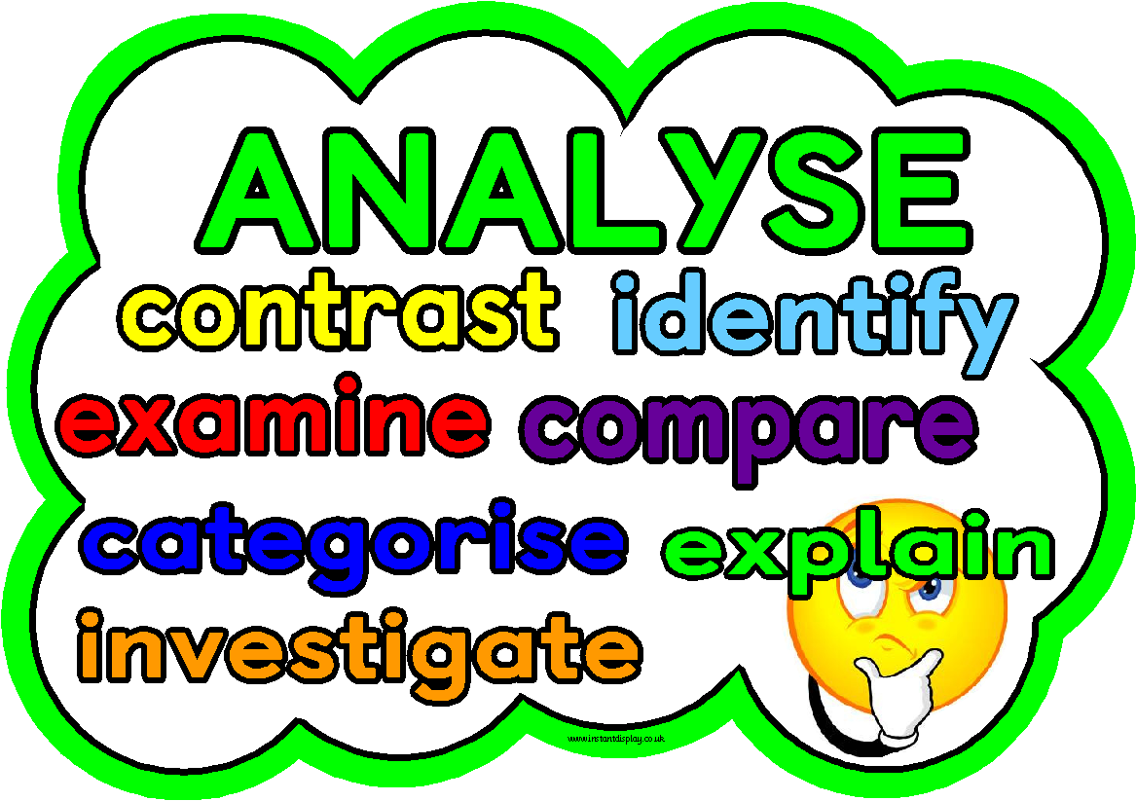
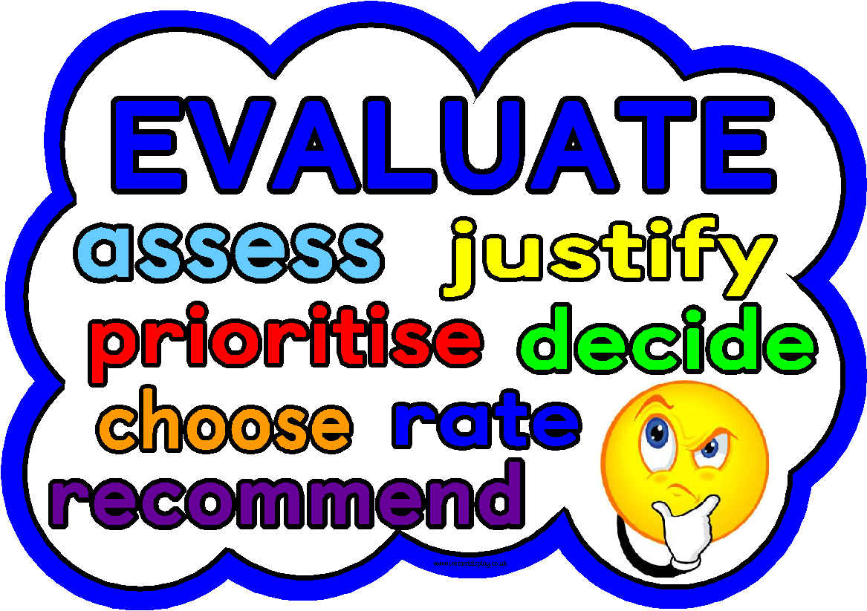
Notes:
Possible classroom visuals – helpful for staff and pupils

Slide 12
Effective Questioning
Aiming for more than recall questions
Accessing pupils’ prior knowledge
Re-framing questions

Slide 13
Remembering questions
Who can remember what happened in the last chapter?
What’s the capital of Germany?
Who knows what a plant needs to grow?

Slide 14
Framing Questions
Basic recall questions
Will often lead to same few hands, some pupils checking out and, “I don’t know.”
Instead, questions can be reframed so that they are more accessible and generate discussion:
Notes:
Try to reframe recall questions to make them more engaging and challenging.
The following can be used for starter questions to access prior knowledge / last day’s learning, or as questions during a lesson…

Slide 15
Giving range of answers

Slide 16
Giving range of answers
Original Question | Question Reframed
What is 5²? | What is 5²? Discuss each of the following answers and give reasons why they are right or wrong: 3 5 7 10 25 125
What physical activities improve the efficiency of the heart? | Which of these physical activities improve the efficiency of the heart? Give a reason for your answer. Cycling Walking Golf Swimming Skydiving Darts
What does a plant need to grow? | Which of the following does a plant need to grow? air water lemonade light heat sand soil
Notes:
https://www.shirleyclarke-education.org/video/maths-subtraction/ (just two answers)
https://www.shirleyclarke-education.org/video/literacy-debate-writing/ (three)

Slide 17
Aim to choose two right, two wrong and two debatable answers, which will generate the most discussion

Slide 18
Discussion statements, rather than questions

Slide 19
Discussion statements, rather than questions
Original Question | Question Reframed
What forms of exercise improve the efficiency of the heart? | All forms of exercise improve the efficiency of the heart. Do you agree or disagree? Have a reason for your answer.
Which drugs are bad for you? | All drugs are bad for you. Do you agree or disagree? Have a reason for your answer.
Why do we need prisons? | We need to have prisons. Do you agree or disagree? Have a reason for your answer.

Slide 20
Odd one out

Slide 21
Odd one out
Original question | Question reframed
What is a metaphor? | They glided across the room like swans. Her look shot through him like a bullet. They were skating on thin ice and they knew it. He felt as fragile as glass when he finally got up. - Which is the odd one out and why?

Slide 22
What went wrong?

Slide 23
What went wrong?
Original question | Question reframed
10 + 2 10 – 2 | 10 – 2 = 12 - What went wrong?

Slide 24
Put in order

Slide 25
Put in order
Original question | Question reframed
Which character is the most cowardly and why? | Put the characters in order from bravest to most cowardly.
What makes this a good final paragraph? | Put these final paragraphs in order from most to least effective.

Slide 26
Showing differing examples

Slide 27
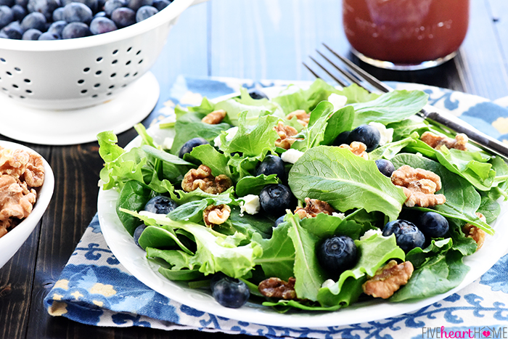
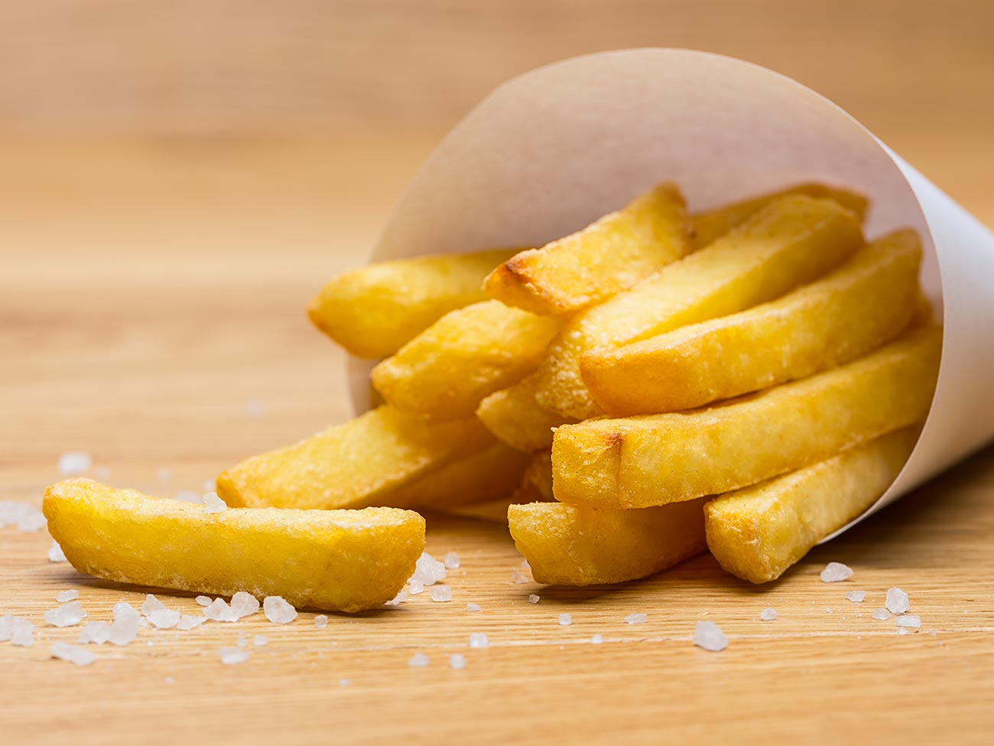
Showing differing examples
Original question | Question reframed
What makes a healthy meal? | Why is this a healthy meal… but this not?

Slide 28
Showing differing examples
Original question | Question reframed
Fix this sentence. She was stunned, no-one had ever been so rude to her, she didn’t understand. | Why is Sentence A correct, but Sentence B is not? A She was stunned – no-one had ever been so rude to her. She didn’t understand. B She was stunned, no-one had ever been so rude to her, she didn’t understand.

Slide 29
Opposing statement

Slide 30
Opposing statement
Original Question | Question Reframed
Why is it wrong to steal? | What would a mother whose children were starving think about shoplifting?
Why was it cruel to employ Victorian children to clean chimneys? | How would Victorian industrialists justify their employment of children?

Slide 31
Opposing statement
Original Question | Question Reframed
Why is it wrong to steal? | What would a mother whose children were starving think about shoplifting?
Why was it cruel to employ Victorian children to clean chimneys? | How would Victorian industrialists justify their employment of children?
All good questions.
Reframed ones offer differentiation, challenge and application.

Slide 32
True or false

Slide 33
True or false
Original Question | Question Reframed
What is a prime number? | Prime numbers are divisible by 2. True or false?
What does “setting” refer to? | Setting means where a story takes place. True or false?
When did World War 2 end? | World War 2 ended on August 14th 1945. True or false?
What is the biggest country in the world? | Russia is the biggest country in the world. True or false?

Slide 34
Other Starter ideas
Exemplars
A quick question on a whiteboard
A bingo game

Slide 35
Responding to Answers
Give pupils time to discuss these questions together while eavesdropping
Take answers – and reasons – from the class
Use the responses to inform the rest of the lesson – does something need to be revisited? Can an element of the planned lesson be skipped? Can some or all of the class move on?
Where appropriate, develop pupil responses, either:
By yourself – repeating their ideas for emphasis, clarifying or paraphrasing a muddled point they made
By asking more questions to tease out more details
By taking more answers from the class – ask for similar points, opposing points, for someone else to clarify…

Slide 36
Task
On your handout is a potted version of each of these strategies.
Traffic light them on the following basis:
Green = I have used this successfully
Amber = I haven’t used this before but think I could
Red = I don’t think this would work in my class / subject / stage

Slide 37
Task
Then share your thoughts with your partner, explaining:
Green = What you used it for and why you feel it worked
Amber = What you think you could use this for
Red = Why you think it won’t work – perhaps your partner will have a suggestion to help

Slide 38
Learning Intentions
We will know strategies to ask effective questions to access pupils’ prior learning
Notes:
How will we know we can do these?
- Be able to explain strategies to others; be able to use one tomorrow

Slide 39
Going Forward
Pair up with another teacher and plan prior knowledge questions for your next three lessons
Aim to use each prior learning question over the next few weeks, to find out which questions work best for your subject

