Slide 1
Assessment is for Learning
Feedback

Slide 2
Formative Assessment
Effective questio-ning
Self and peer assessment
Effective feedback
Sharing learning goals
Underpinned by a belief that all learners can make progress; that achievement comes from effort not just ability – growth mindset.
Notes:
Formative Assessment – all about using assessment to make adjustments to support pupils; literally to support learning, to see what needs to be retaught, to see what can be moved on from

Slide 3
Formative Assessment
Effective questio-ning
Self and peer assessment
Effective feedback
Sharing learning goals
Notes:
Today’s focus

Slide 4
Learning Intentions
We will understand the importance of effective feedback
We will be able to give effective feedback both during and after lessons
Notes:
How will we know we can do these?
- Be able to explain strategies to others; be able to use one tomorrow

Slide 5
T-P-S
What is the purpose of giving feedback?

Slide 6
Ensures learners – and staff! – are clear about what they have done well and what they need to do next to improve
Ensures learners are engaged in high quality interactions throughout the learning process
Supports learners when target setting/profiling/personal learning planning
Provide specific areas for improvement, based on Success Criteria
Ensure appropriate pace, progression and challenge

Slide 7
T-P-S
How do we ensure that feedback does these things?
How do we ensure that feedback doesn’t:
  Make able pupils become complacent?
  Make less able pupils feel demotivated?

Slide 8
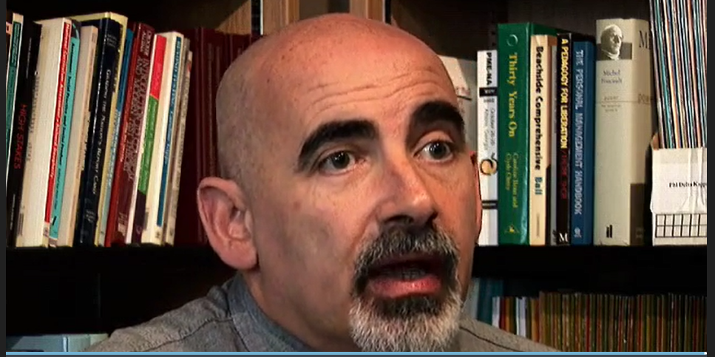
“Good feedback causes thinking”
Notes:
Not to ego boost – not to make pupils sad or scared of failure
Should be factual and constructive
https://glowscotland.sharepoint.com/portals/hub/_layouts/15/PointPublishing.aspx?app=video&p=p&chid=01e457d7-d42d-458c-9cf5-ec8de2ec11c4&vid=e8e948da-b3d3-4383-adb3-90fb0d359143

Slide 9
Good Feedback – T-P-S
What should good feedback be like?
Notes:
Based on Success Criteria
Specific
Achievable
Pupil language
Constructive
Not based on admin (unless this is part of the SC)

Slide 10
Effective feedback should:
Link to Success Criteria
Be specific and understandable
Be based on achievements the pupil has made
Focus on pupil effort
Come from pupils themselves and their peers
Be timely
Be acted upon by the pupil

Slide 11
Effective feedback should not:
Focus on natural ability (“You’re so good at writing!”)
Focus on the speed or ease with which the pupil completed a task (“I knew you’d get it with no bother.”)
Focus on admin or presentation, unless this is part of the Success Criteria

Slide 12
In lesson Feedback
Feedback is most effective when pupils are able to immediately respond to it:
“Memory is the residue of thought. We remember what we think about.” D. Willingham
If pupils simply read the feedback the teacher has written for them after they have completed a task, they are less likely to remember it weeks later than if they actually engage with the feedback there and then.

Slide 13
T-P-S
How do you provide pupils with “in the moment” feedback?

Slide 14
In the moment feedback
Moving around the room, pen in hand, and:
  Asking key questions about the work and the pupils’ intentions
  Putting the correction code or symbols in jotter
  Giving specific advice on how to improve work (“Put one more adjective here.” “You’ve added this part of the sum incorrectly. Have another look.”)

Slide 15
In the moment feedback
Stopping pupils mid-lesson, drawing attention to the Success Criteria and asking them to traffic light their work; greens can then work with ambers and the teacher can work with reds to improve work
Selecting one pupil’s work at random and stopping the whole class to discuss it; discuss the best parts and have pupils make specific suggestions on how to improve it. The rest of the class can then use the remaining time to assess their own work in the same way (https://www.shirleyclarke-education.org/video/literacy-arrival-writing-feedback-3/)
Notes:
2 – how can we make pupil’s work visible to whole class? Visualiser? Photo + smartboard?

Slide 16
In the moment feedback – peer assessment
Having pupils work in pairs to assess their work (sometimes called Self and United Improvements).
  Author reads their work aloud
  Both pupils suggest corrections or improvements
  Author holds the pen and actually makes the changes
  Pupil indicates where they made changes by putting “SI” or “UI” (self or united improvement) next to it
  https://www.shirleyclarke-education.org/video/literacy-speech-writing-6/

Slide 17
Crucial that pupils are able to act on the feedback they receive
Notes:
A practical way of ensuring they do…

Slide 18
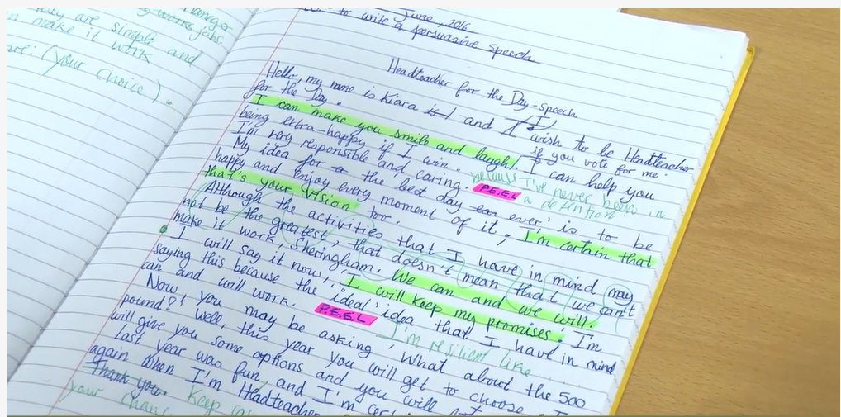
A blank page for corrections / additions…
Notes:
Some schools not redrafting anymore. More importance being placed on the editing and uplevelling process.

Slide 19
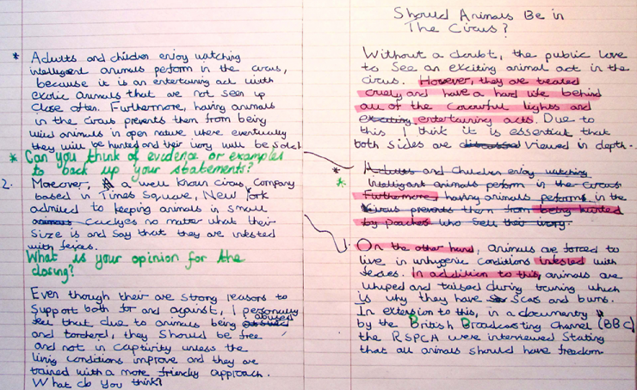
Originally a blank page

Slide 20
In Lesson Feedback – Plenaries
An effective plenary should highlight a pupil’s misconceptions
Once identified these need to be addressed either at the time or within the lessons that follow
They should also give the pupils opportunity to reflect on what and how they have learned and guide them to their next steps to success.
https://www.shirleyclarke-education.org/video/maths-range-mode-5/
  Instant feedback
  Days later, it would have been too late
Notes:
For example:
if pupils bring over their exit passes while they are packing up, the teacher can immediately gauge their understanding and, in certain circumstances, immediately correct it and send the pupil back to fix their mistake;
if this isn’t possible, the teacher can use the exit passes in the next lesson to address misconceptions, perhaps by pairing up pupils who understood with those who did not.

Slide 21
Post Lesson Feedback – T-P-S
Shirley Clarke, Dylan Wiliam and John Hattie all agree that post lesson feedback is less effective than in the moment feedback
Why is post lesson feedback a necessity?

Slide 22
POST LESSON FEEDBACK
Accountability?
A written note seen as more official than verbal comment
Timing issues in lessons
Won’t be forgotten
Can be more thoughtful
Notes:
Accountability? – schools should ask themselves, “Why are we doing this? What is the impact?” – in an ideal world, things like “feeling we have to” shouldn’t be a good reason for doing something; if something has no impact (as written comments often don’t) then we should reconsider
A written note seen as more effective than verbal comment – possibly; though a verbal comment can be acted on immediately
Timing issues in lessons – true; with time, in class feedback should improve
Won’t be forgotten – true, but can be ignored
Can be more thoughtful – true; but if Success Criteria are good and there, this should make it straightforward enough for meaningful feedback to be given on the fly

Slide 23
Obviously, time is a major factor in giving effective post lesson feedback
Instead of marking individual comments and targets in everyone’s jotters, some practical means of giving feedback are:

Slide 24
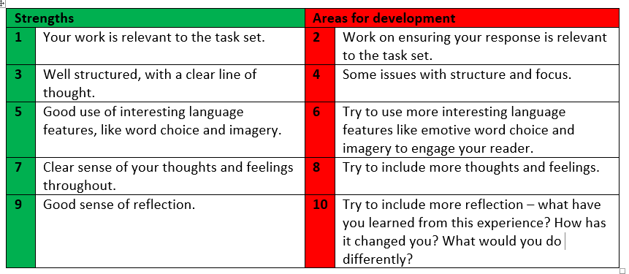
Writing numbers or symbols on the work, which then relate to typed or written feedback on the board
Notes:
Or even giving out these sheets at the start of block of work, so pupils know what they are working towards from the start

Slide 25
Highlighting or underlining in set colours to indicate strengths and areas for improvement
Putting jotters in piles depending on what they need to work on
Giving whole class feedback (ie. “Most of you did a good job with… Something most of you forgot about was…”)
Simply acknowledging you have read it, if the pupil has received in class feedback already (ie. a tick, a signature)
  In all cases, pupils should then spend time acting on this feedback as soon as possible

Slide 26
Of course, sometimes marking full sets of pupil work is required
In these cases, as with all feedback, comments should:
  Relate to Success Criteria
  Be achievable
  Be specific
  Be written in pupil language
  Give them a clear next step

Slide 27
Learning Intention | Success Criteria | Possible feedback
We will be able to use notes to create a new text | I have read my notes carefully to check I understand I have written using my own words I have used the headings to structure my text in paragraphs I have included the key information from my notes | ‘You have used your notes well to organise your writing into paragraphs. You have included the key information. Can you improve the highlighted sections by re-writing them using your own words?’
Notes:
Some good feedback – the following examples come from Education Scotland materials

Slide 28
Learning Intention | Success Criteria | Possible feedback
We will be able to use notes to create a new text | I have read my notes carefully to check I understand I have written using my own words I have used the headings to structure my text in paragraphs I have included the key information from my notes | ‘You have used your notes well to organise your writing into paragraphs. You have included the key information. Can you improve the highlighted sections by re-writing them using your own words?’
Notes:
Some good feedback

Slide 29
Learning Intention | Success Criteria | Possible feedback
We will be able to use notes to create a new text | I have read my notes carefully to check I understand I have written using my own words I have used the headings to structure my text in paragraphs I have included the key information from my notes | ‘You have used your notes well to organise your writing into paragraphs. You have included the key information. Can you improve the highlighted sections by re-writing them using your own words?’
Notes:
Some good feedback

Slide 30
Task
Look at the following pieces of feedback and make brief comments on whether they achieve the Success Criteria of good feedback:
 | Feedback
1 | ‘You’ve completed the task with a score of 9/10. Next time remember the date.’
2 | ‘You’ve included most of the features of a bar graph (title, lines, bars) and your data has been presented clearly. Can you label the X and Y axes?’
3 | ‘Your writing has good detail It is well presented W. Use more ambitious vocabulary, make it more engaging for the reader and come up with a better ending.’

Slide 31
Improving Feedback
Do you agree with these comments?
 | Feedback | Comments
1 | ‘You’ve completed the task with a score of 9/10. Next time remember the date.’ | Focused on task completion and score with no reference to specific area of focus in learning. Focused on a daily routine rather than linking to the learning. Doesn’t help the learner move forward.
2 | ‘You’ve included most of the features of a bar graph (title, lines, bars) and your data has been presented clearly. Can you label the X and Y axes?’ | Specific achievements. Gives a clear next step which the pupil can immediately act upon, and which shows the teacher that they need to spend more time on this topic if they get it wrong.
3 | ‘Your writing has good detail It is well presented W. Use more ambitious vocabulary, make it more engaging for the reader and come up with a better ending.’ | Gives some indication of what has been done well but needs to be more specific – why was the detail good? Was presentation part of the intended learning? If not, this isn’t relevant. Too many next steps, and these are vague too – what sort of “ambitious vocabulary”? Adjectives? Imagery? Where should these go? What will make it more engaging? How can the ending be better?

Slide 32
Thinking about feedback
Building in regular class time to think about feedback is important.
Example:
  Every Friday, the class discuss what they have worked on each day, what they have learned and what skills they have used.
  The teacher supports as required, making notes on the board and leading discussion
  Pupils note down what they have learned with an example of this learning (eg. “We learned about verbs,” followed by a sentence with underlined verbs)
  Pupils decide how to present their learning; younger pupils could draw
  OR they write down that they did not understand this piece of learning.
This allows the pupils to focus on their learning individually while helping the teacher see who needs extra support.
A feedback jotter solely dedicated to this (with both blank and lined pages) would be helpful.

Slide 33
One to one
Very effective, especially with Literacy work.
The teacher points out good qualities of the pupil’s work and suggests ways to improve it
They also ask for the pupil’s opinion and why they made certain choices.
Five/ten minute conversations (every three, four, five, six weeks?)
Could be very effective in providing pupils with next steps and means to improve their work.
Meanwhile, rest of class reflect on own learning / finish off work

Slide 34
Peer feedback
Pupils require training in how to do this properly.
Some practical means of using peer assessment include:
  Pupils going around the room putting post its with comments on each other’s work – this means each pupil receives a large amount of feedback from a variety of pupils, while also ensuring every pupil gets to read a range of responses and learn from their peers
  Pupils using Success Criteria as a “checklist” on a peer’s work, in order to point out anything they have missed
  Pupils giving two stars and a wish to each other’s work, after using Success Criteria and exemplar work to ensure all pupils understand what makes a good piece of work
  United improvements

Slide 35
Learning Intentions
We will understand the importance of effective feedback
We will be able to give effective feedback both during and after lessons
Notes:
How will we know we can do these?
- Be able to explain strategies to others; be able to use one tomorrow

Slide 36
Next steps
Aim to incorporate elements of in lesson feedback into your practice – begin with one per week (approximately) and build up from there
Bring two pieces of feedback to a staff meeting and moderate with colleagues, checking that they are specific, based on Success Criteria, pupil friendly, achievable and not distracted by admin
Experiment with Feedback Fridays or one to one literacy conversations – see how many weeks it takes to see every pupil

