Slide 1
ASSESSMENT IS FOR Learning
Effective questioning

Slide 2
Formative Assessment
Effective questio-ning
Self and peer assessment
Effective feedback
Sharing learning goals
Underpinned by a belief that all learners can make progress; that achievement comes from effort not just ability.
Notes:
Formative Assessment – all about using assessment to make adjustments to support pupils; literally to support learning, to see what needs to be retaught, to see what can be moved on from

Slide 3
Formative Assessment
Effective questio-ning
Self and peer assessment
Effective feedback
Sharing learning goals
Notes:
Today’s focus; however, will be making use of others

Slide 4
Learning Intentions
We will be able to establish a classroom culture in which all pupils engage in discussion
We will know strategies to ask effective questions
Notes:
How will we know we can do these?
- Be able to explain strategies to others; be able to use one tomorrow

Slide 5
T-p-s
How we establish a culture where every pupil is involved?

Slide 6
To establish a culture where all pupils are involved…
Thinking time
Strategies for gathering in answers
Talking Partners

Slide 7
Thinking time
Three seconds at least (rather than one)
Making it clear that it is thinking time
Better to have something to do – jot down answer; discuss with a partner; Think Pair Share…
Notes:
avoid simply asking questions and immediately taking answers from the same pupils who quickly raise their hands. If a pupil is trying to think of an answer, hands shooting up around them will be distracting and disheartening; constantly experiencing this may lead to pupils opting out of class discussion.

Slide 8
Random selection
Selecting pupils to answer rather than having them put their hands up
“Hands up? You must have a question!”
Notes:
Issue of making some pupils uncomfortable
Needs to be a culture that all pupils are involved so they’re used to it
Try to chip away over time
But must respect pupils’ feelings obviously – if they’re uncomfortable make a subtle agreement with them

Slide 9
Taking in answers
Word wave
No hands up
Select pupil to give partner’s response
Select pair; both pupils need to answer
Shouting out at once
“Popcorn”

Slide 10
A Big question
Following a block of teaching, a question is asked with multiple choice answers
Answers indicated by:
Holding up fingers
Going to the corresponding corner
Show me boards
Socrative
What can we do to preserve the ozone layer?
Reduce the amount of carbon dioxide produced by cars and factories
Reduce the greenhouse effect
Stop cutting down the rainforests
Limit the numbers of cars that can be used when the level of ozone is high
Properly dispose of air-conditioners and fridges

Slide 11
Talking Partners
Chance for pupils to consider answers together
30 seconds after questions, especially at start of lesson
Change regularly – weekly, if possible
Continue to randomly select pupils to answer questions
A class success criteria (like a list of rules) for being an effective talk partner should be established at the start of the session and displayed
Where particular support is required there should be a trio rather than a pair
Partners must be assigned by the teacher, rather than pupils just being instructed to discuss their ideas with someone

Slide 12
Talking Partners
Not paired up by ability, gender, friendship…
But randomly
Notes:
Discussion – problems with this?
https://www.shirleyclarke-education.org/video/science-soil-study/ Older Pupils
https://www.shirleyclarke-education.org/video/math-word-problems/ Talk partners, mid-lesson stop; with 3.44 left, teacher discussion about the talk partners

Slide 14
Responding to answers
A teacher’s response to pupils’ incorrect answers is also important
In order to develop a true growth mind-set (vital for AifL to work) we must embrace challenge and remove the stigma around mistakes
Notes:
Want to create an environment when pupils are confident to answer and don’t feel embarrassed by wrong answers – how?

Slide 15
Responding to answers
Gathering answers – “Okay - does anyone have anything they can add to this?”
Asking for explanation of wrong answers – “What makes you say that?”
Offering additional information – “What if I told that…? Would that make a difference?”
Stalling to give pupil reflection time – “Hold that thought and we’ll come back to that.”
No pressure – “What do you think? Anything at all.”
Thanking pupils for mistakes – “Thank you for that, actually, because it means we can discuss this more…”
Notes:
Want to create an environment when pupils are confident to answer and don’t feel embarrassed by wrong answers – how?

Slide 16
Learning Intentions
We will be able to establish a classroom culture in which all pupils engage in discussion
We will know strategies to ask effective questions
Notes:
How will we know we can do these?
- Be able to explain strategies to others; be able to use one tomorrow

Slide 17
Effective Questioning
Aiming for more than recall questions

Slide 18
Notes:
Possible classroom visuals – helpful for staff and pupils

Slide 19
Notes:
Possible classroom visuals – helpful for staff and pupils

Slide 20
Effective Questioning
Aiming for more than recall questions
Accessing pupils’ prior knowledge
Re-framing questions

Slide 21
Remembering questions
Who can remember what happened in the last chapter?
What’s the capital of Germany?
Who knows what a plant needs to grow?
Notes:
Not without worth but not the most challenging or engaging

Slide 22
Framing Questions
Basic recall questions
Will often lead to same few hands, some pupils checking out and, “I don’t know.”
Instead, questions can be reframed so that they are more accessible and generate discussion:
Notes:
Try to reframe recall questions to make them more engaging and challenging.
The following can be used for starter questions to access prior knowledge / last day’s learning, or as questions during a lesson…

Slide 23
Giving range of answers

Slide 24
Giving range of answers
Original Question | Question Reframed
What is 5²? | What is 5²? Discuss each of the following answers and give reasons why they are right or wrong: 3 5 7 10 25 125
What physical activities improve the efficiency of the heart? | Which of these physical activities improve the efficiency of the heart? Give a reason for your answer. Cycling Walking Golf Swimming Skydiving Darts
What does a plant need to grow? | Which of the following does a plant need to grow? air water lemonade light heat sand soil

Slide 25
Aim to choose two right, two wrong and two debatable answers, which will generate the most discussion

Slide 26
Discussion statements, rather than questions

Slide 27
Discussion statements, rather than questions
Original Question | Question Reframed
What forms of exercise improve the efficiency of the heart? | All forms of exercise improve the efficiency of the heart. Do you agree or disagree? Have a reason for your answer.
Which drugs are bad for you? | All drugs are bad for you. Do you agree or disagree? Have a reason for your answer.
Why do we need prisons? | We need to have prisons. Do you agree or disagree? Have a reason for your answer.

Slide 28
Odd one out

Slide 29
Odd one out
Original question | Question reframed
What is a metaphor? | They glided across the room like swans. Her look shot through him like a bullet. They were skating on thin ice and they knew it. He felt as fragile as glass when he finally got up. - Which is the odd one out and why?

Slide 30
What went wrong?

Slide 31
What went wrong?
Original question | Question reframed
10 + 2 10 – 2 | 10 – 2 = 12 - What went wrong?

Slide 32
Put in order

Slide 33
Put in order
Original question | Question reframed
Which character is the most cowardly and why? | Put the characters in order from bravest to most cowardly.
What makes this a good final paragraph? | Put these final paragraphs in order from most to least effective.

Slide 34
Showing differing examples

Slide 35
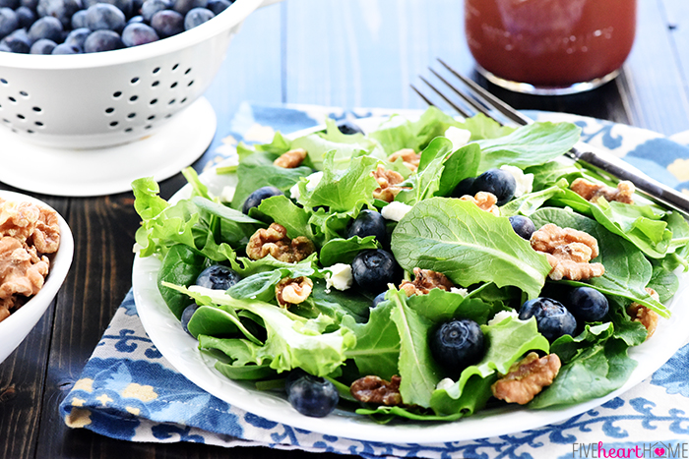
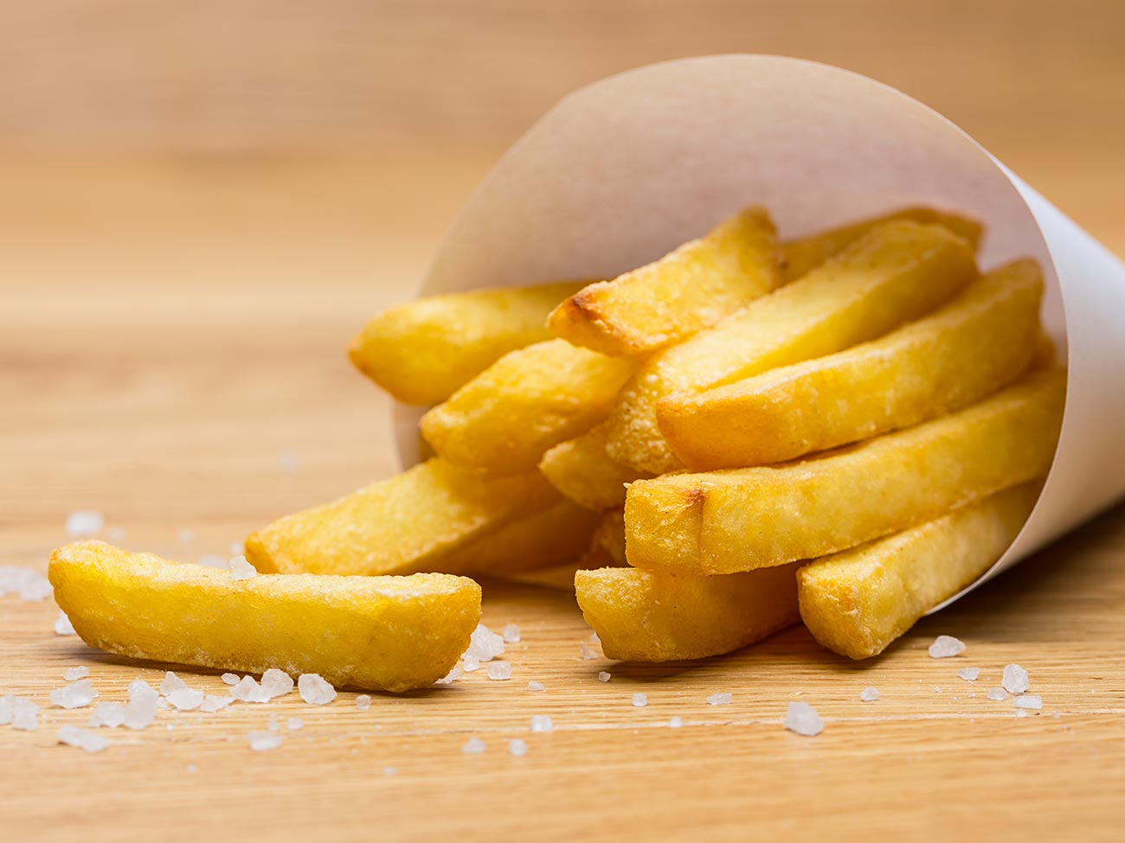
Showing differing examples
Original question | Question reframed
What makes a healthy meal? | Why is this a healthy meal… but this not?

Slide 36
Showing differing examples
Original question | Question reframed
Fix this sentence. She was stunned, no-one had ever been so rude to her, she didn’t understand. | Why is Sentence A correct, but Sentence B is not? A She was stunned – no-one had ever been so rude to her. She didn’t understand. B She was stunned, no-one had ever been so rude to her, she didn’t understand.

Slide 37
Opposing statement

Slide 38
Opposing statement
Original Question | Question Reframed
Why is it wrong to steal? | What would a mother whose children were starving think about shoplifting?
Why was it cruel to employ Victorian children to clean chimneys? | How would Victorian industrialists justify their employment of children?

Slide 39
Opposing statement
Original Question | Question Reframed
Why is it wrong to steal? | What would a mother whose children were starving think about shoplifting?
Why was it cruel to employ Victorian children to clean chimneys? | How would Victorian industrialists justify their employment of children?
All good questions.
Reframed ones offer differentiation, challenge and application.

Slide 40
True or false

Slide 41
True or false
Original Question | Question Reframed
What is a prime number? | Prime numbers are divisible by 2. True or false?
What does “setting” refer to? | Setting means where a story takes place. True or false?
When did World War 2 end? | World War 2 ended on August 14th 1945. True or false?
What is the biggest country in the world? | Russia is the biggest country in the world. True or false?

Slide 42
Responding to Answers
Give pupils time to discuss these questions together while eavesdropping
Take answers – and reasons – from the class
Use the responses to inform the rest of the lesson – does something need to be revisited? Can an element of the planned lesson be skipped? Can some or all of the class move on?
Where appropriate, develop pupil responses, either:
By yourself – repeating their ideas for emphasis, clarifying or paraphrasing a muddled point they made
By asking more questions to tease out more details
By taking more answers from the class – ask for similar points, opposing points, for someone else to clarify…

Slide 43
Task
On your handout is a potted version of each of these strategies.
Traffic light them on the following basis:
Green = I have used this successfully
Amber = I haven’t used this before but think I could
Red = I don’t think this would work in my class / subject / stage

Slide 44
Task
Then share your thoughts with your partner, explaining:
Green = What you used it for and why you feel it worked
Amber = What you think you could use this for
Red = Why you think it won’t work – perhaps your partner will have a suggestion to help

Slide 45
Learning Intentions
We will be able to establish a classroom culture in which all pupils engage in discussion
We will know strategies to ask effective questions
Notes:
How will we know we can do these?
- Be able to explain strategies to others; be able to use one tomorrow

Slide 46
Going Forward
Pair up with another teacher and plan three HOTS questions for an upcoming lesson
Pair up with another teacher and have them observe during a period of questioning in your class. Have them make notes on whether you:
Give appropriate thinking time
Encourage all pupils to engage (using strategies like no hands up, talk partners)
Use HOTS questions
Respond appropriately to pupil responses

