Slide 1
Planning learning, teaching and assessment using the NAR flowchart.
Notes:
‘Assessment practice will follow and reinforce the curriculum and promote high quality learning and teaching approaches. Assessment of children’s and young people’s progress and achievement during their broad general education to the end of S3 will be based on teachers’ assessment of their knowledge and understanding, skills, attributes and capabilities, as described in the experiences and outcomes across the curriculum.’
(Building the Curriculum 5: A Framework for Assessment, p. 8)

Slide 2
The NAR flowchart = the moderation cycle

Slide 3
Planning the learning
Which Es and Os will be the focus of the learning? Identify a theme and pertinent Es and Os.
Planned learning may touch on several curriculum areas but focus the selection of Es and Os on the learning you plan to assess.
Remember, the principles and practice documents will outline the broad features of assessment for a curricular area and for the ‘responsibility of all’ areas of the curriculum.

Slide 4
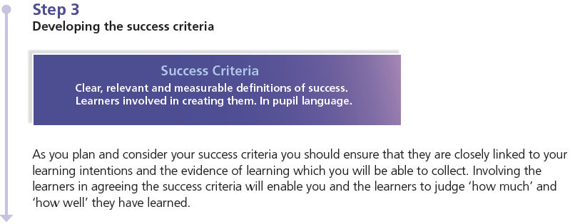
Planning the learning contd
Look at the selected Es and Os and consider the learning opportunities in each.
Determine the learning intentions, keeping in mind the assessment evidence you plan to gather.
Plan for differentiation within the level.

Slide 5
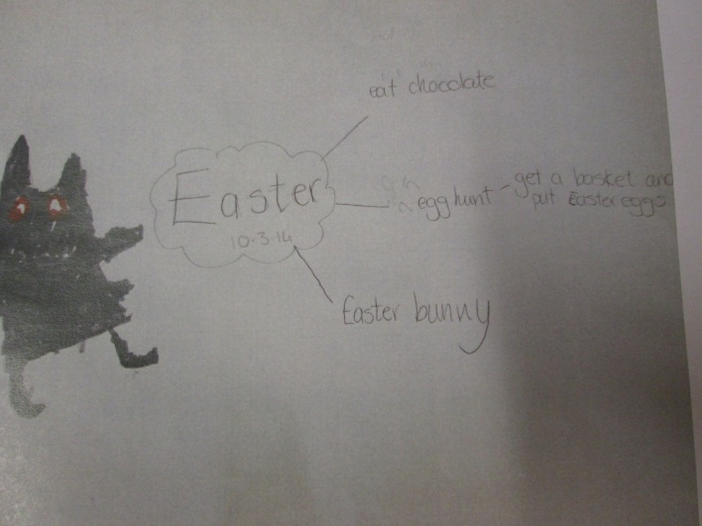
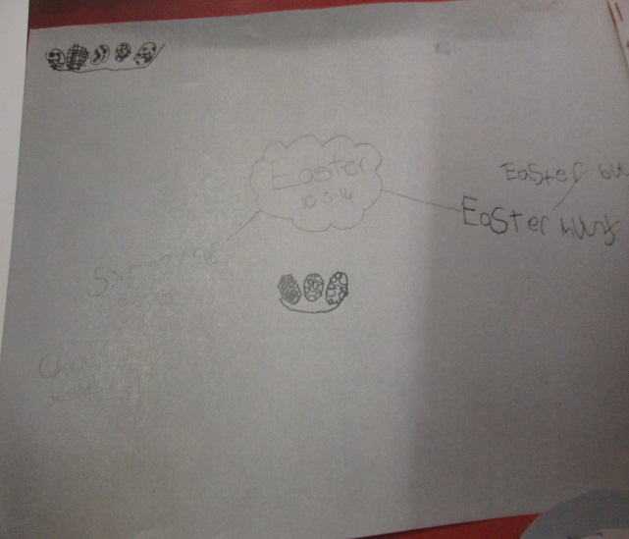
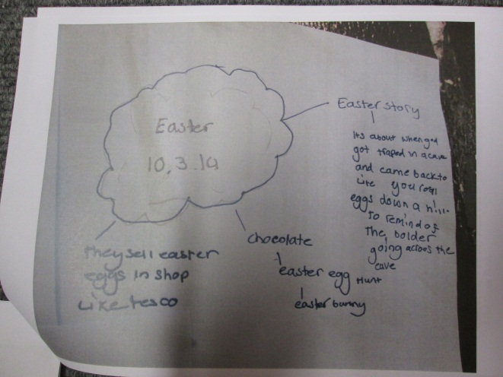
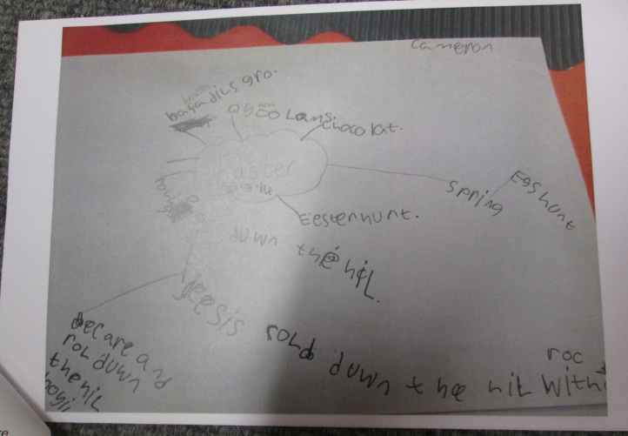
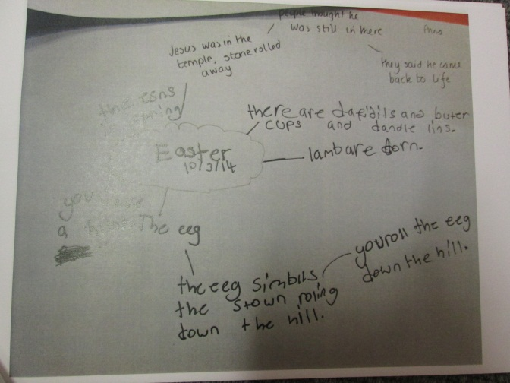
What do I already know?
Notes:
At the start of a topic, the pupils are asked to complete a mindmap where they write down everything they already know about that topic. From this I can then see the starting point for each pupil and how they can be grouped. This means pupils are being grouped by ability and not by class- this is so that all pupils are working at a level appropriate to them, to ensure progress and challenge.

Slide 6
What is a learning intention?
What learners should know, understand or be able to do by the end of a learning experience.
The focus should be on what is to be learned
What makes a good Learning Intention?
set the learning intention in context
keep it focused
use language the pupils will understand
use words associated with learning

Slide 7
Why are learning intentions important?
Learners will be more focused and actively engaged in their own learning.
Sharing the learning intention makes it easier to give quality feedback specifically on what has been learned.

Slide 8
The first ‘active’ element of formative assessment in the classroom is the sharing of learning intentions with children… Without the learning intention, children are merely victims of the teacher’s whim. Unlocking Formative Assessment Shirley Clarke, 2001

Slide 9
Over to you . . .
Looking at the learning intentions for this training, create your own success criteria.

Slide 10
What are success criteria?
Success criteria are suggested ways to achieve the learning intention. As you plan and consider your success criteria you should ensure that they are directly linked to your learning intentions and the evidence of learning which you will be aiming to collect.
Children should be co-constructing success criteria from early level onwards.

Slide 11
Guiding Questions to help…
What can you do to show me that you have learnt this?
What could we make?
What can you do to show me that you played a role?
How will we know if our __________ has been a success?
What roles are required for a successful ___________?
What skills would a person require to fill each of these roles?
How will you know that you have been successful as an individual and as part of a group?
How will we measure our success?
What evidence might you gather to show me that you were successful?
How will you record your evidence?
How will you tell your parents about our project and show them that you were successful in your role?

Slide 12
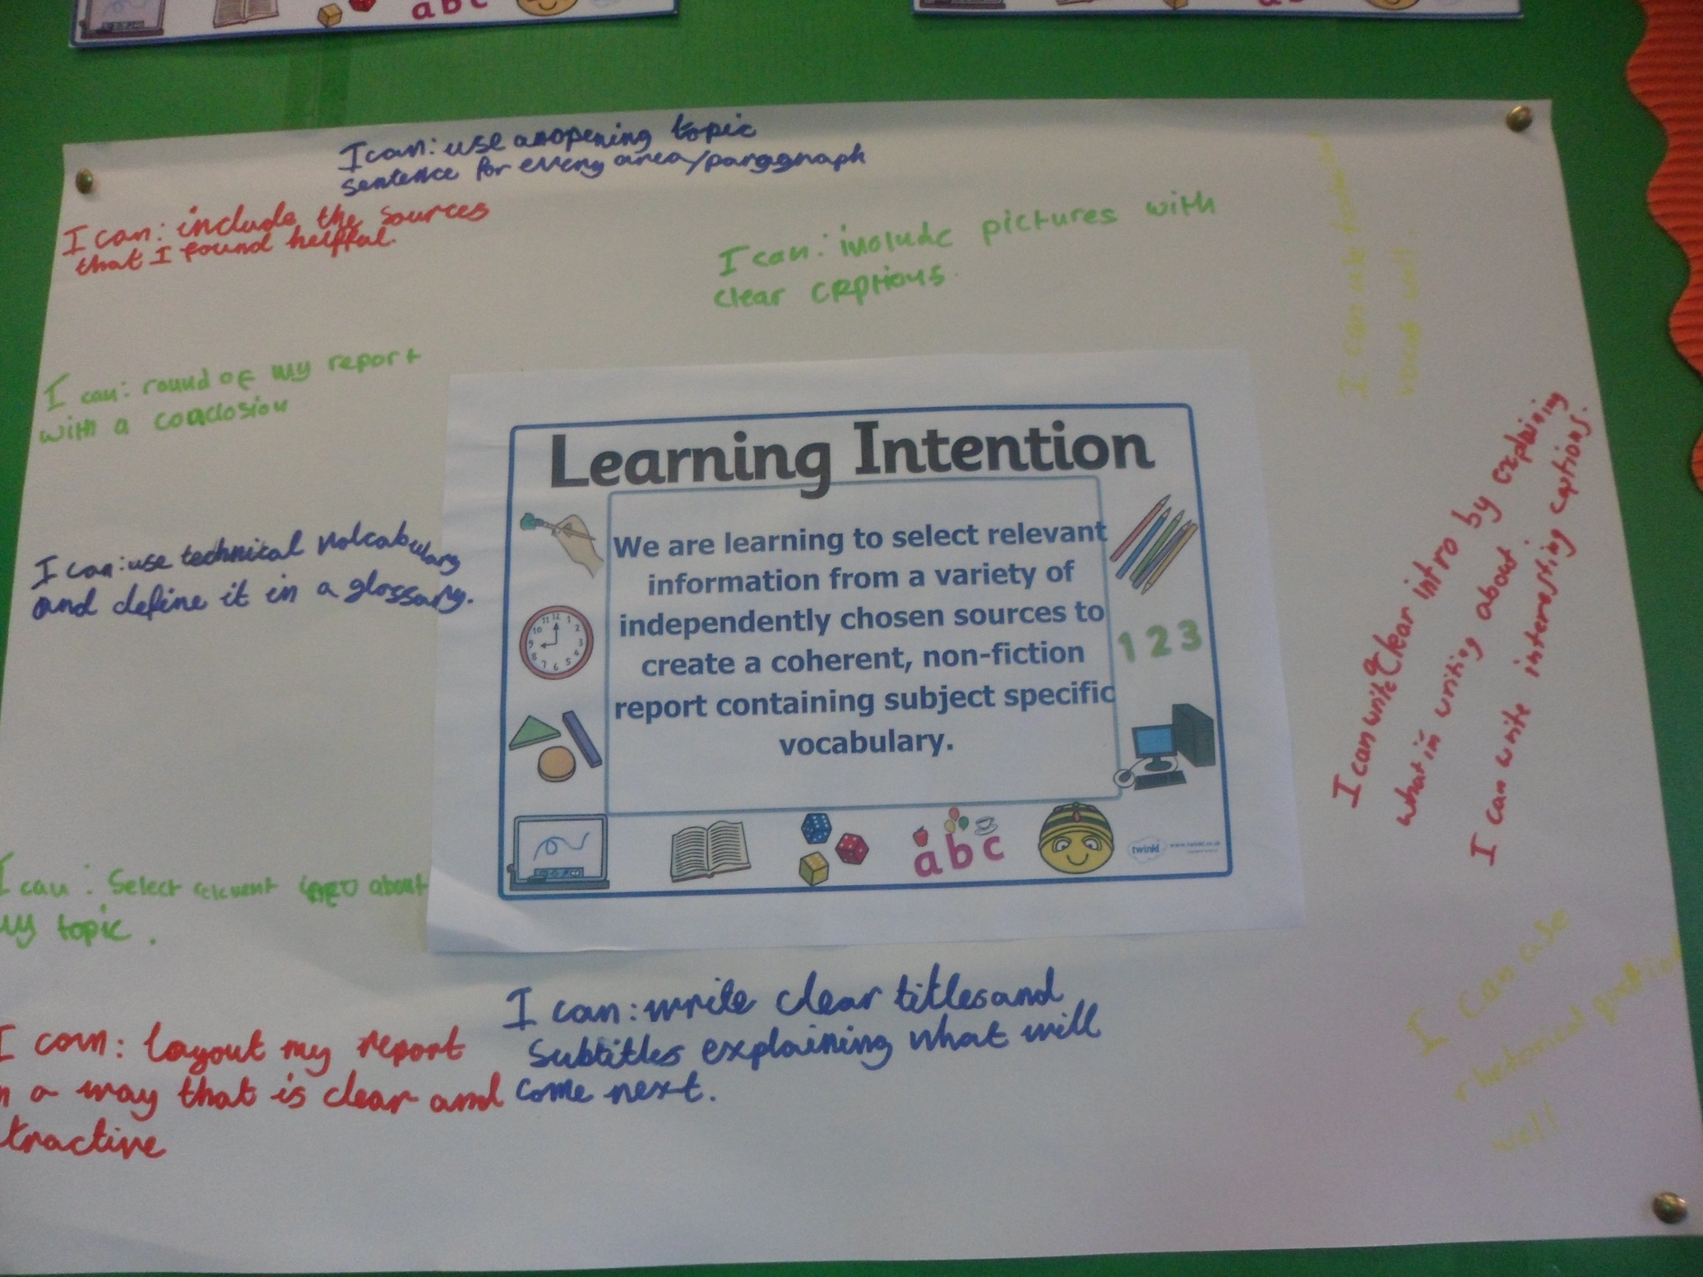

Slide 13
Report Writing Moderation: Jan-April 2016 Simple task Progression of Success Criteria – Early toward third level Complex task LIT 0-26a, 1-26a, 2-26a We are learning to….
share information in a way that communicates my message. | select information to create a report that communicates my message. | select information and organise it to create a report to communicate my message. | select relevant information to and organise it to create a report which is useful to others. | select relevant information from given sources to create a report for a specific audience. | select relevant information from a range of given sources to create a coherent report for a specific audience. |  | select relevant information taken from independently chosen sources to create a coherent, nonfiction, report containing subject specific vocabulary.
Success Criteria I can…
* present information that is true. * use my listening skills to find out information. *create a report that is neat, tidy and correct. * use new vocabulary related to my topic when I am talking. | * with support I can write about what I’ve found out in my own words. * select information about the topic from what I see and hear. * write a neat report with pictures and a title. * I can select topic words from a word bank to use in my writing. | * write about what I’ve found out in my own words. * select information about the topic from what read. * write a neat report with pictures, a title and subheadings. * I can select topic words from a range of resources to use in my writing. | * with guidance I can use the books and websites given to find information for each question. * choose information about my subject which answers a question. * I can use a writing frame to structure my report that includes headings and pictures. * I can use topic language to give information to others. | * use the books or websites given to find information for a research question. * choose information about my subject which answers the questions I have written. * I can organise my writing under subheadings and consider my layout so it makes sense. * I can use topic language which is suitable for my audience. | * choose sources from a given selection that are suitable for my needs. * record specific information and put it in my own words. * use the features of a report including a clear introduction and rounding off nicely. * write clear sentences using some technical language. | * use a range of independently selected sources (internet, books, people) to gather information on each of my subheadings. * gather relevant and concise information and demonstrate an understanding by discussing it in my own words. * organise my information into a coherent non-fiction report including (a suitable introduction explaining what will be in the report, a conclusion to sum up, chronological organization where possible, links) * include subject specific vocabulary and define this in my glossary. * Include my sources at the end – listing what websites or primary sources I used.

Slide 14
Planning the learning experiences
Plan learning experiences which match the learning intentions and provide breadth, challenge and application of learning.
Consider the different needs in the classroom and the best tasks / activities to motivate and engage learners.
Will the learning experiences give learners the opportunity to develop and demonstrate their knowledge, understanding, skills, attributes and capabilities?
Reflect the 7 design principles.

Slide 15
The principles of design
Challenge
Enjoyment
Breadth
Depth
Progression
Personalisation
Choice
Relevance

Slide 16
“Buzzwords”
How many examples of good practice have you heard about over the years?!
List as many as you can in 1 minute
http://www.online-stopwatch.com/countdown-timer/

Slide 17
Experiences and Outcomes | Learning Intentions | Success Criteria | Teaching and Learning Activities | Links and Applying Skills
I can use primary and secondary sources selectively to research events in the past. SOC 2-01a I can use evidence selectively to research current social, political or economic issues. SOC 2-15a When listening and talking with others for different purposes, I can: • share information, experiences and opinions • explain processes and ideas • identify issues raised and summarise main points or findings • clarify points by asking questions or by asking others to say more. LIT 2-09a | We are learning to: Select appropriate primary and secondary sources to gather information about historical warfare. Use our research skills to gather information on a current political conflict. Take on a role that contributes towards producing our final outcome. | 1. I can: Select relevant sources for researching WWI. Distinguish between primary and secondary sources. Gather information about the causes and consequences of WWI. 2. I can: Gather information from various sources about the Israel/Palestine conflict. Discuss our findings in group and class situations. Compare the key features of historical and modern warfare. 3. I can: Ensure that everyone in my group has a role and set responsibilities. Share my ideas and listen respectfully to the ideas of others. Evaluate how effectively I have carried out my responsibilities. | What is conflict: Define war and conflict. Look at different definitions, what does this really mean? Use interactive site (RGS: What’s conflict) + information sheet to create a timeline of major wars/conflict. Consider distribution on world map, is this even? How do modern/historical compare? Why do wars occur: Look at poem, discuss and illustrate. Discussion: what reasons are they aware of? Discuss broad categories and what these mean by referring to examples. Watch BBC clip explaining how climate change can cause war. Focus specifically on WWI and its causes. Diamond ranking activity using BBC site as support. Consider: was it inevitable or could steps be taken to avoid? Refer back to learning on WWI, consider how the war developed and how it ended. Learn the difference between primary and secondary sources. Children will then be deciding whether a range of given sources are primary or secondary and using them to create an information booklet about key aspects of WWI. What were the consequences of this war? Scrutinise the implications of the Treaty of Versailles and how it affected Europe. Create an abridged version of the Treaty of Versailles, specifically focusing on the political and economic effects on France and Germany. Debate whether the decisions in Versailles were too hard on Germany. Modern day conflict: what modern day conflicts did we consider in week 1? Today we will be learning more about the cause of the Israel/Palestine conflict (this will tie in with work in RME). Power-point with reading for information and research tasks throughout. Watching short documentary about the development of the conflict. This conflict is still going on today, but what are the consequences? Compare statistics on civilian lives lost. Modern/historical warfare comparison. Assessment task. | Comprehension: Children will be studying texts associated with WWI this term (non-fiction, recount, poetry). PE activities are focused on avoiding conflict and taking a leading role. Children will also be developing leadership skills through our technology project.
Notes:
From building the Success Criteria with the pupils, I then look at what Learning Experiences I am going to provide that will ensure the pupils have opportunities to meet the criteria. Again this ensures differentiation and that all pupils are working on experiences suitable to their ability.

Slide 18
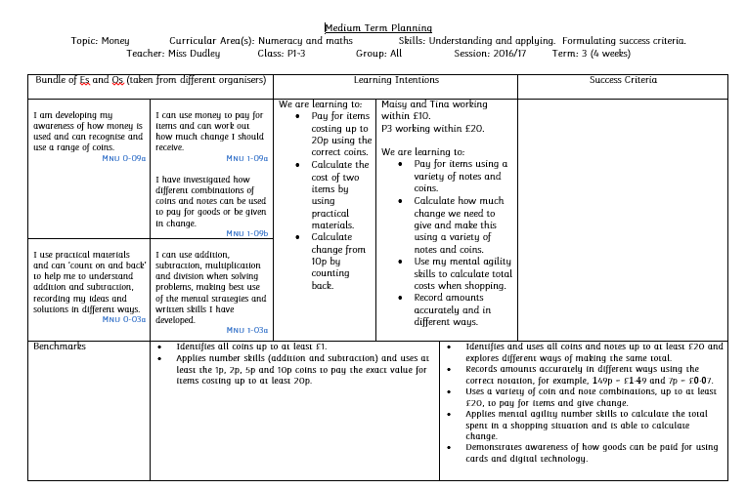

Slide 19
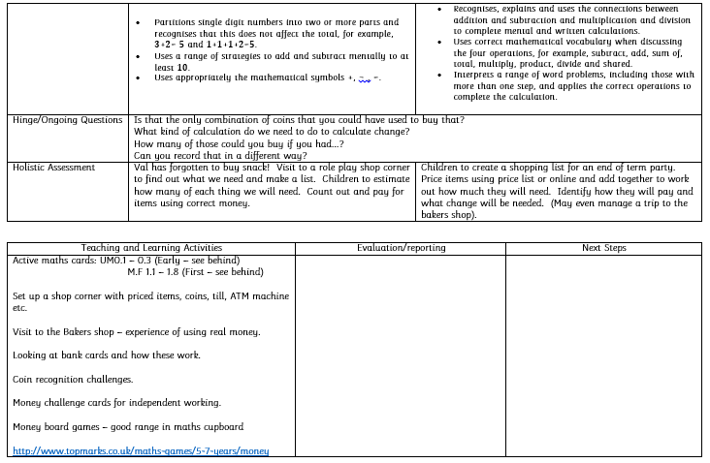

Slide 20
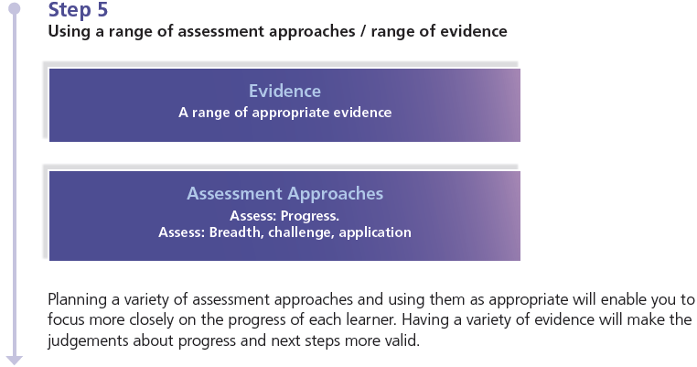
Planning assessment evidence
Consider the evidence you want to gather to best exemplify the learning that has taken place in relation to the agreed success criteria.
Plan to gather a range of evidence as appropriate to the learning and the learner.
A range of evidence allows for a more holistic judgement to be made.

Slide 21
Sources of Evidence
Observations of learners carrying out tasks and activities, including practical investigations, performances, oral presentations and discussions
Records (oral, written, audio-visual) created by children and young people which may include self assessment and/or peer assessment or may be assessed by the teacher
Information obtained through questioning in high quality interactions and dialogue
Written responses
A product, for example, a piece of artwork, a report or a project
Accounts provided by others

Slide 22
Planning assessment approaches
Having decided what evidence you want to gather, consider what assessment approaches would best allow you to do this.
Using a range of assessment approaches allows a clearer picture to emerge about each learner.
Ensure assessment approaches meet the needs of all learners – must consider breadth, challenge and application.

Slide 23
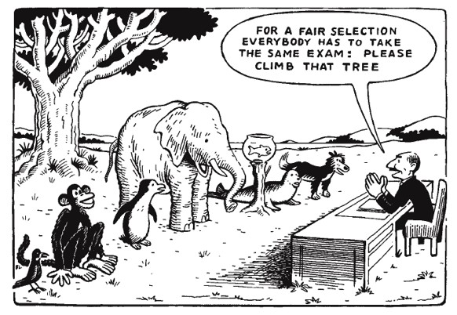

Slide 24
Holistic assessment tasks
Demonstrate breadth of learning
Require the learner to draw on a range of learning from a number of Es and Os across different organisers
Demonstrate challenge
Promote higher order thinking skills-analyse, evaluate & create
Demonstrate application of learning in new and unfamiliar situations
Come from one of the four contexts of learning
Tackling bureaucracy – reducing the time for assessment as focusing on bundles of Es and Os

Slide 25
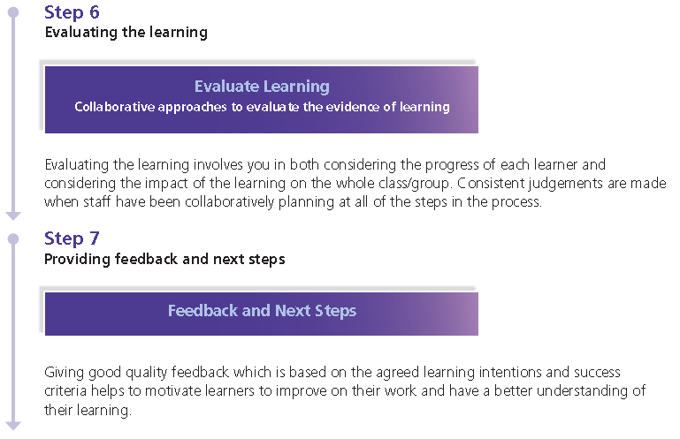
Evaluation, feedback and next steps
Did the learning and assessment approaches give learners the opportunity to develop and demonstrate their knowledge, understanding, skills, capabilities and attributes?
What does the assessment evidence tell you about each learner?
Consider each learner’s progress and share feedback linking learning back to agreed learning intentions and success criteria
What are the next steps?

Slide 26
Evaluation and Feedback
Valid/reliable judgements are made when staff have been collaboratively planning at all of the steps in the process.
When learners reflect on their own learning, they come to understand what they have achieved, what they can do to improve and how to go about it.
Learners will need help and careful monitoring in the initial stages of introducing self assessment as it can prove difficult for some young people. They need to be trained, supported and encouraged to develop these skills.

Slide 27
Reporting on progress
Has the learning experience been shared and understood by learners, parents and others?
What is the best approach to reporting in your context for your learners, parents and others?

Slide 28
Reporting on Progress
Must be regular!
Child’s voice/teacher’s voice and opportunity for the parent voice
Reflect on learning that has taken place – successes/setbacks
Plan next steps together
KU, skills, attributes and capabilities – 4 contexts
Learning Logs
Learning overviews
End of year reports
Profiles

Slide 29
NAR Planning Display
Notes:
NAR Flowchart Planning Displays do not need to be done all the time. However they are good for reviewing and discussing with the children what they have been learning, especially for younger pupils.

Slide 30
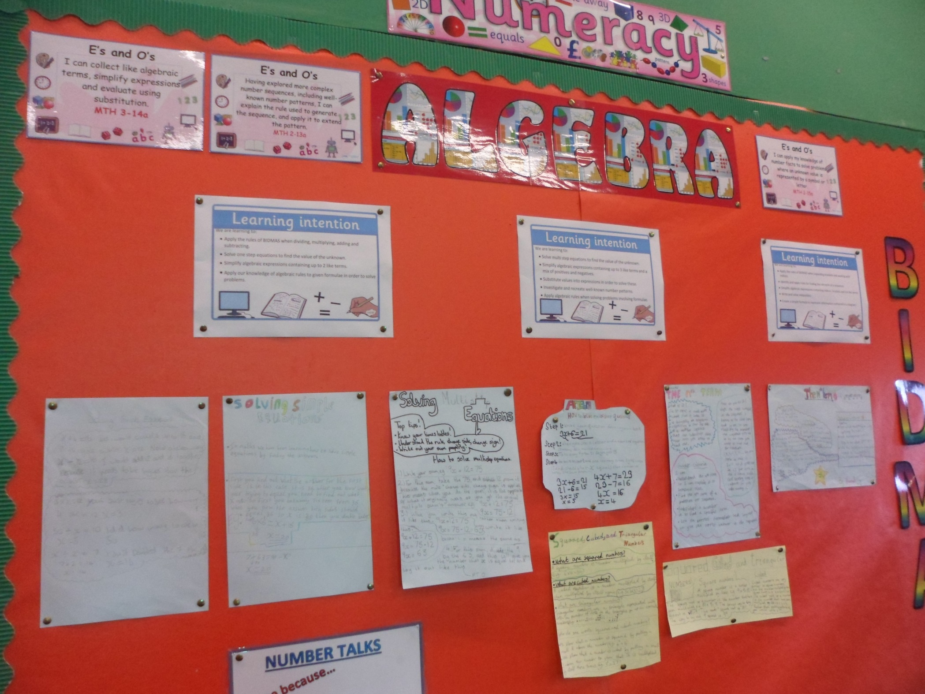

Slide 31
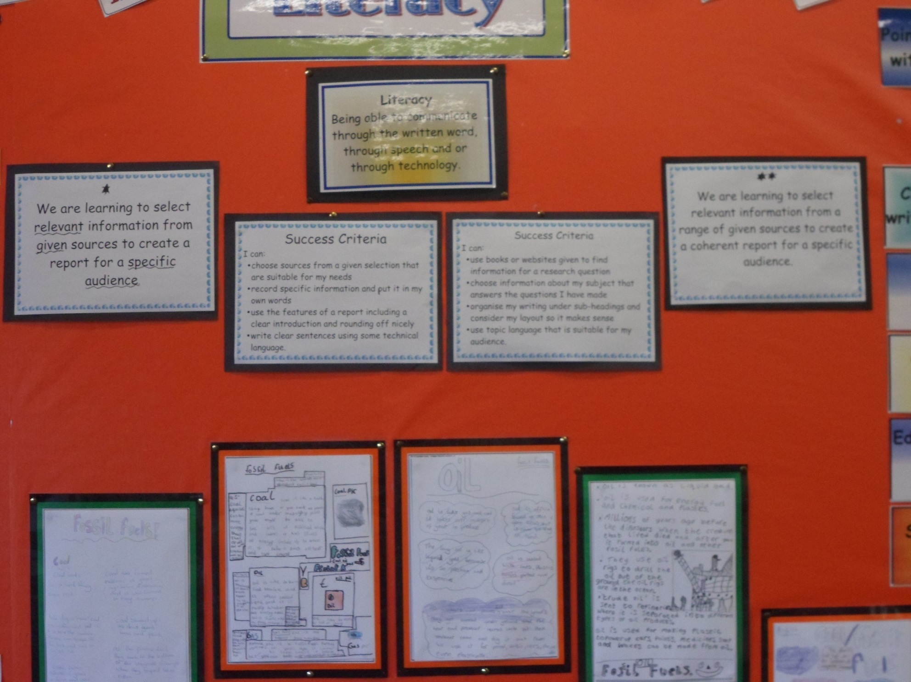

Slide 32
`

Slide 33
Question to consider in your groups:
How could you gather evidence for numeracy/literacy across the four contexts of learning?

