Slide 1

7268
Holistic Assessments

Slide 2


Why do we use holistic assessments?
Demonstrate genuine understanding of learning
Promotes whole school focuses on literacy and numeracy
Promotes pupil engagement
Gives pupils more independence as learners
Enables clearer identification of next steps
Fuller range of evidence
INCREASE ATTAINMENT

Slide 4

St Columba’s Primary School Progression Planner Block 2 Term 2018/19 Literacy – Reading – Inference Experiences and Outcomes LIT 0-16a, LIT 1-16a, 2-16a)
Step 1 | Step 2 | Step 3 | Step 4 | Step 5 | Step 6 | Step 7
I can share my thoughts and feelings about stories I can contribute to discussions on what I infer from pictures/texts/stories | I can infer the main purpose of a text (e.g. using picture clues) I can make inferences about characters and settings based on writers’ use of language I can contribute to discussions on what I infer from pictures/texts/stories | I can infer the main purpose of a text using different clues (e.g. pictures/headings) I can make inferences about characters and settings, showing my evidence I can contribute to discussions on what I infer from pictures/texts/stories | I can infer the main purpose of a text, showing my evidence I can create my own inferences for other readers to solve I can contribute to discussions on what I infer from pictures/texts/stories | I can infer the writer’s purpose from a text (e.g. persuade, comedy) I can contribute to discussions on what I infer from pictures/texts/stories | I can infer the writer’s purpose from a text (e.g. persuade, comedy) referring to the text I can contribute to discussions on what I infer from pictures/texts/stories | I can infer the writer’s purpose from a text (e.g. persuade, comedy) using supporting detail I can contribute to discussions on what I infer from pictures/texts/stories Step 8 I can infer the writer’s purpose from a text (e.g. persuade, comedy) using supporting detail with appropriate justification
Success Criteria I can…

Slide 5
Step 1 – Success Criteria
I can share my thoughts and feelings about various texts
I am beginning to explain my reasoning for my different thoughts and feelings
I can express what I visualise when I listen to and read new stories (e.g. what do you think the character looks like? What do you think is in the room?)
I can make simple inferences from pictures and texts
I can share with others why I have made these inferences

Slide 6
St Columba’s Primary School Progression Planner Tools for Writing Experiences and Outcomes LIT 0-13a, 0-21a, ENG 0 -12a, LIT 1-21a, 1-22a,1-23a,1-24a, LIT 2-21a,2-22a,2-23a,2-24a
Step 1 | Step 2 | Step 3 | Step 4 | Step 5 | Step 6 | Step 7
To be able to form all letters correctly and legibly Knows all single letter sounds and all double letter sounds. (Block 1 and Block 2) Knows the sounds of all lowercase and some uppercase letters Can write at least one sentence with finger spaces and a capital letter and full stop Makes an attempt to spell Tricky Words (Bronze)/CVC words correctly | To be able to form and position all letters correctly Knows the sounds of all lowercase and all uppercase letters Spells all of Silver Tricky Words correctly Knows all phonic patterns (Block 3) To be able to use a wordbook Can write three sentences with finger spaces and capital letter and full stop Can use connectives - and, because | Spells all of Gold Tricky Words correctly Increase the number of letter patterns and spelling rules that can be applied to learning To be able to use a Picture Dictionary Can write three sentences with finger spaces and including capital letters, full stops and attempting to use question marks and exclamation marks Can use connectives – and, because, but, so then Can open sentences with time openers – First, next, then, Finally etc | Spells all of Platinum Tricky Words correctly Increase the number of letter patterns and spelling rules that can be applied to learning To be able to use a dictionary searching the 1st, 2nd and 3rd letters To be able to use a basic Thesaurus (Junior Thesaurus) Can write with finger spaces and including capital letters, full stops and can use question marks and exclamation marks consistently Can use a wider variety of connectives Can open sentences using a variety of adverbs | Spells all of Diamond Tricky Words correctly To be able to use a Thesaurus Can self and peer assess work. Can use commas in a list, direct speech and apostrophes and contractions Can use past and present tense, singular and plural appropriately To be able to use adverbials to open sentences Can use a wider variety of connectives To begin to use paragraphs | Spells all of GeniusTricky Words correctly Can self and peer assess work. Can use commas to pause, broken speech and apostrophes to show possession. Vary sentence length Can use a wider variety of connectives To use paragraphs accurately | Applies consistent and accurate spelling across the curriculum Can self and peer assess work. Can apply all punctuation consistently and accurately across the curriculum Can write everything grammatically correct Uses sentences of different lengths and types and varies sentence openings Can use a wider variety of connectives To use paragraphs accurately and appropriately

Slide 7
Step 4 – Success Criteria
I can use a dictionary, searching the 1st, 2nd and 3rd letters
I can use full stops, capital letters, question marks and exclamation marks in my writing all of the time
I can use a wide range of connectives
I can use adverbs to start my sentences e.g Quickly, sadly, slowly etc
I can check over my work to ensure it makes sense

Slide 8
Holistic assessment tasks
Demonstrate breadth of learning – they come from a range of Es and Os across different organisers
Demonstrate challenge – they ask pupils to use a range of higher order thinking skills such as analysis, creation, evaluation, problem solving, tackling multi step tasks, interpreting tasks
Demonstrate application of learning in new and unfamiliar situations
Come from one of the four contexts of learning:
Life and ethos of the school as a community
Curriculum areas and subjects
Interdisciplinary learning
Opportunities for personal achievement

Slide 9
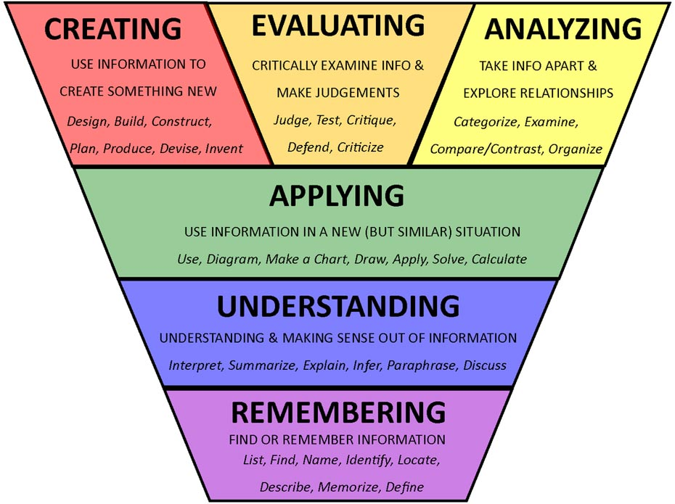
What kind of things might a holistic assessment contain?
Tasks which draw on learning from earlier in the year
Tasks which bring in elements of learning from more than one organiser
Multi-stage task
Tasks which require higher order thinking skills
Tasks without too much explicit instruction

Slide 10

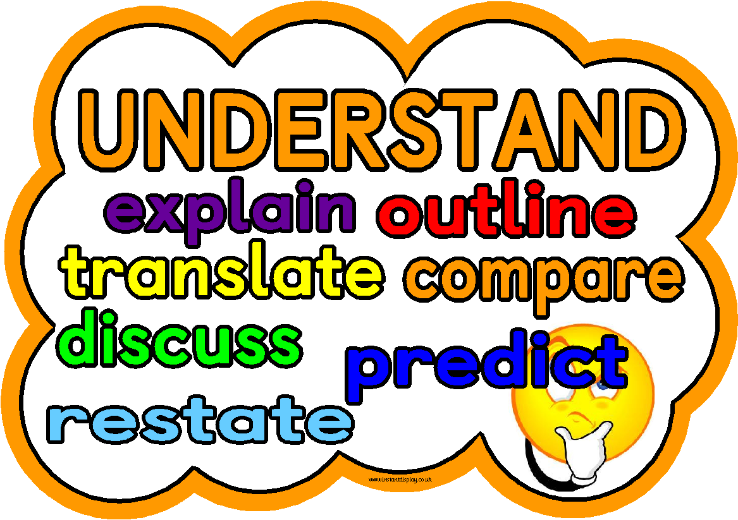
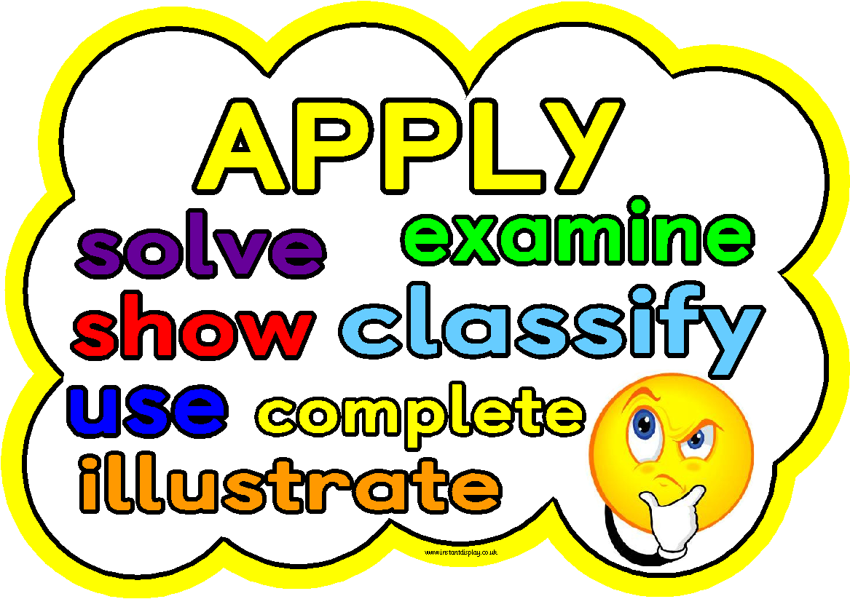
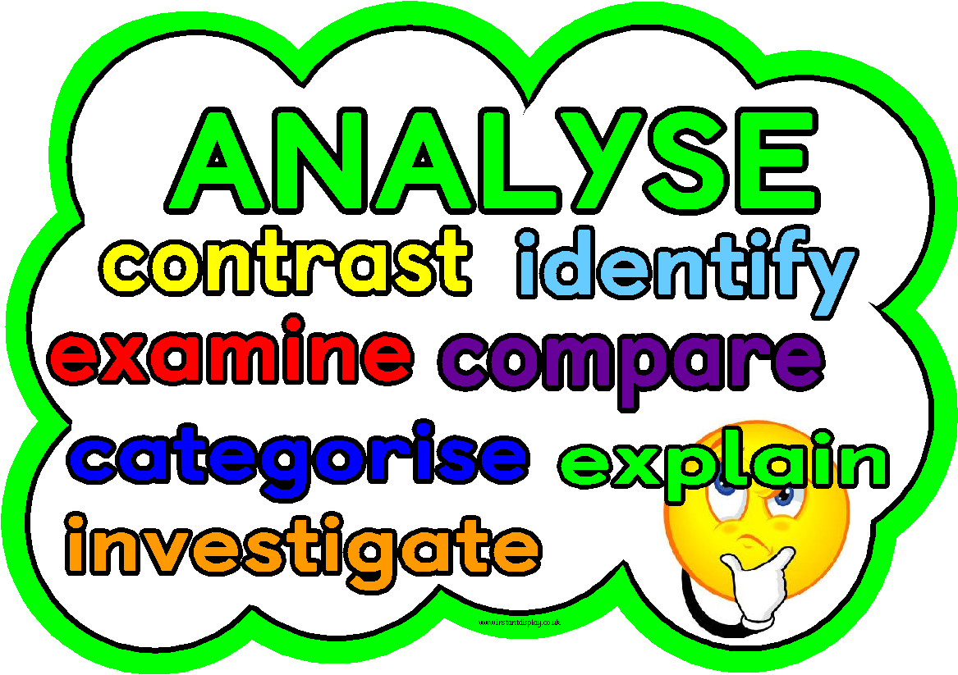
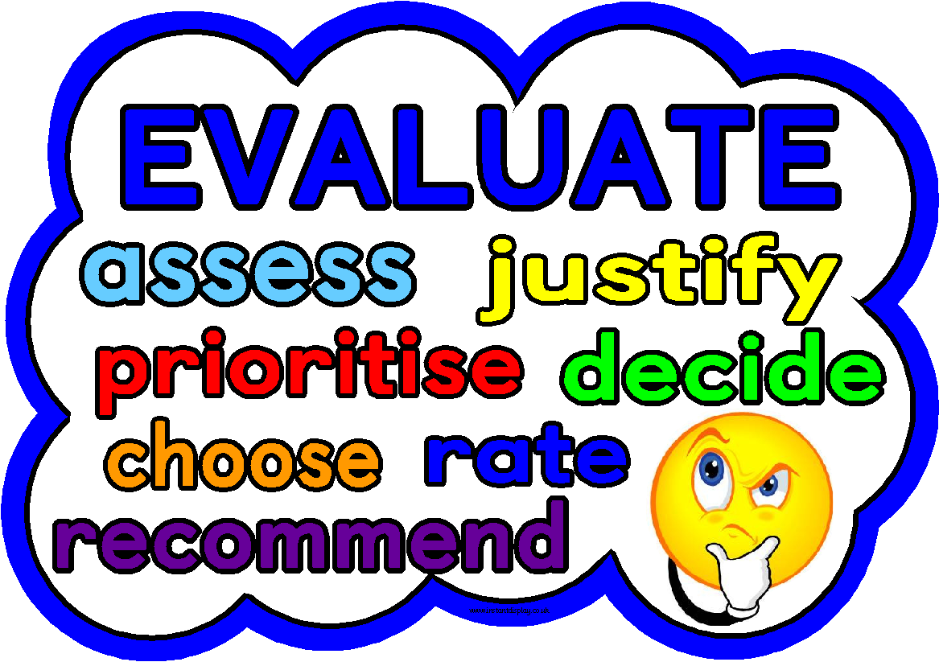
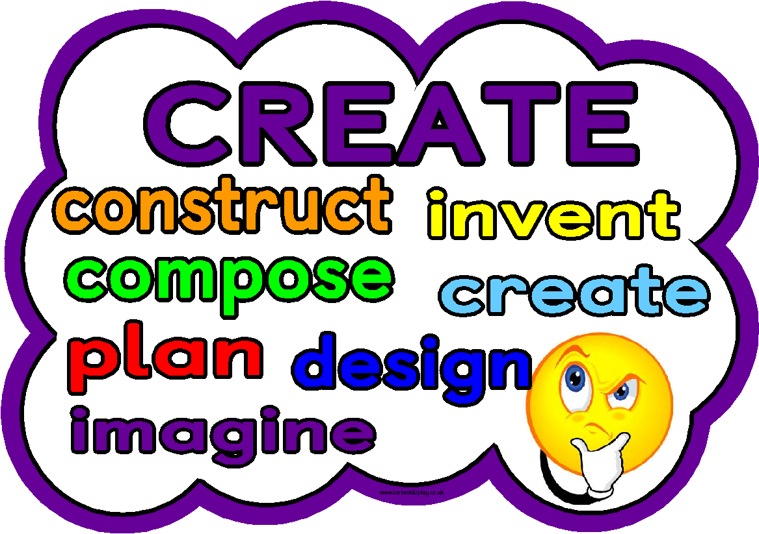

Slide 11
First Level Holistic Assessment – Literacy
Book Project
E&Os
Reading
Tools for reading - LIT 1-13a
Understanding, analysing and evaluating – ENG 1-17a
Writing
Enjoyment and choice – LIT -1-20a
Tools for Writing – LIT 1-22a
Creating texts – LIT 1-28a
Listening and Talking
Creating texts – LIT 1-09a

Slide 12
Task
We are going to invite all of our school community in to celebrate all of the amazing work we do in literacy. As past of this special afternoon, every child in the school is being given a very important task.
Your task is to create a Christmas story book that you can share with our visitors. To be successful in this task you must;
Write and illustrate a story that will appeal to people of your age, ensuring that you use capital letters, full stops, question marks and exclamation marks appropriately
Create your own inference about at least one character and see if your readers can pick up on the clues
Read your book to one of our visitors using expression to keep them engaged and interested in your story

Slide 13
This is holistic because…
Breadth – comes from a range of organisers (writing, reading and listening and talking)
Challenge – requires learners to create, write, illustrate and read
Application – using the skills that they have learned in a new context

Slide 14
What do we now do with this assessment?
Informs teacher of next steps in learning and how well a pupil can apply learning in different contexts
Assessment 75%-80% of the way through a block of learning
Appropriate feedback in given to the pupil with regards to the success criteria
Creates part of a range of evidence of achievement of a level

