Slide 1
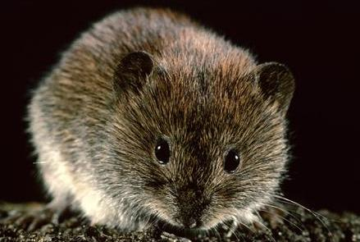

Slide 2
Bank Vole
Bank Vole
Bank Vole
Bank Vole
Bank Vole
Bank Vole
Bank Vole
Bank Vole
Bank Vole
Bank Vole
Bank Vole
Bank Vole
Bank Vole
Bank Vole
Bank Vole
Bank Vole

