Slide 1
Creating effective holistic assessment tasks

Slide 2
What is your understanding of “holistic assessment task”?

Slide 3
Holistic assessment tasks
Demonstrate breadth of learning – they come from a range of Es and Os across different organisers
Demonstrate challenge – they ask pupils to use a range of higher order thinking skills such as analysis, creation, evaluation, problem solving, tackling multi step tasks, interpreting tasks
Demonstrate application of learning in new and unfamiliar situations
Come from one of the four contexts of learning:
Life and ethos of the school as a community
Curriculum areas and subjects
Interdisciplinary learning
Opportunities for personal achievement

Slide 4
When and how should we use holistic assessments?
As pre-assessment to ascertain levels of understanding and/or competency
As part of on-going learning and teaching approaches
To assess application of knowledge and skills in new and unfamiliar contexts
As part of the evidence base for making a professional judgement of achievement of a CfE level.

Slide 5
Why do we use holistic assessments?
Demonstrate genuine understanding of learning
Promotes whole school literacy, numeracy and HWB
Promotes pupil engagement
Gives pupils more independence as learners
Enables clearer identification of next steps
Fuller range of evidence
INCREASE ATTAINMENT

Slide 6
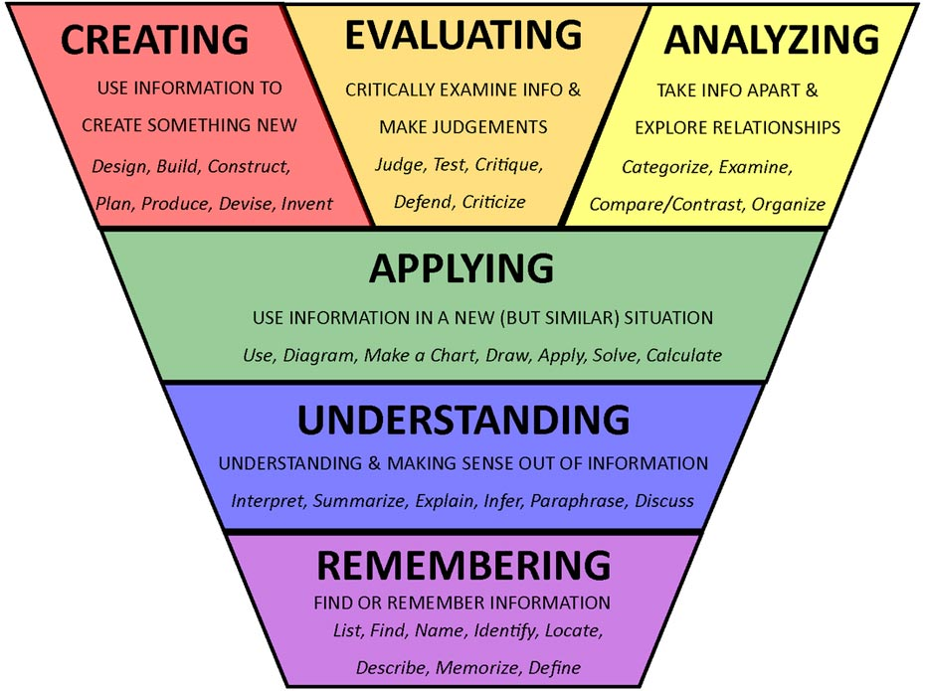
What kind of things might a holistic assessment contain?
Tasks which draw on learning from earlier in the year
Tasks which bring in elements of literacy, numeracy or HWB
Multi-stage task
Tasks which require higher order thinking skills
Tasks which link to whole school context/IDL
Tasks without too much explicit instruction

Slide 7
Examples of holistic assessments in PE
Health and Well Being Physical education, physical activity and sport Evaluating and appreciating HWB 2-24a, 3-24a, 4-24a Literacy Organising and using information 2-25a/3-25a/4-25a 2-26a/3-26a/4-26a Creating texts 2-28a/3-28a/4-28a | Write a report on your basketball skills. Explain what areas you have improved in and highlight areas for further development | Having watched a video of your performance, pick 3 elements of your performance. For each one analyse your strengths and weaknesses. | Having watched a video of your performance and analysed the strengths and weaknesses of 3 elements, research strategies for improvement in these areas. Create a plan for your improvement where you explain your choice of strategies and why you think they will be effective.

Slide 8
This is holistic because…
Breadth – comes from a range of organisers and curricular areas
Challenge – requires learners to use analysis, research and create a plan
Application – using the skills that they have learned in a new context

Slide 9
Example of Holistic assessment in numeracy
William and Harry go for lunch with Granny at 1pm.
William will travel by train at a cost of £12.50. The distance he is travelling is 67 miles and the journey takes 1 hour and 15mins. What is the average speed of the train?
Harry chooses to drive, his journey is also 67 miles. He travels at an average speed of 60mph. His car covers 7 miles per litre and petrol costs £1.08 per litre. Parking costs £5 per day. What time will he need to leave to arrive on time for lunch?
Who has the most cost efficient journey and why?

Slide 10
This is holistic because…
Breadth - comes from a range of organisers across numeracy (time, money, number, FDP)
Challenge - Careful reading of the question to extract the relevant information, problem solving, multi-step question with evaluation, drawing on a range of learning, possibly from throughout the year.
Application - Elements of the question will have been covered previously but this format/combination will be new and unfamiliar, application of key number skills but without explicit instruction.

Slide 11
Group Task 1: Create holistic assessments
Select a bundle of Es and Os which reflect the learning happening in the classroom.
Create 2 holistic assessments which require:
The learner to draw on a range of learning
Appropriate level of challenge
Higher order thinking skills
Application of learning in a new and unfamiliar situation
Come from one of the four contexts of learning

Slide 12
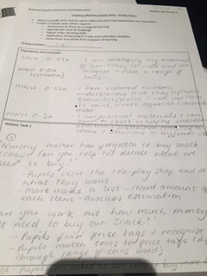
Group Task 2: Evaluation of holistic assessments
Now look at the task created by another group.
Using the evaluative comment checklist, moderate the effectiveness of this task as a holistic assessment.

