Slide 1

Feedback
National support for moderation
“Feedback is only successful if students use it to improve their performance.” – Dylan Wiliam
Notes:
N.B. Practitioner, senior and middle leader and learner self-evaluation pro-formas on feedback and next steps can be found towards the end of the next steps presentation as well as in the Self-Evaluation (Feedback and Next Steps) section of this page.

Slide 2
Aims
Explore and understand the importance of feedback
Identify key features of effective, high quality feedback
Engage in professional dialogue through reflective questions
Evaluate existing practice and identify areas for improvement

Slide 3
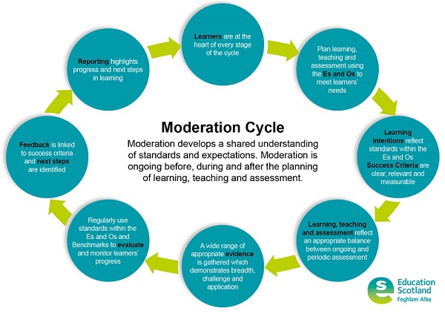

Slide 4
Moderation
Moderation is an ongoing process.
It is not the same as cross-marking (colleagues marking the same piece of work to ensure it is accurately marked) or verification (the process to make sure that centres' assessment decisions are valid, reliable and in line with national standards) though these three areas do overlap.
Effective moderation is where teachers work together to:
  plan learning, teaching and assessment
  review evidence of learners’ progress and achievement
  plan next steps in learning.
Notes:
Notes to presenter:
This presentation contains optional workshop activities. You will need these resources if you intend to do the workshop activities as part of this presentation. These can also be carried out independently of this presentation.

Slide 6
Feedback
Workshop activities
You will need:
Board paper
Pen(s)
Notes:
Notes to presenter:
This presentation contains optional workshop activities. You will need these resources if you intend to do the workshop activities as part of this presentation. These can also be carried out independently of this presentation.

Slide 7
Discussion Questions - Feedback
How do you provide feedback to your pupils?
What are the common issues affecting the quality of feedback in your context?
How do you make use of feedback?
Which do you find more effective – written or verbal feedback? Why?

Slide 8
Why is feedback important?
What are the key features of effective feedback?
(8 minutes to discuss)
Notes:
Why is feedback important? Please pause the presentation and take 5 minutes to discuss this together.

Slide 9
Why is feedback important?
Ensures learners are clear about what they have done well
Provides areas for improvement
Ensures learners are engaged in high quality interactions throughout the learning process
Supports learners when target setting/profiling/personal learning planning
Ensures appropriate, pace, progression and challenge
Ensures practitioners are clear about areas for further development within short and longer term planning

Slide 10
What are the key features of effective feedback?
Based on a set of clear and measurable Success Criteria
Clearly states areas of strength and next steps
Age and stage appropriate
Involves both quality dialogue and/or written comments
Appropriately timed and based on observation of learning
Based on learner progress both in the short term and over a longer period of time
Notes:
Notes for presenter:
Feedback should not a be a mark or grade – it should be formative comments
Emphasise the importance of timely feedback

Slide 11
What are the key features of effective feedback?
  Helpful to the learner
  Tailored to the individual learner
  Agreed together with the learner
  Focused and manageable
  Give clear indication of both what and how the learner can move forward
  Focused on aspects of learning the learner will have the opportunity to take forward in the near future

Slide 12

‘We observe learners closely to inform appropriate and well-timed interventions and future learning. We use feedback effectively to inform and support progress in learning.’
(HGIOS 4 2.3 Learning, Teaching and Assessment:
Level 5 illustration - Quality of Teaching)
tea
Notes:
Notes for presenter:
This Level 5 illustration from How Good Is Our School 4, Quality Indicator 2.3 Learning, Teaching and Assessment, highlights the need for well-timed interventions and feedback to inform and support progress in learning.

Slide 13

‘Learners receive high-quality feedback and have an accurate understanding of their progress in learning and what they need to do to improve’
‘Learners are able to give effective feedback to peers on their learning and suggest ways in which they can improve’
(HGIOS 4 2.3 Learning, Teaching and Assessment
Features of highly effective practice: Quality of Teaching)
Notes:
Notes for presenter
HGIOS? 4 highlights the following features of highly effective practice within QI 2.3, Learning, Teaching and Assessment:
Learners receive high-quality feedback and have an accurate understanding of their progress in learning and what they need to do to improve.
Learners are able to give effective feedback to peers on their learning and suggest ways in which they can improve.

Slide 14
‘Children and young people value the professional advice and expertise of school staff and others who support their learning and decision-making. They actively engage in communication and discussions about their next steps and contribute to planning learning pathways which meet their needs and aspirations.’
(HGIOS 4 QI 1.2 Leadership of Learning
Level 5 illustration: Children and young people leading learning)
Notes:
Notes for presenter:
In How Good Is Our School? 4 Quality Indicator 1.2 Leadership of Change, the Level 5 illustrations for Children and young people leading highlights the importance of learners receiving advice and expertise of school staff/practitioners and others who support their learning and decision making. It also highlights the need for learners to be actively engaged in discussions about their next steps and for learners to contribute to planning learning pathways which meet their needs and aspirations.

Slide 15
Inform and support progress
Well-timed
appropriate
Engage in communication and discussions about their next steps
Inform future learning
High-quality
Learners have an accurate understanding of progress
peers
Notes:
Notes to presenter:
This presentation contains optional workshop activities. You will need these resources if you intend to do the workshop activities as part of this presentation. These can also be carried out independently of this presentation.

Slide 16

“Good feedback causes thinking”
https://glowscotland.sharepoint.com/portals/hub/_layouts/15/PointPublishing.aspx?app=video&p=p&chid=01e457d7-d42d-458c-9cf5-ec8de2ec11c4&vid=e8e948da-b3d3-4383-adb3-90fb0d359143
Notes:
N.B. To access this video clip on the National Improvement Hub, you may have to come out of the main presentation and go into the NOTES version (bottom right of screen).
In this 3 minute video clip on the NIH, Dylan Wiliam discusses the importance of high quality feedback.
https://glowscotland.sharepoint.com/portals/hub/_layouts/15/PointPublishing.aspx?app=video&p=p&chid=01e457d7-d42d-458c-9cf5-ec8de2ec11c4&vid=e8e948da-b3d3-4383-adb3-90fb0d359143
https://www.youtube.com/watch?v=MzDuiqaGqAY

Slide 17
Common issues with feedback…
Feedback focused solely on completion of task or score achieved without comments
“Ego-involving” feedback
Feedback focused solely on ‘right or wrong’ rather than process
Feedback and next steps which don’t refer to the intended focus for learning
‘Generic’ feedback focused solely on effort, not specific or including references to learning and Success Criteria
Can be difficult for pupils to access
Difficult to ensure high quality peer feedback
Very time consuming
Comes at the end of learning and is not acted upon
Notes:
Notes for presenter:
Reflect on current/own practice

Slide 18
Common issues with feedback…
Feedback focused solely on completion of task or score achieved without comments
“Ego-involving” feedback
Feedback focused solely on ‘right or wrong’ rather than process
Feedback and next steps which don’t refer to the intended focus for learning
‘Generic’ feedback focused solely on effort, not specific or including references to learning and Success Criteria
Can be difficult for pupils to access
Difficult to ensure high quality peer feedback
Very time consuming
Comes at the end of learning and is not acted upon
Notes:
Notes for presenter:
Reflect on current/own practice

Slide 19
How do you give learners time and opportunity to reflect and act on feedback?
Notes:
How do you build in time for your learners to reflect on feedback? Please pause the presentation and take 5 minutes to discuss this together.

Slide 20
Building feedback into day to day learning:
Mid-lesson reviews using Success Criteria
Sharing examples of work mid-lesson (Modelling Review)
Plenary sessions
Effective questioning and interventions during lessons
Discussions and verbal feedback
Giving time to respond to written and verbal feedback from previous lesson at the start of the next lesson
Opportunities for learners to engage in self and peer assessment
Notes:
Notes for presenter:
Importance of building in time for feedback and planning how and when you are going to do this
Emphasise that feedback can be given by the practitioner and/or the learners
Opportunities should be given for self and peer assessment

Slide 21
Building feedback into longer term learning:
Planned opportunities to reflect on learning over time
One to one planned learning conversations
Personal Learning Planning
Use of Learning Logs or Journals
Profiling
Feedback can be given by the practitioner or learners.
Notes:
Notes for presenter:
Importance of building in time for feedback and planning how and when you are going to do this
Emphasise that feedback can be given by the practitioner and/or the learners
Opportunities should be given for self and peer assessment

Slide 22

“Feedback Friday”
While others
complete work /
have reading time

Slide 23
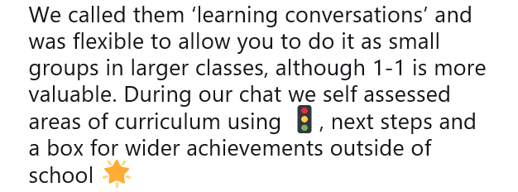
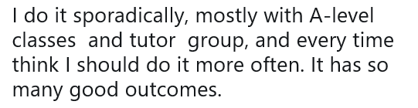

Slide 24
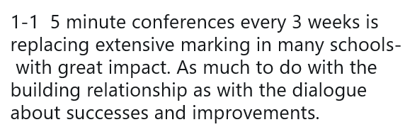
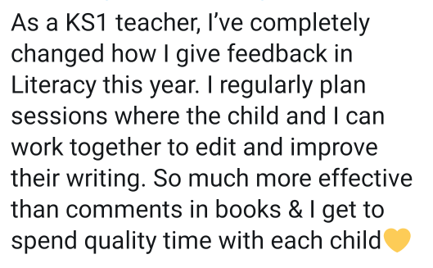

Slide 25
How do you ensure peer feedback is effective?
Notes:
What are the advantages and disadvantages of verbal and written feedback? Please pause the presentation and take 5 minutes to discuss this together.

Slide 26
Effective Peer Feedback
Consistently modelled by teacher – ensure pupils are familiar with basing comment on SC, using two stars and a wish, being very specific…
Giving pupils a clear structure to follow – a checklist
Having pupils discuss work together (Self and United Improvements; as a whole class when Discussing Excellence)
Giving opportunities for all pupils to see everyone’s work – by having them move around the room with post its for example
Notes:
Notes for presenter:
Importance of building in time for feedback and planning how and when you are going to do this
Emphasise that feedback can be given by the practitioner and/or the learners
Opportunities should be given for self and peer assessment
https://www.shirleyclarke-education.org/video/literacy-descriptive-sentences-2/
Self and United Improvements

Slide 27
Feedback
It is important that the feedback we give pupils is of a high quality. It should be based on Success Criteria, understandable and achievable.
Here is an example of feedback based on the Learning Intention and Success Criteria which highlights areas of strength and an area for further development:
Learning Intention | Success Criteria | Possible feedback
We will be able to use notes to create a new text | I have read my notes carefully to check I understand I have written using my own words I have used the headings to structure my text in paragraphs I have included the key information from my notes | ‘You have used your notes well to organise your writing into paragraphs. You have included the key information. Can you improve the highlighted sections by re-writing them using your own words?’
Notes:
Notes for presenter:
Feedback must be focused on agreed set of success criteria
Do not try to assess too much

Slide 28
Feedback
It is important that the feedback we give pupils is of a high quality. It should be based on Success Criteria, understandable and achievable.
Here is an example of feedback based on the Learning Intention and Success Criteria which highlights areas of strength and an area for further development:
Learning Intention | Success Criteria | Possible feedback
We will be able to use notes to create a new text | I have read my notes carefully to check I understand I have written using my own words I have used the headings to structure my text in paragraphs I have included the key information from my notes | ‘You have used your notes well to organise your writing into paragraphs. You have included the key information. Can you improve the highlighted sections by re-writing them using your own words?’
Notes:
Notes for presenter:
Feedback must be focused on agreed set of success criteria
Do not try to assess too much

Slide 29
Feedback
It is important that the feedback we give pupils is of a high quality. It should be based on Success Criteria, understandable and achievable.
Here is an example of feedback based on the Learning Intention and Success Criteria which highlights areas of strength and an area for further development:
Learning Intention | Success Criteria | Possible feedback
We will be able to use notes to create a new text | I have read my notes carefully to check I understand I have written using my own words I have used the headings to structure my text in paragraphs I have included the key information from my notes | ‘You have used your notes well to organise your writing into paragraphs. You have included the key information. Can you improve the highlighted sections by re-writing them using your own words?’
Notes:
Notes for presenter:
Feedback must be focused on agreed set of success criteria
Do not try to assess too much

Slide 30
Moderation questions
The following slide contains some examples of questions that could be used when moderating feedback.
Notes:
The full set of moderation questions for each stage of the moderation cycle are available within the materials for each step.

Slide 31
Moderating Feedback
Are the learners receiving on-going feedback on their work?
Is this based on the Success Criteria?
Does the feedback state areas of success?
Does the feedback state what the learner’s next steps are?
Does the feedback include a mix of self, peer and practitioner assessment?
Are the learner’s next steps clear and specific?
Is the language used pupil friendly?
Is the language used “ego-involving”?
Could a learner set appropriate targets from the feedback?

Slide 32
Workshop activities
You will need:
A pen and an activity sheet
Notes:
You will need these resources if you intend to do the workshop activity now.

Slide 33
Feedback Activity 1
Look at the feedback comments on the next slide
Discuss with colleagues any issues you see with the feedback
Look at the comments on the following slide. Do you agree with them?

Slide 34
Improving Feedback
Discuss these feedback comments.
How might they be improved?
 | Feedback
1 | ‘You’ve completed the task with a score of 9/10. Next time remember the date.’
Are the learners receiving on-going feedback on their work?
Is this based on the Success Criteria?
Does the feedback state areas of success?
Does the feedback state what the learner’s next steps are?
Does the feedback include a mix of self, peer and practitioner assessment?
Are the learner’s next steps clear and specific?
Is the language pupil friendly?
Is the language used “ego-involving”?
Could a learner set appropriate targets from the feedback?

Slide 35
Improving Feedback
Do you agree with these comments?
 | Feedback | Comments
1 | ‘You’ve completed the task with a score of 9/10. Next time remember the date.’ | Focused on task completion and score with no reference to specific area of focus in learning. Focused on a daily routine rather than linking to the learning. Doesn’t help the learner move forward.

Slide 36
Feedback Activity 2
Look at the rest of the feedback comments on your sheet
Discuss with colleagues any issues you see with the feedback, using the moderation questions to help

Slide 37
Moderating Feedback
Are the learners receiving on-going feedback on their work?
Is this based on the Success Criteria?
Does the feedback state areas of success?
Does the feedback state what the learner’s next steps are?
Does the feedback include a mix of self, peer and practitioner assessment?
Are the learner’s next steps clear and specific?
Is the language pupil friendly?
Is the language used “ego-involving”?
Could a learner set appropriate targets from the feedback?

Slide 38
Feedback Activity 3
Look at the comments on the following slides. Do you agree with them?

Slide 39
Improving Feedback
Discuss these feedback comments.
How might they be improved?
 | Feedback
2 | ‘Good effort, great work. Totally perfect!’ 
3 | ‘Your writing has good detail It is well presented W. Use more ambitious vocabulary, make it more engaging for the reader and come up with a better ending.’

Slide 40
Improving Feedback
Do you agree with these comments?
 | Feedback | Comments
2 | ‘Good effort, great work. Totally perfect!’ | Positive but not linked to the learning. Although there is a place for motivational feedback, like “good effort”, it should be combined with specific comments relating to the intended learning and be specific about areas of strength and development. Some skills can be “perfectly” achieved but this wouldn’t be appropriate for written work.
3 | ‘Your writing has good detail It is well presented W. Use more ambitious vocabulary, make it more engaging for the reader and come up with a better ending.’ | Gives some indication of what has been done well but needs to be more specific – why was the detail good? Was presentation part of the intended learning? If not, this isn’t relevant. Too many next steps, and these are vague too – what sort of “ambitious vocabulary”? Adjectives? Imagery? Where should these go? What will make it more engaging? How can the ending be better?

Slide 41
Improving Feedback and Next Steps
Discuss these comments. How might they be improved?
.
Feedback
4. | “I agree with the pattern that you have identified in the table. I am not convinced that the rule you wrote works for all the values in the table. How could you prove this?”
5. | “You put in a lot of effort today. Well done for persevering with the task.”
6. | “You’ve included lots of persuasive language in this letter. Add a final short paragraph to summarise your points and bring the letter to a powerful, certain close.”

Slide 42
Improving Feedback
Do you agree with these comments?
.
 | Feedback | Comments
4. | “I agree with the pattern that you have identified in the table. I am not convinced that the rule you wrote works for all the values in the table. How could you prove this?” | Gives specific information about what has been done well. Indicates there is an area for improvement and uses questioning to challenge the learner to explore this themselves.
5. | “You put in a lot of effort today. Well done for persevering with the task.” | Motivational comment but does not indicate strengths and next steps in learning.
6. | “You’ve included lots of persuasive language in this letter. Add a final short paragraph to summarise your points and bring the letter to a powerful, emphatic close.” | Could define ‘persuasive language more’ Gives a clear next step, with details about what the pupil should do (write final paragraph) and how they should do it (short; summarising points; emphatic tone).

Slide 43
Improving Feedback
Discuss these feedback comments. How might they be improved?
.
 | Feedback
7. | “You completed half of the questions. Next time, try to speed up a bit.”
8. | “You’ve included most of the features of a bar graph. Your data has been presented clearly. W. Can you add the X and Y axis?’

Slide 44
Improving Feedback
Do you agree with these comments?
.
 | Feedback | Comments
7 | “You completed half of the questions. Next time, try to speed up a bit.” | Is based on amount of work completed rather than learning. Not helpful to move learning forward. How should they speed up? Is there a particular method they can use, like writing in note form, not copying the question, asking a friend, etc.?
8 | “You’ve included most of the features of a bar graph. Your data has been presented clearly. W. Can you add the X and Y axis?’ | Could be more specific in what has been done well – which features have they used? Gives a clear next step which the pupil can immediately act upon, and which – if they get it wrong – shows the teacher that they need to spend more time on this topic.

Slide 45
Feedback Activity 4
Look at some evidence with feedback and next steps from your own context
Use the moderation questions on the next slide to discuss the feedback and next steps
Make notes on your post its about your feedback – what are its strengths, and is there anything you could improve?

Slide 46
Moderating Feedback
Are the learners receiving on-going feedback on their work?
Is this based on the Success Criteria?
Does the feedback state areas of success?
Does the feedback state what the learner’s next steps are?
Does the feedback include a mix of self, peer and practitioner assessment?
Are the learner’s next steps clear and specific?
Is the language pupil friendly?
Is the language used “ego-involving”?
Could a learner set appropriate targets from the feedback?

Slide 47
Reflective Questions
The following reflective questions are designed to promote professional dialogue
Notes:
The next slide gives a range of reflective questions designed to promote professional dialogue.

Slide 48
Reflective Questions - Feedback
Do you make use of Success Criteria when providing feedback?
Do you give pupils specific, targeted advice on how to improve their work?
Do you give pupils an opportunity to act on the feedback they have received as soon as possible?
Do you provide opportunities for peer assessment?
Do your pupils base their targets on feedback provided?
Do you use the feedback you provide as a basis for your ongoing planning?

Slide 49
Next Steps…
Aim to incorporate in lesson feedback the next time your class are working on a task
Consider the next batch of marking you plan to do – can you give feedback in a more meaningful, simple manner?
When next marking pupil work, consider the moderation questions we have looked at today
Take part in lesson observations which focus on in lesson feedback

