Slide 1
The MODERATION cycle

Slide 2
What is moderation?
Extracts from the Statement for Practitioners:
‘Moderation is the way in which practitioners arrive at
a shared understanding of standards and expectations.’
Moderation is integral to planning learning, teaching and assessment
It is not the same as cross-marking or verification, and is not an activity that happens only at the end of a block or year
Notes:
This is an extract from the statement for practitioners. It states that moderation is integral to planning learning, teaching and assessment and is a process rather than a one-off activity or event. Moderation is on-going throughout the learning and teaching process.

Slide 3
CfE statement
Statement for Practitioners
Take a collegiate approach to moderation of planning learning, teaching and assessment
Work together with colleagues to review and reduce any unnecessary bureaucracy
Moderate assessment judgements by taking account of a sample of evidence from different sources to discuss standards and the progress of learners
Regularly discuss tracking information with colleagues to plan additional support and interventions to help improve learners’ progress
Notes:
Throughout the Curriculum for Excellence Statement there are direct references to effective moderation.
The importance of a collegiate approach to the process of moderation, using a range of assessment evidence and working together to review and reduce any unnecessary bureaucracy.

Slide 4
What is moderation?
Moderation takes place at local, regional and national levels, including:
  • Teachers and practitioners at the same curriculum level
  • Across a school or setting
  • Across a group of schools/settings
  • Within local authorities
  • Via national groups
Notes:
In order to arrive at a shared understanding of standards and expectations, moderation should take place at a range of levels within school, locally and nationally.
Moderation should be ongoing within schools, for example through collegiate planning and ongoing conversation with colleagues. There should also be planned opportunities to moderate as a whole staff within the school, cluster and local authority.

Slide 5
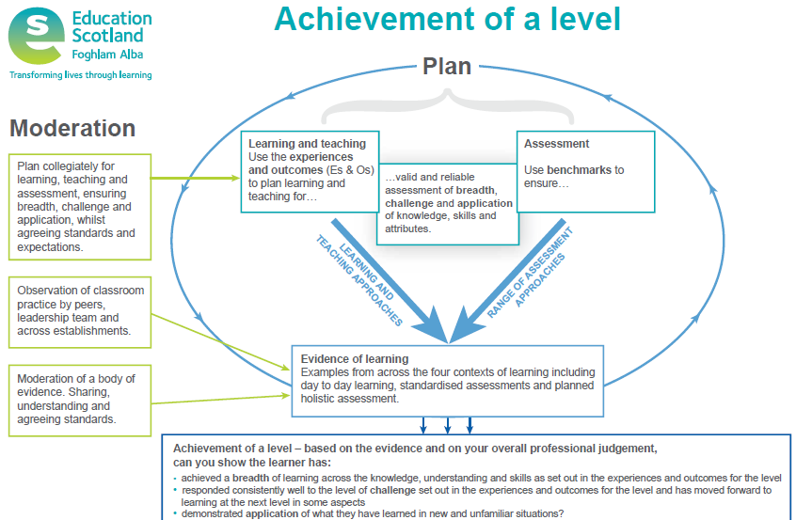
Notes:
The Achievement of a Level poster highlights the importance of moderation and highlights the process throughout planning, learning, teaching and assessment. It can be used to generate discussion and support moderation. The poster outlines that moderation involves:
1.) Collegiate planning
2.) Observation of classroom practice
3.) Reviewing and evaluating a body of evidence

Slide 6
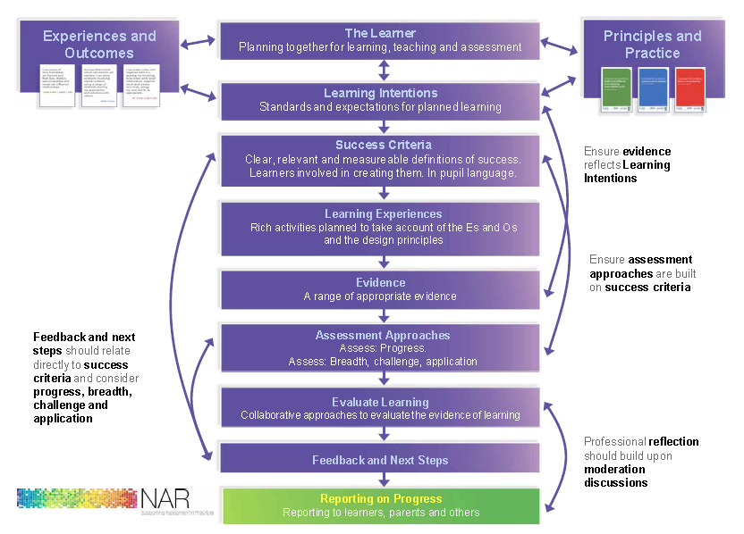
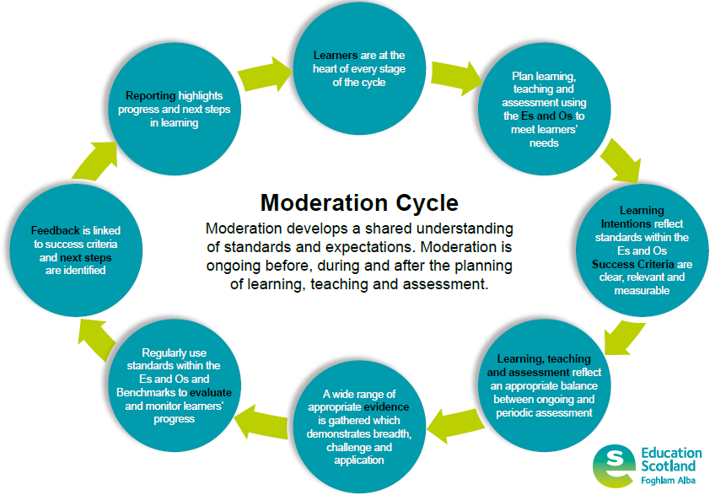
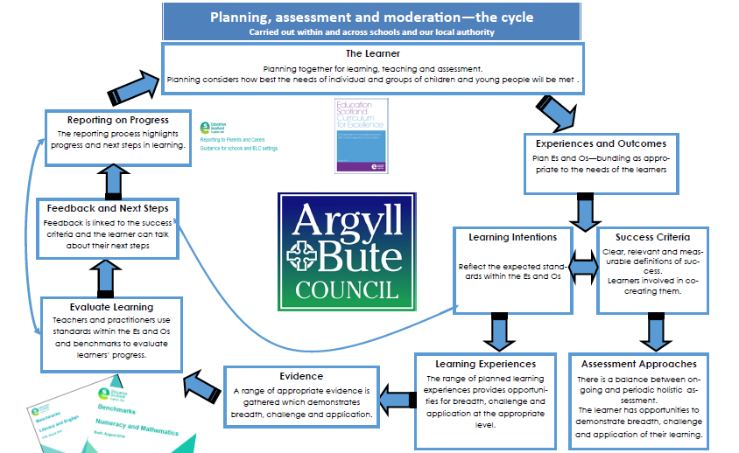
The Moderation Cycle replaces the NAR Flowchart and the PAM Cycle
Notes:
The moderation cycle replaces the NAR Flowchart. The NAR resource no longer exists, however the stages within the NAR flowchart remain valid and are reflected in the moderation cycle. The change to format is to emphasise the cyclical nature of moderation and the understanding of moderation as a process rather than a ‘one-off event’. There have been some slight changes to wording, for example learning intentions and success criteria have been drawn together into one stage within the cycle and learning experiences and assessment approaches have been drawn together as ‘Learning, Teaching and Assessment’.

Slide 7
Notes:
The moderation cycle should be used to structure moderation discussions around.

Slide 8
Moderation…the process
Experiences and Outcomes
Learning Intentions
Success Criteria
Learning, Teaching and Assessment (breadth, challenge and application)
Evidence
Evaluation
Feedback
Next steps
Reporting
Notes:
These are the steps in the learning process that we have highlighted for moderation and professional dialogue. Using this process ensures professional dialogue takes place around planning, learning and teaching, assessment, evaluations etc.

Slide 9
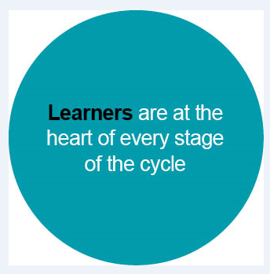
Learners should be actively involved at each stage of the cycle, from planning through to reviewing and evaluating evidence
Notes:
Learners should be involved at each stage of the cycle.
In which ways are your learners involved at each stage?

Slide 10
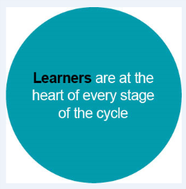
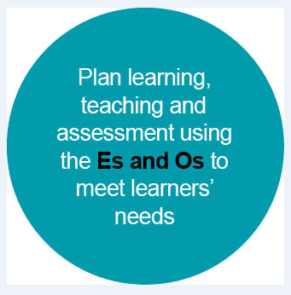
Es and Os should be bundled to link concepts appropriately
Learning, teaching and assessment should be planned together from the outset
Learning, teaching and assessment should be planned from the Es and Os
Notes:
Learning, teaching and assessment should be planned using the Es and Os. It is important to recognise that the Es and Os outline the experiences/pedagogy aswell as the intended outcomes.

Slide 11
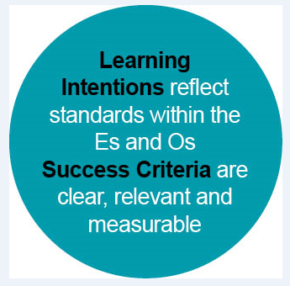
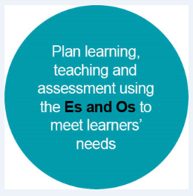
Learning intentions should clearly outline what the learner should know, understand or be able to do by the end of the lesson/series of lessons/
block of learning
Success criteria should:
  outline what the learner has to do
  to be successful in achieving the
  learning intention
  be clear, relevant and measurable
  be co-constructed with learners
Notes:
Learning intentions and success criteria have been drawn together into one stage within the cycle as they clearly link. It is important both to share the learning intention and to co-construct success criteria to ensure learners are clear about what they have to do to be successful. Success criteria should also provide the framework for feedback discussions.

Slide 12
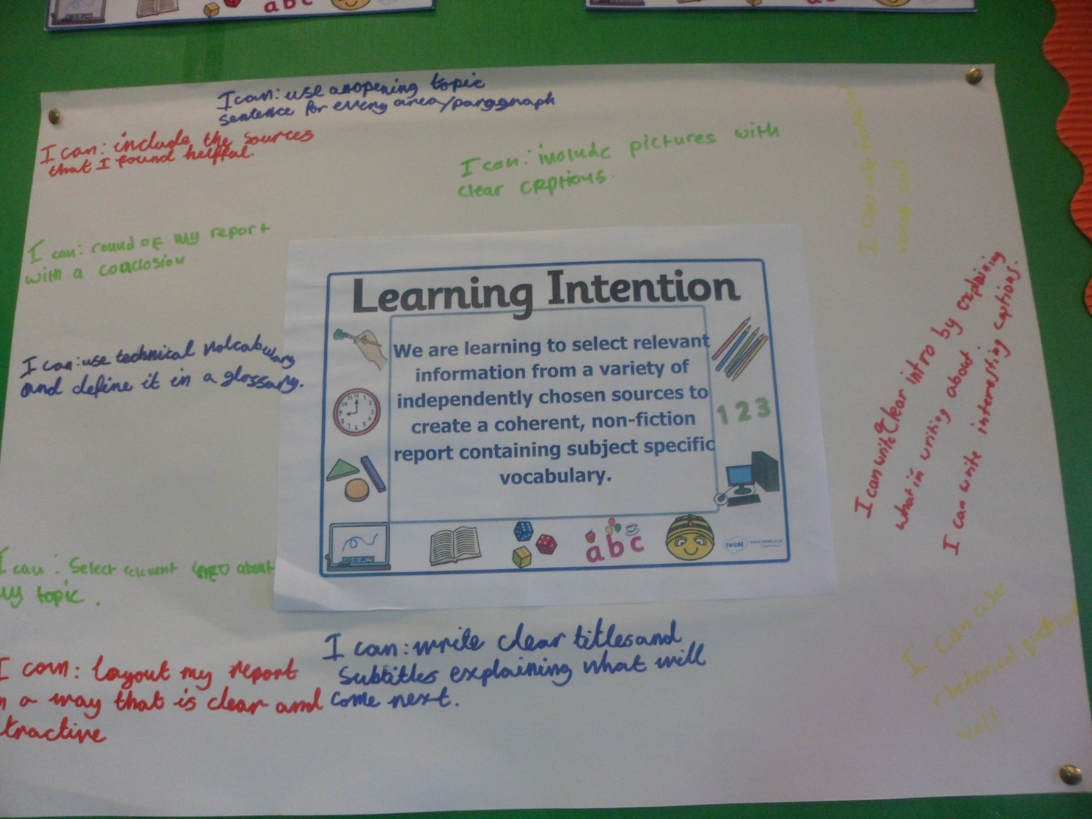
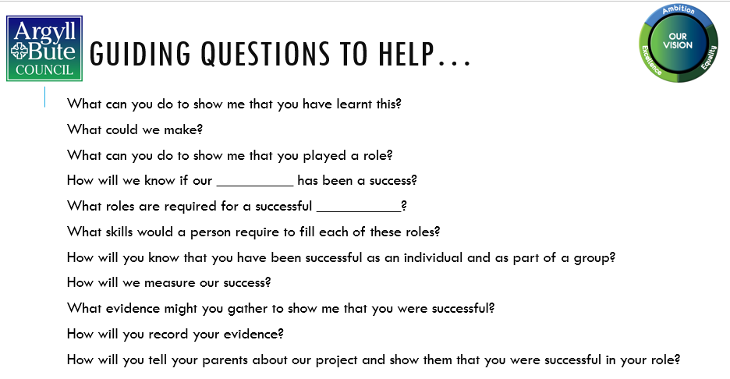
Good exemplars
Pair discussion
Modelling

Slide 13
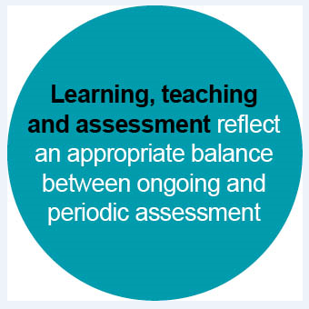
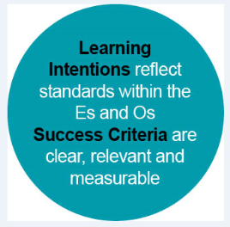
Learning, teaching and assessment should be:
  Planned together using the Es and Os
  Planned to allow opportunities
  for breadth, challenge and
  application
There should be an appropriate
balance between ongoing and
periodic assessment
Notes:
Learning, teaching and assessment draws together ‘learning experiences’ and ‘assessment approaches’. This reflects the Quality Indicator 2.3 in Hoe Good is our School 4 and also emphasises the importance of planning for learning, teaching and assessment together.

Slide 14
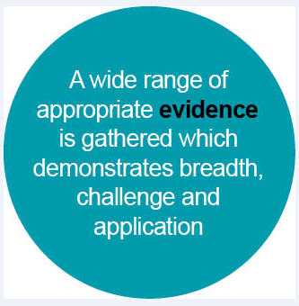
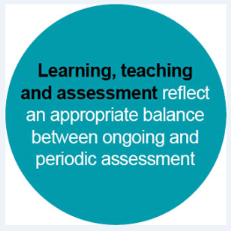
A wide range of evidence should be considered when making
judgements around progress towards or achievement of a level
The range of evidence will exist in different places (e.g. jotters,
displays, learner conversations, periodic assessments)
Evidence should
demonstrate breadth,
challenge and
application
Notes:
A range of evidence demonstrating breadth, challenge and application should be considered when reviewing and evaluating progress towards or achievement of a level. The evidence will come from a variety of different sources, for example classwork, jotters, displays, observations of learning, planned periodic assessments, standardised assessments.

Slide 15
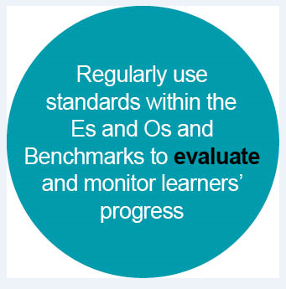
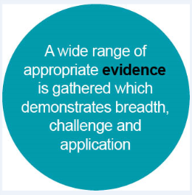
Standards within the Es and Os and Benchmarks should be used to
evaluate and monitor learners’ progress
Evaluation should be ongoing to inform short term planning
Practitioners should have opportunities to evaluate a range of
evidence together when considering progress towards or
achievement of a level to ensure consistency in teacher professional
judgement
Notes:
Practitioners evaluate learning all the time and this informs short term responsive planning.
It is also important that practitioners are given opportunities to evaluate together, particularly when coming to teacher professional judgements around progress towards or achievement of a level.

Slide 16
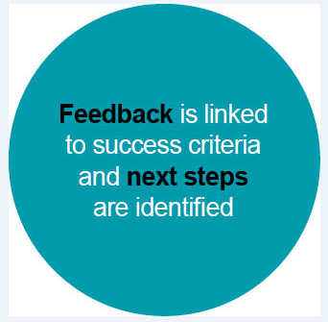
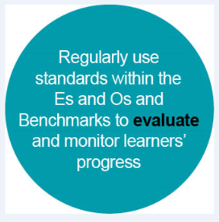
Feedback should be clearly linked to success criteria
Next steps in learning should be identified using success criteria
Feedback discussions should be ongoing throughout lessons
Learners should have opportunities to take part in feedback
discussions when reviewing learning over a period of time in order to
set longer term targets (e.g. as part of the Profiling/Personal learning
planning process)
Notes:
Feedback and next steps should be based on the co-constructed success criteria. Feedback should be ongoing throughout lessons as well as periodically to review a range of learning over time and to set longer term targets. Feedback and next steps identified should also inform teachers’ planning.

Slide 17



Reporting should highlight the learners most recent progress and next steps in learning
Further advice and guidance can be found in the document ‘Reporting to Parents and Carers Guidance for schools and ELC settings’
Notes:
Reporting should reflect most recent progress and next steps in learning. Reporting guidance is available on the National Improvement Hub.

Slide 19
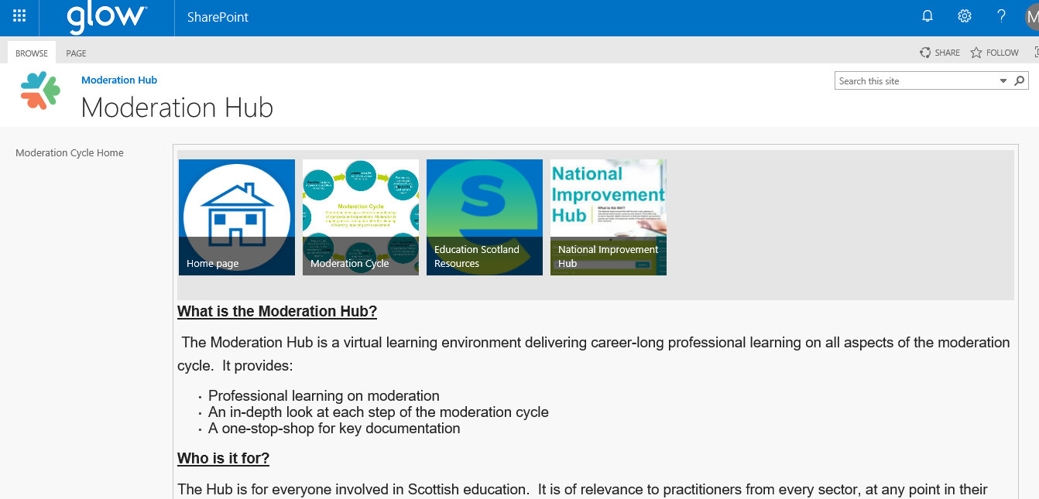

Slide 20
Resources and Opportunities
Moderation Hub
Case studies on SALi
PT Assessment and Moderation
March Achievement of a Level events
AMFs
QAMSOs

Slide 21
What are the key features of effective moderation?
Moderation:
Is a process rather than a one-off event
Involves high levels of professional dialogue at every stage
Is an integral part of planning, learning, teaching and assessment
Involves discussions about breadth, challenge and application at every stage
Takes place at a range of levels (school, cluster, local authority and beyond)
Looks at more than just the end result
Notes:
Effective moderation:
Is an on-going process rather than a one-off event
Involves high levels of professional dialogue at every stage
Is integral to planning, learning, teaching and assessment
Includes discussions focused on breadth, challenge and application at every stage
Takes place at a range of levels within school and beyond

Slide 22
What are the benefits of moderating teacher professional judgement?
Notes:
What are the benefits of moderating teacher professional judgement? Please pause the presentation and take 5 minutes to discuss this together.

Slide 23
What does moderation look like in your context?
Consider the questions on the next slide and then discuss them in small groups.
Notes:
What does moderation look like in your context? What are your next steps for improving opportunities for moderation?
Please pause the presentation and take 5 minutes to discuss this together.

Slide 24
Evaluating moderation in your own context
How are you doing?
Is there a shared understanding of effective moderation?
Is time given for moderation?
Do staff plan together?
Is there a shared language for Learning Intentions and Success Criteria?
Are assessments considered at the planning stage?
Do you plan for progression?
Do staff have regular opportunities for moderating evidence?
Notes:
Now that you have thought about moderation within your own context, consider the following questions to help you identify your next steps.

