Slide 1
The National and Local context

Slide 2
Aims
To develop assessment and moderation in Argyll and Bute
To support our schools in their assessment and moderation practice
To fulfil Argyll and Bute’s six priorities

Slide 3
What should effective assessment and effective moderation look like?

Slide 4
Background
Pre CfE…
Clear indication that curriculum needed reviewed – Early Years, 5-14, Standard Grades, National Qualifications
System failing the lowest 20% of pupils
Too great a focus on testing
Need to ‘de-clutter’ the curriculum
Curriculum Review Group set up

Slide 5
Steps towards CfE
Building the curriculum 1 – The contribution of curriculum areas
Building the curriculum 2 – Active learning in the early years
Building the curriculum 3 – A framework for learning and teaching
Building the curriculum 4 – Skills for learning, life and work
Building the curriculum 5 – A framework for assessment

Slide 6
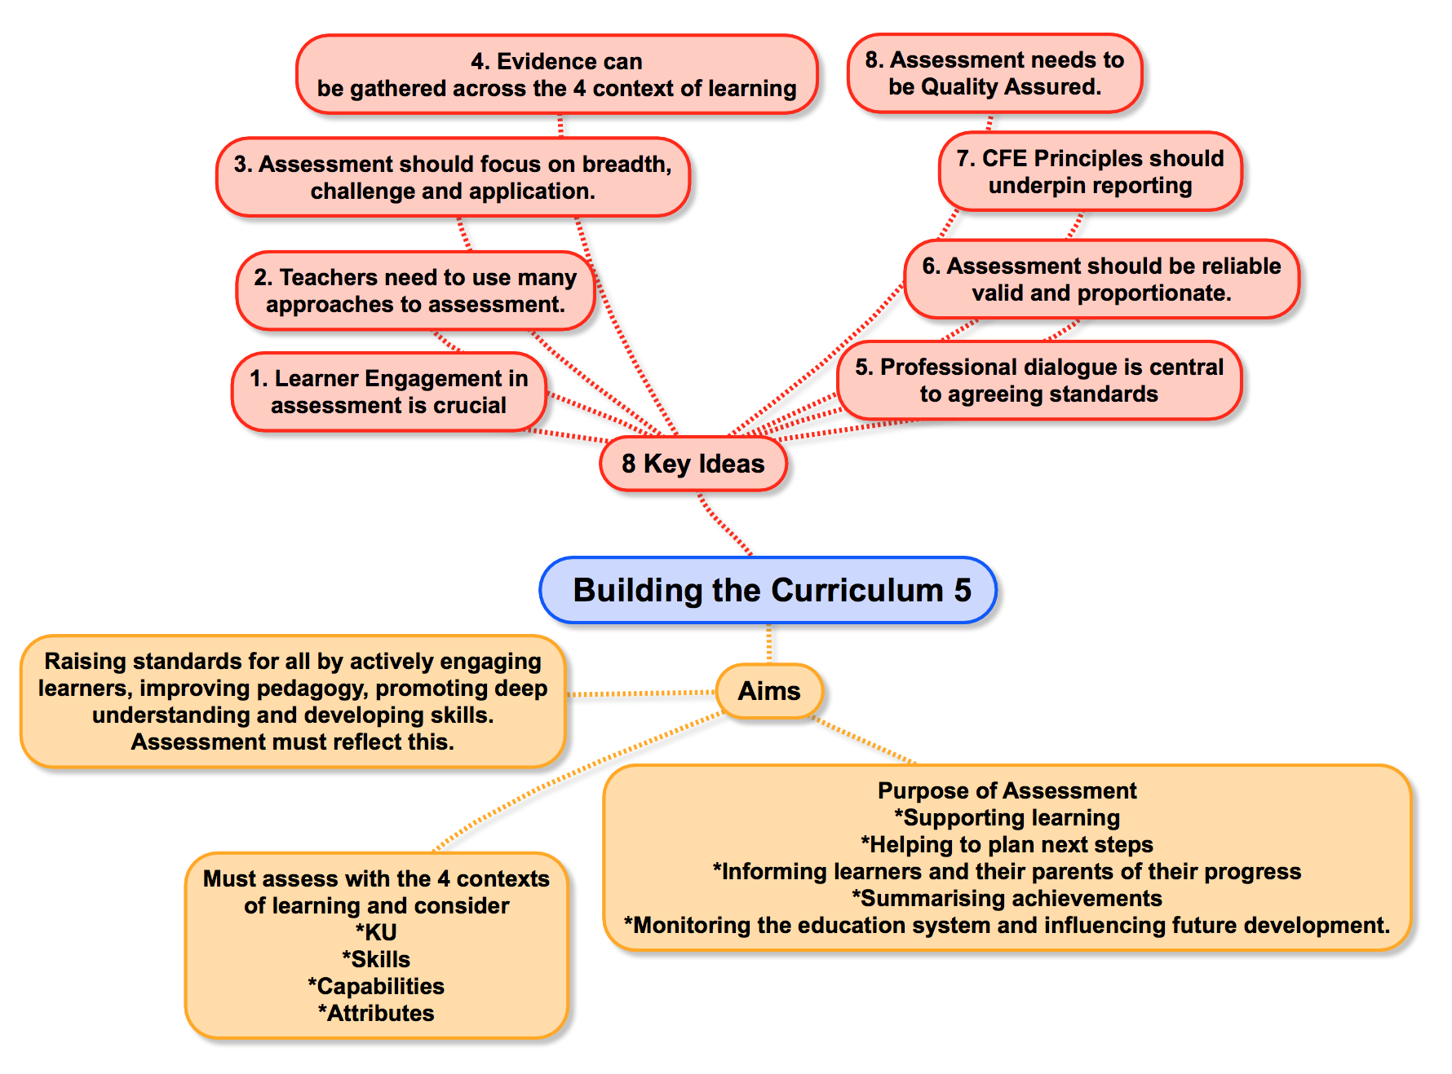

Slide 8
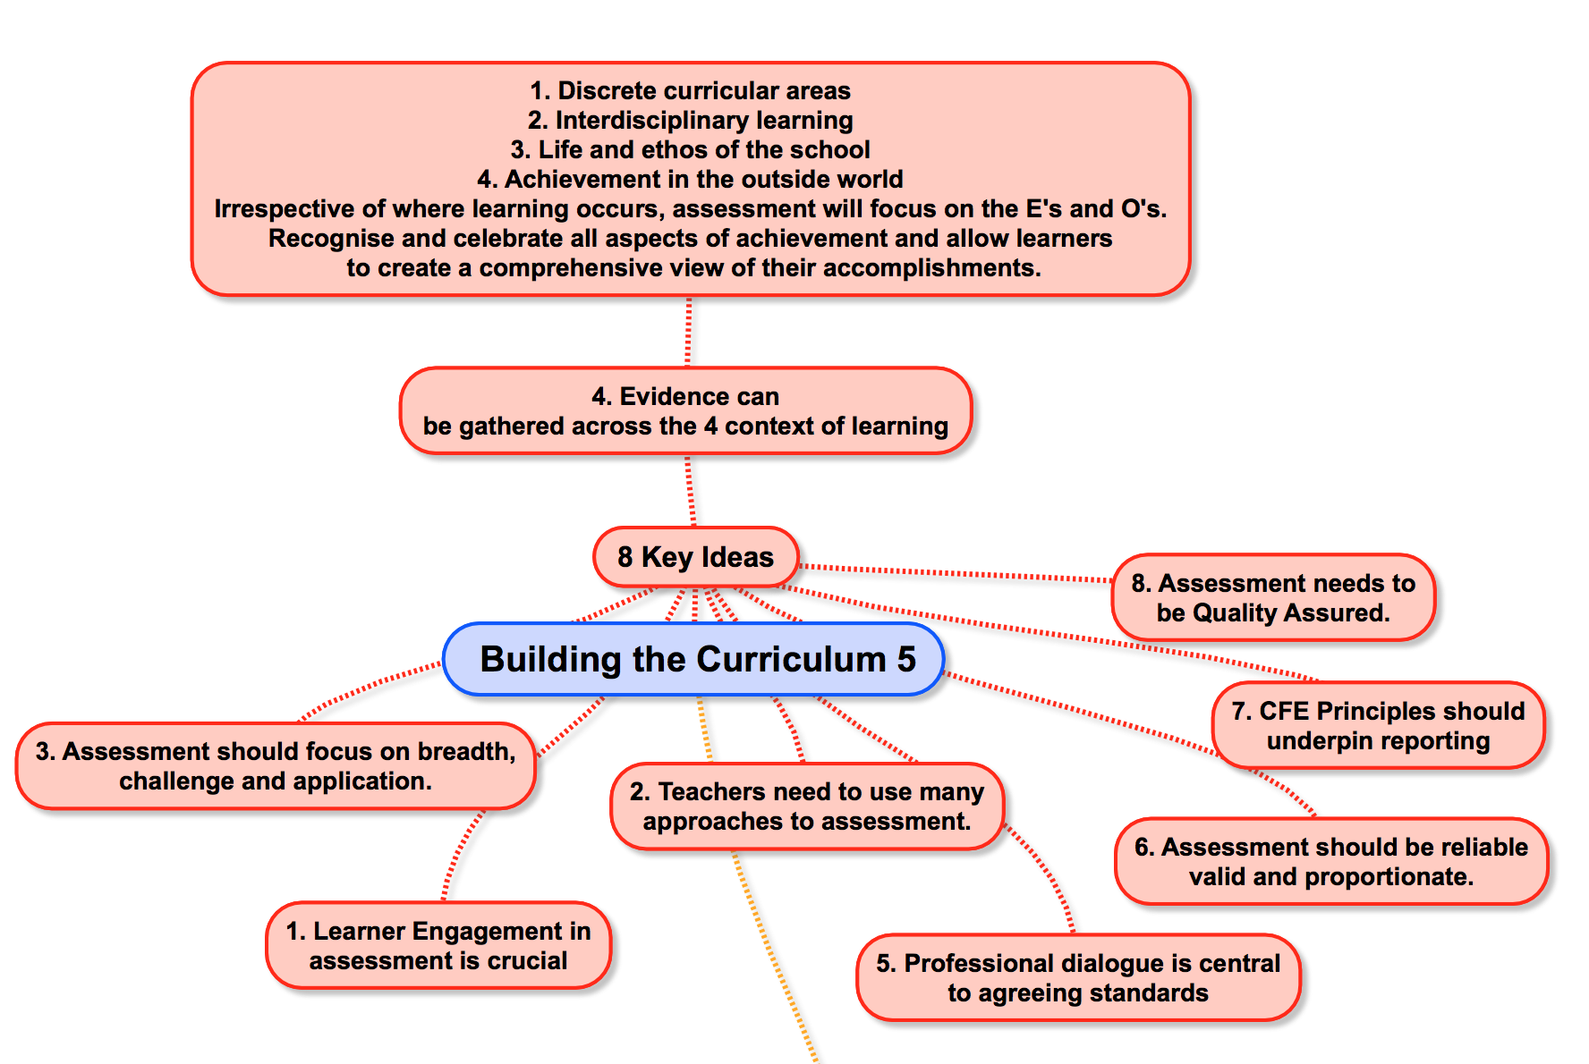

Slide 9
BtC5 Principles of Assessment
‘Assessment practice will follow and reinforce the curriculum and promote high quality learning and teaching approaches. Assessment of children’s and young people’s progress and achievement during their broad general education to the end of S3 will be based on teachers’ assessment of their knowledge and understanding, skills, attributes and capabilities, as described in the experiences and outcomes across the curriculum.’
(Building the Curriculum 5: A Framework for Assessment, p. 8)

Slide 10
Argyll and Bute Skills list…
Communication | Employability | Leadership | Learning | Self-Management
Active Listening | Assertiveness | Adhering to principles | Remembering | Accessing Support
Giving and Receiving Feedback | Awareness of self/local/national/ global issues | Extending the thinking of others | Understanding | Adaptability
Reflecting | Conflict Management | Offering Encouragement | Applying | Balancing life and work
Speaking | Managing Resources and Time | Recognising and using the strengths of others | Analysing | Coping Techniques
Writing | Putting yourself in another’s place | Being Enterprising | Synthesising | Making informed choices
 | Teamwork |  | Evaluating | Perseverance
 |  |  | Systems Thinking | Positive Thinking
 |  |  | Creativity | Resilience
 |  |  | Formulating Success Criteria | Risk Management
 |  |  | Information Handling | Self Discipline
 |  |  | Investigating and Problem Solving | Taking the initiative
 |  |  | Peer and Self Assessment
 |  |  | Digital literacy skills
 |  |  | Fine motor skills

Slide 11
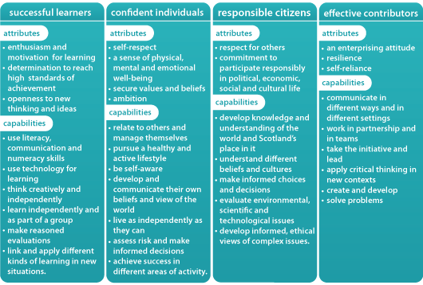
capabilities and attributes

Slide 12
BtC5 and ‘Moderation’
‘Moderation is the term used to describe approaches for arriving at a shared understanding of standards and expectations for the broad general education.’
(Building the Curriculum 5: A Framework for Assessment, p. 36)
Notes:
What is moderation in the Broad General Education?
Source: BtC5 p. 36.
Through dialogue professionals will arrive at a shared understanding and have higher expectations. As a result standards will be raised – the purpose of CfE

Slide 13
Quality Assurance and Moderation – key messages
Moderation:
Is a collaborative process involving all stakeholders, including the learner
Is the means by which we develop a shared understanding
Ensures a rigorous and robust system
Is integral to every stage of:
Planning
Learning and Teaching
Assessment
Feedback and evaluation
Provides opportunities for feedback and planning for improvement
Should be an on-going, sustainable process by which we raise standards and expectations
Notes:
Refer back to NAR flowchart – focus on moderation at every stage, not just the moderation of evidence
Highlight the importance of the feedback loop – using evaluation to feed back into planning – cyclical approach
Sustainability (refer to this as a pre-requisite for many of the projects currently being funded by ES)

Slide 14
Priorities of NIF
Improvement in attainment, particularly in literacy and numeracy
Closing the attainment gap between the most and least disadvantaged children
Improvement in children and young people’s health and wellbeing
Improvement in employability skills and sustained, positive school leaver destinations for all young people.

Slide 15
6 Key Objectives:
Raise educational attainment and achievement for all
Use performance information to secure improvement for children and young people
Ensure children have the best start in life and are ready to succeed
Equip young people to secure and sustain positive destinations and achieve success in life
Ensure high quality partnership working and community engagement
Strengthen leadership at all levels

Slide 16
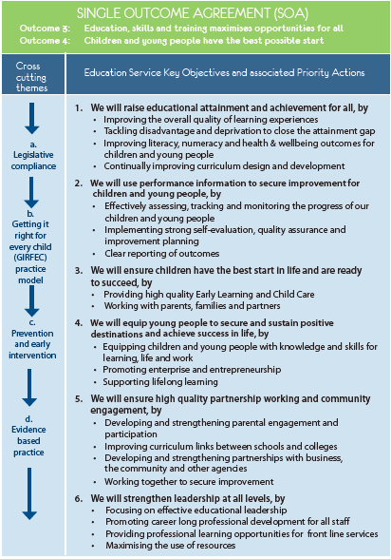

Slide 17
In 2018, local authority feedback and inspection reports show that nationally:
Moderation within the BGE is an improving picture across Scotland
Many local authorities/schools are implementing plans for improvement
In many cases, the role of QAMSO/AMF is crucial to the success of moderation and this has been built upon to support others
Some local authorities/schools have developed a clear strategy for improving moderation
Some local authorities have identified their own targets for improvement through assessment frameworks.

Slide 18
However...
While many local authorities have clear plans, most are in the early stages
There is a varying degree of expectation for moderation across Scotland, affecting the time set aside for meaningful dialogue
In some areas, the role of QAMSO is not being used effectively to support local systems
There are time constraints
At secondary level, it is predominantly English & Maths specialist-led.

Slide 19
Best national practice identified in 2017-18
Assessment & moderation as a priority across the Authority
Tiers of drivers – QIOs/HTs/Moderation Coordinators/Teachers – shared expectation
Effective use of in-service for planned moderation
Sectors working together
Calendar of planned events
Local banks of evidence as reference points
Each school contributing to evidence gathering for QAMSO events or local events

Slide 20
Best National practice identified in 2017-18
Shared value of moderation
Shared expectations
Moderation is integrated into everything – not ‘……………….& moderation’
Improvement plans detailing moderation
Working Time Agreement outlining moderation as a priority
Clear expectations for the role of senior staff in moderation
Investment in leadership
Involve learners
Professional learning

Slide 21
Argyll and Bute Practice 2017-18
Increasing confidence in the use of assessment and moderation to ensure that data, particularly across BGE, is valid and reliable.
This is well supported by Assessment and Moderation Facilitators.
Positive steps to strengthen leadership capacity across schools.
Examples of schools prioritising moderation in WTA and SIPs
Examples of successful school and cluster moderation work across authority
Almost all schools have conducted some moderation as a whole school

