Slide 1
AMF Recall Day
Thursday 18th April

Slide 2
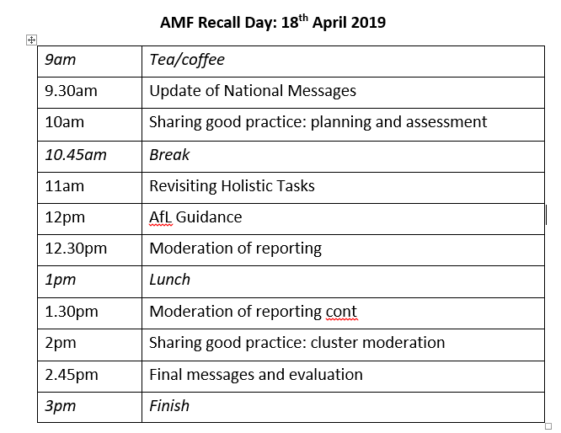

Slide 3
What are you hoping to get out of today?

Slide 4
Update of National Messages
Moderation Cycle update
Listening and Talking Moderation
SNSA as part of a range of evidence

Slide 5
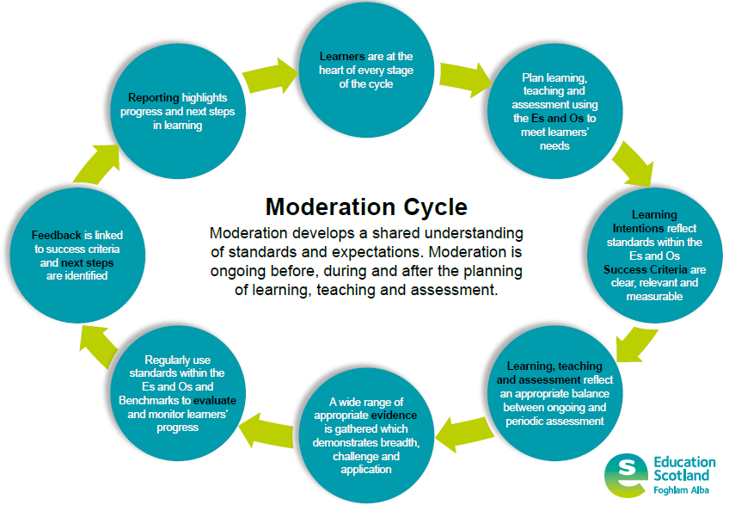
Notes:
This is the guide; exemplars available on SALi but this has all the steps to follow
Some talk about its name – better to have been called “teaching and learning cycle”

Slide 6

Update of National Messages: Moderation Cycle
Group Es and Os together in ways which best suit learners
Do not ‘tick off’ the Es and Os separately
Take a collegiate approach to moderation of planning learning, teaching and assessment
Work together with colleagues to review and reduce unnecessary bureaucracy
For Scotland's learners, with Scotland's educators

Slide 7
Update of National Messages: Moderation Cycle
Periodically use assessments to sample and pull together learning in a joined-up way
Moderate assessment judgements by taking account of sample evidence from different sources to discuss standards and progress
Use the Benchmarks to help monitor progress and support overall professional judgement of when a learner has achieved a CFE level
Assessment is a central part of everyday learning and teaching for children and young people and helps to identify where strengths lie and where more support is required
For Scotland's learners, with Scotland's educators

Slide 8
Update of National Messages: SNSA
The SNSAs are a diagnostic tool to support improvement in learning
Should be used as part of a range of evidence to inform teachers’ professional judgement on pupil progress
The SNSAs cannot say if a child or young person has achieved a level
SNSA can be carried out at any point in the year
For Scotland's learners, with Scotland's educators

Slide 9
Update of National Messages: SNSA
Training on analysing SNSA data available on 30th April at 4pm as a webinar; email to follow
Training materials also available on SNSA website (log in through Glow) and SALi
More training can be accessed through authority
For Scotland's learners, with Scotland's educators

Slide 10
Update of National Messages: Range of evidence
Breadth, challenge and application
Mix of summative and formative assessment
Jotter work and observations
All underpinned by professional judgement and moderation
Can include SNSA
For Scotland's learners, with Scotland's educators

Slide 11
Update of National Messages: Listening and Talking
New to the QAMSO programme
Focus more on process than pupil evidence
Good practice:
  Every year, record one or two pupils doing talking assessment (solo talk, group discussion, etc.)
  Watch with colleagues and discuss strengths, areas for development, etc.
  Use this experience to then assess other pupils
  No need to record every pupil
For Scotland's learners, with Scotland's educators

Slide 12
Sharing good practice: Planning and Assessment
Thursday 18th April

Slide 13
At your tables, discuss:
How do you ensure a collegiate approach to planning?
How do you involve children in your planning?
How could you develop your planning and assessment practice to ensure it is in line with the moderation cycle?

Slide 14
Break
Thursday 18th April

Slide 15
Revisiting Holistic Tasks
Thursday 18th April

Slide 16
At your table, spend five minutes discussing what an effective Holistic Assessment is.

Slide 17

Indicate with a thumb your level of confidence in regard to Holistic Assessments.

Slide 18
They are simpler than you think…
Demonstrate breadth of learning – they come from a range of Es and Os across different organisers;
Demonstrate challenge – they ask pupils to use a range of higher order thinking skills such as analysis, creation, evaluation, problem solving, tackling multi step tasks, interpreting tasks;
Demonstrate application of learning in new and unfamiliar situations;
Come from one of the four contexts of learning:
  Life and ethos of the school as a community;
  Curriculum areas and subjects;
  Interdisciplinary learning;
  Opportunities for personal achievement.

Slide 19
Breadth
There are a range of Experiences and Outcomes covered, which are taken from more than one organiser within a curricular area OR from across a range of curricular areas.
For example…
Finding and using information + Creating texts
OR
Maths + Science

Slide 20
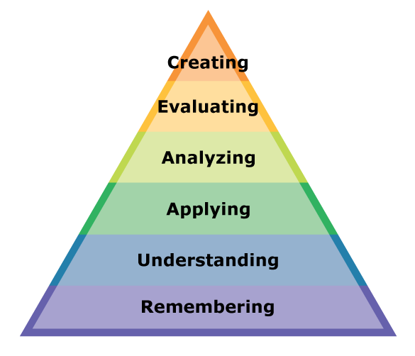
Challenge

Slide 21
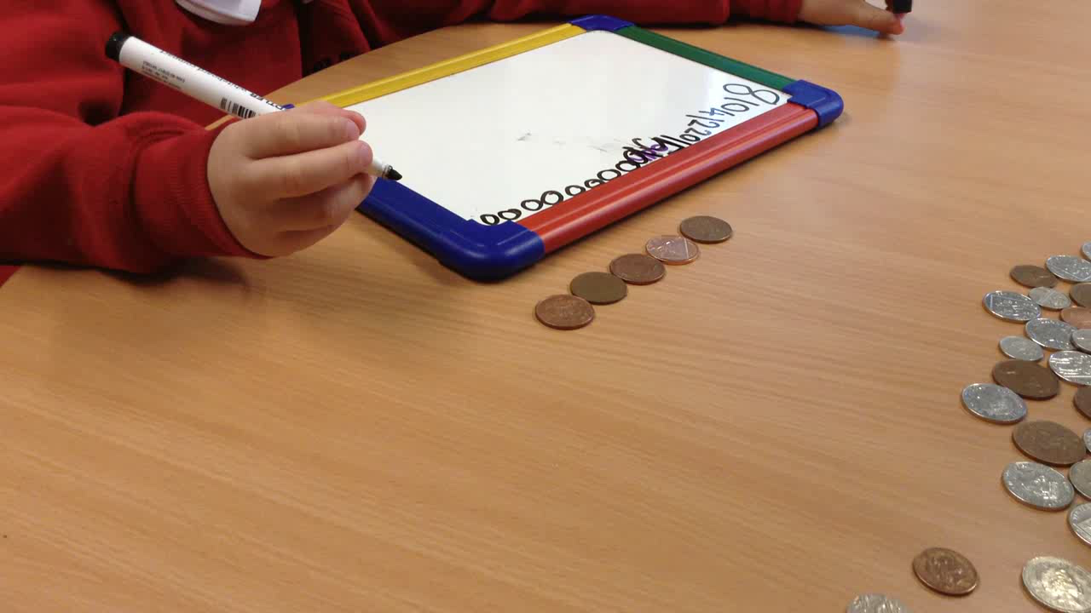
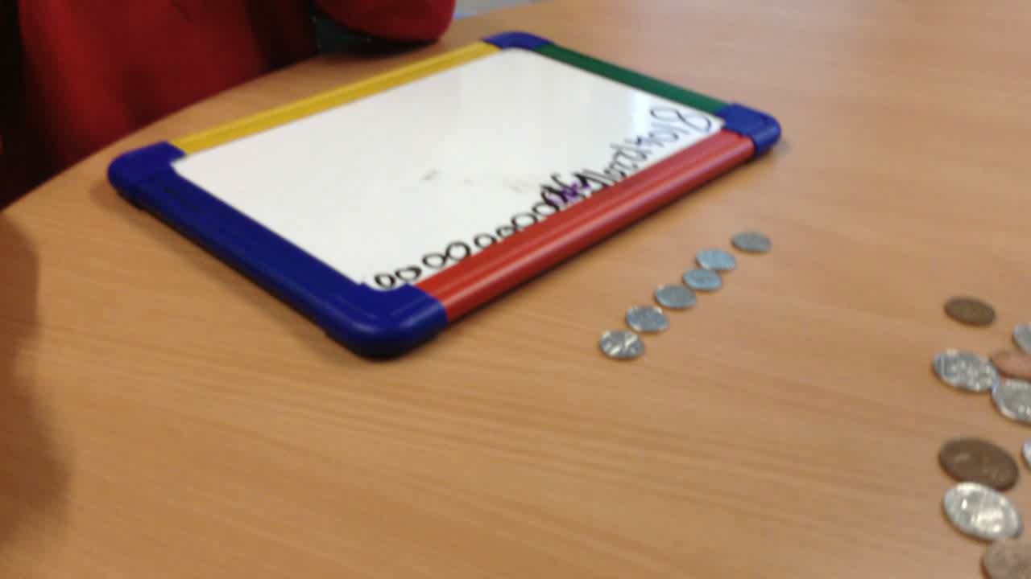
Application
EXAMPLE: Pupils have been learning to count in groups of 2s, 5s and 10s.
During this task they apply that learning to counting with money – can they use their knowledge to find the total amount?
Notes:
Discuss which es and os are being covered through this task. Explain children had to find the correct coins as part of the task and the demonstrate ability to count in appropriate jumps.

Slide 22
Task: Research and then write a persuasive essay and then use it as a basis for a persuasive talk.
In January, this class began work on a persuasive language topic. We:
watched a speech by Barack Obama and answered questions on this
watched a documentary on zoos and made notes on this
conducted further research on zoos or a topic of our own choice
looked at exemplar introductions and conclusions
looked at different types of linking phrases
wrote a persuasive essay
delivered a talk to a group and received peer feedback
delivered a talk to the whole class

Slide 23
Task: Research and then write a persuasive essay and then use it as a basis for a persuasive talk.
In January, this class began work on a persuasive language topic. We:
watched a speech by Barack Obama and answered questions on this
watched a documentary on zoos and made notes on this
conducted further research on zoos or a topic of our own choice
looked at exemplar introductions and conclusions
looked at different types of linking phrases
wrote a persuasive essay
delivered a talk to a group and received peer feedback
delivered a talk to the whole class
Breadth?

Slide 24
Task: Research and then write a persuasive essay and then use it as a basis for a persuasive talk.
In January, this class began work on a persuasive language topic. We:
watched a speech by Barack Obama and answered questions on this
watched a documentary on zoos and made notes on this
conducted further research on zoos or a topic of our own choice
looked at exemplar introductions and conclusions
looked at different types of linking phrases
wrote a persuasive essay
delivered a talk to a group and received peer feedback
delivered a talk to the whole class
Challenge?

Slide 25
Task: Research and then write a persuasive essay and then use it as a basis for a persuasive talk.
In January, this class began work on a persuasive language topic. We:
watched a speech by Barack Obama and answered questions on this
watched a documentary on zoos and made notes on this
conducted further research on zoos or a topic of our own choice
looked at exemplar introductions and conclusions
looked at different types of linking phrases
wrote a persuasive essay
delivered a talk to a group and received peer feedback
delivered a talk to the whole class
Application?

Slide 26
Look at the Holistic Tasks you have brought with you and discuss them in a pair or a trio.
Consider:
Does your planned task provide opportunities for breadth, challenge and application? – KEY
Are there “ceilings” to what pupils can achieve?
Do the Es and Os outlined link together and fit naturally?
Do your Learning Intentions outline the intended learning, rather than the task?
Do your Success Criteria outline the process to complete the task?

Slide 27
Assessment for Learning Guidance
Thursday April 18th

Slide 28
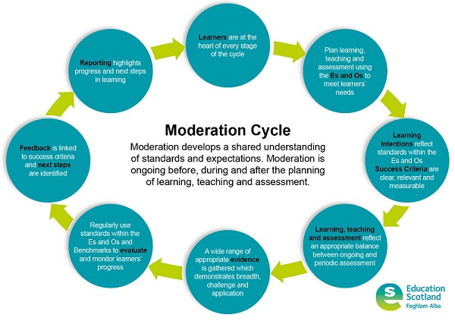
Assessment for Learning Guidance

Slide 29
Assessment for Learning Guidance

Slide 30
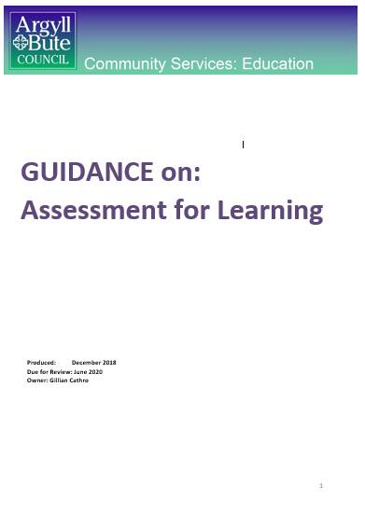
Includes sections on:
Learning Intentions
Success Criteria
Prior learning
Effective questioning
Feedback
Collaborative learning
Differentiation
Self and peer assessment
Plenary

Slide 31
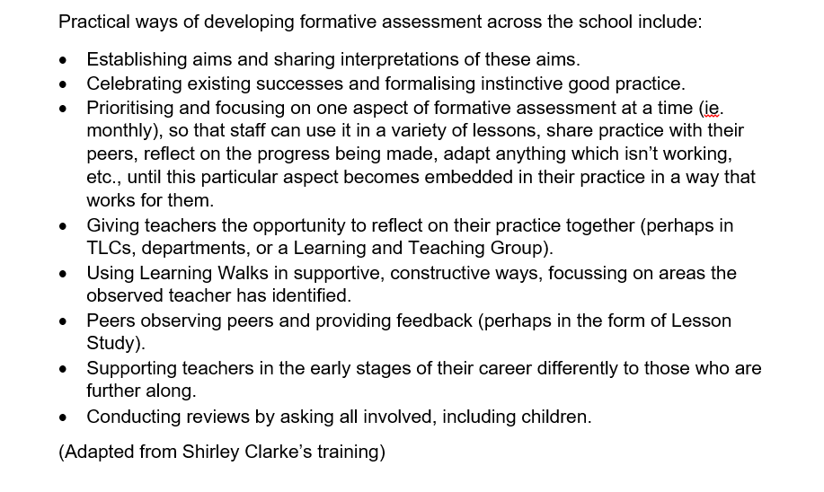
advice on embedding AfL in school

Slide 32
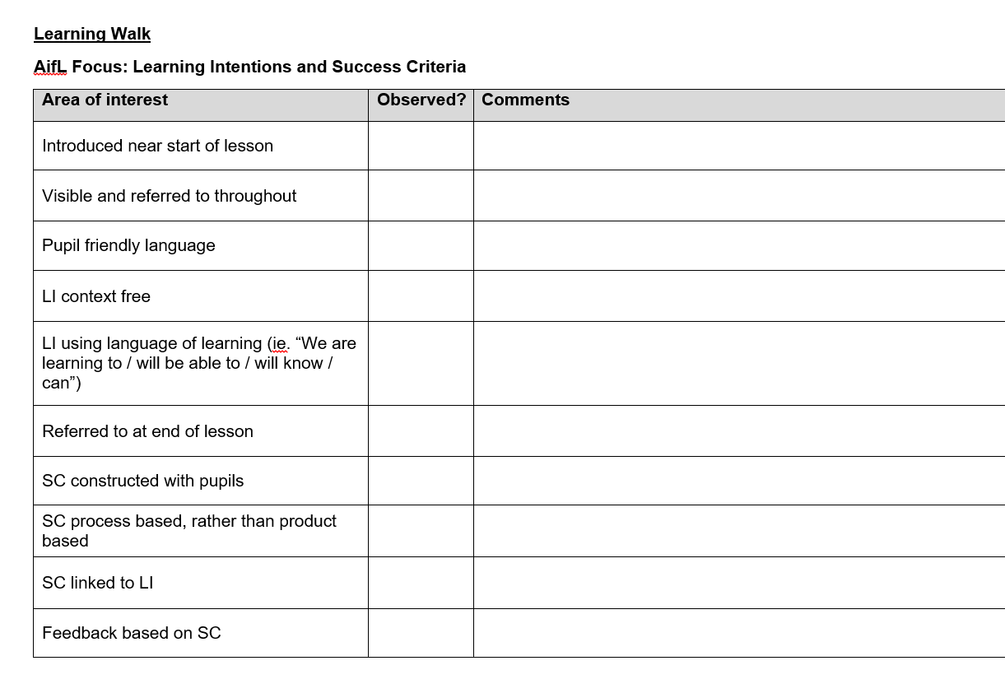
checklists for learning walks / peer observations

Slide 33
Putting it to use
Share the resource with colleagues
Identify needs of practitioners / school (using audit on SALi)
Training on specific areas (using Guidance and associated PowerPoints, available on SALi)
Focus on one aspect at a time – use LTG / TLC / checklists to assess progress

Slide 34
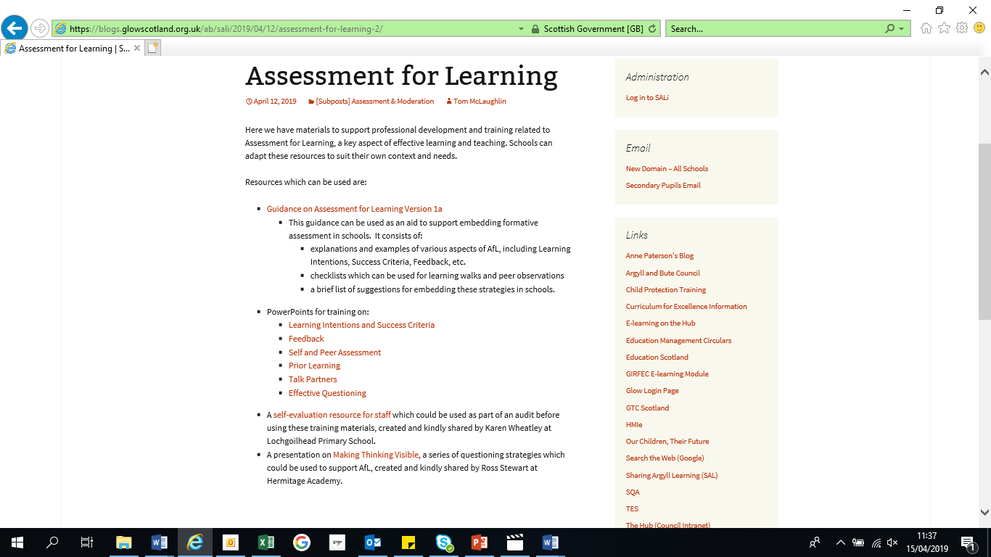

Slide 36
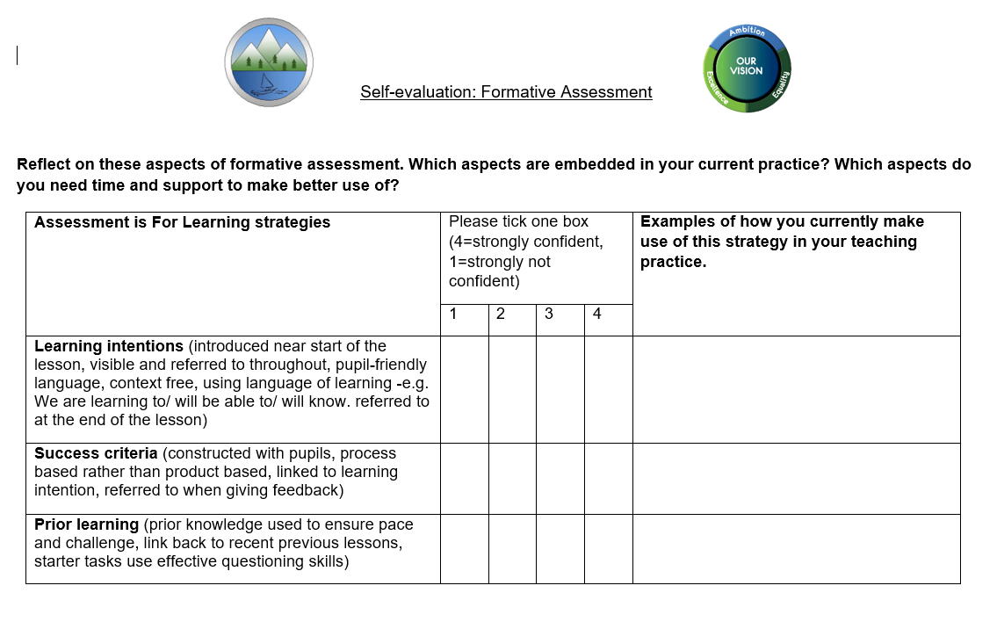

Slide 37
Self Evaluation
At your tables, pick a section from the guidance to look at and identify:
Two things you already do
Two things you could use

Slide 38
Review
Spend five minutes discussing:
How you will use the guidance in your school / context
If anything else could be added to the guidance

Slide 39
Moderation of reporting
Thursday 18th April

Slide 40
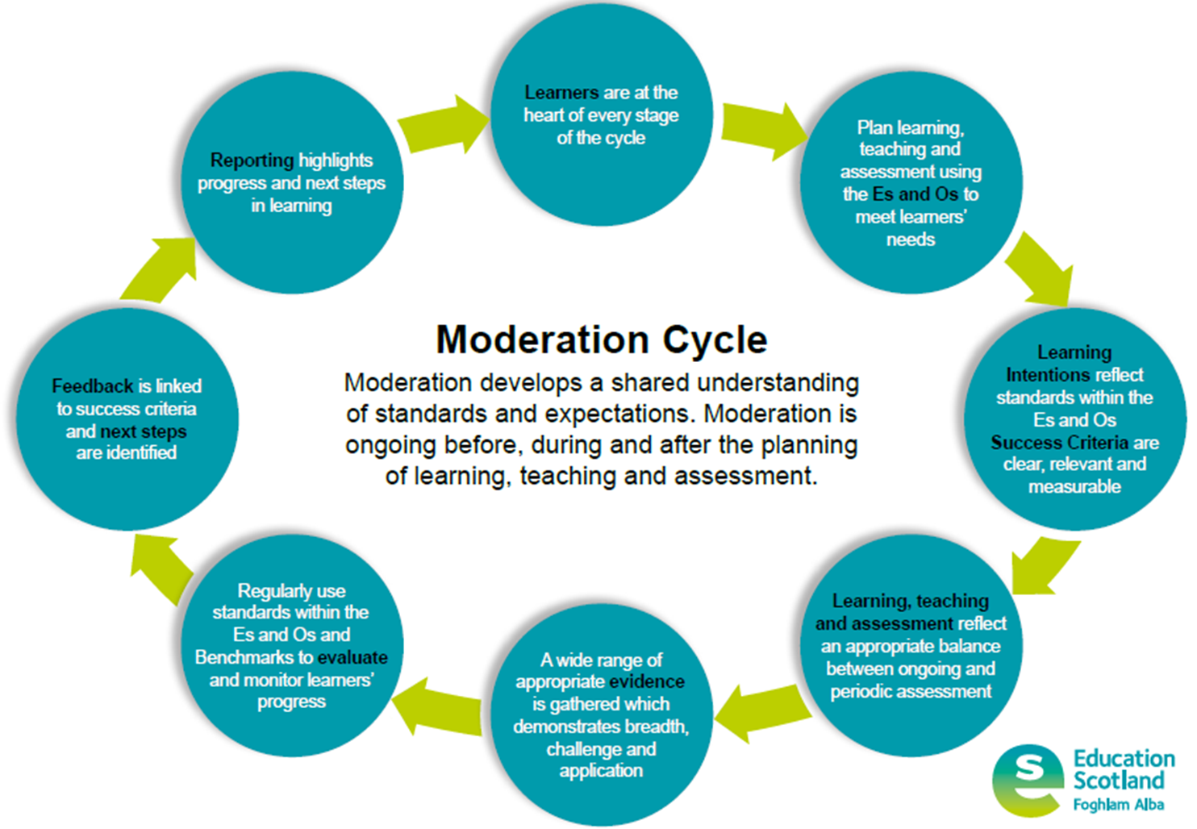
Notes:
The Moderation Cycle is the essential reference point regarding moderation for every practitioner involved in 3-15 education in Scotland, replacing the NAR Flowchart.
Particular attention to circled section – reporting
We will be discussing what effective reporting (written) may look like. This session is in effect, a moderation session, not a session designed to convey information.

Slide 41
What are the key features of effective reporting?

Slide 42


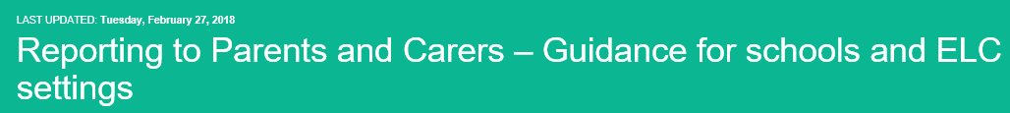
☑ Schools should involve parents in developing more simple and effective means of reporting that emphasise quality of engagement rather than reams of paperwork.
National Publications
 Do not spend time writing long reports for parents which describe lots of classwork or use professional jargon.
☑ The purpose of reporting is to support and improve learning. It should be an on-going process which provides clear information on a learner’s strengths, areas for development and specifically what needs to be done to ensure continued progress and improved standards of achievement. As much as possible learners should be involved in the reporting process through on-going reflection and dialogue about their learning…
Notes:
TB follow up (2015)
A Statement for Practitioners from HM Chief Inspector of Education (August 2016)

Slide 43
How do you report on pupil’s progress?

Slide 44
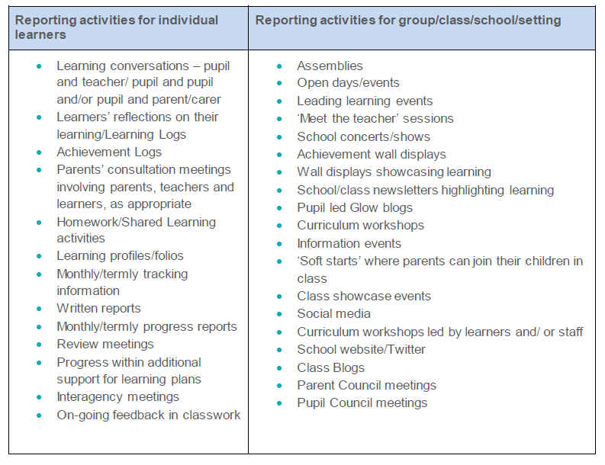

Slide 45

Do my comments:
Focus on the learner
Describe progress in learning (not tasks)
Are they:
Clear
Constructive
Jargon free
Positive
Concise
Notes:
Points to consider relating to qualitative statements
Moderation of comments, to ensure quality, a key component
Also an expectation as outlines in PKC Assessment Framework
‘In addition to this, schools in a positon to review their approaches to written reporting will:
identify reporting as an action within their School Improvement Plan and allocate appropriate time in Working Time Agreement and collegiate calendars, including time for moderation’
Written comments must be appropriate to the intended audience; using clear, concise, jargon free language, describing progress in learning rather than a description of classwork.

Slide 46

Read the example reporting comment and consider:
Have the successes been reported appropriately?
Are the areas for improvement appropriate?
Is it written in plain, jargon-free language?
Would the comments help parents to support learning at home?
If needed, how could they be improved?
Task 1: Qualitative statements?
Notes:
Task in pairs/trios discussion approx 20 mins
Selection of reporting qualitative statements from actual reports available for moderation
The statements for each stage don’t relate to just one child. Taken from a variety of reports.

Slide 47
P7 – Health and wellbeing
X is a kind and considerate individual. She has been learning about positive relationships, the qualities of a good friend and cyberbullying. X enjoys the challenges of P.E and participates well in all activities. We have discussed classifying food groups and how to create a balanced meal. She has been learning the physical and emotional changes of living and growing.
Notes:
Weak

Slide 48
P1 – English and Literacy
X is making good progress within the Early Level in all aspects of Languages. X has progressed well with his phonic sounds and would benefit from daily practice with flashcards until the 42 sounds are embedded. X can demonstrate good listening and can speak about his experiences well. X is beginning to hear and blend sounds and should be encouraged to sound each letter out when reading, then blend to form the word. Again, key words on flashcards will help with word recognition. His next step would be to recall simple tricky words. He is developing his ability to recall stories and sequence their events. X would benefit from free painting, drawing and writing activities to practise his letter formation.
Notes:
Strong

Slide 49
Lunch

Slide 50
Moderation of reporting

Slide 51
Now look at your own report and in a small group consider:
Have the successes been reported appropriately?
Are the areas for improvement appropriate?
Is it written in plain, jargon-free language?
Would the comments help parents to support learning at home?
If needed, how could they be improved?
Task 1: Qualitative statements?
Notes:
Task in pairs/trios discussion approx 20 mins
Selection of reporting qualitative statements from actual reports available for moderation
The statements for each stage don’t relate to just one child. Taken from a variety of reports.

Slide 52
Recap: Key messages about reporting
Reporting can take a variety of forms
Schools should involve parents in developing more effective means of reporting
Involve learners where possible
Written comments must be appropriate to the intended audience, using clear, concise, jargon free language, describing progress in learning
Moderate comments to ensure quality, a key component
Sample summative reports at the start of the process i.e. as staff begin to write

Slide 53
Sharing good practice: Cluster Moderation
Thursday April 18th
Notes:
An area a lot of AMFs wanted support with – moving from school to cluster moderation

Slide 54
Spend five minutes discussing:
The challenges of cluster moderation
The benefits of cluster moderation

Slide 55
Available resources
Cluster moderation models on SALi:
Ardrishaig
St Columba’s
Dalintober
Mid Argyll
Cluster moderation timeline (based on Dalintober presentation)
Other AMFs
QAMSOs
Teams
Notes:
Authority push on cluster moderation; three meetings a session, on planning, assessing and evidence
Get it in your WTA
Discuss creation of Teams

Slide 56
Islay and Jura Cluster Moderation
3 mins 40

Slide 57
At your tables, discuss:
Any cluster work currently taking place in your area and how it has impacted your classroom / school practice
Any opportunities for taking cluster work forward (ie. existing projects, strong transition, linked schools, etc.)
Future plans for taking forward cluster moderation

Slide 58
Final Messages

Slide 59
Moderation – still a priority
Focus on cluster moderation
Use expertise – QAMSOs, other AMFs, Education Officers

Slide 60
Thank you!
Thank you for coming together and for engaging with the moderation process!
Remember to complete the evaluation. ☺

